Slide 1
THE FUTURE OF SAM.GOV
Acquisition Hour Webinar
FEBRUARY 13, 2018

Slide 2
Webinar Etiquette
PLEASE
  Log into the GoToMeeting session with the name that you registered with online
  Place your phone or computer on MUTE
  Use the CHAT option to ask your question(s). We will share the questions with our guest speaker who will respond to the group
THANK YOU!

Slide 3
ABOUT WPI
Supporting the Mission
Serving Wisconsin companies for 30 years!

Slide 4
Assist businesses in creating, development and growing their sales, revenue and jobs through Federal, state and local government contracts.

Slide 5

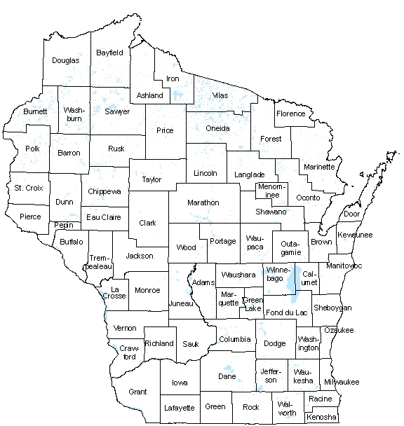
WPI OFFICE LOCATIONS
MILWAUKEE – Technology Innovation Center
MADISON –
  Madison Enterprise Center
  FEED Kitchens
CAMP DOUGLAS– Juneau County Economic Development Corporation (JCEDC)
WAUSAU – Wausau Region Chamber of Commerce
APPLETON – Fox Valley Technical College
WAUSAU
APPLETON
CAMP DOUGLAS
MADISON
MILWAUKEE

Slide 6
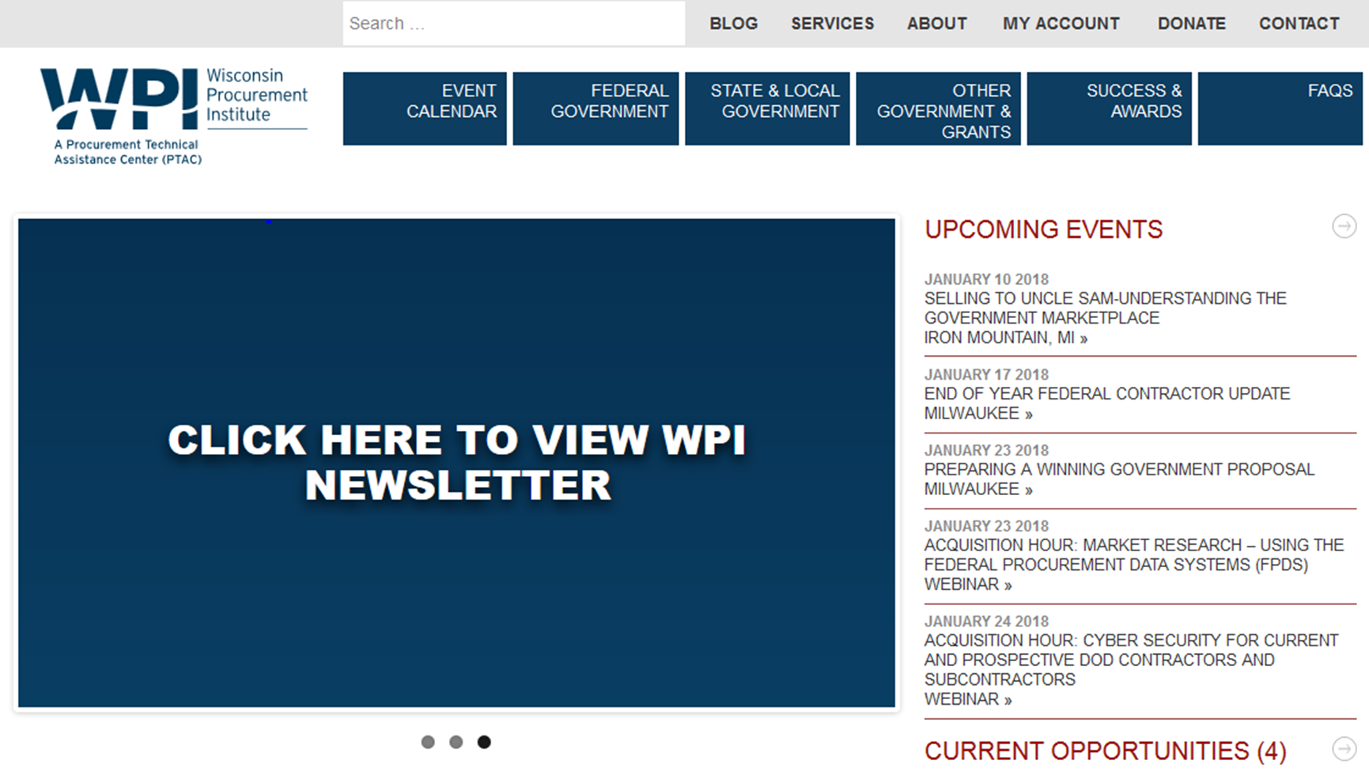


Slide 7
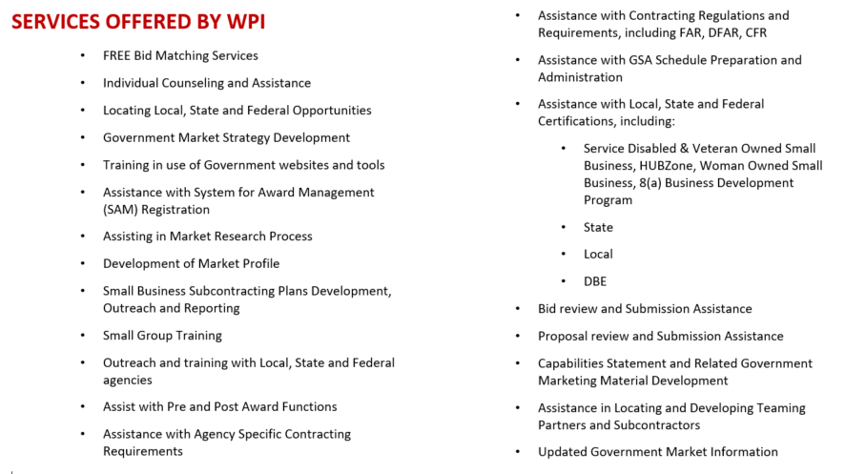

Slide 8
What we will Cover Today
Overview of Integrated Award Environment
Overview of changes with beta.SAM.gov
Transitioning to the new SAM.gov

Slide 9
OVERVIEW OF INTEGRATED AWARD ENVIRONMENT

Slide 10
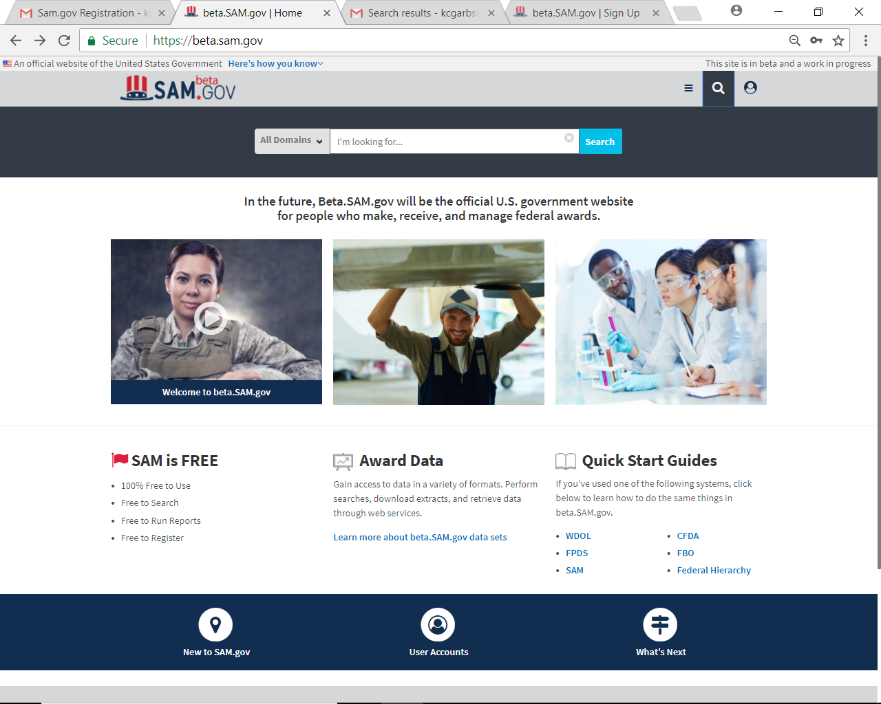
INTEGRATED AWARD ENVIRONMENT
https://beta.sam.gov/

Slide 11
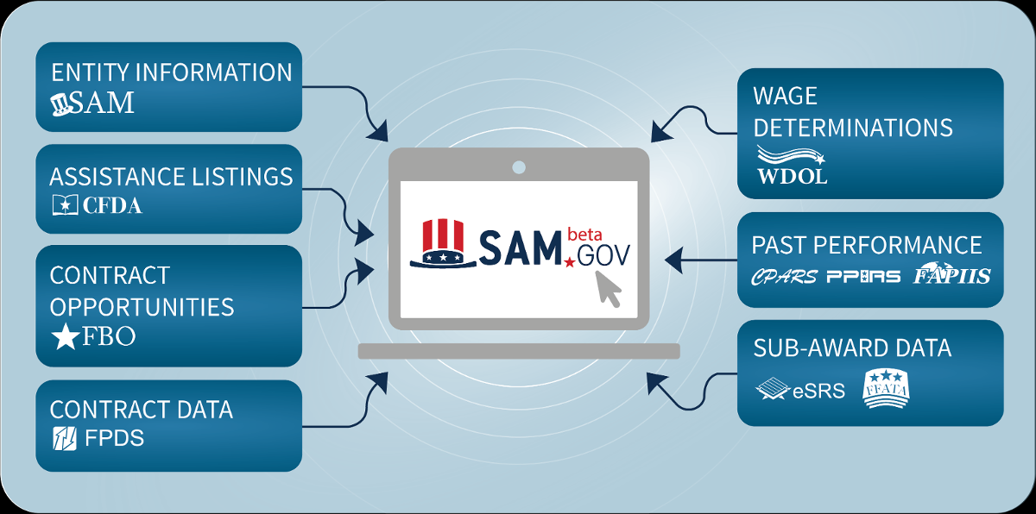

Slide 12
Ten databases rolled into one
Entity Information: System for Award Management (SAM.gov) – Registrations and Exclusions
Contract Opportunities: Federal Business Opportunities (fbo.gov)
Contract Data: Federal Procurement Data System (fpds.gov)
Sub-Award Data: Electronic Subcontracting Reporting System (eSRS.gov), Federal Funding Accountability and Transparency Act Subaward Reporting System (fsrs.gov)
Wage Determinations: Wage Determinations OnLine (wdol.gov)
Past Performance: Contractor Performance Assessment Reporting System (cpars.gov), Past Performance Information Retrieval System (ppirs.gov), Federal Awardee Performance and Integrity Information System (fapiis.gov)
Assistance Listings: Catalog of Federal Domestic Assistance (cfda.gov)

Slide 13
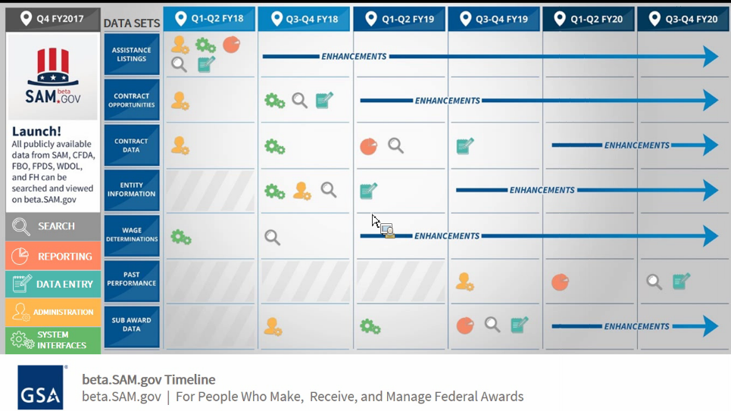

Slide 14
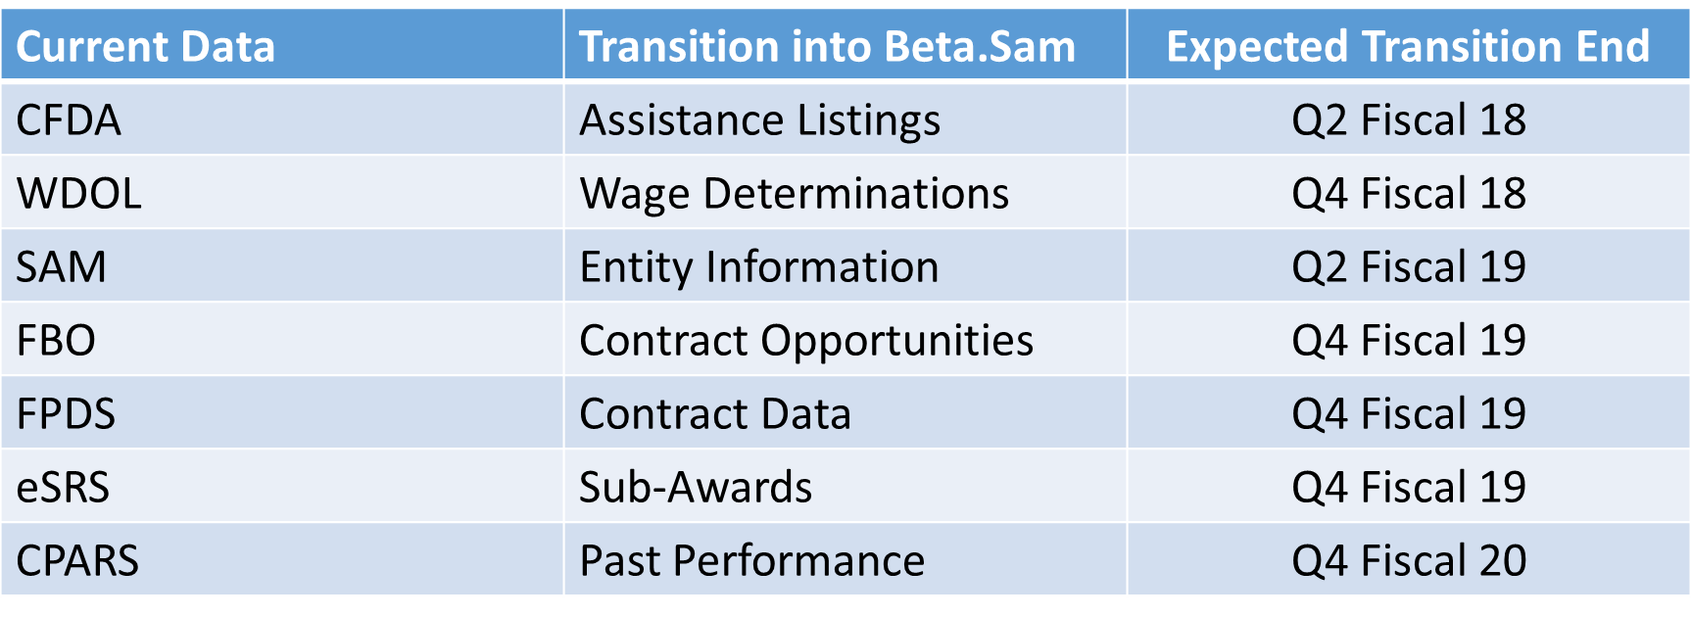
ONE WEBSITE – DOMAIN – TRANSITION TIMES

Slide 15
WHAT & WHY
The objective of the consolidated web site is to reduce the federal contracting burden on contractors and government officials alike by creating a single place to access a range of data, including contractor registration information, contract award data on prime contractors and subcontractors, and information about companies excluded from pursuing government work.
Improving existing sites. More than 160 federal employees are testing beta.sam.gov's search and display functions.
Eventually, the functions of 10 existing sites – including SAM.gov; the Federal Procurement Data System, at fpds.gov; Federal Business Opportunities, also known as “FedBizOpps,” at fbo.gov; the Federal Funding Accountability and Transparency Act Subaward Reporting System, at fsrs.gov; and the Federal Awardee Performance and Integrity Information System, at fapiis.gov – will be folded into the SAM beta site.
Once complete, that site will resume as the new SAM.gov and the other sites will “retire.”
“SAM.gov is the official U.S. government website for people who make, receive and track federal awards.” Improvements will continue to be made to the existing sites as the new site is being tested. That includes installing comprehensive search filters.

Slide 16
OVERVIEW OF CHANGES WITH BETA.SAM.GOV

Slide 17
WHAT CAN I DO NOW?
You can perform searches for public data without a user account
In the future, you’ll be able to create a SAM account to save your search results and access non-public data

Slide 18
Domain | Description
Assistance Listings | Find assistance listings by entering a keyword, CFDA number, or agency name into the search field.
Contract Opportunities | Find contract opportunities by entering a keyword, solicitation ID, or an agency name into the search field.
Contract Awards | Find contract award data by entering a keyword, award type, NAICS Code, PSC Code, or DUNS.
Entity Registrations | Find entity registrations by entering an entity’s name into the search field. The search filter will automatically display “active” entities, but you can also switch to view only inactive results.
Entity Exclusions | Find exclusions associated with a particular entity by entering the entity’s name, DUNS number, or CAGE code. To search for a person, type in his or her name. Be sure to confirm that you’ve found the correct person—it’s easy to misidentify someone if he or she has a common name. If no exclusion record is found for the entity, the entity does not have an active exclusion in SAM.
Federal Hierarchy | Enter a department or sub-tier. Use the Federal Hierarchy filter to narrow your results.
Wage Determinations | Find applicable DBA and SCA wage determinations required for each contract action by entering a wage determination (WD) number, or using the filters to narrow down your results by geographic location.

Slide 19
WHAT CAN I DO WITHOUT AN ACCOUNT?
You can search for the following public information without a user account:
Federal assistance listings
Contract opportunities
Contract awards
Entity registrations
Wage determinations

Slide 20
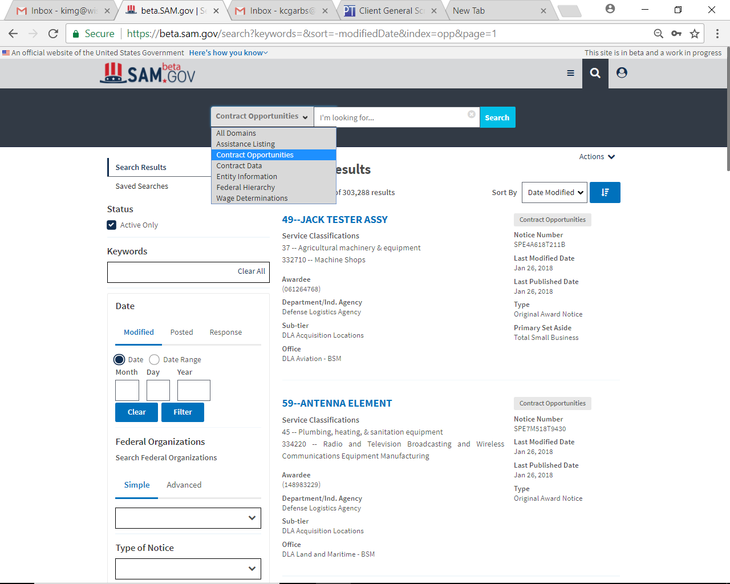
SEARCHING THE DATA – CONTRACT OPPORTUNITIES
https://beta.sam.gov/

Slide 21
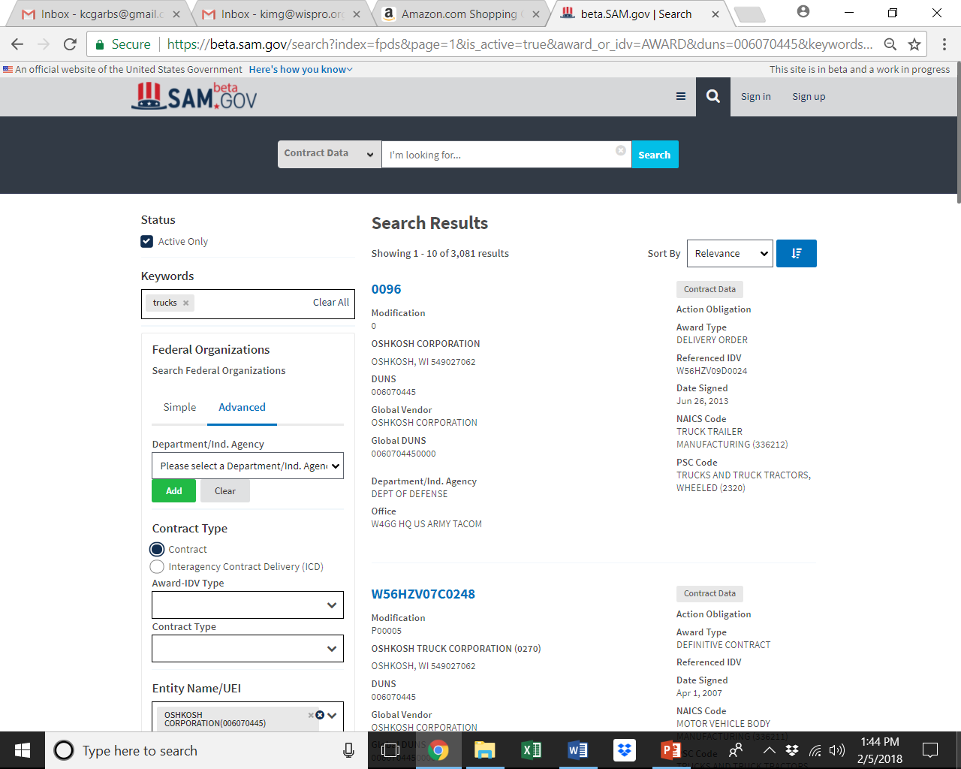
SEARCHING THE DATA – CONTRACT AWARDS
https://beta.sam.gov/

Slide 22
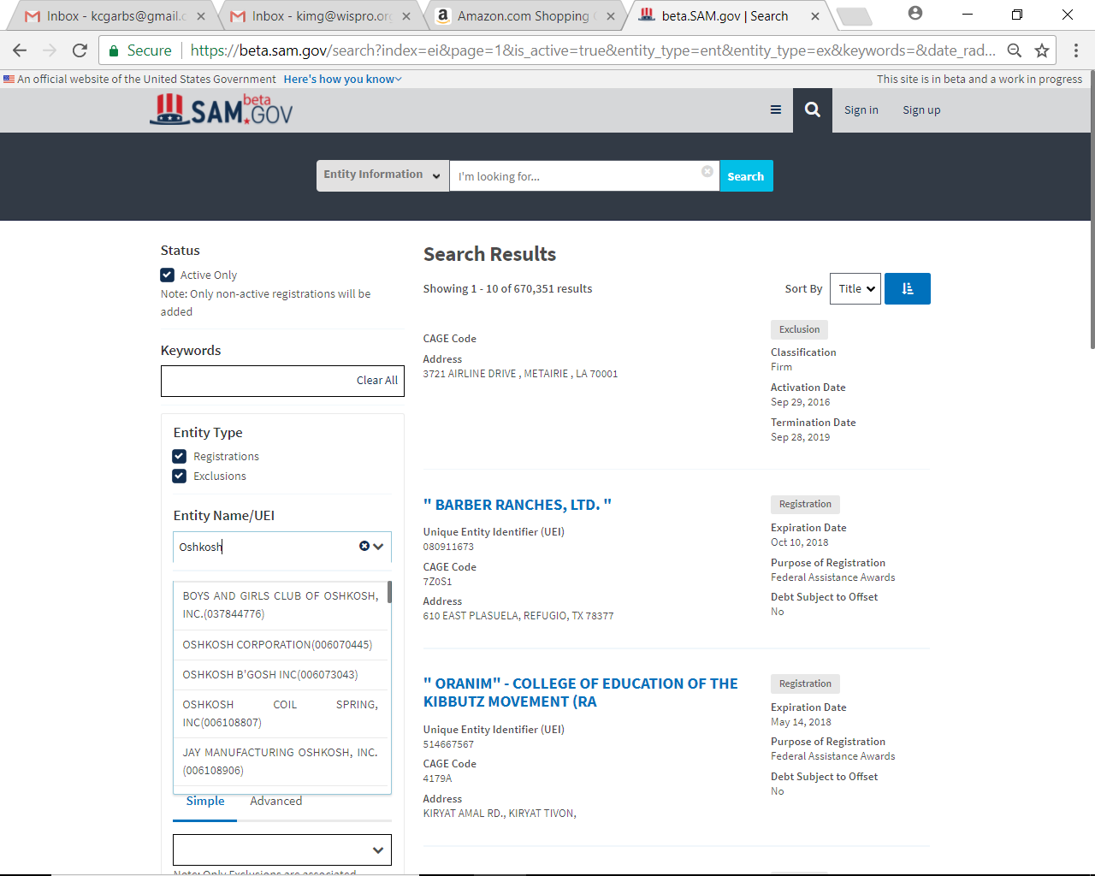
SEARCHING FOR ENTITIES
https://beta.sam.gov/

Slide 23
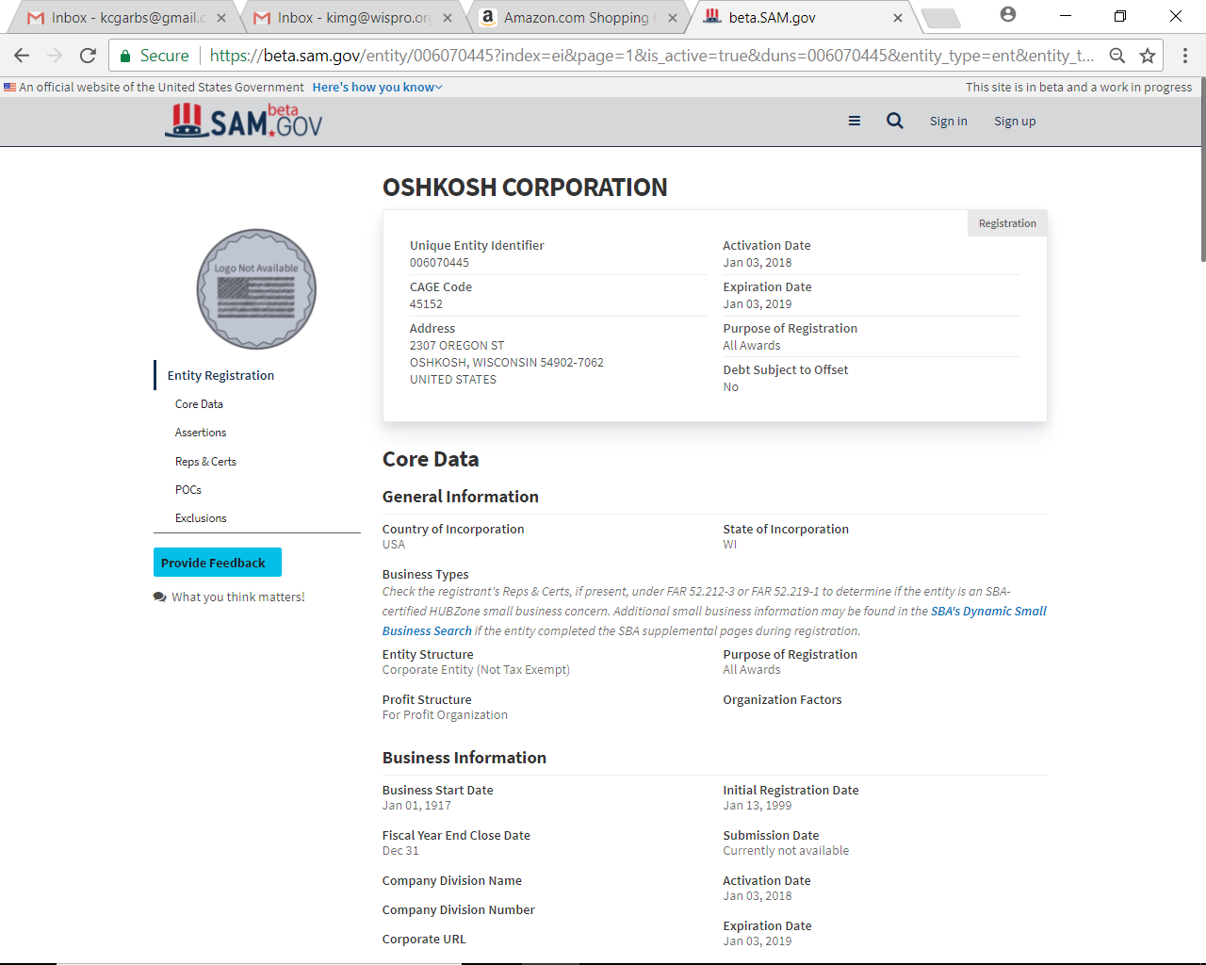
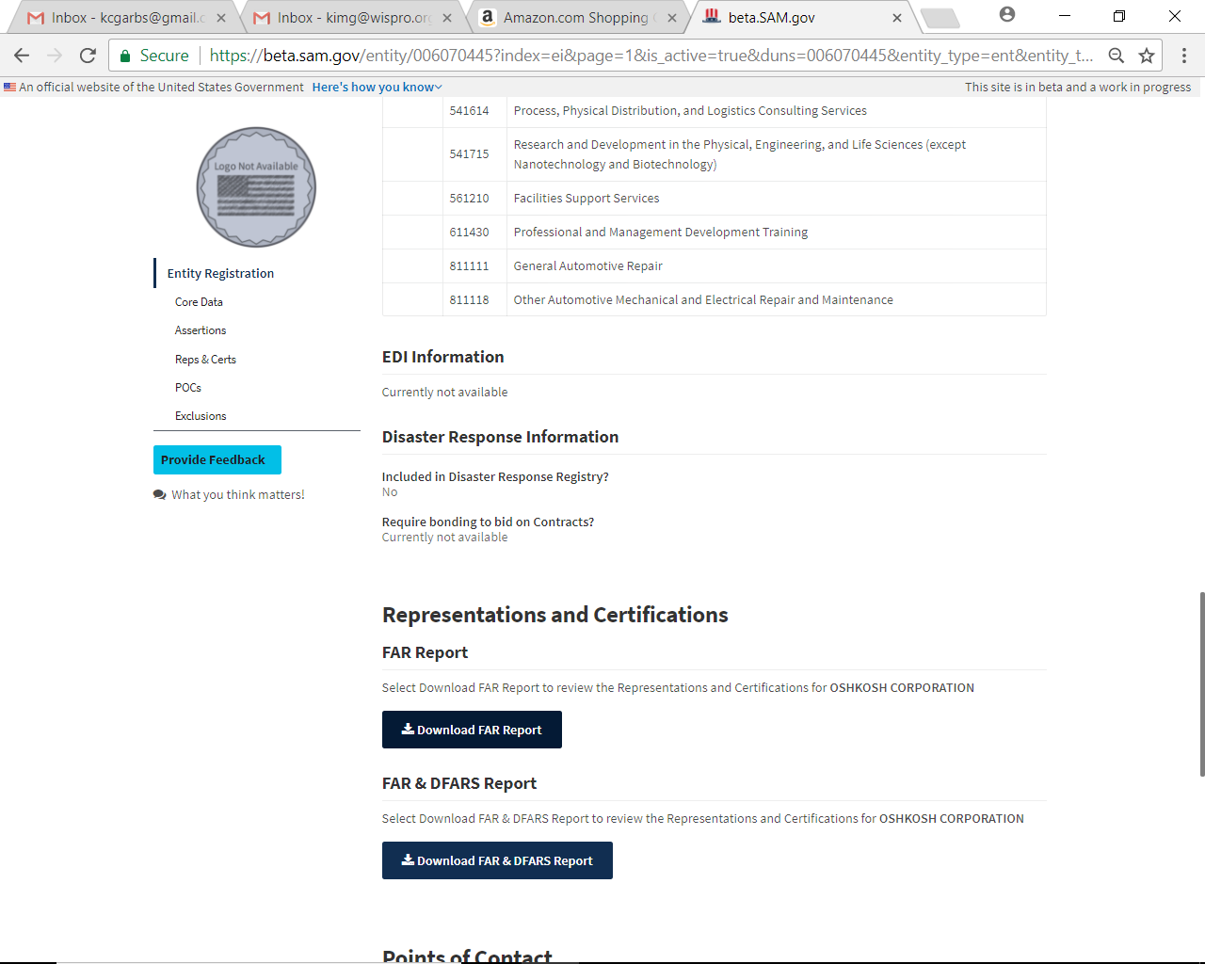
SEARCHING FOR ENTITIES
https://beta.sam.gov/

Slide 24
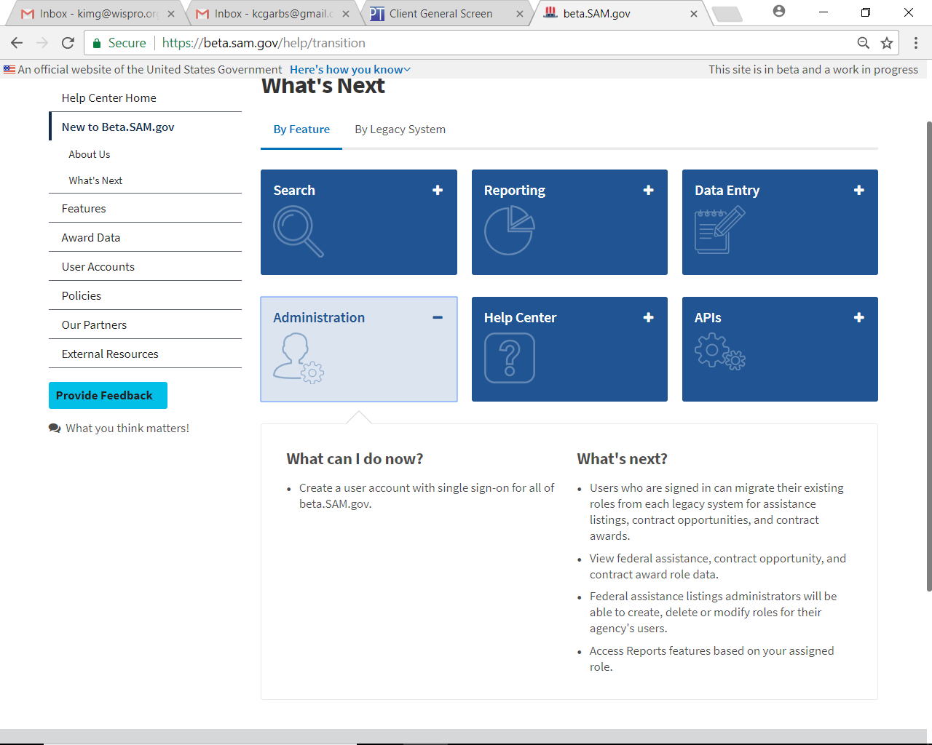
HELP BY FEATURE
https://beta.sam.gov/

Slide 25
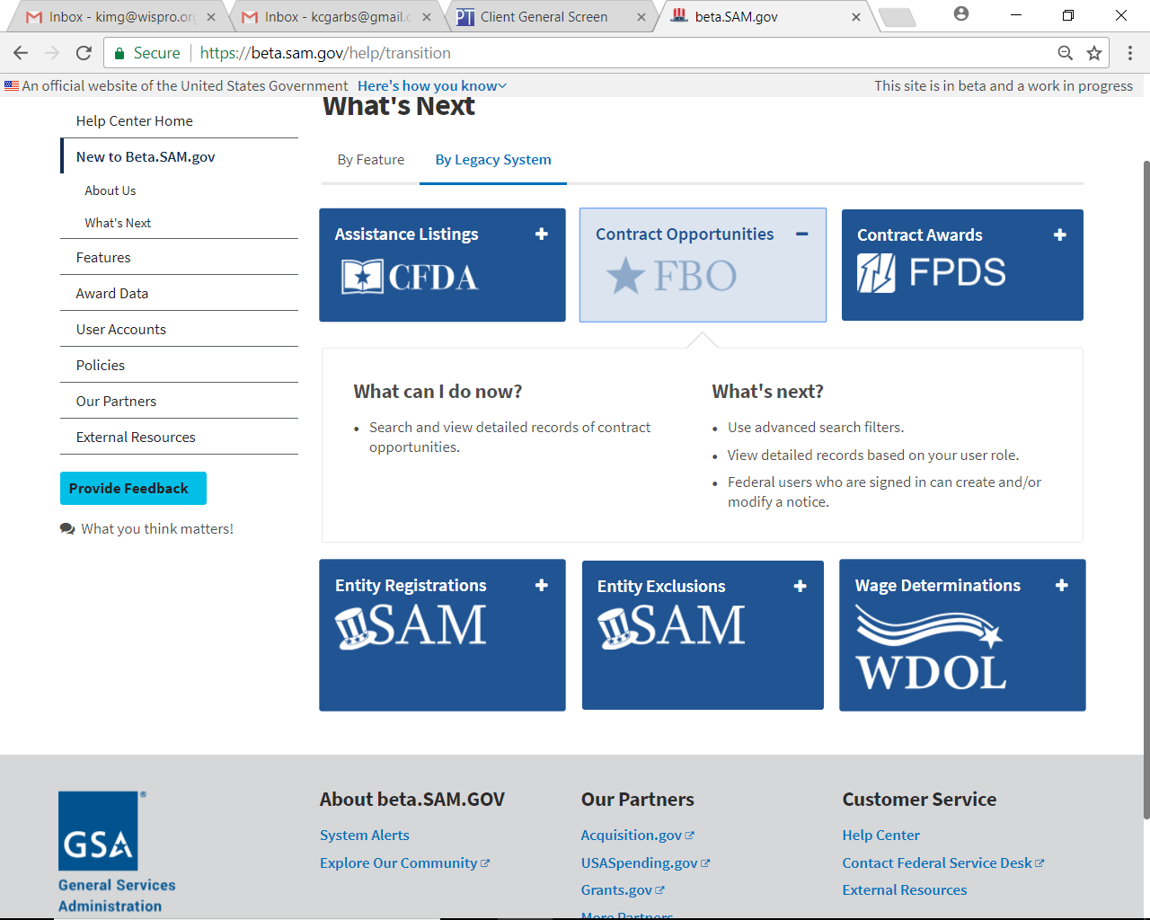
HELP BY LEGACY FEATURE
https://beta.sam.gov/

Slide 26
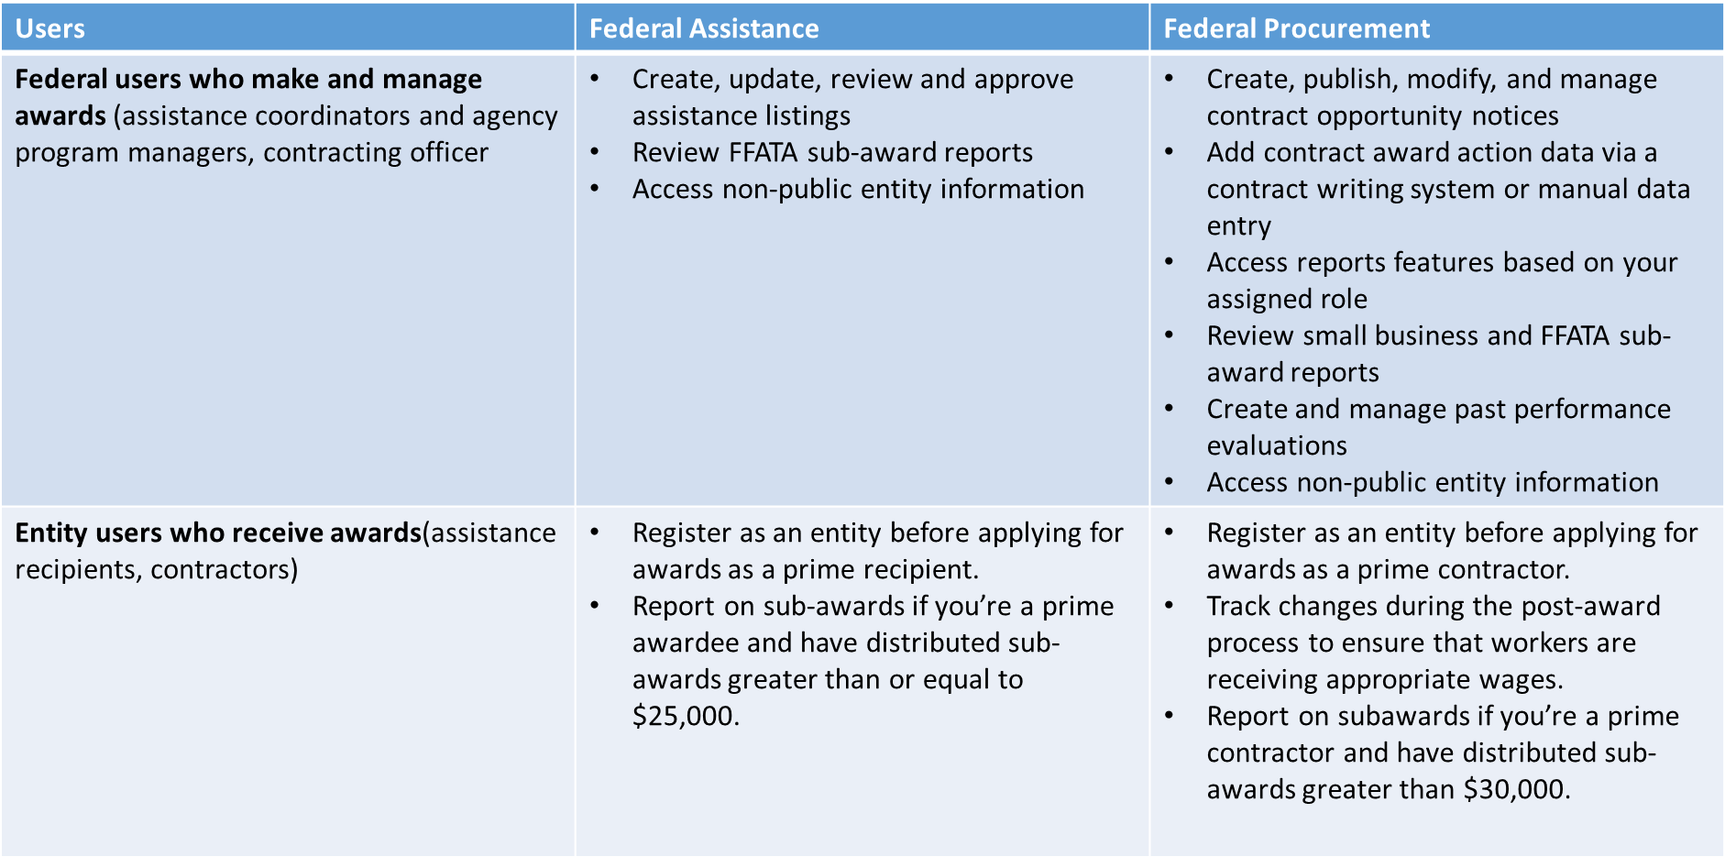
COMING SOON

Slide 27
AWARD DATA – FORMERLY FPDS – THE PLAN
Progressive and filters available
Boolean searches not in current plan
Data normalization & standardization: Once data entry moves to new platform
Saved searches
Sort by date still coming
All current data fields will be migrated
All current data fields will be exportable
Exports to increase from 30K up to 150K lines of data
Single record display format still evolving
Current standard reports
24 now in alpha testing
Forecast mid 2018 into beta
AdHoc reports
Utility will be available
Current functions kept
Easier
New functions planned

Slide 28
TRANSITIONING TO THE NEW SAM.GOV

Slide 29
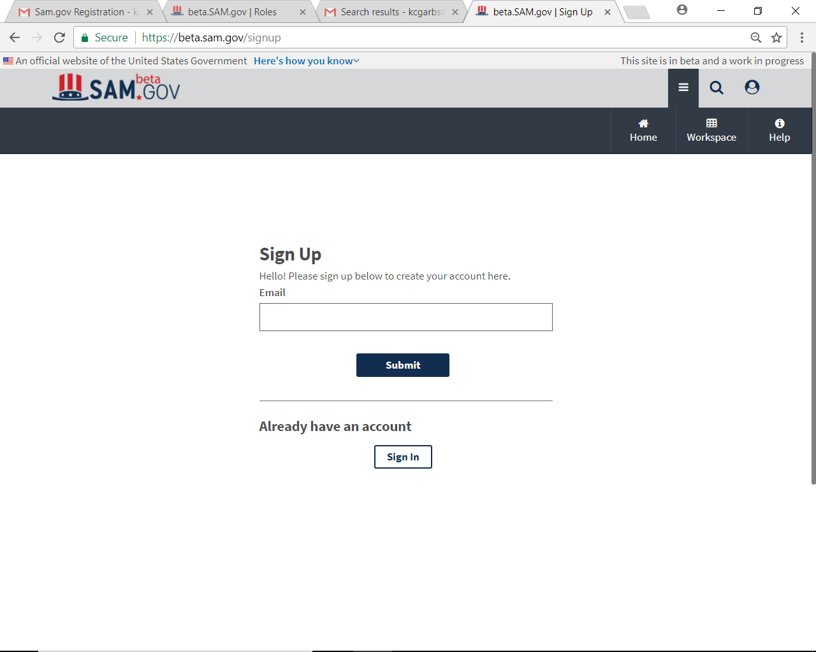
WHERE TO SIGN UP:
https://beta.sam.gov/

Slide 30
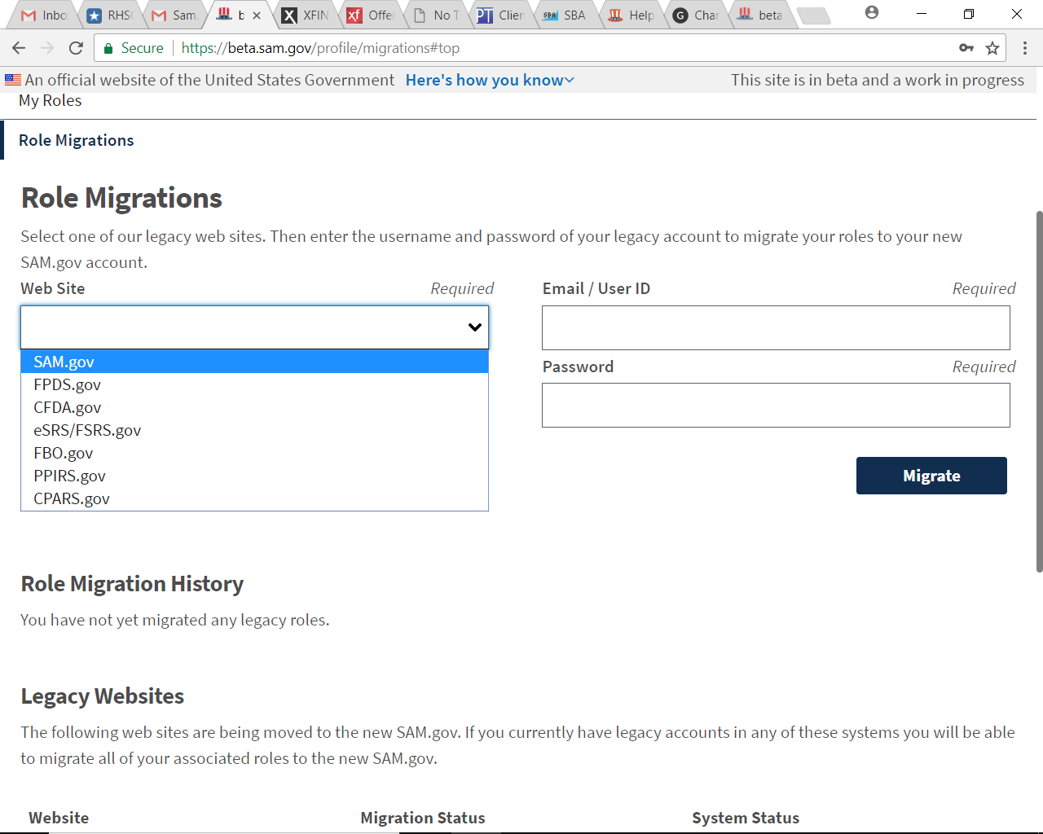

Slide 31
RECENT UPDATES
Release 11 Wrap Up The IAE team for beta.SAM.gov recently wrapped up the latest developments in Release 11. Completing this work brings us closer to our goal of retiring the Catalog of Federal Domestic Assistance (CFDA.gov) and Wage Determinations OnLine (WDOL.gov) later in fiscal year 2018. Significant Accomplishments Made During Release 11
Assistance Listing data entry is complete and user testing for this is now underway as we continue making additional refinements in preparation for CFDA retiring
Additional search filters and sorting capabilities were added to beta.SAM.gov to further enhance the search experience for users
An option was added for users to receive a one-time passcode via text instead of email, which will be available on beta.SAM.gov early next year
The wage determinations search functionality is complete and undergoing testing with users and additional refinements in preparation for WDOL retiring
A new section in the help center was created with searchable frequently asked questions, glossary terms, and videos available for users later in fiscal year 2018 after testing is complete

Slide 32
RECENT UPDATES
Fixed an issue where users were unable to view through search entity registrations with an All Awards purpose of registration, which were created or updated prior to October 6, 2017 if the certified user was different from the user who created the registration.
Updated the SAM Exclusions XML Upload documentation and on-page description to align it with application changes to the deactivate path made during the October 6, 2017 release. Now, to deactivate an exclusion record using the upload tool, an exclusion official must update the record and add or set a new termination date increasing data quality.

Slide 33
Acquisition Hour Live Webinar Series
February 13, 2018 – The Future of SAM.gov – CLICK HERE for additional information – presented by Kim Garber – Wisconsin Procurement Institute (WPI)
February 21, 2018 – Overview of CPARS – CLICK HERE for additional information – presented by Carol Murphy – Wisconsin Procurement Institute (WPI)
February 21, 2018 – Selling to State and Local Governments – CLICK HERE for additional information – presented by Kate Hill – Heartland Information Research (HIR)
February 27, 2018 – Understanding your Obligations when Quoting and Receiving Awards from Defense Logistics Agency (DLA) DIBBS – CLICK HERE for additional information – presented by Jean Polka – Wisconsin Procurement Institute (WPI)
February 27, 2018 – Growing Your Small Business With the Disadvantaged Business Enterprise (DBE) Program – CLICK HERE for additional information – presented by Benjamin Blanc – Wisconsin Procurement Institute (WPI)

Slide 34
Acquisition Hour Live Webinar Series
February 28, 2018 – Cyber Security for Current and Prospective DOD Contractors and Subcontractors – CLICK HERE for additional information – presented by Marc Violante – Wisconsin Procurement Institute (WPI)
March 13, 2018 – Information Management for Federal Contractors – CLICK HERE for additional information – presented by Marc Violante – Wisconsin Procurement Institute (WPI)
March 14, 2018 – Introduction to Certifications Available to Woman Owned Businesses – CLICK HERE for additional information – presented by Kim Garber – Wisconsin Procurement Institute (WPI)
March 27, 2018 – Update on Federal Hour Wage Labor Laws – CLICK HERE for additional information – presented by Corey Walton, Community Outreach and Resource Planning Specialist – U.S. Department of Labor/Wage & Hour Division
March 28, 2018 – Cyber Security for Current and Prospective DOD Contractors and Subcontractors – CLICK HERE for additional information – presented by Marc Violante – Wisconsin Procurement Institute (WPI)

Slide 35
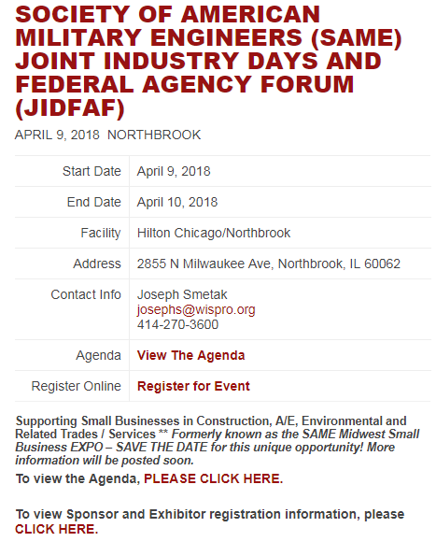
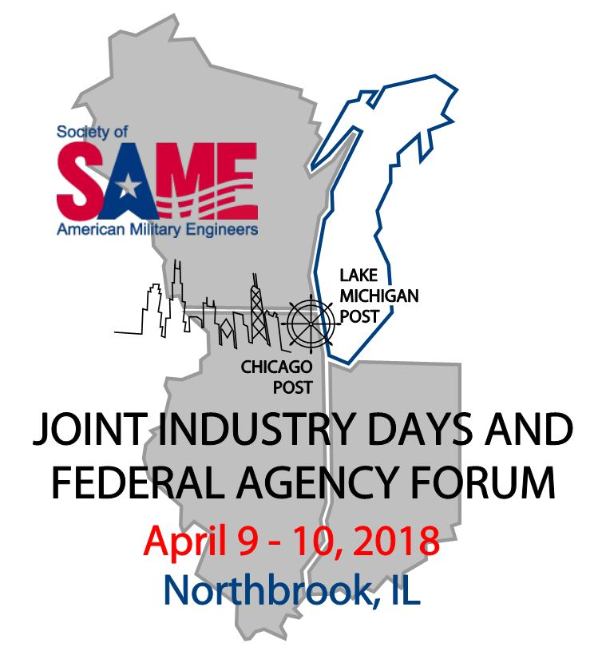
UPCOMING EVENT
https://www.wispro.org/events/society-of-american-military-engineers-same-joint-industry-days-and-federal-agency-forum/

Slide 36

QUESTIONS?

Slide 37

survey

Slide 38

Continuing Professional Education
CPE Certificate available, please contact:
Benjamin Blanc
benjaminb@wispro.org

Slide 39
Presented By
Wisconsin Procurement Institute (WPI)
www.wispro.org
Kim Garber| Manager, Small Business Programs
Wisconsin Procurement Institute (WPI)
kimg@wispro.org 608-444-0047
Benjamin Blanc, CFCM, CPPS | Government Contract Specialist
Benjaminb@wispro.org 414-270-3600
10437 Innovation Drive, Suite 320
Milwaukee, WI 53226

