Slide 1


ACQUISITION HOUR WEBINAR HOW TO QUICKLY ANALYZE SOLICITATIONS
April 26, 2016

Slide 2

WPI Offices located at:
Milwaukee County Research Park
10437 Innovation Drive, Suite 320
Milwaukee, WI 53226
414-270-3600 FAX: 414-270-3610
Juneau County Economic Development Corp. 122 Main St - Camp Douglas, WI 54618
608-427-2455 FAX: 608-427-2086
Western Dairyland EOC, Inc.
418 Wisconsin St. - Eau Claire WI 54703
608-427-2455 FAX: 608-427-2086
Fox Valley Technical College – DJ Bordini Center
5 Systems Drive – Appleton WI 54912
920-840-3771 FAX: 414-270-3610
Racine County Economic Development Corporation – Launch Box
141 Main Street, Suite 2, Racine, WI 53403
414-270-3600 FAX: 414-270-3610
Madison Enterprise Center
100 S. Baldwin St., Madison, WI 53703
608-444-0047 FAX: 414-270-3610
Food Enterprise & Economic Development (FEED)
1219 N. Sherman Ave., Madison, WI 53704
608-444-0047 FAX: 414-270-3610
Wausau Region Chamber of Commerce
200 Washington Street, Wausau, WI 54403
920-456-9990 FAX: 414-270-3610
www.wispro.org - info@wispro.org

Slide 3
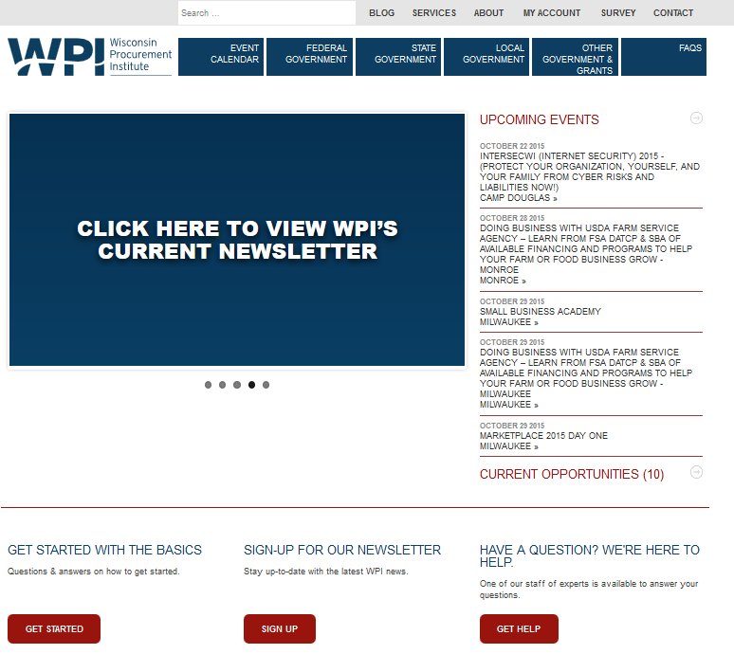

Slide 4
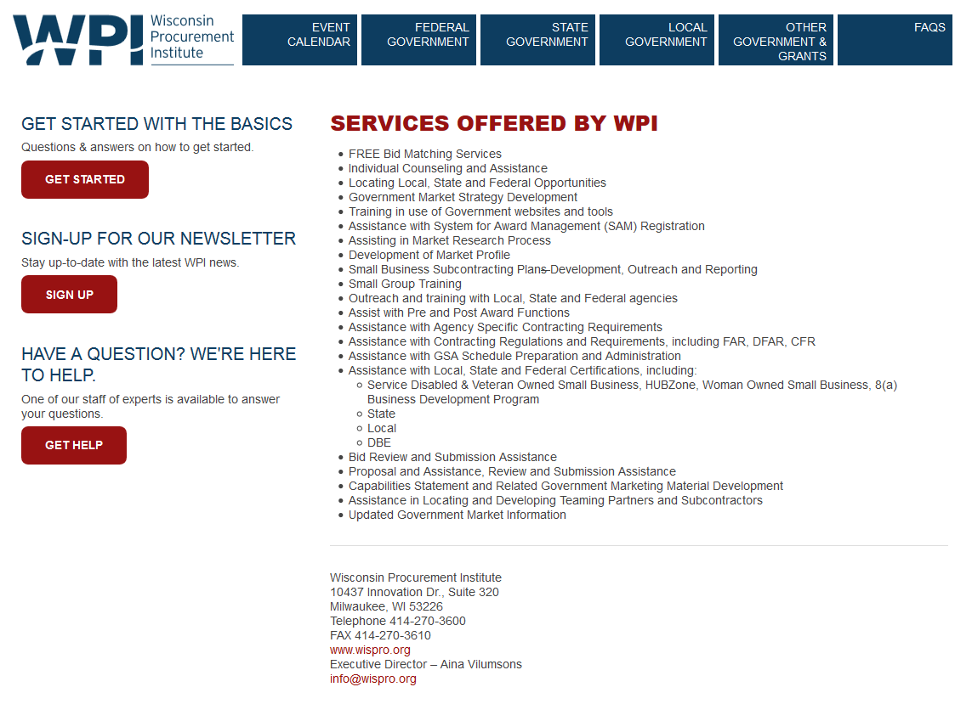

Slide 5

What we will Cover Today
Locating Opportunities
Types of Solicitations
Review of the FBO Announcement
Review of the Solicitation
Go/No Go Decision

Slide 6
WPI Bid Matching Service
Free Service
Provides opportunities daily by email
Looks at over 2,000 websites including federal, state, and local
Matches keywords based on contractor’s capabilities
Contact WPI to set up

Slide 7
Types of Documents
Request For Information (RFI)
Request For Quotations (RFQ)
Invitation For Bid (IFB)
Request For Proposal (RFP)

Slide 8
Request for Information (RFI)
Sources Sought Announcement
Is not a solicitation
Government uses for Market Research
Typically followed by a solicitation

Slide 9
Request for Quotation (RFQ)
Simplified Procurement
Contractor submits quotations
Government evaluates quotations
Award made based on evaluation factors in solicitation
Uses FAR 13

Slide 10
Invitation For Bid (IFB)
Sealed Bid
Public Bid Opening
Awarded to lowest price responsible, responsive bidder
Uses FAR 14

Slide 11
Request For Proposal (RFP)
Negotiated procurement
Contractor submits proposal
Government evaluates proposals
Award made based on evaluation factors in solicitation
Uses FAR 15

Slide 12
Federal Business Opportunities (FBO) Website
Presolictation Notice is generally posted 15 days in advance of the solicitation document. Timeframe may be shorter for commercial items.
Watch opportunities you are interested in. FBO will send you an email message when the solicitation or amendments are posted to FBO.
Log into FBO and click on the Watch This Opportunity button
Locate the actual solicitation and any attachments on FBO.

Slide 13

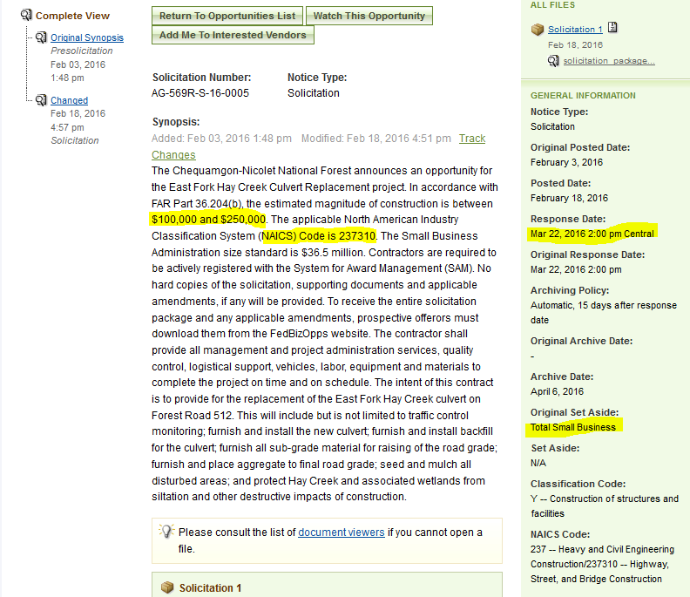

Slide 14
Review FBO Announcement
Scan FBO PreSolicitation Announcement to locate
Response Date – Do you have time to submit a thorough proposal?
Set Aside – Do you qualify to submit a proposal?
NAICS Code – Is this NAICS code in your SAM registration?
You can add a NAICS code to your SAM registration
Contract Dollar Range – Generally located on construction solicitations - Can you support this large of a contract? Or is the dollar amount too small to make a reasonable profit?
Log in and review Interested Vendors List to see who else is interested in the requirement.

Slide 15
Review Solicitation Document
Quickly review the following solicitation parts:
Cover Page
Actual Requirements
Contract Type
Price Schedule
Method of Award
Evaluation Factors

Slide 16
How to Locate the Solicitation Sections
Many large solicitation documents have a Table of Contents – Use it to locate the sections
Cover Page – First page of solicitation document
Actual Requirements – Statement of Work (SOW), Statement of Objectives (SOO), - May follow behind Table of Contents, may be an attachment, for construction includes specifications and drawings, Section C under Uniform Contract Format
Contract Type – May state in FAR 52.216-1 – Type of Contract, may be on cover page or FBO announcement, may be included in first part of SOW

Slide 17
How to Locate the Solicitation Sections
Price Schedule – May be on front or back of cover page, may be in front of or behind actual requirements, may be separate attachment, Section B under Uniform Contract Format
Method of Award- May be part of price schedule or actual requirements, Section M under Uniform Contract Format
Evaluation Factors – Section M under Uniform Contract Format
The more documents you review the easier it becomes to locate the various sections.

Slide 18
Items that may be found on Cover Page
Type of procurement – IFB, RFP, RFQ - Do you want to or have time to respond to that type of procurement document?
Competition restrictions - Set aside – Do you qualify? Could you team with another contractor to qualify?
Review Response Date - Do you have time to submit a thorough response?
Review NAICS Code – Do you meet the size standard for that NAICS code? Is the NAICS code in your SAM registration?

Slide 19
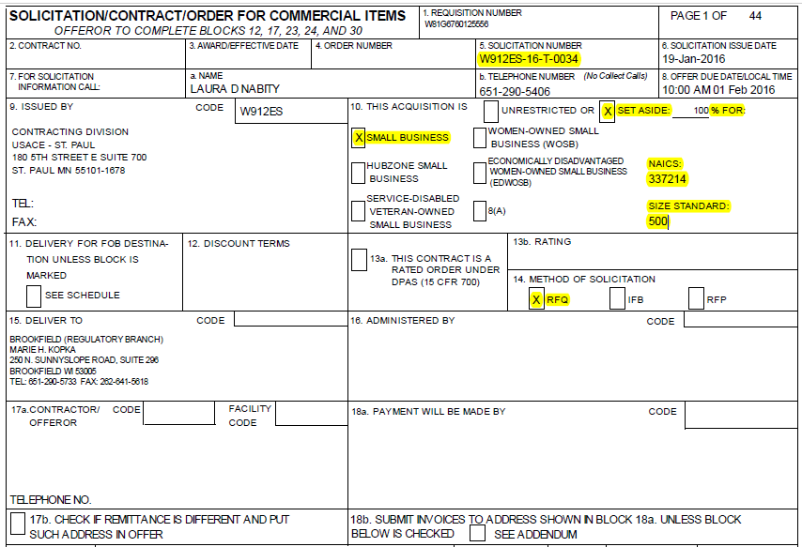

Slide 20
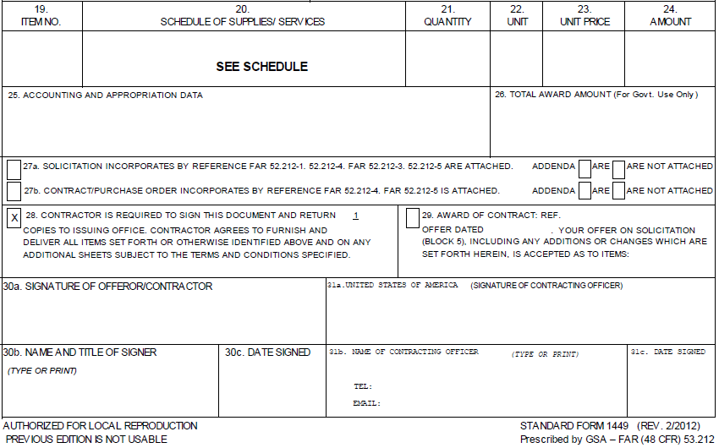

Slide 21
Common Forms
Standard Form (SF) 18 – Request for Quotation
Standard Form (SF) 33 – Solicitation, Offer and Award
Standard Form (SF) 252 – Architect-Engineer Contract
Standard Form (SF) 1442 Solicitation, Offer and Award (Construction, Alteration, or Repair)
Standard Form (SF) 1449 – Solicitation/Contract/Order for Commercial Items

Slide 22
Other Forms
Standard Form (SF) 26 – Award/Contract
Standard Form (SF) 1447 – Solicitation/Contract
Optional Form 307 – Contract Award
Optional Form 308 – Solicitation and Offer-Negotiated Acquisition

Slide 23
Review Actual Requirements
Look at the requirement – Can you perform the work yourself? Do you have teaming partners or subcontractors available?
Is funding currently available? – Do you want to proceed if there currently is no funding for this requirement?
Contract period of performance – Can you meet the performance schedule and complete the work in the timeframe provided?
Bonds – Are you able to provide any required bonds?
Pre-Bid Conferences/Site Visits – Can you attend the pre-bid meetings?

Slide 24
Review Contract Type
What type of contract will be awarded?
Fixed Price
Cost Reimbursement
Indefinite Delivery
Time and Materials
Incentive

Slide 25

Review Price Schedule
Understand how the government wants you to price the contract
Will you be able to make a profit?
Can you complete the price schedule as is or will it generate additional work for your staff?
Can you offer a fair and reasonable price?
Does the contract include progress payments?

Slide 26
Review Method of Award
How will the Government make an award?
Lowest price responsive, responsible bidder – usual method for IFBs
Lowest price, technically acceptable (LPTA) – RFPs and RFQs
Best Value – cost/technical trade off – RFPs and RFQs

Slide 27
Review Evaluation Factors – RFP & RFQ
What Evaluation Factors will be used?
Management/Key Personnel – Do you have the appropriate people on staff?
Experience – Do you have the number of years of experience required?
Past Performance – Have you successfully completed similar work?
Can you address all evaluation factors, demonstrating your expertise? Do you have the time to respond?

Slide 28

GO/NO GO
Once you have completed your review you should have quickly located enough information to determine:
Is this requirement a good fit for your company?
Do you have the required expertise?
Can you meet the required schedule?
Are you able to make a profit?
How much risk for your company is involved?
Who else may be competing for this work?

Slide 29
GO/NO GO
GO DECISION
Read the entire solicitation
Start to work on your response
NO GO DECISION
Move on to the next opportunity

Slide 30

Summary
Locate opportunities, quickly review, and be selective – not every requirement is a good fit for your business. Consider probability of winning, cost of proposal preparation, and estimated profit.

Slide 31

Resources
FAR: https://www.acquisition.gov/?q=browsefar
Air Force FAR: http://farsite.hill.af.mil/
Acquisition.gov is: https://www.acquisition.gov/
Federal Business Opportunities (FedBizOpps) website - https://www.fbo.gov/
Wisconsin Procurement Institute
Phone: 414-270-3600
www.wispro.org

Slide 32
Upcoming WPI Events
Acquisition Hour Live Webinar Series - Tuesdays and Wednesdays
Virtual FAR Training Webinar Series – Wednesday evenings
4th Annual US Department of Veterans Affairs Business Conference – May 12, 2016 – Brown Deer, WI
Government Manufacturing Conference – Supporting the Federal Defense Supply Chain – May 19, 2016 – Green Bay, WI
Managing Your Cost Type or DOD SBIR Contract-What you Need to Know Prior to Submitting a Proposal and After Award – May 24, 2016 – Pewaukee, WI
How to do Business with the U.S. Forest Service – May 26, 2016 – Rhinelander, WI
National Education Seminar: Subcontract Management From A to Z – June 2, 2016 – Lake Geneva, WI
10th Annual Volk Field Small Business Conference – June 15-16, 2016 – Camp Douglas, WI

Slide 33
questions?

Slide 34

Continuing Professional Education
CPE Certificate available, please contact:
Benjamin Blanc
benjaminb@wispro.org

Slide 35
For Assistance or Additional Information - Contact
Wisconsin Procurement Institute (WPI)
Carol Murphy
10437 Innovation Drive, Suite 320
Milwaukee, WI 53226
414-270-3600 or carolm@wispro.org

