Slide 1
Industry Day with Mission & Installation Contract Command (MICC) MICC - McCoy
Tony Steinhoff
Deputy Director
1108 South R Street
Fort McCoy, WI 54656
tony.r.steinhoff.civ@mail.mil

Slide 2
DISCUSSION ITEMS
Who We Are
Construction Opportunities
Pursuing Opportunities
Q&A

Slide 3
Who We Are
MICC McCoy is made up of 32 personnel and supports the Fort McCoy Garrison and it’s many tenants with the largest being the 88th Regional Support Command which spans over a 19 state geographical region and over 350 facilities.
MICC McCoy is one of 33 offices within the MICC at the field level and falls under the Army Contracting Command and the Army Materiel Command.

Slide 4
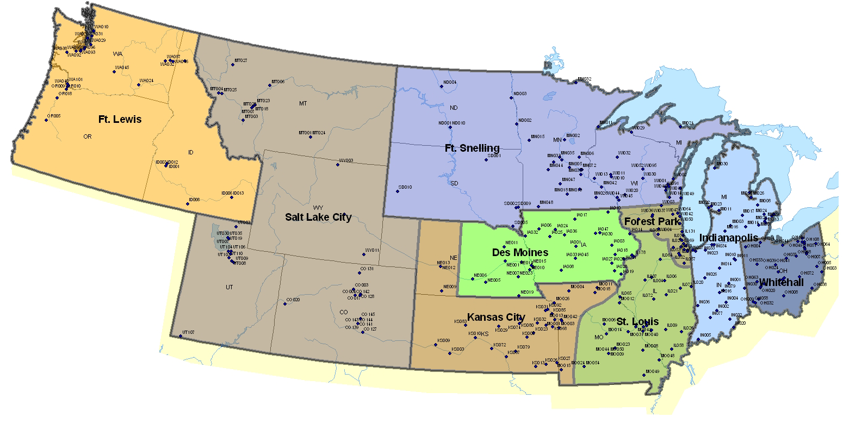
88TH RSC FACILITY LOCATIONS

Slide 5
Who We Are?
Construction Division: Provides construction support for all activities such as building alterations/renovations, demolition, A&E and a multitude of supply type items.

Slide 6
Who We Are?
Division Chief: Ms. Christina Lene (608) 388-4525
Lead Pre-Award KO: Steve Bailey x6077
Lead Post-Award KO: Bob Echternach x2123
Contract Specialists:
Jamie Gregar x1007
Melissa Gore x1251
Tonja Dreke x4617
Katie Opper x4617
Victor Gutierrez x2263

Slide 7
Construction Opportunities
Fiscal Year (FY 15) Projects:
Repair Clarifier 1
Repair Replace Bird Netting (Various Ranges)
Construct Office Space in Container Loading Facility
Fire Alarm IDIQ
Repair Roof and Exterior of Bldg. 110
Install Flags and Tags on Fire Hydrants
Asphalt IDIQ

Slide 8
Construction Opportunities Continued
Fiscal Year (FY 15) Projects Continued:
Repair the Flooring and Walls in Bldg. 2532 & 821
Install Customer Counter at Bldg. 3050

Slide 9
Construction Opportunities Continued
Fiscal Year (FY 16) Projects:
Concrete/Gravel IDIQ
Flooring IDIQ
Municipal Water IDIQ
Repair Misc. Bldgs.
Install Programmable Thermostats
Repair Concrete Panels and Joints in Bldg. 495
Install New Beacon at Airport Comm Site

Slide 10
Construction Opportunities Continued
Fiscal Year (FY 16) Projects Continued:
Install Emergency Power Shut in Bldgs. 2691 & 2692
Construct Picnic Shelter for NCO Academy
Install Switches in Troop Training Facilities
Construct New Pads & Repair Pads Commemorative Area IDIQ
Install Occupancy Lighting Sensors in Bldg. 1370
Install Cages in 2 Bays of Bldg. 1473 for Storage

Slide 11
Pursuing Opportunities (cont.)
Know where to seek opportunities:
  Army Single Face to Industry https://acquisition.army.mil/asfi/default.cfm
  Federal Business Opportunities
  https://www.fbo.gov/
  FedBid
  http://www.fedbid.com/

Slide 12
Pursuing Opportunities (cont.)
The Department of Defense Activity Address Code (DoDAAC) is a six position code that uniquely identifies a Department of Defense unit, activity, or organization that has the authority to requisition, contract for, receive, have custody of, issue, or ship DoD assets, or fund/pay bills for materials and/or services. The first positions of the code designate the particular Service/Agency element of ownership.
Our DoDAAC is W911SA

Slide 13
Pursuing Opportunities
Knowledge is empowering
  Federal Acquisition Regulation (FAR)
  Defense Acquisition Regulation Supplement (DFARS)
  Army Federal Acquisition Regulation Supplement (AFARS)
  http://farsite.hill.af.mil/vffar.htm

Slide 14
Pursuing Opportunities (cont.)
Marketing Sets the Pace
  Know your product/service
    Know your Federal Supply Class or Service Codes (FSC/SVC) http://www.outreachsystems.com/resources/tables/pscs/ and North American Industry Classification System (NAICS) code http://www.naics.com/search.htm for your product or service
  If you are an 8(a), HUBZone, Service Disabled Veteran (SDV), or otherwise eligible for one of the set-aside programs, then you MUST go visit the SBS and let them know who you are and what you can do
    Work with the Small Business Administration to obtain certification or self-certify, as applicable should you believe you qualify for one, or more, of the programs. Please visit http://www.sba.gov/ for more information.

Slide 15
Pursuing Opportunities (cont.)
You must register your business before being eligible to receive award with the Federal Government:
  Obtain a DUNS number (Data Universal Number System (DUNS) - a unique 9-character ID. Contact Dun and Bradstreet for further information http://fedgov.dnb.com/webform
  Registration in System for Award Management https://www.sam.gov/portal/public/SAM/
    SBA, Dynamic Small Business Search http://dsbs.sba.gov/dsbs/search/dsp_dsbs.cfm, as well as a wide variety of search engines are used by the Government to identify small business concerns for potential prime contract opportunities

Slide 16
Pursuing Opportunities (cont.)
Explore Subcontracting Opportunities
  Subcontracting opportunities through Prime contracts is a large secondary market
  Our website contains a list of active, recurring type contracts-info on prime’s is available
  SBA Sub-Net is a resource on which Prime contractors can post subcontracting opportunities - http://web.sba.gov/subnet/
  Establish relationships with prime contractors

Slide 17
Pursuing Opportunities (cont.)
Know the resources available to assist you
  Wisconsin Procurement Institute (WPI) guides, trains and provides hands-on assistance to firms interested in developing government business, and improving process and technical capabilities to access and compete in the government marketplace.
  http://www.wispro.org/
  Association of Procurement Technical Assistance Centers (APTACS) provides technical and marketing assistance to businesses interested in selling products and services to the government.
  http://www.aptac-us.org/new/index.php
  Small Business Specialists are normally available to provide information on how to do business with the Government as well as site specific information
  http://www.mccoy.army.mil/Visitors/Doingbusiness.asp

Slide 18
Pursuing Opportunities (cont.)
MICC McCoy Small Business Goals
FY15 Goal Achieved
SB 54.95% 86.54%
SDB 31.39% 56.72%
SDVOSB 12.04% 24.57%
Woman-Owned 12.13% 16.90%
hubzone 6.10% 10.11%

Slide 19
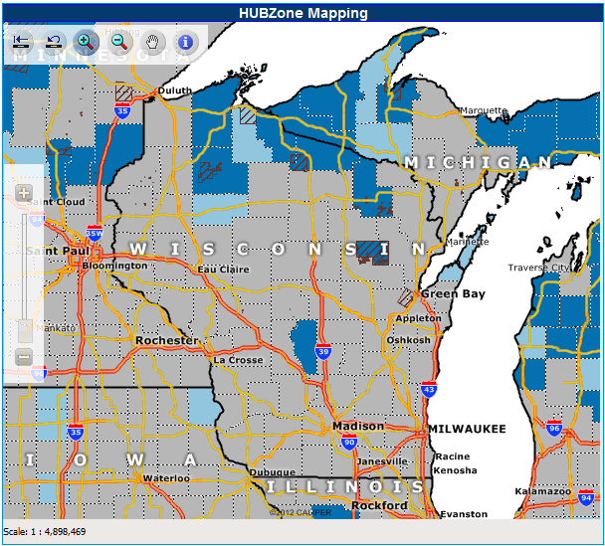
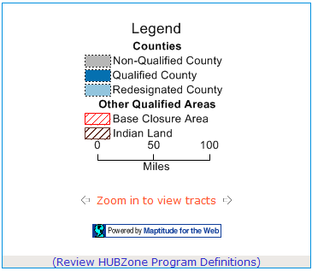
Pursuing Opportunities (cont.)
http://map.sba.gov/hubzone/maps/

Slide 20
Historical Contract Workload (Actions/Dollars)
Fiscal Year # Actions Dollars
2010 2,708 $193.8M
2011 2,747 $134.7M
2012 2,122 $127.9M
2013 1,774 $116.4M
2014 1,449 $127.1M
GPC Spend FY14: $ 12.5M

Slide 21
POINT OF CONTACT
Tony Steinhoff
Deputy Director
Mission & Installation Contracting Command
(MICC - Fort McCoy)
(608) 388-7351
tony.r.steinhoff.civ@mail.mil

Slide 22
QUESTIONS
??????

