Slide 1
Working as a Federal Government Manufacturing Subcontractor
February 28, 2018 - Manitowoc, WI

Slide 2





Slide 3

INTRODUCTIONS
Your name
Company name
City
DoD contracting experience?

Slide 4
ABOUT WPI Supporting the Mission Serving Wisconsin companies for 30 years!

Slide 5
Assist businesses in creating, development and growing their sales, revenue and jobs through Federal, state and local government contracts.

Slide 6

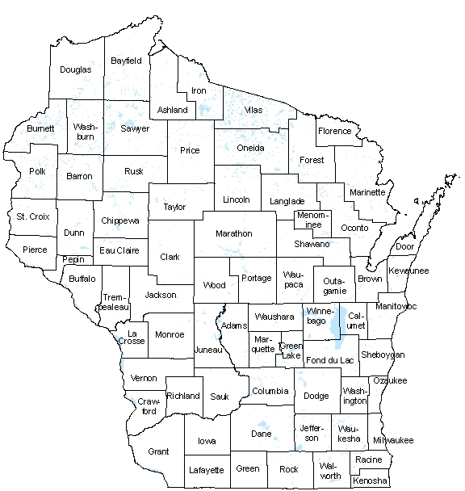
WPI OFFICE LOCATIONS
MILWAUKEE – Technology Innovation Center
MADISON –
Madison Enterprise Center
FEED Kitchens
CAMP DOUGLAS– Juneau County Economic Development Corporation (JCEDC)
WAUSAU – Wausau Region Chamber of Commerce
APPLETON – Fox Valley Technical College
WAUSAU
APPLETON
CAMP DOUGLAS
MADISON
MILWAUKEE

Slide 7
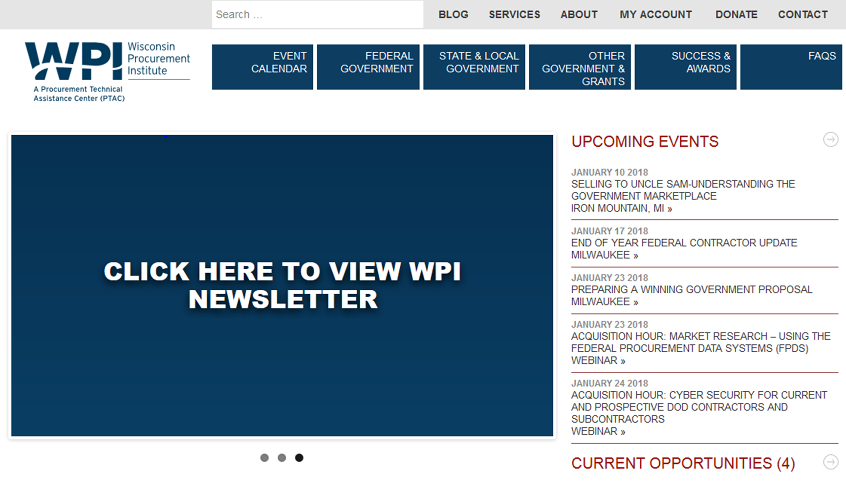


Slide 8
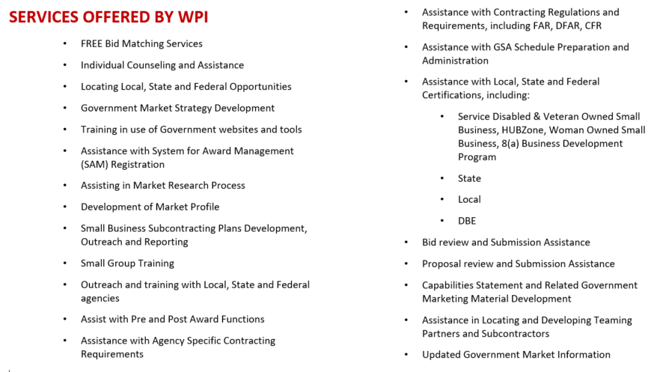

Slide 9
What we will talk about today
The Process – how this REALLY works
Understanding how to leverage small business programs
THE MARKET – how to get noticed and considered
Practical advice and wisdom

Slide 10
The process – how this really works

Slide 11
UNDERSTAND THESE BASIC PRINCIPALS
There MUST be a need
There MUST be money to pay for the product or service
YOU MUST be COMPETITIVE
YOU MUST MAKE MONEY
YOU MUST have the CAPABILITIES, CAPACITY and RESOURCES to support the requirement
This is a NATIONAL / INTERNATIONAL market – NOT (usually) a local opportunity
It must be done “THEIR” way

Slide 12
what does a prime contractor look for
BASIC BUSINESS – LOW RISK
Management
Core Competencies
Past Performance
Current Customers
Capacity – current and future
SITE VISIT

Slide 13
what does a prime contractor look for
Strength of the SUPPLY CHAIN
ON TIME – capacity – resolving issues – ordering system
QUALITY
Level of certification – DOD, DLA, NAVY, Aerospace
Certification vs. Compliance
COMPETITIVENESS
Cost vs. Price / design to cost vs. cost to design
Sustainable cost structure
Understanding requirements / regulations and administrative process
Expertise
Resources dedicated to project

Slide 14
what does a prime contractor look for
UNDERSTANDING OF FLOW DOWN CLAUSES
Berry Amendment
Buy American Act
Termination for Convenience
DPAS Rating
Equal Opportunity
Encouraging Contractor to Ban Texting While Driving
Human Trafficking
Packaging and Markings
Counterfeit Parts – traceability
Cyber Security
ITAR
Others

Slide 15
PULL TOGETHER your pertinent information
D&B Number
Banking information
Tax ID number
NAICS CODES - https://www.census.gov/cgi-bin/sssd/naics/naicsrch
PSC CODES - https://www.acquisition.gov/PSC_Manual
Information on certifications / compliance –
Small Business
Quality
Other
Capabilities detail
Past performance
Other

Slide 16
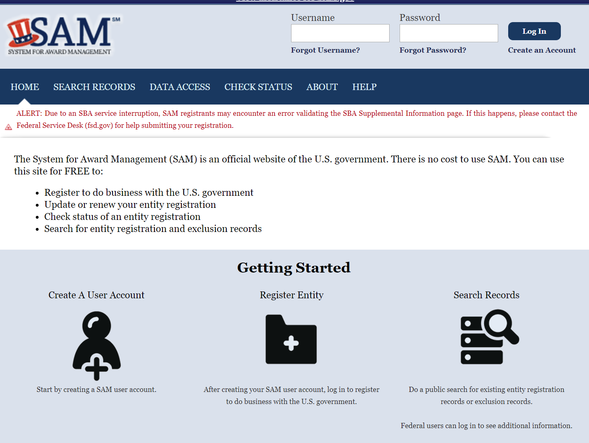
REGISTER IN sam.gov - required by many primes
WHY?? This is where PRIMES look for sources
NOTE: SAM is in a state of CHANGE – see https://beta.sam.gov/
AND NO COST to register

Slide 17
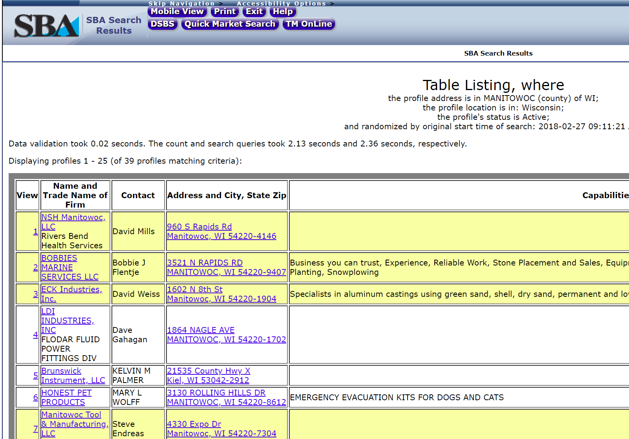
Develop your small business profile in dsbs
WHY?? This is also where PRIMES look for sources

Slide 18
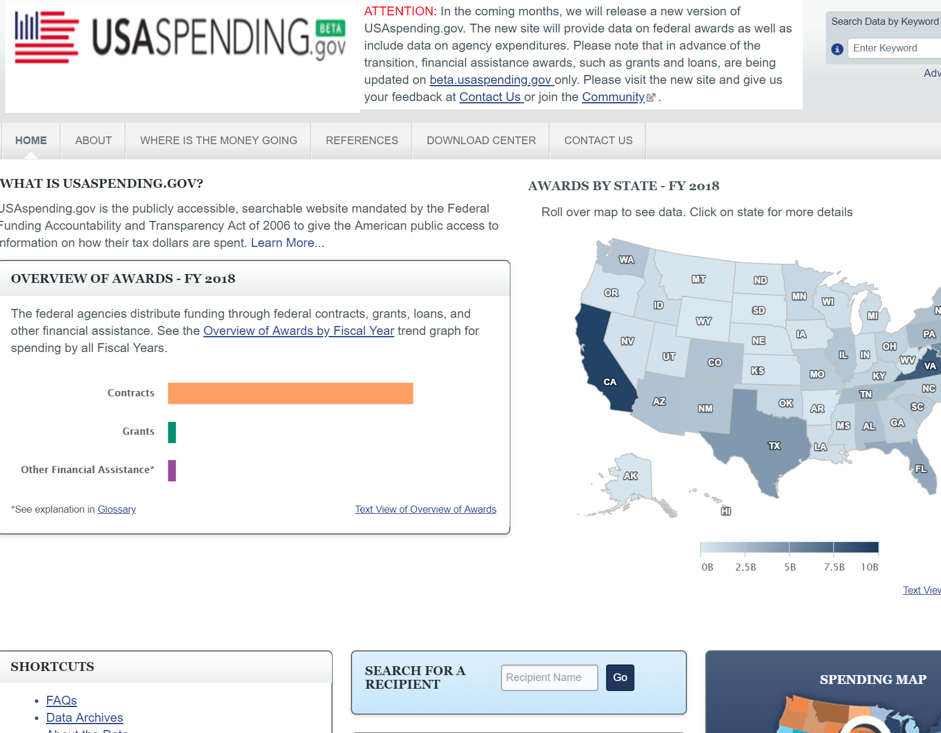
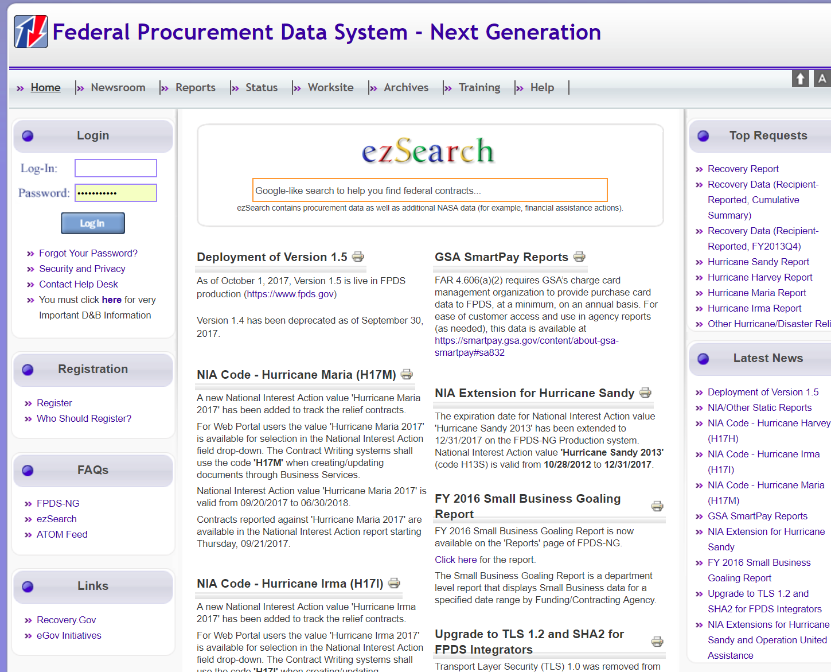
Target your market – who is getting awards
https://www.fpds.gov
https://www.usaspending.gov

Slide 19
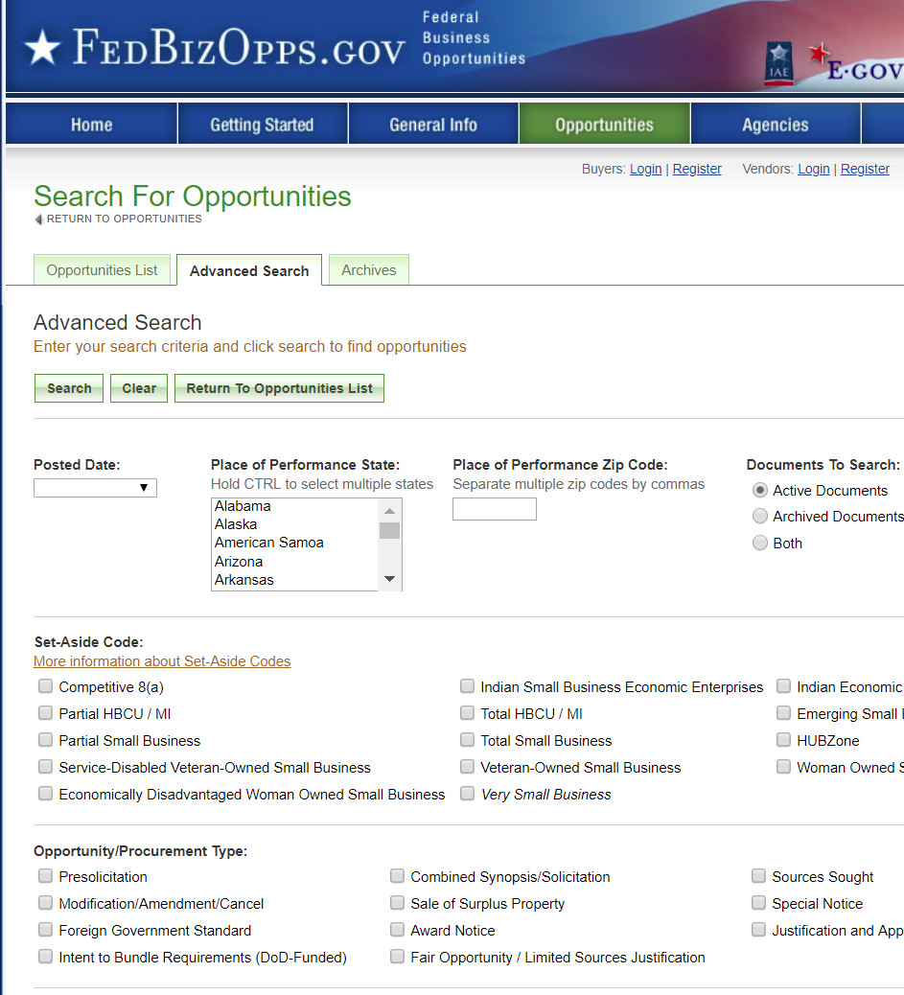
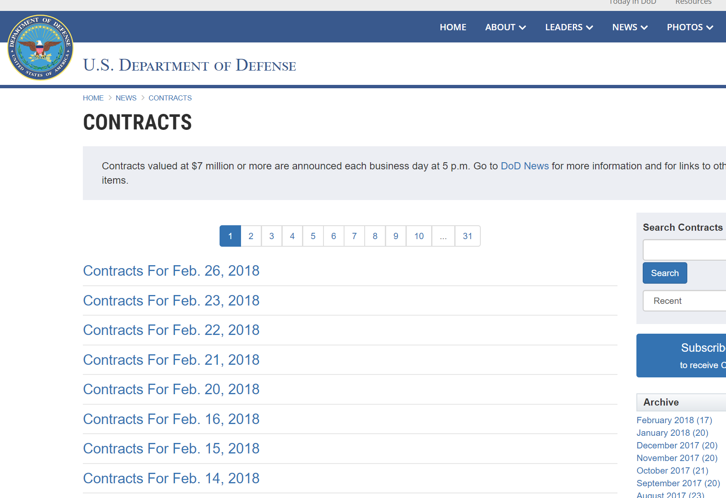
Target your market – who is getting awards
https://www.defense.gov/News/Contracts/
Jean Polka will be sharing a list of TOP DEFENSE PRIME CONTRACTORS WITH YOU

Slide 20
NOW GO AFTER THE WORK……
More on this after the US SBA talks about the value of SMALL BUSINESS PROGRAMS and their importance in becoming a SUBCONTRACTOR

Slide 21
UNDERSTANDING HOW TO LEVERAGE SMALL BUSINESS

Slide 22
PRESENTED BY
James Strube
Business Opportunity Specialist/
SBDC Project Officer
U.S. Small Business Administration
Milwaukee, WI
James.strube@sba.gov
Office: 414-297-3951

Slide 23
HOW TO GET NOTICED AND CONSIDERED

Slide 24
Small Business Liaison Officer - SBLO
SBLO – in short – is responsible for a firms small business subcontracting program, i.e., developing, preparing, and executing individual subcontracting plans, monitoring performance relative to the particular plan and periodic reporting requirements
Every large Federal contractor with large contracts is required to have
Know who they are – connect with them
http://www.acq.osd.mil/osbp/docs/DoDPrimeContractorsJuly2015Final.xlsx list of Prime Contractors for DOD 2014 – contact information may be outdated
WHAT WILL THEY LOOK FOR…….?

Slide 25
Register in the prime portals
Most – not all – have entry points for current and potential suppliers
Take a serious look at what they expect from a subcontractor
Do not enter your information until you review their requirements and priorities – it will determine how you enter your information
Understand this is just an entry point registration – this is their list
They will search for suppliers if there is a need
They will search by small business status, NAICS, ……… be complete and accurate

Slide 26
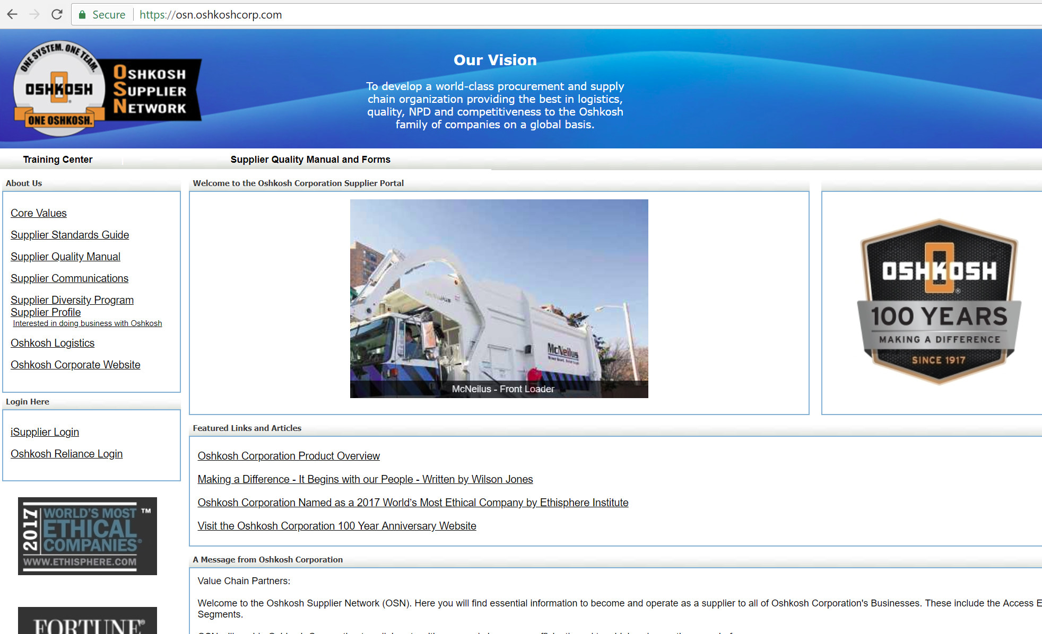

Slide 27
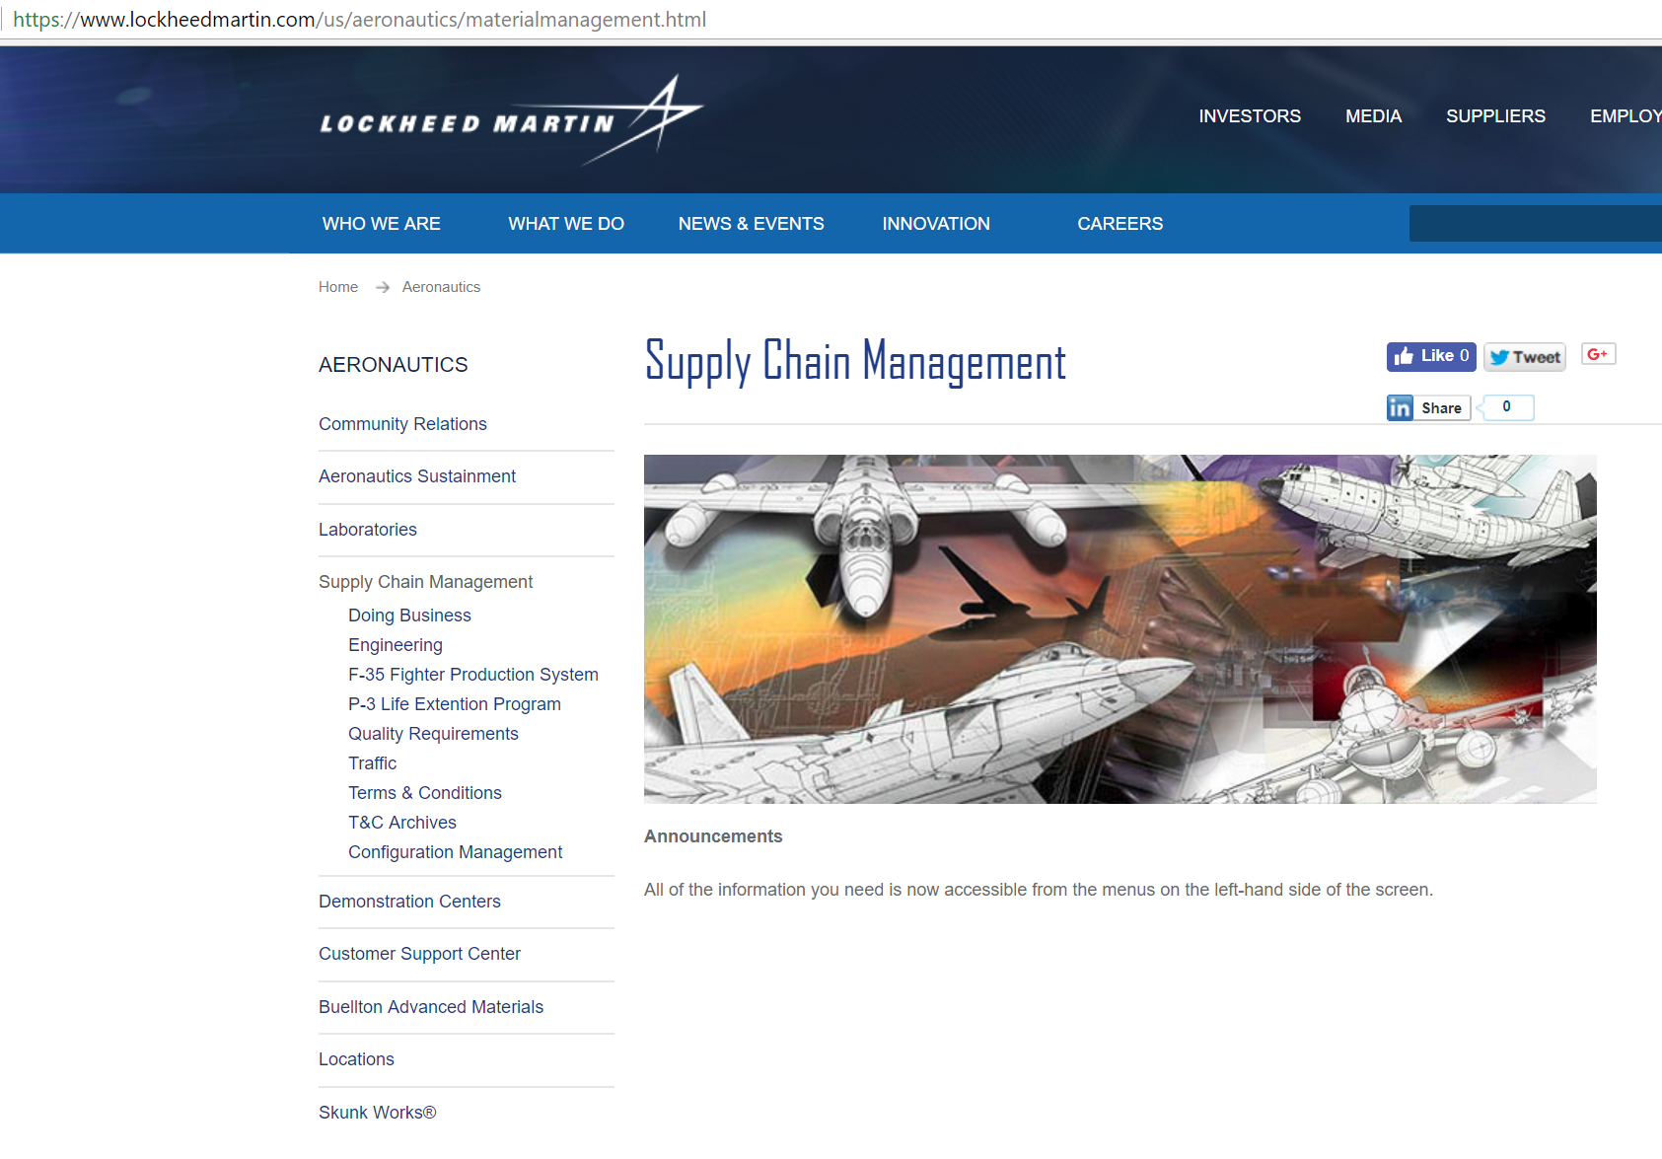

Slide 28
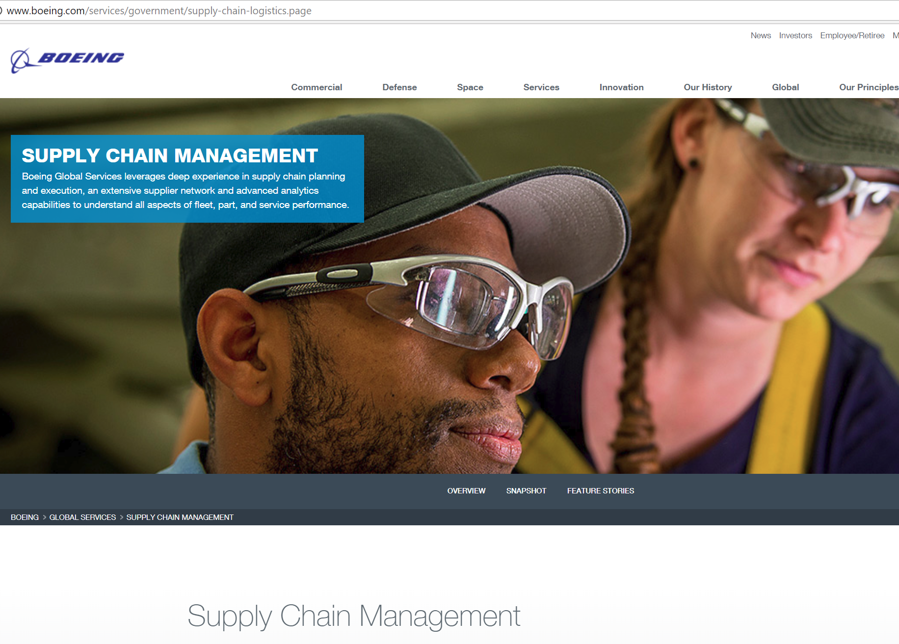

Slide 29
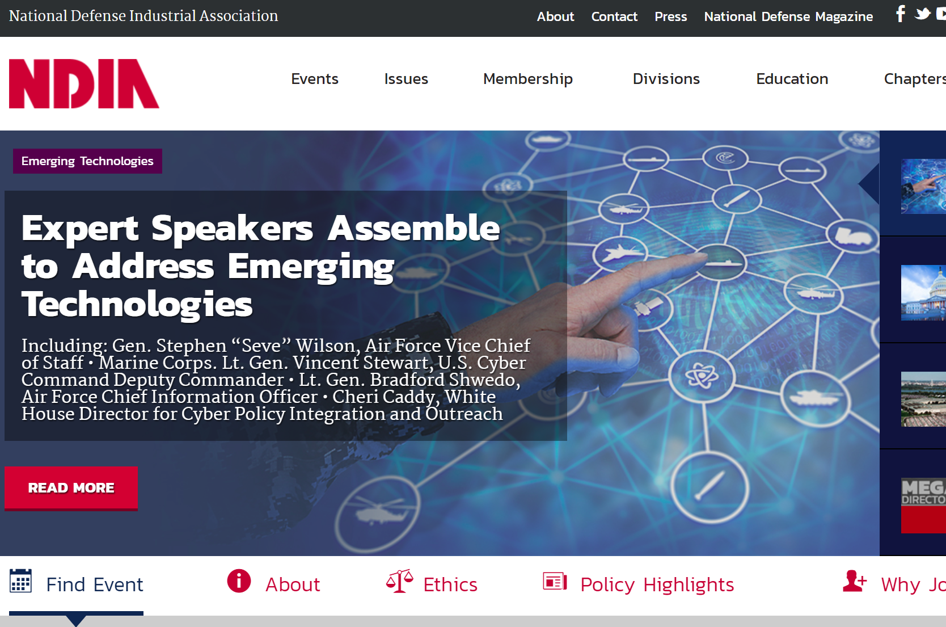

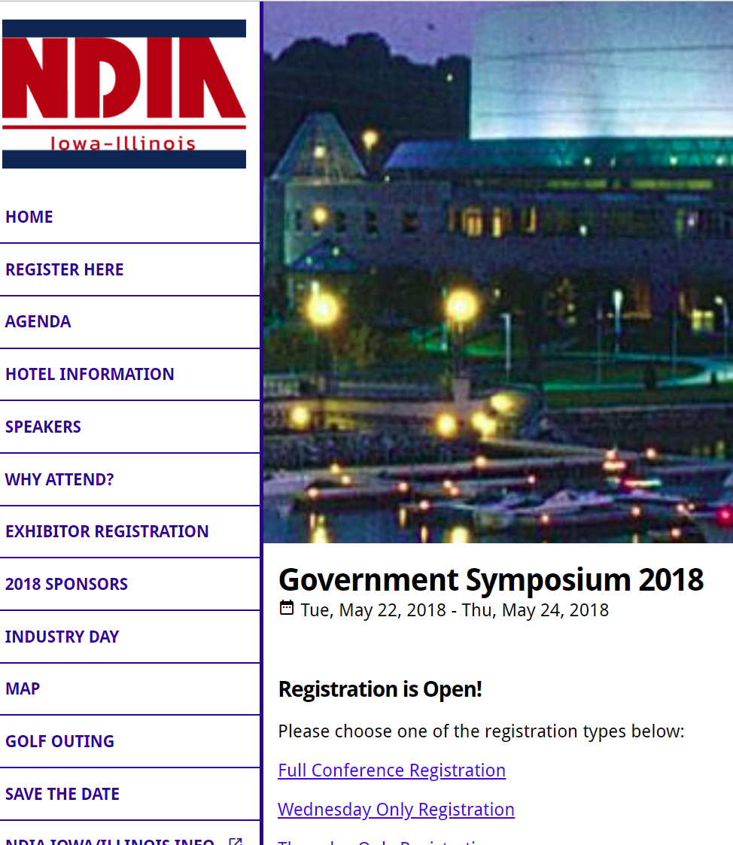

NETWORK, attend AND SCHMOOZE

Slide 30
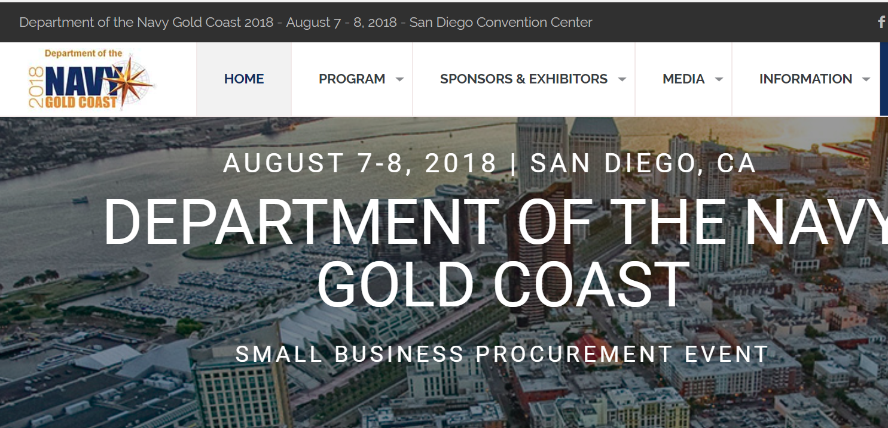
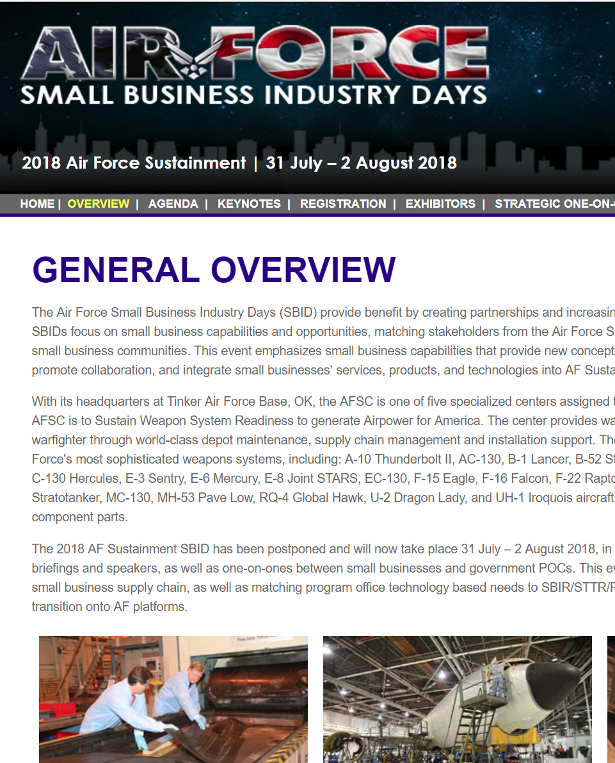
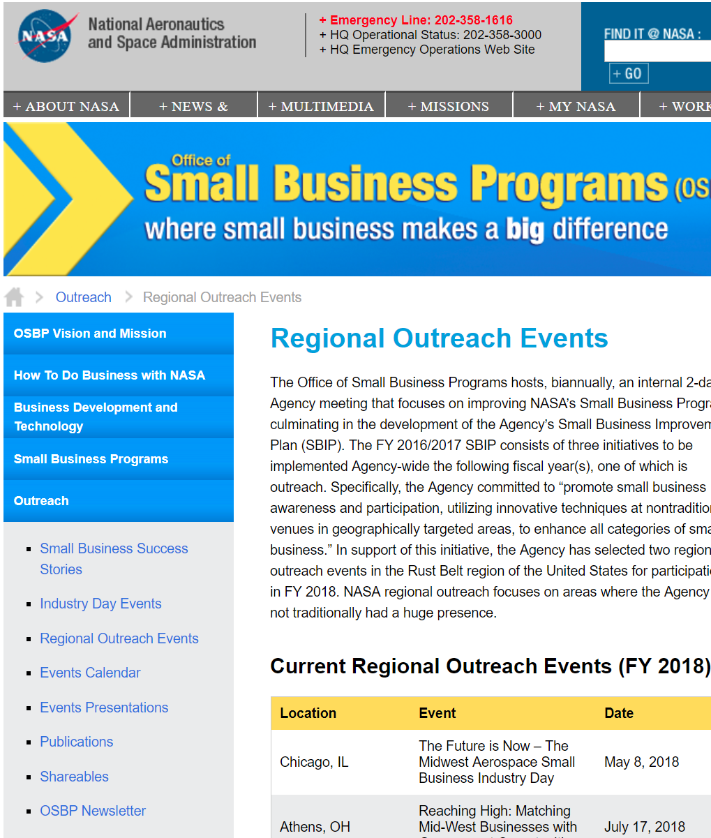

Slide 31

Preparing for networking and schmoozing
BE PREPARED for BUSINESS MEETINGS with BUSINESS PROFESSIONALS
Active registration in SAM with a DSBS profile
Business Card
Capabilities Statement
ON LINE presence
Verbal
Introduction
Discussion of more detail

Slide 32
Preparing for networking and schmoozing
Do your homework prior to meetings / events – know your potential customer
What they are looking for
What are their priorities
What projects they are working on
Any current news – good and bad
TO GET THE SALE – YOU NEED TO GO AND GET IT!
If they cannot find you and they do not know who you are and what you can do………………….NO SALE!

Slide 33

THE BUSINESS CARD
Appearance
Light in color – so recipient can write on
Not glossy – so recipient can write on
Not CUTE – this is business
Leave “white space” for notes by recipients

Slide 34
Capabilities statement
Five key elements are included in a successful capability statement:
1. Core competencies
2. Past performance
3. Differentiators
4. Corporate data
5. Contact information
A Capability Statement should also include your firm’s name, logo, tag line and other branding elements. It should be free of long paragraphs but instead, should use short sentences and bulleted lists for quick review. We recommend that you customize your CAPE’s for various market segments. You should not itemize or number your CAPE statement but should include ALL 5 elements.

Slide 35
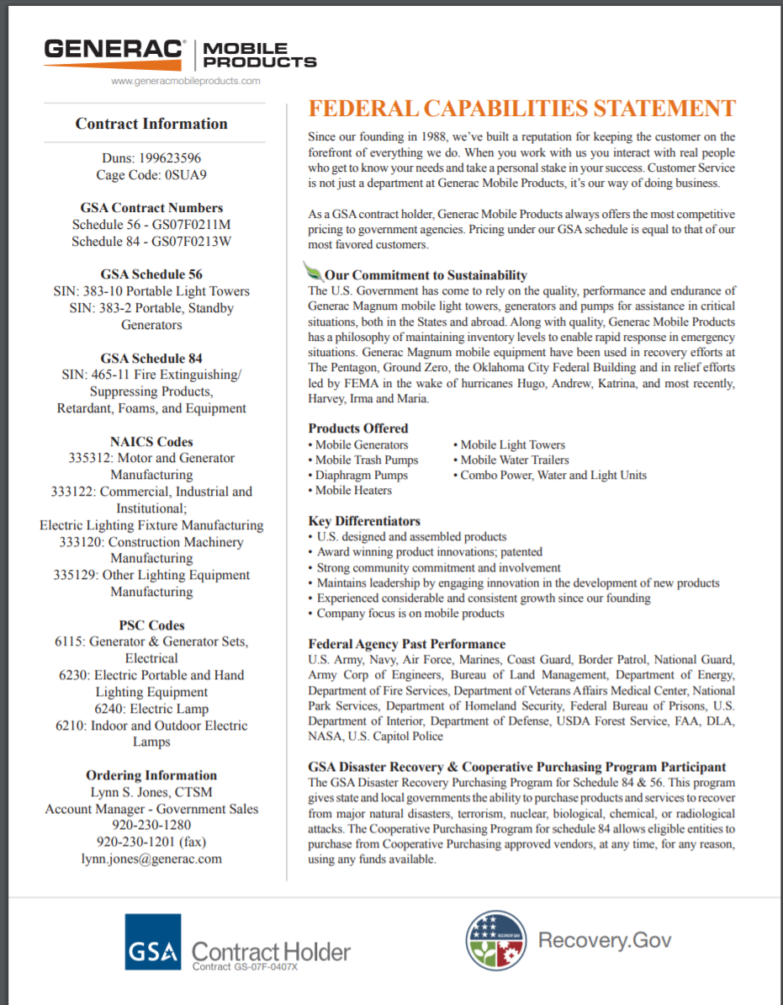
Capabilities statement

Slide 36
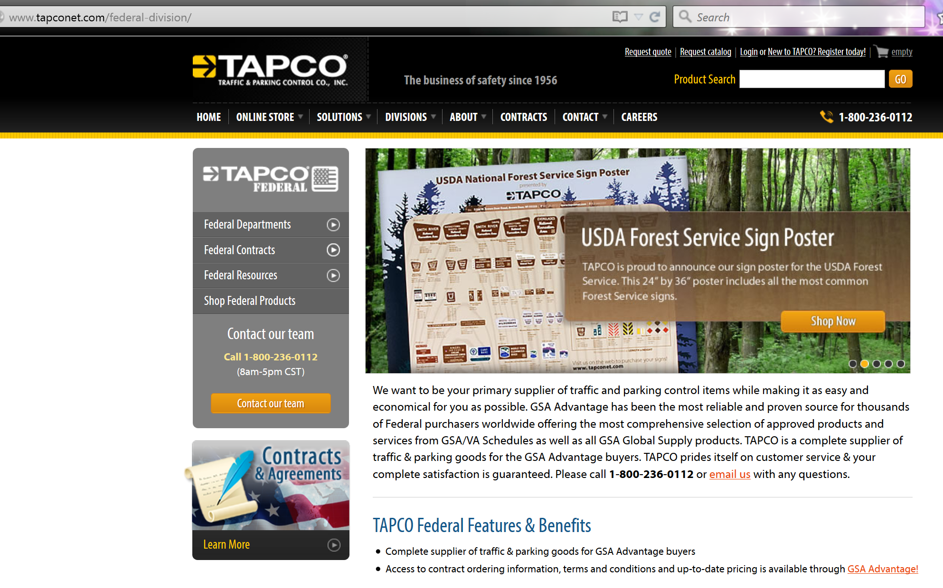

websites

Slide 37
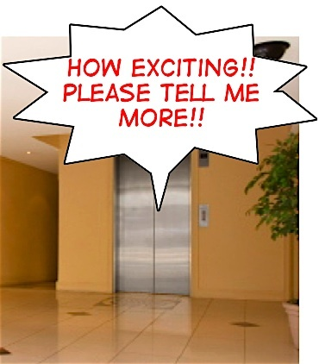
THE TALKING PART
Verbal
Introduction
Have your brief 30 second “elevator pitch” prepared and refined
Discussion of more detail
Expanded discussion
Next meeting
Advice on following up

Slide 38
PRACTICAL ADVICE AND WISDOM from someone that has taken the journey

Slide 39
PRESENTED BY
William Capelle – Director of Operations
American Pride Industrial Equipment & Services LLC
“Service-Disabled Veteran-Owned Small Business”
1978 Commercial Way
Suite A
Green Bay, WI 54311
Toll Free 877-739-8601
Phone 920-785-1165 Fax 920-785-1624
Mobile 920-676-5336
william.capelle@americanprideindustrial.com

Slide 40
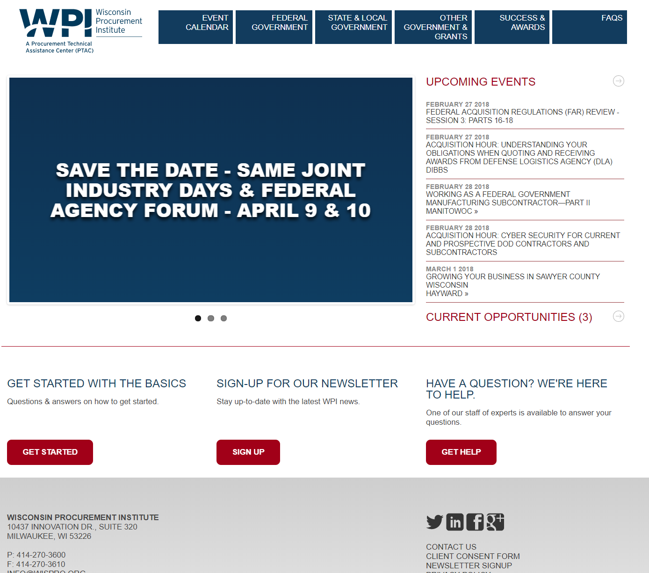

Slide 41
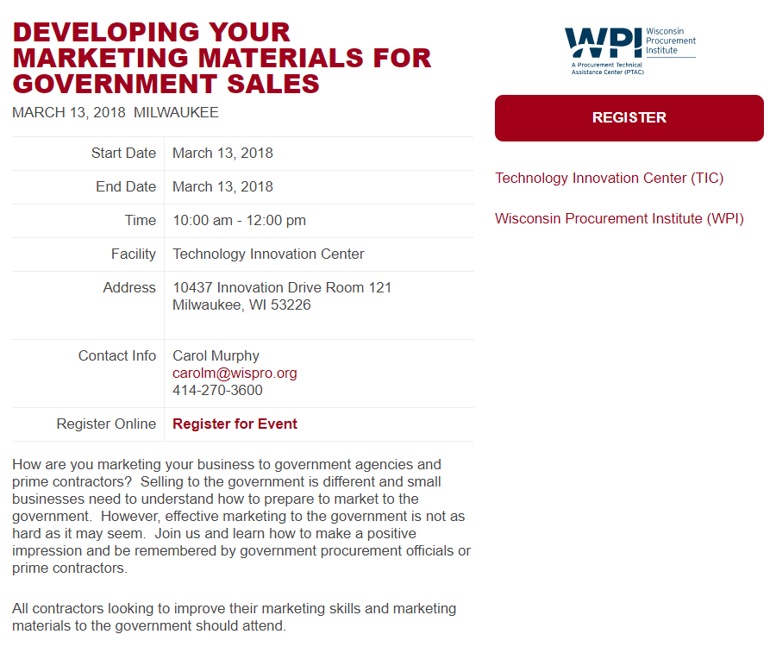
https://www.wispro.org/events/developing-your-marketing-materials-for-government-sales/

Slide 42
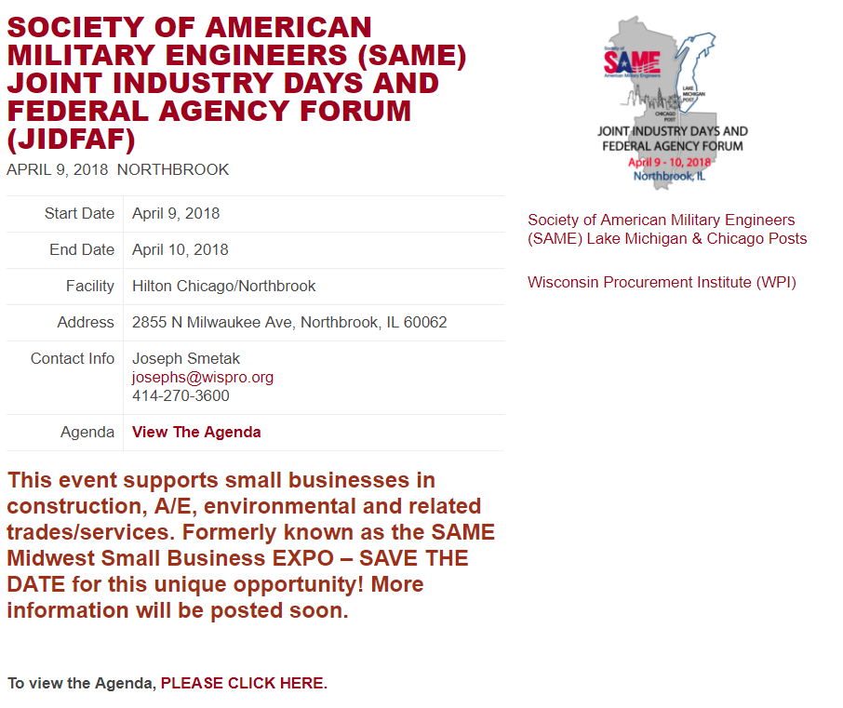
https://www.wispro.org/events/society-of-american-military-engineers-same-joint-industry-days-and-federal-agency-forum/

Slide 43

QUESTIONS?

Slide 44
Presented By Wisconsin Procurement Institute (WPI) www.wispro.org Joseph Smetak - Manager, Business Outreach / Government Contract –
josephs@wispro.org – 414-270-3600
Jean Polka – Government Contract Specialist - jeanp@wispro.org – 920-285-4442
Ken Kotloski – Government Contract Specialist - kenk@wispro.org – 920-840-4699
10437 Innovation Drive, Suite 320 - Milwaukee, WI 53226

