Slide 1


ACQUISITION HOUR WEBINAR PIECES OF THE PROPOSAL PUZZLE
April 27 2016

Slide 2

WPI Offices located at:
Milwaukee County Research Park
10437 Innovation Drive, Suite 320
Milwaukee, WI 53226
414-270-3600 FAX: 414-270-3610
Juneau County Economic Development Corp. 122 Main St - Camp Douglas, WI 54618
608-427-2455 FAX: 608-427-2086
Western Dairyland EOC, Inc.
418 Wisconsin St. - Eau Claire WI 54703
608-427-2455 FAX: 608-427-2086
Fox Valley Technical College – DJ Bordini Center
5 Systems Drive – Appleton WI 54912
920-840-3771 FAX: 414-270-3610
Racine County Economic Development Corporation – Launch Box
141 Main Street, Suite 2, Racine, WI 53403
414-270-3600 FAX: 414-270-3610
Madison Enterprise Center
100 S. Baldwin St., Madison, WI 53703
608-444-0047 FAX: 414-270-3610
Food Enterprise & Economic Development (FEED)
1219 N. Sherman Ave., Madison, WI 53704
608-444-0047 FAX: 414-270-3610
Wausau Region Chamber of Commerce
200 Washington Street, Wausau, WI 54403
920-456-9990 FAX: 414-270-3610
www.wispro.org - info@wispro.org

Slide 3
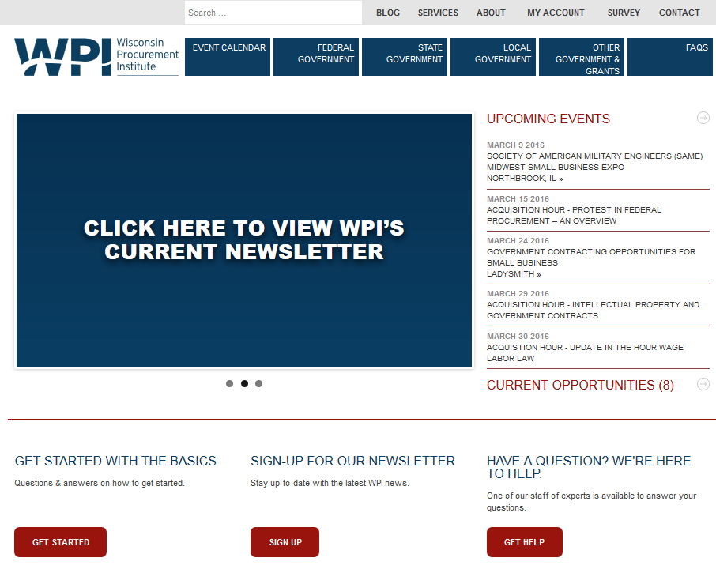

Slide 4
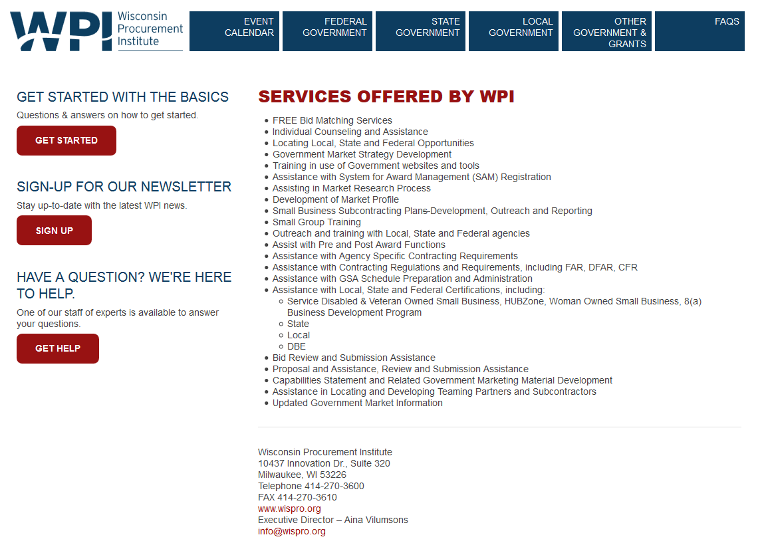

Slide 5
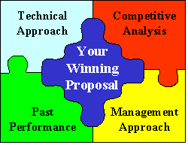
What we will Cover Today
Located the Opportunity - Now What’s Next
Proposal Outline
Pulling the Pieces Together

Slide 6


Slide 7
What’s Next?
Read the solicitation – Read all of the solicitation documents, carefully, end to end. Make notes as you go. Pay attention to the requirements, requested format, evaluation factors, and submission schedule
Highlight the document. Mark it up. Use post-its.
Note due date and draft a time line for proposal submission
Note submission requirements and page limitations
Prepare questions for submission to the contracting officer and submit timely there is usually a cutoff time for questions

Slide 8

Establish a Team
One person should be in charge of coordinating all efforts of the response.
How large of a team formed can depend on the size of your business.
Team should include finance, human resources, leadership, and project management.
UNLESS you are responding to a complex proposal - you do not need to hire a consultant – you can do this

Slide 9

Develop Strategy
How important is this piece of work for you to win?
Would it help in winning associated work?
Are you going for highly differentiated value added services or lowest priced bid?

Slide 10
Proposal Outline
Cover Page
Table of Contents
Cover Letter
Technical Proposal
Past Performance
Price
Solicitation Document
Representations and Certifications

Slide 11
Cover Page
Include your company information
Company Name
Company Address
Company Phone Number
Date
Contact person name, phone, email
Include Government solicitation number, and requirement title

Slide 12
Table of Contents
Include a Table of Contents if response includes multiple sections and pages
Use Page Numbers
Include Tabs

Slide 13
Cover Letter
Note page limitations for cover letter. Also note if cover letter counts towards any other page limitations.
Include name and address of company submitting proposal.
Include name, address, e-mail address and telephone number of person with the actual power to legally bind the company
Cover letter should persuade the government as to why the company should be awarded the contract.

Slide 14
Technical Proposal
Prepare a technical proposal addressing all requirements and evaluation factors.
Response should provide sufficient information to demonstrate the offerors capability to satisfactorily perform the objectives and meet the Government’s requirement.
Proposal shall be clear, concise, and shall include sufficient detail for effective evaluation and for substantiating the stated claims.
Respond in the same order as the requirement and evaluation factors. Even number them the same.

Slide 15
Technical Proposal
Show your capabilities, don’t just tell. Never overstate qualifications. Focus on firm’s strengths.
Focus on the benefits to the Government.
Make sure your proposal is well-written and error free.
Provide the Government with a low risk solution to the problem.
Assume the Government has no prior knowledge of your abilities and experience even if you are the incumbent.
Submit bonding, if required.
Demonstrate ability to meet all solicitation requirements including terms and conditions, representations and certifications, and technical requirements.

Slide 16
Writing the Proposal
Start with an outline based on information from the solicitation document.
Include all technical evaluation factors. Organize proposal to match solicitation.
Address how you will meet the requirement. Completely cover the who, what, where, how, and why.
Include any required statements, sample reports, resumes, etc.
Review solicitation again to make sure nothing has been overlooked.

Slide 17
Past Performance
Review solicitation requirements. May need to provide detailed information or even send out questionnaires to your references.
Note any page limitations and number of copies
Use the format outlined in the solicitation
Relatively new companies with no prior past performance should be rated neutral having no positive or negative significance. However, try to provide something.
Can generally use commercial past performance.

Slide 18

Price
Complete price schedule
Check, double check, and then recheck pricing, extensions, and totals.
How are you going to price option years?
You must make a profit. Offer a fair price.
Never low ball your proposal thinking you will make money on contract modifications.
Factor in all costs to complete contract, including reporting requirements.

Slide 19

Contract Pricing
Is Certified Cost and Pricing Data Required?
Is other than certified cost and pricing data required?

Slide 20
Solicitation Document
Determine what portions of the solicitation document need to be returned.
Usually any page with a contractor fill in needs to be returned.
Some contracting officers want the entire document returned.
Return any solicitation amendments, signed by the same official signing the proposal.

Slide 21
Representations and Certifications
Complete Representations and Certifications annually in SAM.
Indicate if any of them change based upon this solicitation.
Complete any new Representations and Certifications as directed by the contracting officer or solicitation.

Slide 22

Note any requirements for specific type/sized font, margin requirements, and maximum number of pages.
Mark and label envelopes as instructed to. Generally price and technical proposals are submitted in separate volumes/envelopes.
Note address to submit response to. May be different than what is on the first page.
Sign Proposal
Submit proposal in media requested, and include the number of copies requested.
Submit timely – late offers are not accepted.

Slide 23
What to Avoid
Nonconformance with the instructions may result in an unfavorable proposal evaluation
Do not simply rephrase or restate the Government’s requirement, address how the Offeror intends to meet the requirement
Elaborate brochures or documentation, binding, detailed art work, or other embellishments are generally unnecessary and are not desired

Slide 24
WPI Bid Matching Service
Free Service
Provides opportunities daily by email
Looks at over 2,000 websites including federal, state, and local
Matches keywords based on contractor’s capabilities
Contact WPI to set up

Slide 25
Summary
The key is pulling it all together in a proposal package that clearly describes why your company offers the best solution and is the best fit to perform the work.

Slide 26

Resources
FAR: https://www.acquisition.gov/?q=browsefar
Air Force FAR: http://farsite.hill.af.mil/
Acquisition.gov is: https://www.acquisition.gov/
Federal Business Opportunities (FedBizOpps) website - https://www.fbo.gov/
Wisconsin Procurement Institute
Phone: 414-270-3600
www.wispro.org

Slide 27
Upcoming WPI Events
Acquisition Hour Live Webinar Series - Tuesdays and Wednesdays
Virtual FAR Training Webinar Series – Wednesday evenings
4th Annual US Department of Veterans Affairs Business Conference – May 12, 2016 – Brown Deer, WI
Government Manufacturing Conference – Supporting the Federal Defense Supply Chain – May 19, 2016 – Green Bay, WI
Managing Your Cost Type or DOD SBIR Contract-What you Need to Know Prior to Submitting a Proposal and After Award – May 24, 2016 – Pewaukee, WI
How to do Business with the U.S. Forest Service – May 26, 2016 – Rhinelander, WI
National Education Seminar: Subcontract Management From A to Z – June 2, 2016 – Lake Geneva, WI
10th Annual Volk Field Small Business Conference – June 15-16, 2016 – Camp Douglas, WI

Slide 28
questions?

Slide 29

Continuing Professional Education
CPE Certificate available, please contact:
Benjamin Blanc
benjaminb@wispro.org

Slide 30
For Assistance or Additional Information - Contact
Wisconsin Procurement Institute (WPI)
Carol Murphy
10437 Innovation Drive, Suite 320
Milwaukee, WI 53226
414-270-3600 or carolm@wispro.org

