Slide 1
Small Business Government Contracting Series Marketing your business to the government
February 17, 2015
Milwaukee, WI

Slide 2
Market Research – does the government buy what I sell?
What marketing materials do I need?
Where can I meet potential customers and teaming partners?
And more!

Slide 3
Basic Principals
There MUST be a need
There MUST be money to pay for the product or service
YOU MUST be COMPETITIVE
YOU MUST MAKE MONEY
YOU MUST have the CAPABILITIES, CAPACITY and RESOURCES to support the requirement
Make sure you are registered on all of the required websites/databases

Slide 4
Federal Government
Manufacturing
Department of Defense www.acq.osd.mil/osbp/doing_business/index.htm
Construction
US Army Corps of Engineers www.usace.army.mil/CESB/Pages/Default.aspx
US Department of Ag/Forest Service www.da.usda.gov/smallbus/
Naval Facilities https://portal.navfac.navy.mil/portal/page/portal/navfac/navfac_forbusinesses_pp/smallbusiness/
Commercial type goods and services
General Services Administration www.gsa.gov
Mixed
Department of Veterans Affairs http://www.va.gov/OSDBU/
Research and development
SBIR-STTR Program www.sbir.gov

Slide 5
Federal Government
Department of Veterans Affairs – Milwaukee / Iron Mountain / Chicago
US Forest Service – Rhinelander
Forest Products Laboratory – Madison
Oxford Prison – Oxford
EPA – Chicago
General Services Administration (GSA) – Chicago
Tank Automotive Command (TACOM) – Rock Island
Military Bases
Volk Field – Camp Douglas
Ft. McCoy – Tomah
128th ARW – Milwaukee / 115th Madison
US Army Corps of Engineers – St. Paul / Chicago / Rock Island / Detroit
Naval Station Great lakes – North Chicago – [contracting moving]
ALSO – SOME LARGE CONTRACTORS LIKE Oshkosh Corp and Marinette Marine Corp (looking for small firms)

Slide 6
State of Wisconsin
Department of Administration – VendorNet
Department of Administration – Facilities
WisDOT

Slide 7
Tribal Government
Tribal Economic Impact
The twelve member tribes represent six nations on twelve reservations, a land base of about 1 million acres spanning 45 counties. In many counties, the tribe’s agencies and enterprises amount to the largest employer in the county, and the total annual economic impact of tribal purchases and payroll amounts to more than
$1 billion dollars.

Slide 8
Tribal Government
Government Pathways: federal, state, municipal, and tribal
Understanding the multi-jurisdictionality components & operational aspects of working with Tribal clients is critical to success
Cultural responsiveness & appropriateness is a business strategy that can demonstrate required skills for conducting business in this context – competitive edge
Tribal pathways include:
Tribal Governments: Elected or appointed officials that oversee the tribal government programs, initiatives, and employees
Tribal Enterprises: Businesses run by the TG
Tribal Businesses: Businesses run by tribal entrepreneurs
Tribal Non-Profits: Organizations with 51%+ Tribal Board
Tribal Colleges: TG chartered & provide higher education
(Courtesy Bowman Performance Consulting)

Slide 9
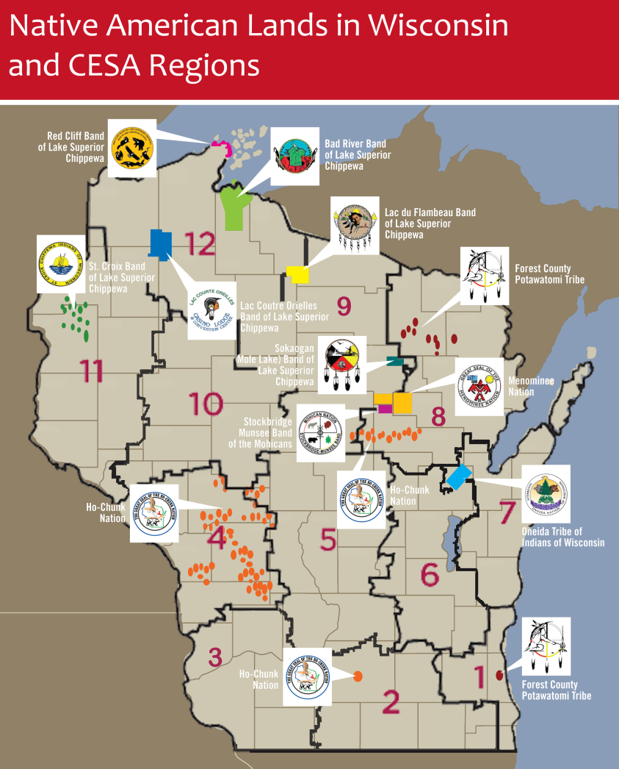
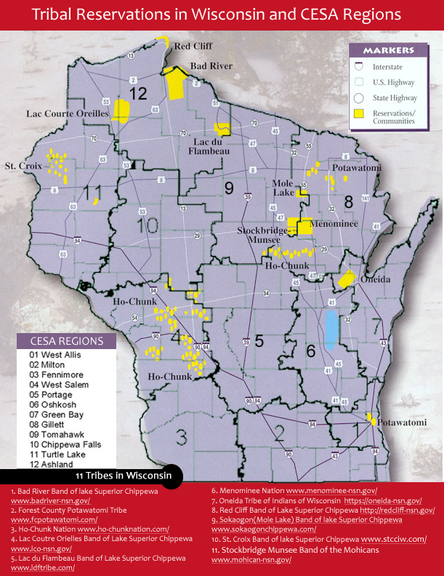
Tribal Government
(Courtesy Bowman Performance Consulting)

Slide 10
Tribal Government
Great Lakes Inter-Tribal Council
Red Cliff Band of Lake Superior Chippewa Indians
Saint Croix Chippewa Indians of Wisconsin
Lac du Flambeau Band of Lake Superior Chippewa Indians
Oneida Tribe of Indians of Wisconsin
Stockbridge-Munsee Community
Lac Courte Oreilles Band of Lake Superior Chippewa Indians of Wisconsin
Sokaogon Chippewa Community
Forest County Potawatomi Community
Lac Vieux Desert Band of Lake Superior Chippewa Indians
Bad River Band of the Lake Superior Tribe of Chippewa Indians
Ho-Chunk Nation
Menominee Indian Tribe of Wisconsin

Slide 11
Market Research
Do your research before entering the market
Know your NAICS Code(s) and other government contracting codes
NAICS: http://www.census.gov/eos/www/naics/
FSC/PSC: http://support.outreachsystems.com/resources/tables/pscs/
NIGP: http://vendornet.state.wi.us/vendornet/default.asp
Government spending is public information

Slide 12
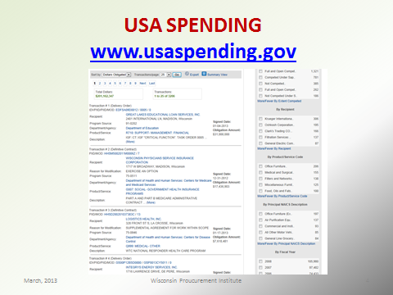
Market Research
www.usapsending.gov

Slide 13
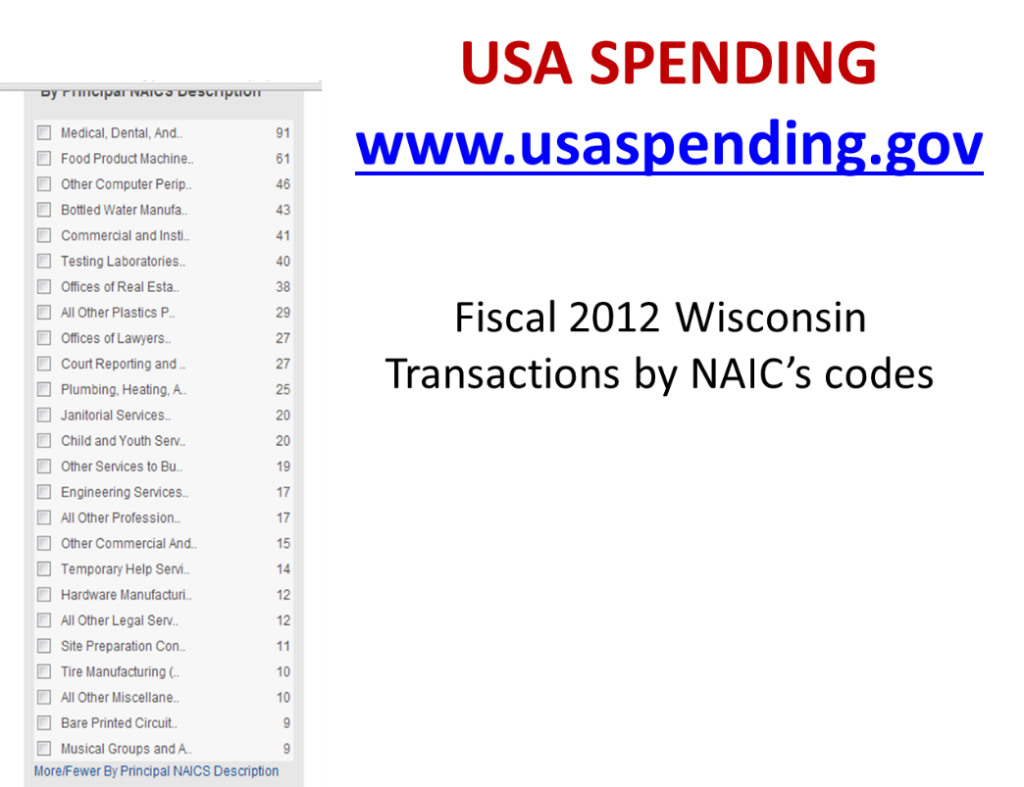
Market Research

Slide 14
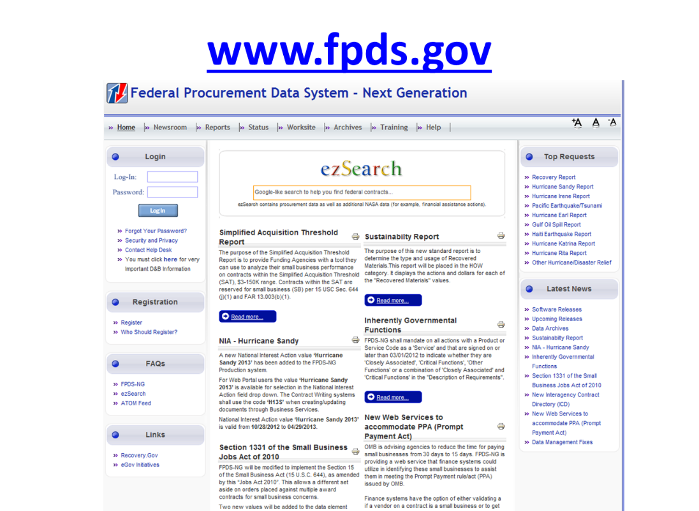
Market Research
www.fpds.gov

Slide 15
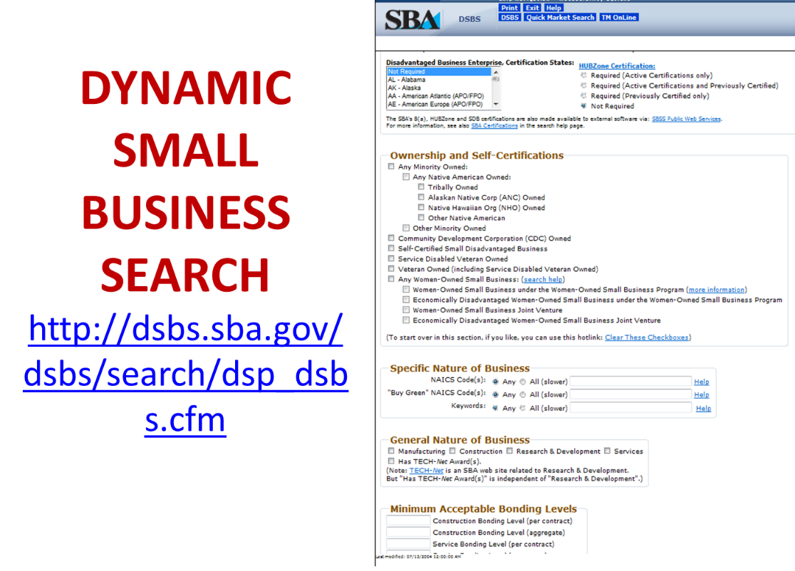
Market Research

Slide 16
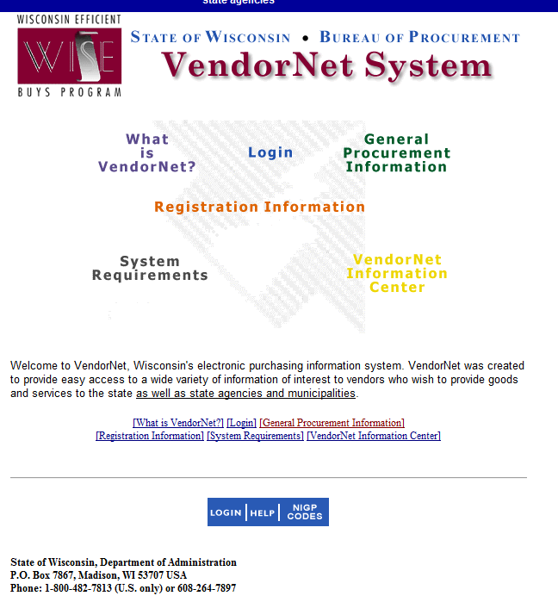
http://vendornet.state.wi.us/vendornet/default.asp

Slide 17
Your Business card
Business Card (a MUST HAVE)
MUST identify clearly the company, the person and contact information – MUST HAVE EMAIL
MUST identify clearly what you do
In the Government world consider adding
NAIC’s codes
Small Business Classifications
Cage Code/DUNS #
Federal Supply Codes
Keywords
GSA Schedule number
Consider two sided
Consider light colored background and not glossy
Other

Slide 18

Your Business card

Slide 19
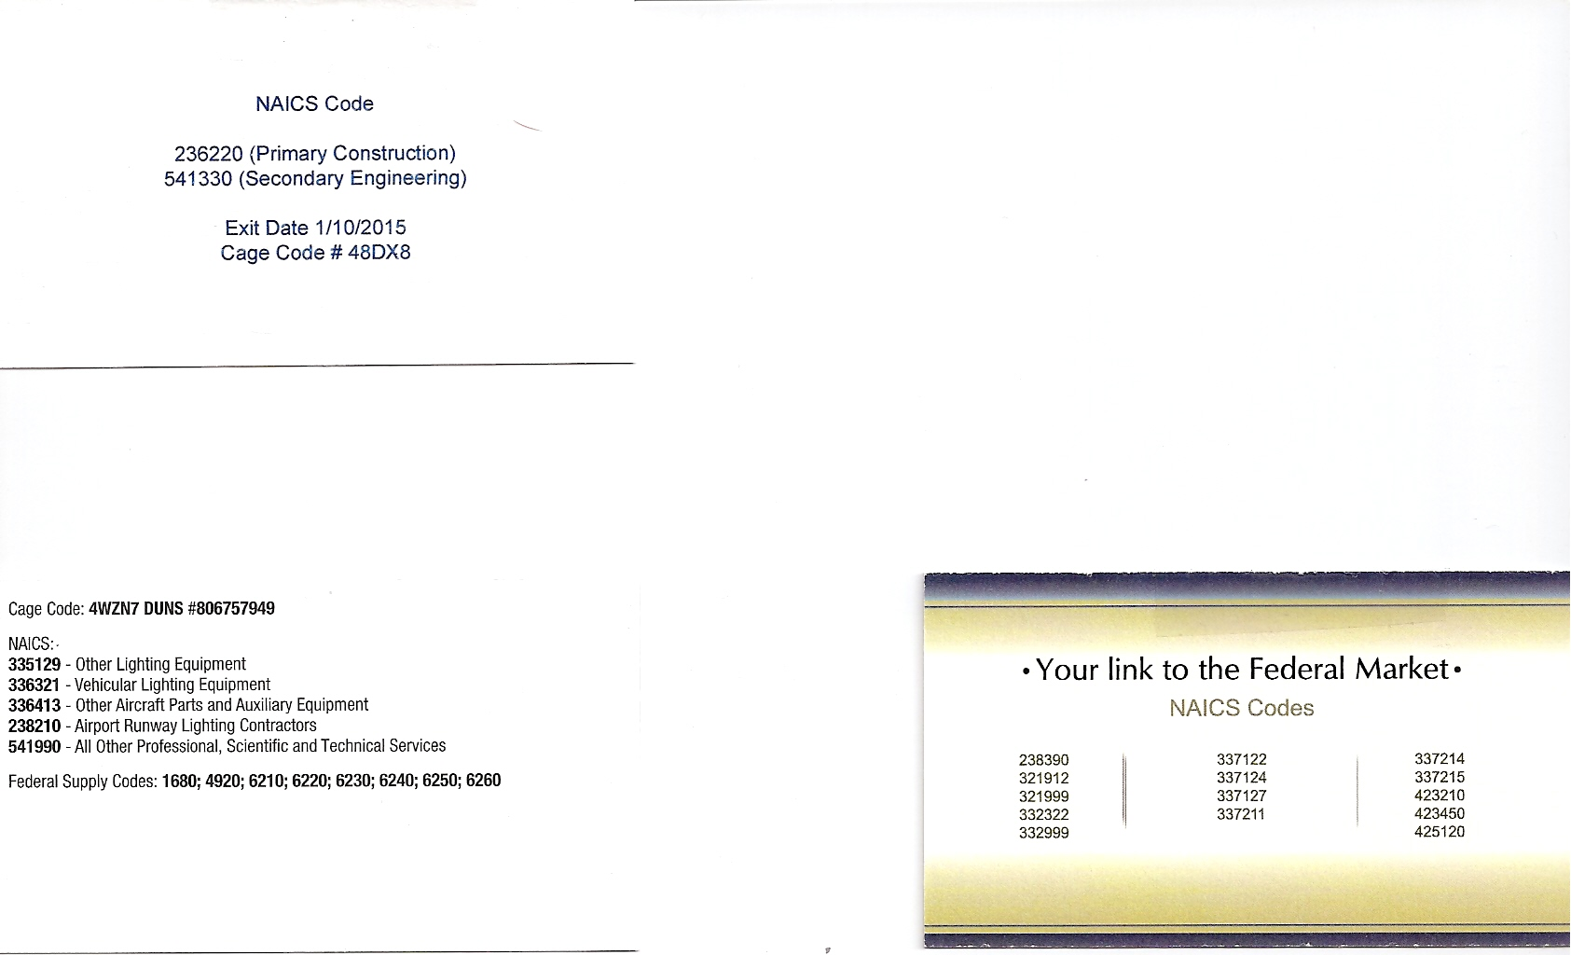
Your Business card

Slide 20
Your capability statement
No more than one page (front and back if need be)
May need to customize a bit for various uses
Shows what is important to the person / agency you are trying to sell to – HOW DO YOU KNOW THIS – market research or ASK
Keep it Simple and Easy to read
Includes contact information and website link
What is important? Depends on if you are in manufacturing, technology, construction……
Past related work
Graphics showing capability
Certifications, designations, codes, classifications, important training and other relevant information
It should look GOOD – easy to look at, answers basic questions about your business AND uses good grammar and good spelling

Slide 21

Your capability statement

Slide 22
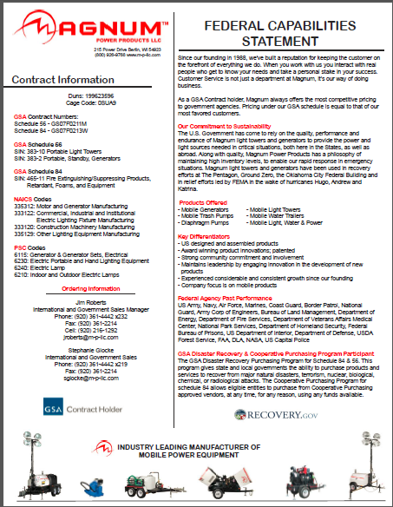
Your capability statement

Slide 23
Your Website
Yes you should have one – WHY – so you can be found and found out about
It can be simple
Yes there is a cost to design, build and update – plan well and don’t go on the “cheap”
Consider separating Government – the important parts may be very different
Same rules as capabilities statement apply

Slide 24
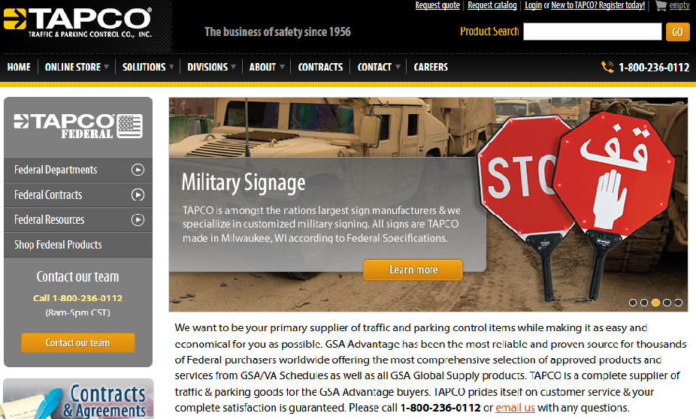
Your Website

Slide 25
Other Visibility
Press releases – news articles
Facebook, LinkedIn, other web visibility
Awards
Participation in related organizations
Presentations and education – you are the expert
Be a mentor to others
Conferences, professional organizations and other networking opportunities

Slide 26
Your elevator pitch
The presentation needs to be fact-based, interesting, and give the buyer a reason to not just remember your company, but consider your company for opportunities. You are selling yourself and your company.
Remember the buyer or evaluator’s time is valuable. AND they listen to businesses trying to sell to them every day.

Slide 27
Your elevator pitch
1 minute pitch – elevator pitch – KEEP IT TIGHT
Know what the buyer’s company does and how you would fit
Know what is important to the buyer
Who you are
What you do
Have you done any work with the government before
What makes you special
Keep it business
5 minute pitch – should include a visual of some kind then ADD
WHAT CAN YOU DO FOR THEM
A bit of history
Capacity
Past work
What makes you special – management team, design capabilities, relationships………
Other as appropriate
15 minute pitch – more visual
Mission – vision
Increased specifics depending on what is being sold
Other

Slide 28
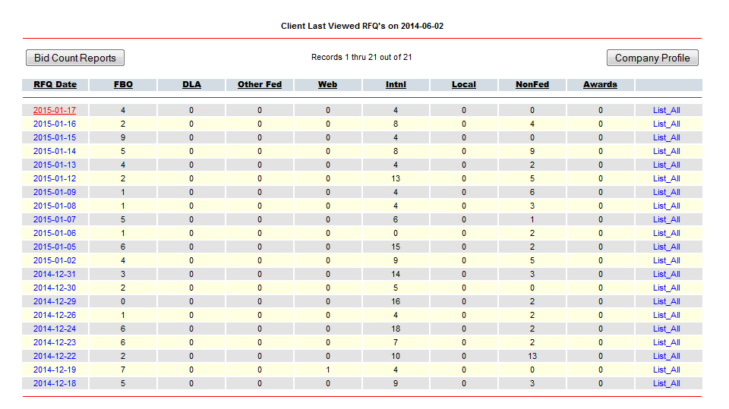
Selling to the Federal Government
WPI Bidmatching Service

Slide 29
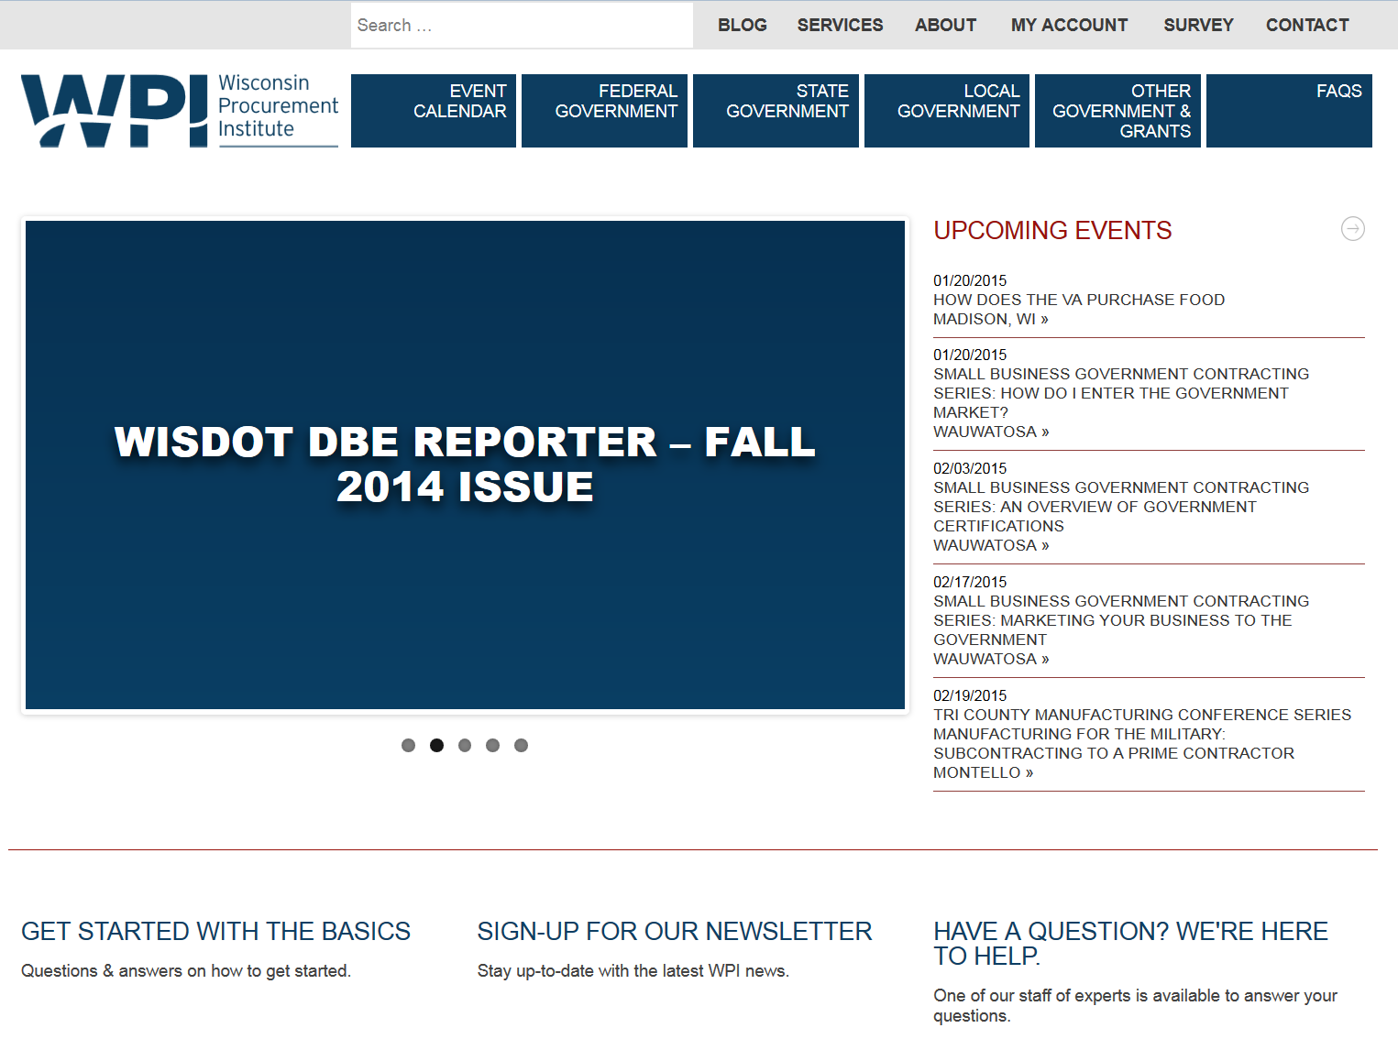
WPI WEBSITE: www.wispro.org

Slide 30
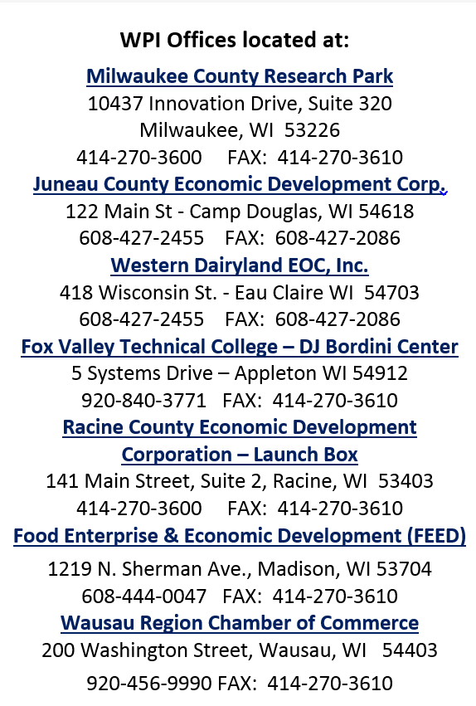
Contact WPI if you need assistance Joe Smetak, CFCM 414 270 3600 josephs@wispro.org

