Slide 1
How to Access DLA Land and Maritime’s
TKO Seminar PowerPoints

Slide 2
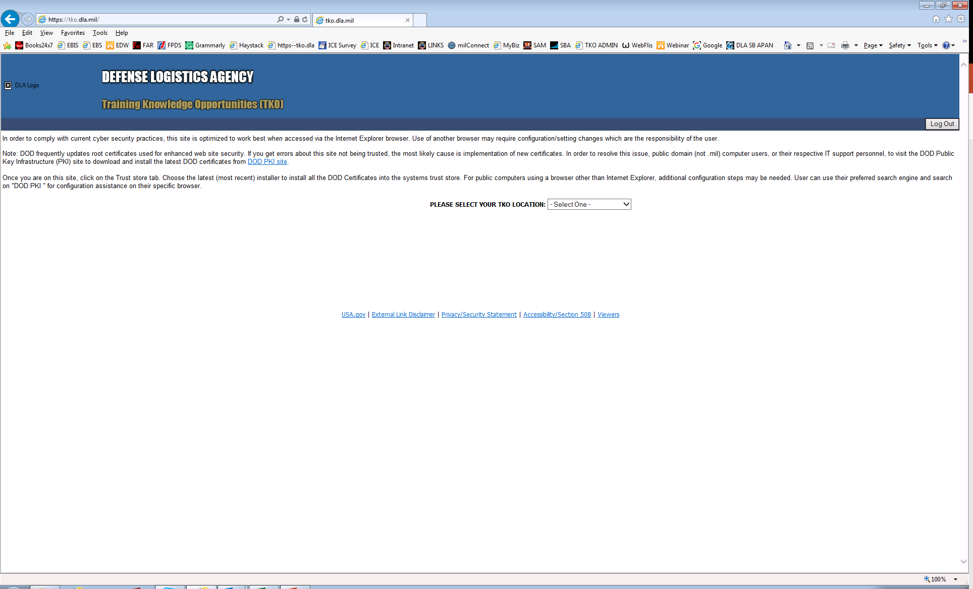
https://tko.dla.mil/
Select the Dropdown Box

Slide 3
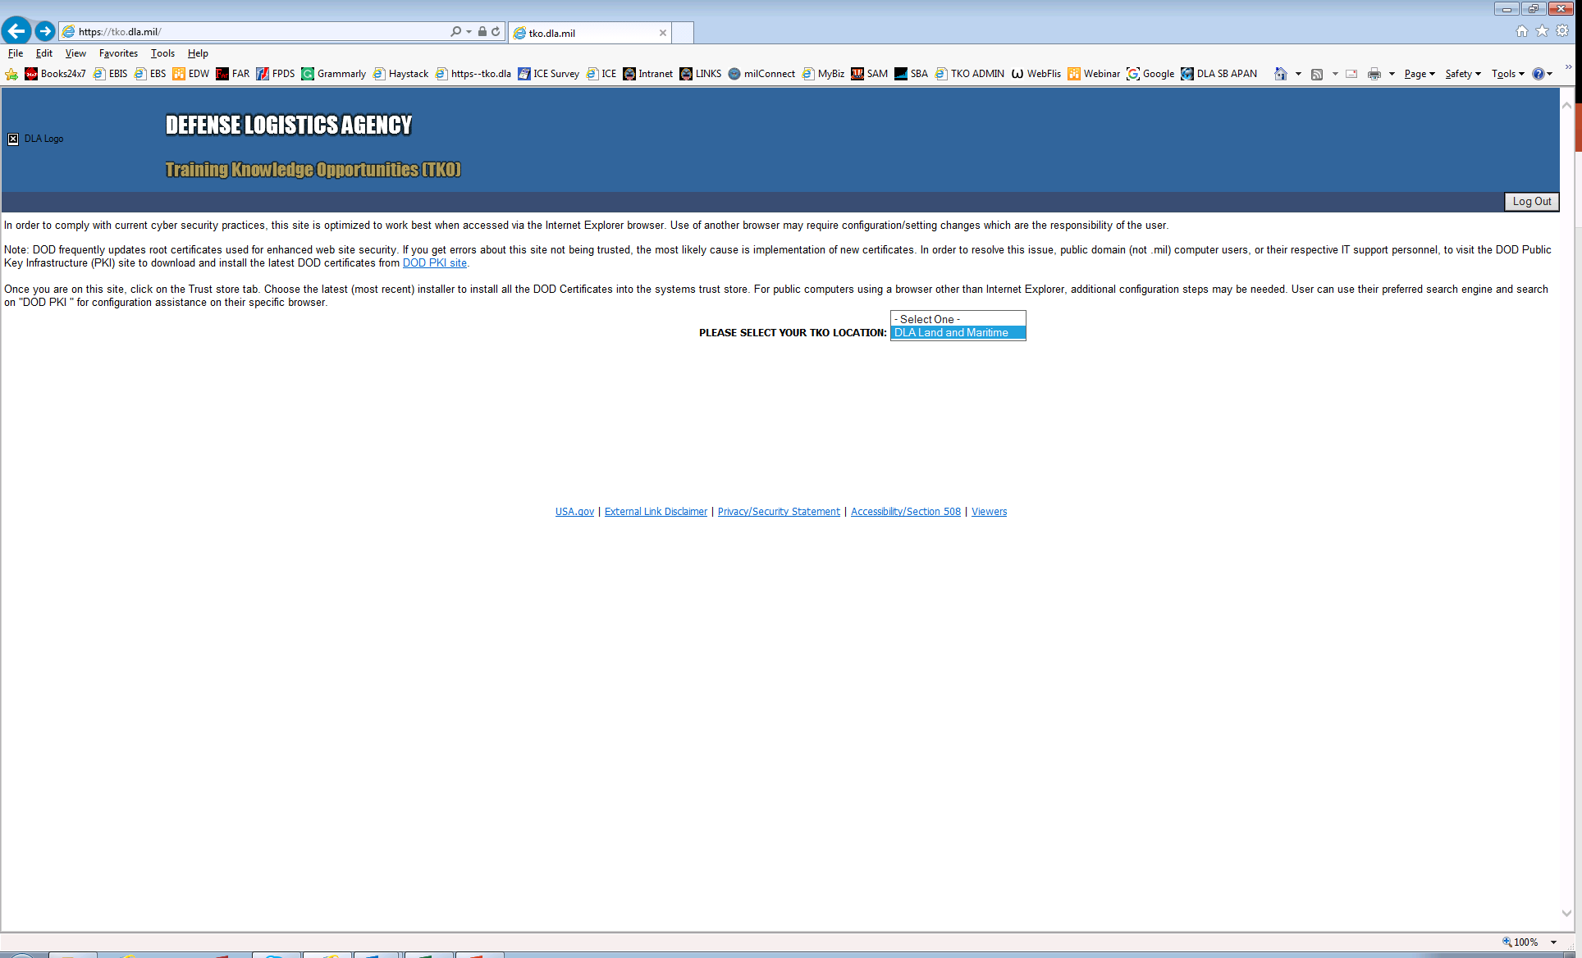
https://tko.dla.mil/
Select “DLA Land and Maritime”

Slide 4
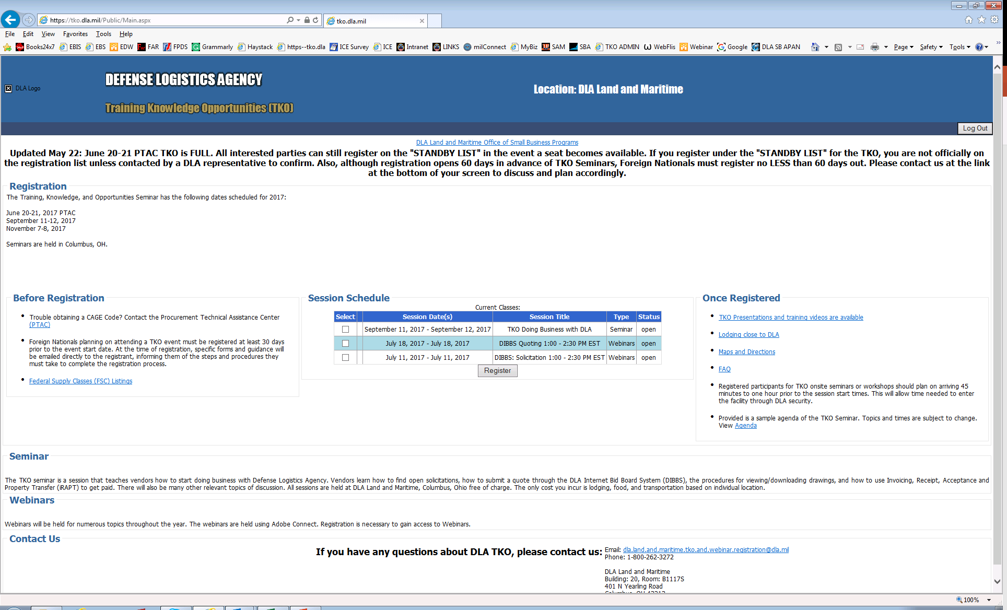
https://tko.dla.mil/Public/Main.aspx
Click Here

Slide 5
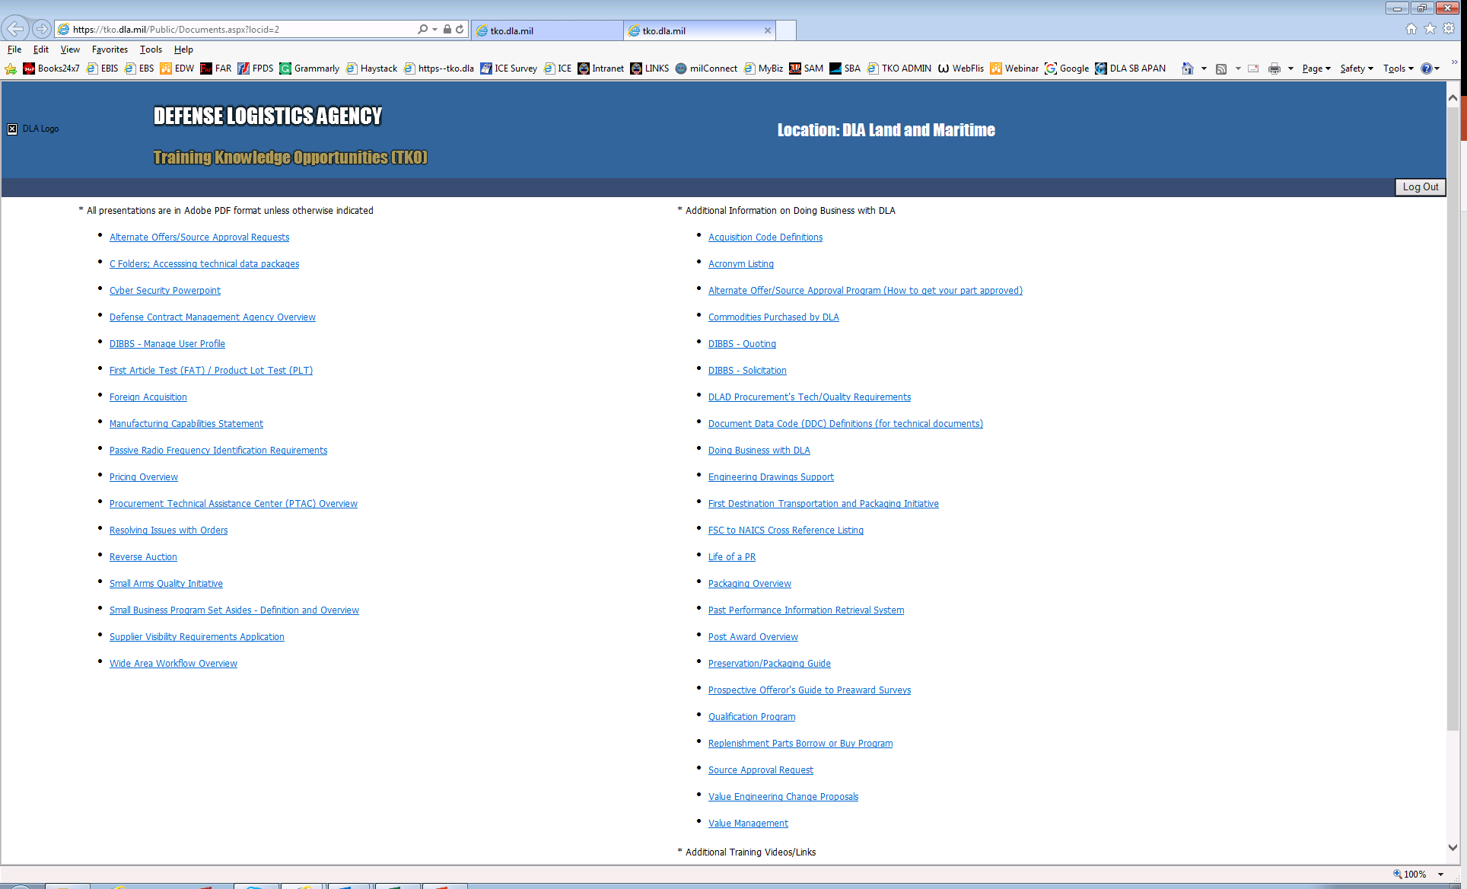
https://tko.dla.mil/Public/Documents.aspx?locid=2
TKO PowerPoints
Additional Videos/Links

