Slide 1
The lifecycle of federal disaster response and support
Acquisition Hour Webinar
July 24, 2018

Slide 2
Webinar Etiquette
PLEASE
Log into the GoToMeeting session with the name that you registered with online
Place your phone or computer on MUTE
Use the CHAT option to ask your question(s). We will share the questions with our guest speaker who will respond to the group
THANK YOU!

Slide 3

Assist businesses in creating, development and growing their sales, revenue and jobs through Federal, state and local government contracts.
WPI is a Procurement Technical Assistance Center (PTAC) funded in part by the Defense Logistics Agency (DLA), WEDC and other funding sources.

Slide 4
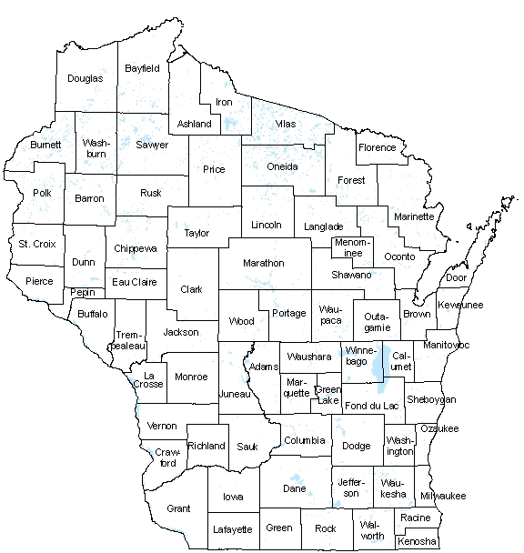
WPI OFFICE LOCATIONS
MILWAUKEE – Technology Innovation Center
MADISON –
Madison Enterprise Center
FEED Kitchens
CAMP DOUGLAS– Juneau County Economic Development Corporation (JCEDC)
WAUSAU – Wausau Region Chamber of Commerce
APPLETON / OSHKOSH – Fox Valley Technical College ‘
WPI partner co-locations
Eau Claire – Western Dairyland
Ladysmith – Indianhead Community Action Agency
Menomonie – Dunn County EDC
Racine - Launchbox
WAUSAU
APPLETON and OSHKOSH
CAMP DOUGLAS
MILWAUKEE
MADISON

Slide 5
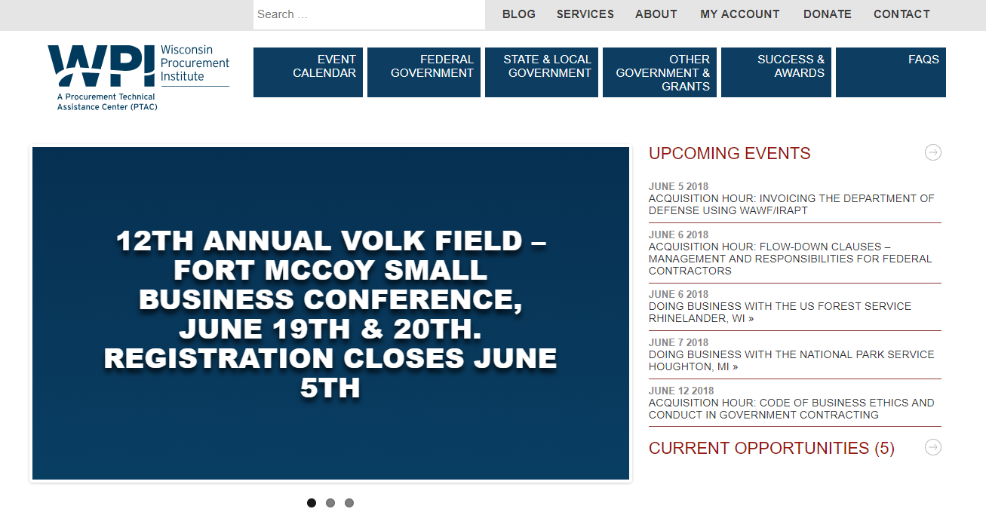


Slide 6
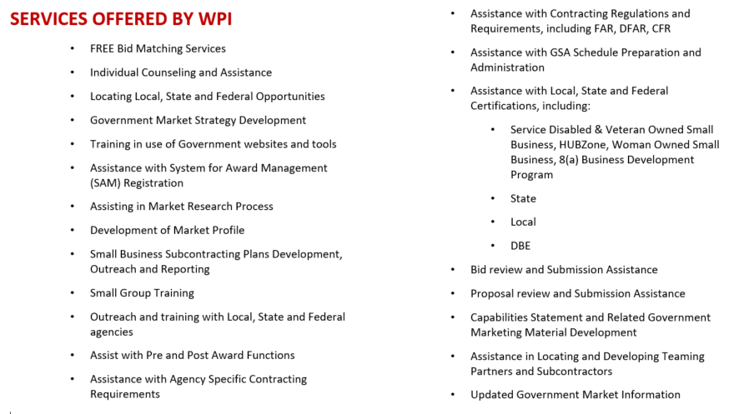

Slide 7
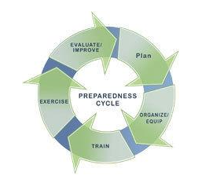
The Lifecycle of Federal Disaster Response and Support
Marc N. Violante
Wisconsin Procurement Institute
July 24, 2018
Image copied from: https://www.fema.gov/media-library/assets/images/114295

Slide 8
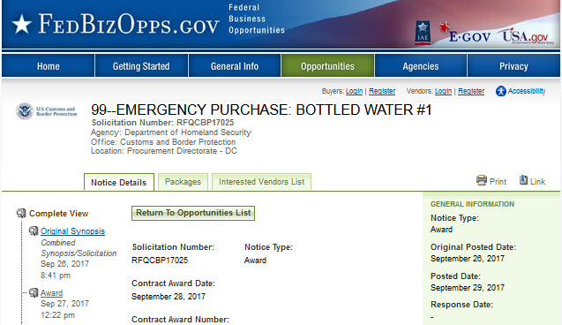

US Customs and Border Protection
Copied from: https://www.fbo.gov/spg/DHS/USCS/PDDC20229/RFQCBP17025/listing.html

Slide 9
Harvey, Irma, Maria – June 2018 - activity
Hurricane | Dates | June 2018 Procurements
Harvey | Aug 17, 2017 – Sep 3, 2017 | 91
Irma | August 30, 2017 – September 13, 2017 | 28
Maria | September 16, 2017 – October 2, 2017 | 190
Data from FPDS – https://www.fpds.gov / web

Slide 10
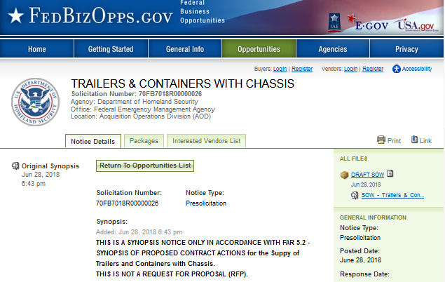

FEMA
Copied fromhttps://www.fbo.gov/spg/DHS/FEMA/PP5-2/70FB7018R00000026/listing.html//

Slide 11

Regulations and Programs
Key elements of business plan/strategy
Creates the framework
Identifies key participants
Defines participant authorities and responsibilities
What is allowed / what isn’t

Slide 12
The Business Case – What we know
There is opportunity
Multiple types of “threats”
Volume can be large
Time is critical
Performance matters
Duration – finite to very long
Require a variety of resources

Slide 13
Research – key questions
What is needed?
What is being purchased?
Who, (which Agency/Contracting Office) is purchasing?
How are the purchases being made? – contract vehicle
What is known about purchase volume, vehicle users, open period
Competition
Other vehicles
Will there be acceptable ROI?

Slide 14
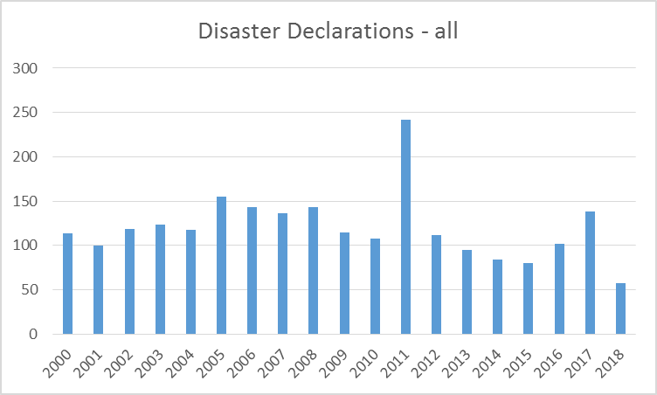
Data: https://www.fema.gov/disasters/year

Slide 15
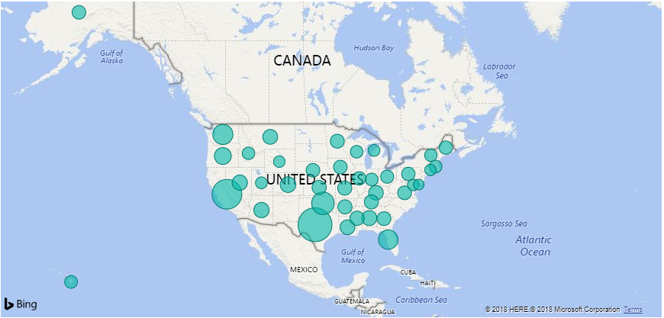
States with Disaster declarations – over time
Data: https://www.fema.gov/disasters/year

Slide 16
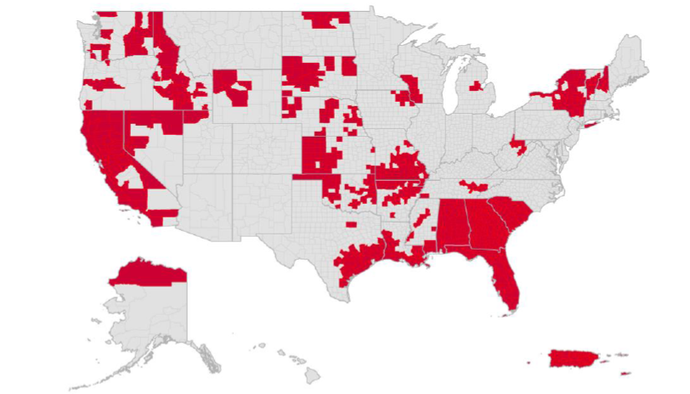
Calendar Year 2017 Major &Emergency Disaster Declarations by County
FEMA’s Daily Operations Brief; June 19, 2018

Slide 17
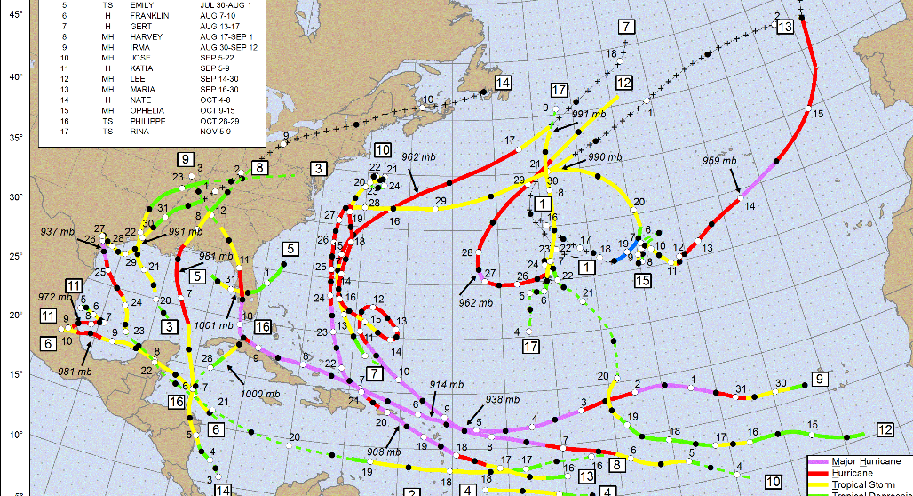
What drives the need? – the activity?
Data: https://www.nhc.noaa.gov/data/tracks/tracks-at-2017.png

Slide 18
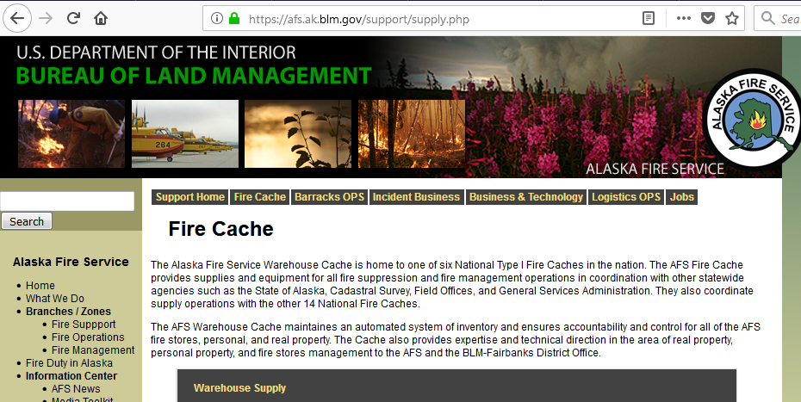
Identify drivers, need, vehicles, owners
https://afs.ak.blm.gov/support/supply.php

Slide 19
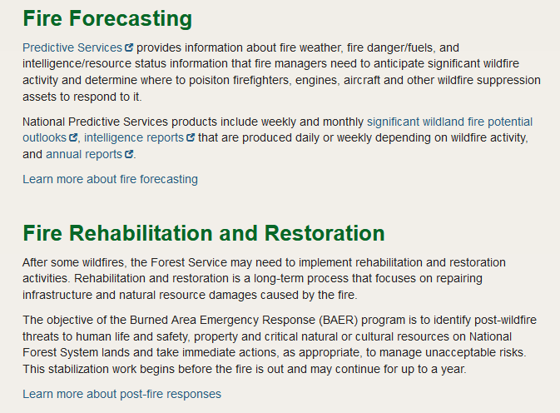
Explore be curious – ask questions
https://www.fs.fed.us/science-technology/fire

Slide 20
Design & Need v. Execution
End Result
Government
Funding
Contract

Slide 21
Solutions – in general
Budget
Internal Resources
Solution
Budget
Contract
Solution
Budget
Inter-governmental Resources
Solution

Slide 22
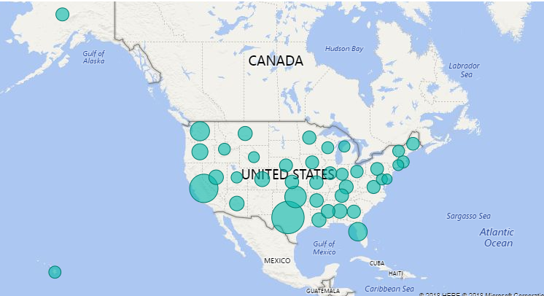
Awards, Hurricane Harvey
Data from FPDS Hurricane Harvey; processed with Power BI

Slide 23
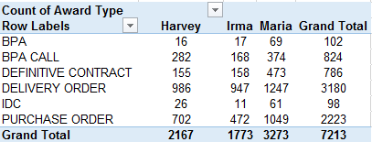
Information is a powerful driver!
Data from FPDS

Slide 24
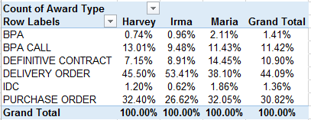
Use multiple perspectives!
Data from FPDS

Slide 25
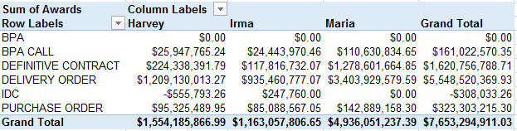
Focus on context and applicability!
Data from FPDS Hurricane Harvey

Slide 26
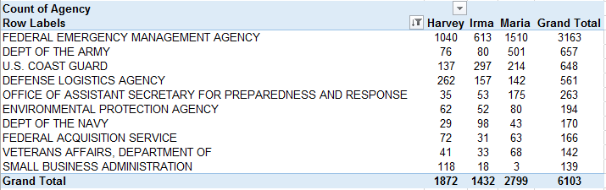
Who is your customer?
Data from FPDS ; Item 11, FEMA AAR, July 12, 2018

Slide 27
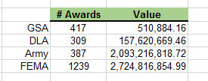
What Contract Vehicles should you pursue?
Data from FPDS ;

Slide 28
What initiates Federal Activity?
The Stafford Act (§401) requires that: "All requests for a declaration by the President that a major disaster exists shall be made by the Governor of the affected State." A State also includes the District of Columbia, Puerto Rico, the Virgin Islands, Guam, American Samoa, and the Commonwealth of the Northern Mariana Islands. The Marshall Islands and the Federated States of Micronesia are also eligible to request a declaration and receive assistance.
https://www.fema.gov/declaration-process

Slide 29
The Disaster Declaration Process
Preliminary Damage Assessment
State or Tribal Indian Government Resources Overwhelmed
Declaration Types
Emergency Declarations – made by President
Any occasion, when determined federal assistance is needed
Assistance supplements state/local/tribal
$5 million cap, with report to Congress
Major Disaster Declaration – for any natural event
Appeals
Post Declaration Actions
https://www.fema.gov/es/node/33733

Slide 30
Included Natural Events
Hurricane
Tornado
Storm
high water
wind-driven water
tidal wave
Tsunami
Earthquake
volcanic eruption
Landslide
Mudslide
Snowstorm or drought
regardless of cause,
Fire
Flood
Explosion
https://www.fema.gov/es/node/33733

Slide 31
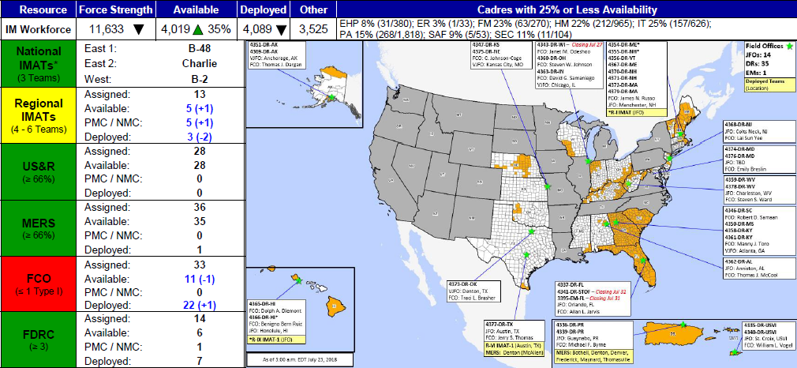
Readiness –Deployable Teams and Assets
FEMA’s Daily Operations Brief; July 23, 2018

Slide 32
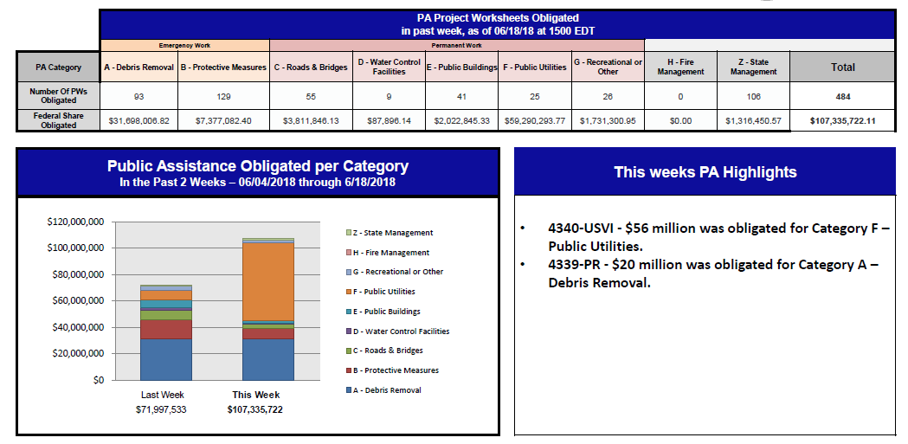
Public Assistance Grants Program
FEMA’s Daily Operations Brief; June 19, 2018

Slide 33
Lessons Learned
“governments need to be better prepared with their own supplies
To have pre-positioned contracts with enforcement
Establishing “rainy day” fund or disaster relief funds
FEMA’s AAR; July 12, 2018 page ii

Slide 34
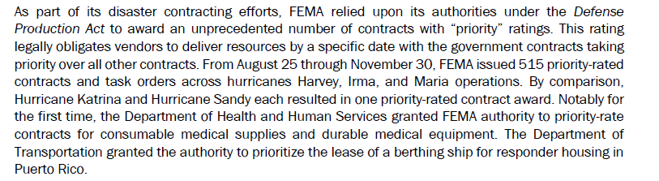
Understand DPAS and Flow-down requirements
FEMA’s AAR; July 12, 2018 page ii

Slide 35
Background (DPAS)
(a) Certain national defense and energy programs (including military, emergency preparedness, homeland security, and critical infrastructure protection and restoration activities) are approved for priorities and allocations support. A complete list of currently approved programs is provided at schedule I to this part.
https://www.gpo.gov/fdsys/pkg/CFR-2016-title15-vol2/pdf/CFR-2016-title15-vol2-part700.pdf

Slide 36
Defense Priorities and Allocation System
DPAS – aka – Rated Orders
Defense Production Act of 1950
Managed by Department of Commerce
15 CFR 700
Unrated orders
DO – rated orders
DX – rated order – takes precedence over a DO rated order
Apply to specific, approved programs

Slide 37
DPAS – key definitions
Rated order. A prime contract, a subcontract, or a purchase order in support of an approved program issued in accordance with the provisions of this part.
Approved program. A program determined as necessary or appropriate for priorities and allocations support to promote the national defense by the Secretary of Defense, the Secretary of Energy, or the Secretary of Homeland Security, under the authority of the Defense Production Act and Executive Order 13603, or the Selective Service Act and Executive Order 12742.

Slide 38
Actions/Responsibility (DPAS)
Persons receiving rated orders must give them preferential treatment as required by this part.
(c) All rated orders must be scheduled to the extent possible to ensure delivery by the required delivery date.
(d) Persons who receive rated orders must in turn place rated orders with their suppliers for the items they need to fill the orders. This provision ensures that suppliers will give priority treatment to rated orders from contractor to subcontractor to suppliers throughout the procurement chain.
(e) Persons may place a priority rating on orders only when they are in receipt of a rated order, have been explicitly authorized to do so by the Department of Commerce or a Delegate Agency, or are otherwise permitted to do so by this part.
?

Slide 39
For example
Flood Control and Coastal Emergency Act (PL 84-99)
USACE also has authority under PL 84-99, Flood Control and Coastal Emergencies (FCCE) (33 U.S.C. 701n) (69 Stat. 186) for emergency management activities.
Under PL 84-99, the Chief of Engineers, acting for the Secretary of the Army, is authorized to undertake
activities including disaster preparedness,
Advance Measures,
emergency operations
(Flood Response and Post Flood Response),
rehabilitation of flood control works threatened or destroyed by flood,
protection or repair of federally authorized shore protective works threatened or damaged by coastal storm,
and provisions of emergency water due to drought or contaminated source.

Slide 40
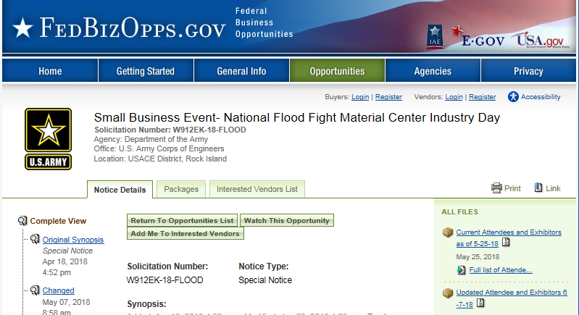
US Army Corps of Engineers
Copied from: https://www.fbo.gov/spg/USA/COE/DACA25/W912EK-18-FLOOD/listing.html//

Slide 41
USACE – Disaster Response Missions and Information
Critical Public Facility Restoration
Debris Management
Emergency Infrastructure Assessments
Infrastructure System RSF
Temporary Emergency Power
Temporary Housing
Temporary Roofing
Urban Search and Rescuse
Copied from: https://www.usace.army.mil/Missions/Emergency-Operations/National-Response-Framework/

Slide 42
USACE – Emergency Water Assistance Due to Drought
Types of Assistance
Transport of water to local water points,
Distribution of bottled water,
Temporary connection of a new supply to the existing distribution system,
Installation of temporary filtration,
Use of military units with water purification/storage/ distribution capability.
USACE assistance for the measures listed above will be at 100 percent Federal cost,
Wells constructed by USACE will be paid for by the applicant.
Copied from: https://www.usace.army.mil/Missions/Emergency-Operations/Drought/

Slide 43
FEMA – Response Core Capabilities
Planning
Public Information and Warning
Operational Coordination
Critical Transportation
Environmental Response/Health and Safety
Fatality Management Services
Fire Management and Suppression
Infrastructure Systems
Logistics and Supply Chain Management
Mass Care Services
Mass Search and Rescue Operations
On-Scene Security, Protection, and Law Enforcement
Operational Communications
Public Health, Healthcare, Emergency Medical Servicees
Situational Assessment
FEMA National Response Framework (3rd Edition) – Information Sheet

Slide 44
MARAD – Maritime Administration
The Maritime Administration
An agency within the U.S. Department of Transportation
Deals with waterborne transportation
Its programs promote the use of waterborne transportation and its seamless integration with other segments of the transportation system, and the viability of the U.S. merchant marine.
Maintains a fleet of cargo ships
In reserve to provide surge sea-lift during war and national emergencies,
responsible for disposing of ships in that fleet, as well as other non-combatant Government ships, as they become obsolete.

Slide 45
Jones Act
The Jones Act
The Merchant Marine Act of 1920
U.S. Flagged Ships operated primarily by Americans
Required for waterborne transportation between U.S. Ports
Its programs promote the use of the U.S. Maritime resources
Safety, prevent the exploitation of sailors
Exemption – requires request
DoD / DHS approval authority
https://www.pbs.org/newshour/nation/jones-act-explained-waiving-means-puerto-rico

Slide 46
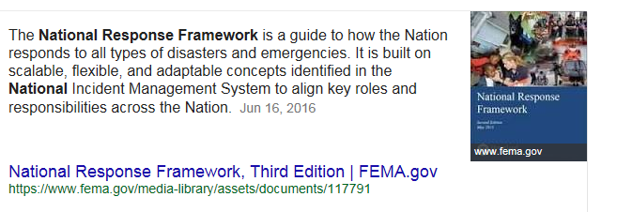
Natural Hazard Mitigation Saves: 2017 Interim Report
See https://www.fema.gov/media-library/assets/documents/117791:

Slide 47
National Response Framework
The National Response Framework presents the guiding principles that enable all response partners to prepare for and provide a unified national response to disasters and emergencies – from the smallest incident to the largest catastrophe. The Framework establishes a comprehensive, national, all-hazards approach to domestic incident response.
Copied from: https://training.fema.gov/nrfres.aspx

Slide 48
National Response Framework
On January 11, 2018 the National Institute of Building Sciences (NIBS) released Natural Hazard Mitigation Saves: 2017 Interim Report, an updated and expanded version of their 2005 study, Natural Hazard Mitigation Saves: An Independent Study to Assess the Future Savings from Mitigation Activities.
The original study showed that $1 spent on mitigation saves society an average of $4 in future disaster costs. Due to the inclusion of additional data and analyses, the 2017 Interim Report shows that the return is actually higher than previously thought.
https://www.fema.gov/natural-hazard-mitigation-saves-2017-interim-report

Slide 49
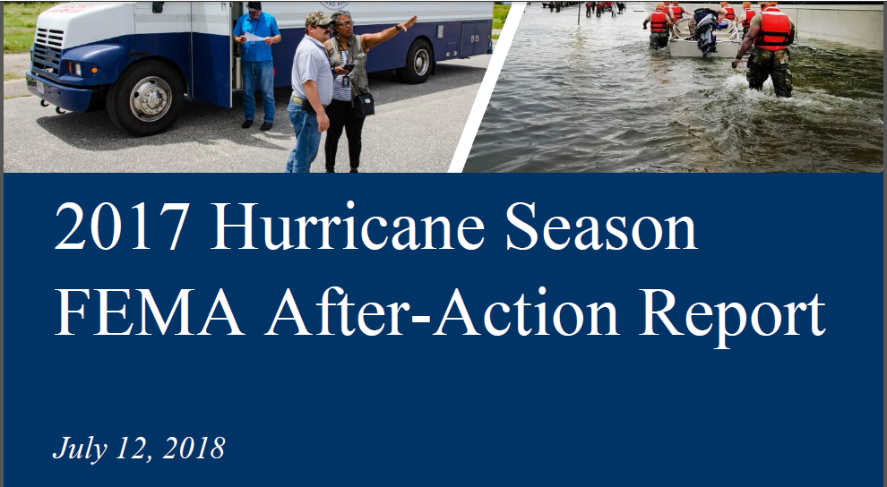
Develop Sources of Information
Cover page FEMA – AAR, July 12, 2018

Slide 50
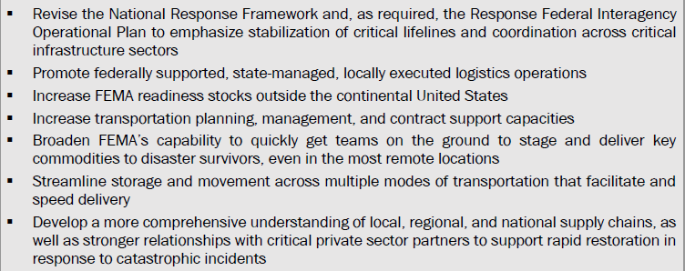
The Disaster Declaration Process
Page 8/65 FEMA’s AAR; July 12, 2018

Slide 51
Lessons Learned
“The response to the California Wildfires required a greate amount of DoD contracts and mission assignments than the hurricane response in support of Texas and Florida combined.”
“FEMA uses Technical Assistance Contracts to supplement and support FEMA staff and to provide technical expertise, particularly in Public Assistance (PA) and Individual Assistance (IA) program execution.”
“FEMA faced challenges with the contracting process due to the number of newly hired contractors, inflexible job descriptions, and high turnover rates during longer deployments. Further, FEMA struggled to process the high volume of contractor security requests.”
FEMA’s AAR; July 12, 2018 page ii

Slide 52
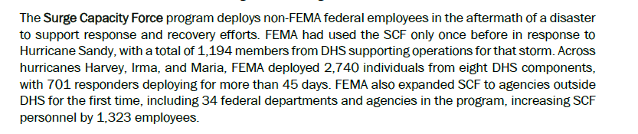
Lessons Learned
“governments need to be better prepared with their own supplies
To have pre-positioned contracts with enforcement
Establishing “rainy day” fund or disaster relief funds
“Before incidents, FEMA establishes pre-negotiated contracts for commodities and services typically required during disaster response.” page 29 AAR
FEMA’s AAR; July 12, 2018 page ii

Slide 53
Stockpiles
Strategic Fuel
National Veterinary Stockpile
CDC
Strategic Metals
Chemical Stockpile Emergency Preparedness Program
Other – Fire caches
GSA Global Supply
USACE Flood Fight Material Center
FEMA National Response Framework (3rd Edition) – Information Sheet

Slide 54
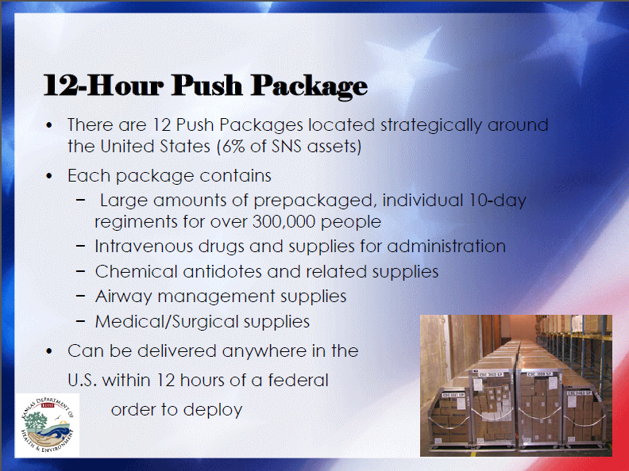
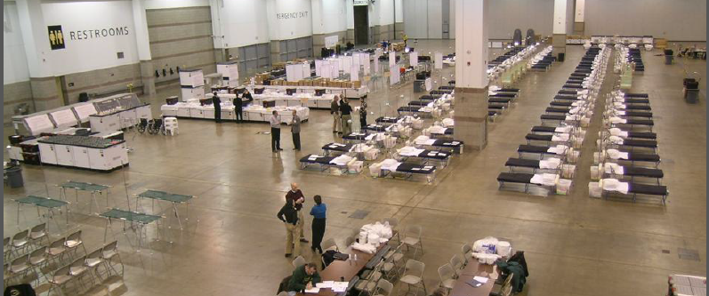
Strategic National Stockpile
Introduction to the Strategic National Stockpile - KDHE Center for Public Health Preparedness

Slide 55
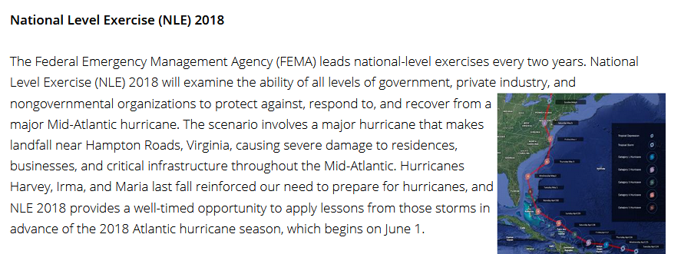
FEMA National Level Exercise
Copied fromhttps://www.fema.gov/nle//

Slide 56
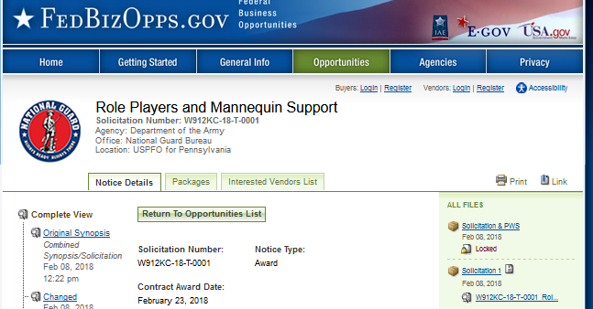
US Army, NGB – exercise support
Copied from: https://www.fbo.gov/spg/USA/NGB/DAHA36/W912KC-18-T-0001/listing.html

Slide 57
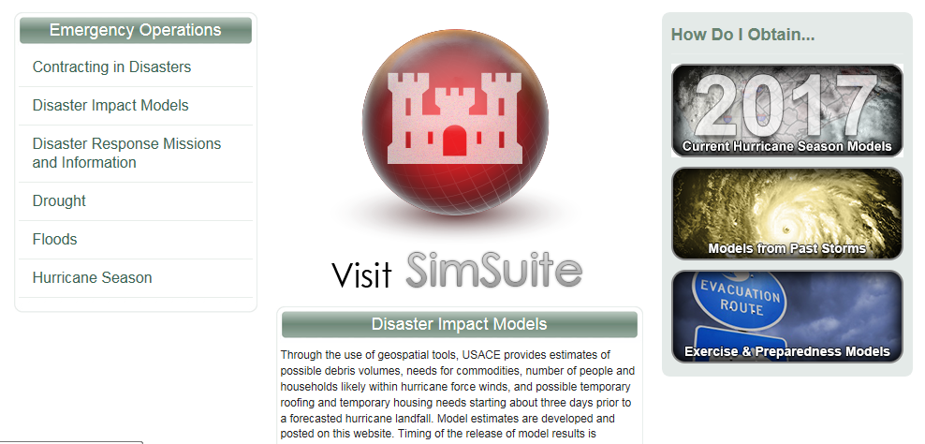
US Army Corps of Engineers
Copied from: https://www.usace.army.mil/Missions/Emergency-Operations/Disaster-Impact-Models//

Slide 58
Required Actions
Register in SAM
Update Dynamic Small Business Search page
Develop refine Capability Statement
Be visible in Disaster Response Registry
Contact FEMA Industry Liaison Program - http://www.fema.gov/industry-liaison-program
Build network
Conduct procurement history research
Research programs and program authorities
Establish capable supply chain

Slide 59
SAM Registration
3.4.2.4 Disaster Relief
Entities wishing to do business with the federal government, such as the Federal Emergency Management Agency (FEMA), in the event of a natural disaster can complete the Disaster Relief section. When national emergencies or natural disasters such as floods and hurricanes occur, supplies and services need to be procured and rushed to the affected area quickly. To expedite this process, the SAM Disaster Relief Registry shows those contractors who are willing to provide debris removal, distribution of supplies, reconstruction, and other disaster or emergency relief supplies and/or services. Collecting this information in SAM provides a means for potential local contractors to identify themselves to the federal agencies during a time of a disaster.

Slide 60
FEMA Industry Liaison Program
The Industry Liaison Program (ILP) establishes strategic relationships with suppliers and stakeholders; serves as an information provider for suppliers seeking to do business with FEMA; and connects suppliers with program offices in support of FEMA’s mission.
If you are seeking to do business with FEMA in support of a disaster recovery effort, please be aware that in accordance with the Robert T. Stafford Act (specifically Section 307), FEMA’s goal is to seek local companies within the disaster area for goods and services related to a specific disaster when practical and feasible.

Slide 61
FEMA’s - Top Commodities Procured for Disasters
Infant/Toddler Products*
Durable Medical Equipment Kits*
Consumable Medical Supplies Kits*
Plastic Sheeting
Tarps
Blankets
Comfort/ Hygiene Kits8
Water
Meals
Forklift Rentals
Cargo Vans
Security Guard Services
Generators
Cots
Joint Field Office Kit8
Leased Copiers
Leased Generators
Office Supplies
Shredded Bins
Portable Toilets
Sign Language
Temporary Labor
Janitorial Services
* For additional information on the Commonly Used Sheltering Items (CUSI), please submit inquiry to FEMA-Industry@fema.dhs.gov, with the email subject titled ‘CUSI Information Request’. Upon review, the inquiry will be distributed to applicable representatives.
https://www.fema.gov/industry-liaison-program

Slide 62
FEMA’s - Debris Removal
Become a member of the Corps of Engineers Contractor Registry if you are interested in performing disaster response and recovery work; e.g. debris removal. Follow this link, www.usace.army.mil/Missions.aspx, to access their website. We encourage you to explore all the links under “Emergency Operations”. Useful information is provided regarding the Corps of Engineers support role to FEMA during disasters. In addition, the U.S. Government uses the Disaster Response Registry, in the System for Award Management (SAM), for contractors to register their business information, including capabilities and locations served to provide debris removal services. Get a quick overview of the Disaster Response Registry in SAM, learn how to search the Disaster Response Registry in SAM, or visit www.SAM.gov to get started.
https://www.fema.gov/industry-liaison-program

Slide 63
FEMA’s - Transportation Services
FEMA procures its transportation needs through the General Services Administration (GSA). Please follow this link, www.moveit.gsa.gov, to (GSA’s Transportation Management Services Solution (TMSS) to seek GSA approval. Additionally, to view GSA's Standard Tender of Service (STOS), which contains the rules and regulations for doing (freight) business with GSA and its customer agencies under the GSA Tenders program, please use this link, https://www.gsa.gov/portal/category/21192, which contains various PDF links related to the Tenders program. Also, be sure to sign up for email notification to ensure you're kept up to date on all things GSA Freight (training opportunities, announcements of open Bid Cycle windows, release of Request For Offers, etc.) at the above link; scroll down to the bottom of the page, enter your email address and subscribe.
https://www.fema.gov/industry-liaison-program

Slide 64
FEMA’s - Transitional Sheltering Assistance
Hotels/motels are able to participate in FEMA’s Transitional Sheltering Assistance program, which offers rooms to disaster survivors seeking housing aid. The program is also referred to as “Emergency Lodging Assistance”. For information on how a hotel/motel can participate by setting up an account with Corporate Lodging Consultants please visit, https://ela.corplodging.com/.
https://www.fema.gov/industry-liaison-program

Slide 65
Upcoming training - events

Slide 66
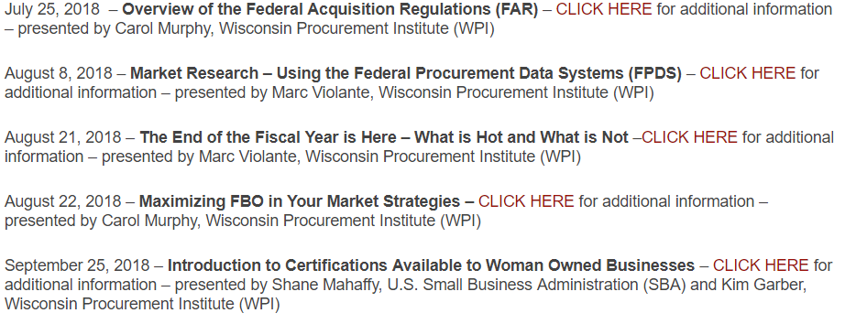
https://www.wispro.org/faqs/what-is-wpis-webinar-schedule/

Slide 67


Slide 68

QUESTIONS?

Slide 69

survey

Slide 70
Presented By Wisconsin Procurement Institute (WPI) www.wispro.org Marc Violante | Director, Federal Market Strategies
Wisconsin Procurement Institute marcv@wispro.org 920-456-9990
Benjamin Blanc | Government Contract Specialist
Wisconsin Procurement Institute benjaminb@wispro.org 414-270-3600 10437 Innovation Drive, Suite 320 Milwaukee, WI 53226

