Slide 1
Locating, Securing, and Managing
Federal Construction Contracts
and Subcontracts
October 23 2019 – The Contract Academy

Slide 2
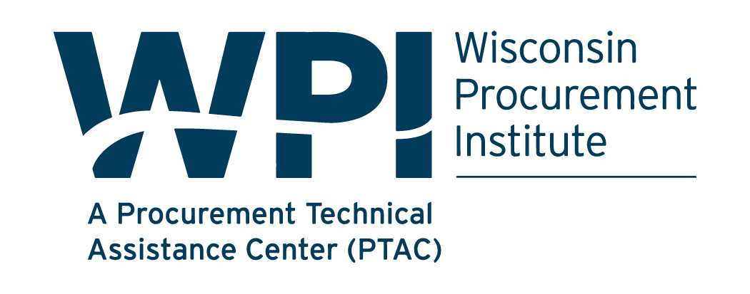
Assist businesses in creating, developing and growing their sales, revenue and jobs through Federal, state and local government contracts.
WPI is a Procurement Technical Assistance Center (PTAC) funded in part by the Defense Logistics Agency (DLA), WEDC and other funding sources.
10/21/2019
Page 2

Slide 3
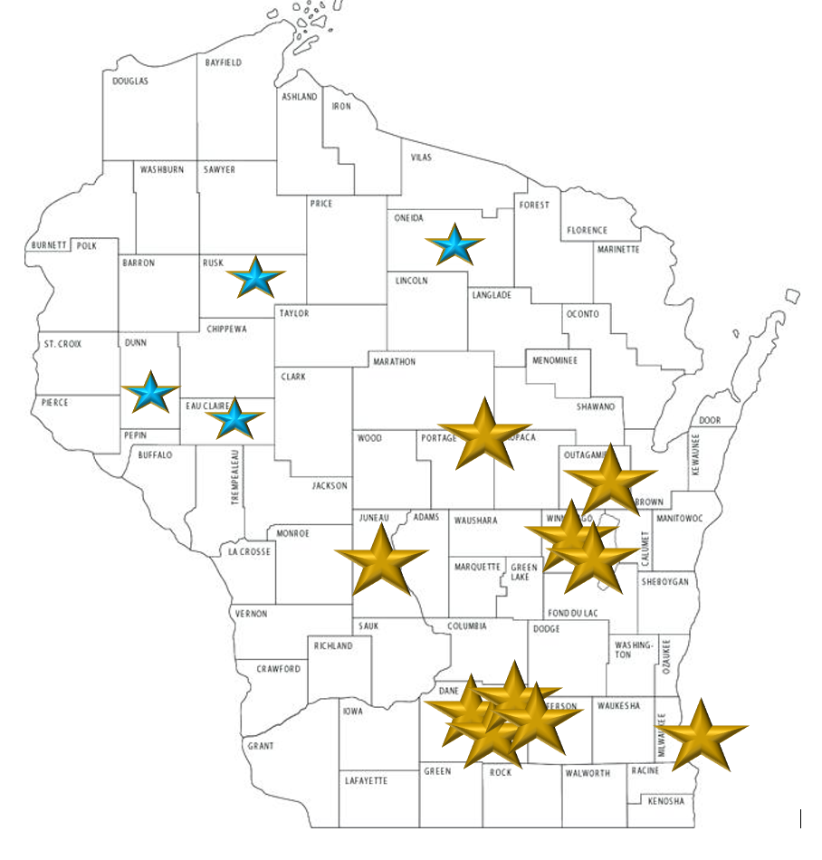

WPI Office Locations
MILWAUKEE
Technology Innovation Center
MADISON
FEED Kitchens
Dane County Latino Chamber of Commerce
Wisconsin Manufacturing Extension Partnership (WMEP)
Madison Area Technical College (MATC)
CAMP DOUGLAS
Juneau County Economic Development Corporation (JCEDC)
STEVENS POINT
IDEA Center
APPLETON
Fox Valley Technical College
OSHKOSH
Fox Valley Technical College
Greater Oshkosh Economic Development Corporation
EAU CLAIRE
Western Dairyland
MENOMONIE
Dunn County Economic Development Corporation
LADYSMITH
Indianhead Community Action Agency
RHINELANDER
Nicolet Area Technical College
GREEN BAY
Advance Business & Manufacturing Center
10/21/2019
Page 3

Slide 4
What we will cover…
Basic first steps
How to locate and evaluate opportunities
Leveraging federal small business programs
Meeting contract requirements and specifications
Unique issues and considerations for contractors and subcontractors

Slide 5
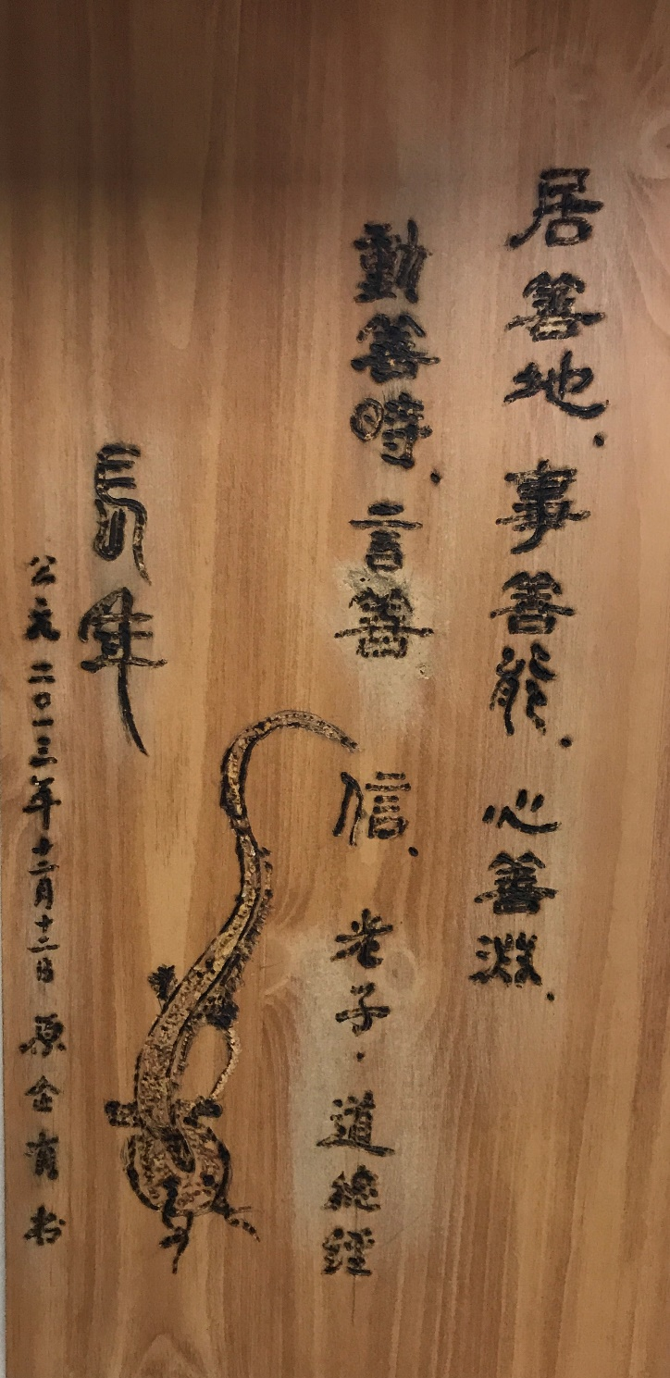
Quotation of Daodejin principles (500 BC)
From Lao zi, 2500 years ago, China
Only work on project that makes sense and truly makes profit;
Only do what you can actually handle within your capabilities;
Make sure you have profound understanding of the project;
When you take a move, make sure the timing is right;
When you speak in business, make sure your words build trust through the business dealings.

Slide 6
Basic First Steps
Are you READY to work with the Federal Government?
Past Performance/Experience– Contracting Officers usually look for experienced prime contractors
Financial requirements – bonding, financing, cash flow
Capacity – labor, equipment, teaming and joint ventures, etc.
Understand the Processes- award process, submittal approval process, change order process, payment process etc.

Slide 7
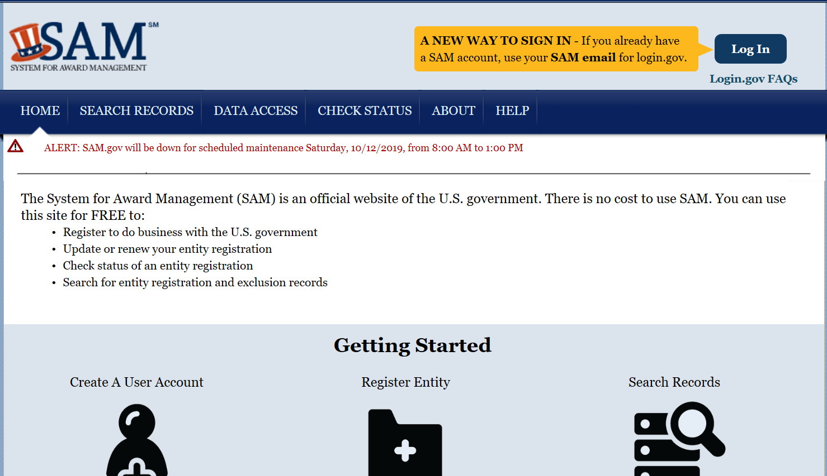
Register in SAM
NO COST TO REGISTER in SAM – WPI can help!
https://www.sam.gov/

Slide 8
Develop a strong profile in SBA’s Dynamic small business search database (DSBS)
http://dsbs.sba.gov
Contracting Officers use this to find small businesses
Large prime contractors use this to find small businesses to meet their subcontracting goals
Small Businesses use this to find other small businesses for teaming and joint venturing

Slide 9
Locating opportunities
https://www.fbo.gov/
(Soon moving to https://www.beta.sam.gov)
Go to Pre-Bid Site Visits –find Prime Contractors that might be bidding and looking for Subcontractors
NETWORK - Go to Industry days and Small Business Conferences
WPI Bid Matching
Notes:
You can review the Interested Vendor List in FBO to see who else is interested.

Slide 10
Evaluating opportunities
Consider HOW the Government will make the award…
Lowest price responsive, responsible bidder –IFBs
Lowest price, technically acceptable (LPTA) – RFPs and RFQs
Best Value – cost/technical trade off – RFPs and RFQs

Slide 11
Evaluating opportunities
If best value, what Evaluation Factors may be used?
Management/Key Personnel – Do you have the appropriate people on staff?
Experience – Do you have the number of years of experience required?
Past Performance – Have you successfully completed similar work?
Technical Approach – How will your company accomplish the specific requirement?

Slide 12
Evaluating opportunities
Competition restrictions/Set asides – Do you qualify? Could you joint venture or team with another contractor to qualify?
Is this requirement a good fit for your company at this time?
Do you have the required experience, expertise?

Slide 13
Evaluating opportunities
Bonds – Are you able to provide the required bonds?
Can you meet the required schedule?
How much time and money will it take to prepare a thorough proposal?
Do you have a good chance of being selected for award?

Slide 14
Leveraging federal Small business programs
23 percent of prime contracts and subcontracts for small businesses table of size standards;
5 percent of prime and subcontracts for women-owned small businesses;
5 percent of prime contracts and subcontracts for Small Disadvantaged Businesses (including minority);
3 percent of prime contracts and subcontracts for HUBZone small businesses;
3 percent of prime and subcontracts for service-disabled veteran-owned small businesses [VA also has both a veteran and service disabled veteran business preference with a higher goal ].
LARGE PRIME CONTRACTORS must also negotiate small business goals

Slide 15
Develop Relationships
Work with more experienced federal contractors
Mentor/Protégé program,
Joint Venture arrangements,
Teaming arrangements
Find supporting resources
Wisconsin Procurement Institute https://www.wispro.org/
Small Business Administration https://www.sba.gov/
Society of American Military Engineers https://www.same.org/

Slide 16


Slide 17

Contractor’s Purpose of Estimating cost and risks
1. Determine project cost and profit and the strategies to win the project against competition and risk analysis.
2. To Implement cost verification measure.
3. To develop a database that can be used for future project and to search database.
4. Federal contracting unique costs.

Slide 18
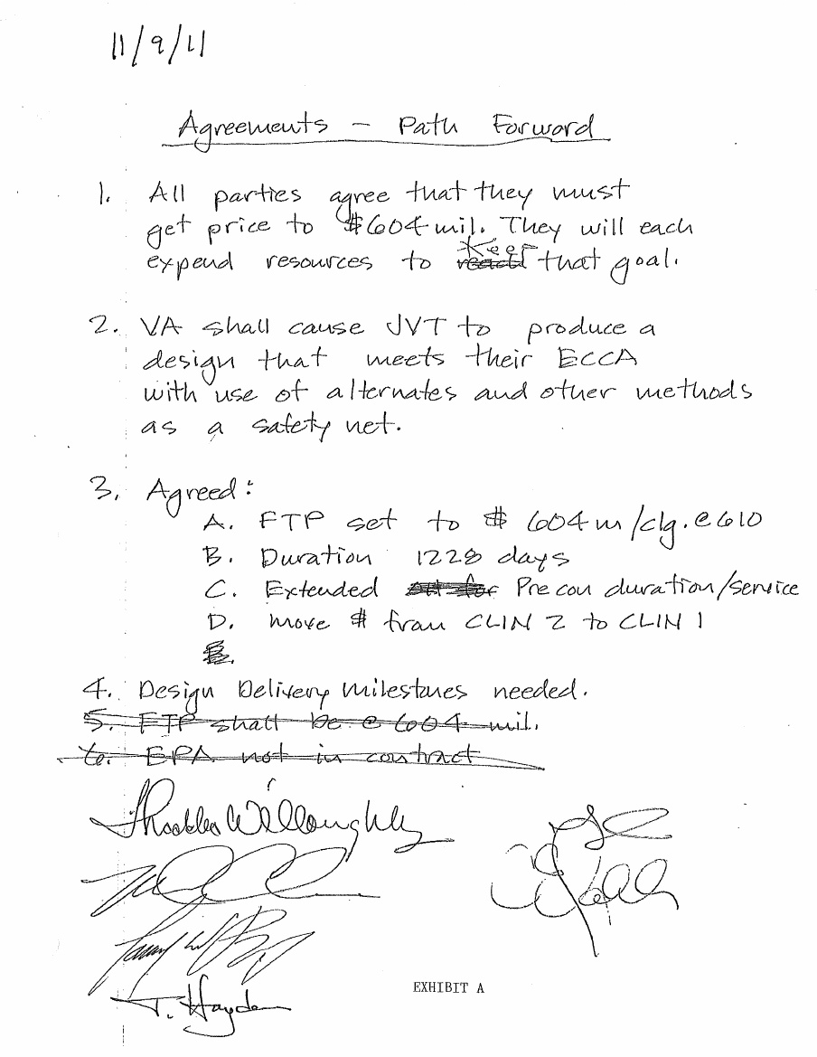


Slide 19

Thumb in the air estimate
Advantages
Allows a quick determination of the feasibility of a project.
A quick decision about feasibilities and go or no go.
Purposes
Assessing the risks and why me
Evaluate feasibility and resources
Evaluate the competitions and traps

Slide 20
Detailed Final Estimate
Prepared after drawings and specification are completed.
Need information on labor rate "productivity", material cost, cost of renting or purchasing equipment, cost of own equipment, lost opportunities cost, weather and critical path long lead items.
Requires a complete quantity takeoff based on drawing and the complete set of contract documents, best to be done independently by two parties to check the accuracy.
Government factor to be considered: ranging from the level of difficulties: City, County, State, VA, USDA, GSA, Army, USACE, Navy, one is more difficult to deal with than the other. From factor of 0.02 cost, each shall add 0.02 cost into your estimate, as a caution of estimating.

Slide 21

Time
Cost increase based on new cost or anticipated cost Published by R.S. Means and ENR. Dakota had a 2% overall cost increase for a project that was temporary stopped by government for one year.
Larger project needs third party TIA through P6 to get paid for delays that could mount up to millions.
Timely response to submittals and RFIs is critical for larger projects because they could cause huge cost overruns and legal challenges down the road.
Have an agreement for how long of a response is to be expected from owner’s rep and assume approved after certain period. Dakota Navy project for boiler room as example.

Slide 22

Location
Fed contracting also means go to far away places and some factors affecting cost in different locations are:
Transport and Per diem cost
Taxes (excise tax and sales tax, special assessed tax from some states and Dakota recent law suit against Navy for tax issues)
Prevailing wage Labor cost
Codes and local inspection and prevailing wage differences.
Multiple mobilization and demobilization cost has to be considered as a major factor

Slide 23
Meeting contract requirements
Federal government insists upon Strict Performance
Contracting Officer Representatives (CORs) and Senior Resident Engineers (SREs) will be inspecting
Federal Construction Specifications can be more stringent than state and local codes and/or Industry standards
Rejection of work can cost you – (ex. retainage, re-procurement under inspection clause)

Slide 24
Meeting contract requirements
Keep track of your costs (each project should be treated as a separate business to track all costs and resources used).
Know what is, and is not, included in the contract for the agreed upon price
Document and track costs for all government changes and differing site conditions
Notify the government as soon as the change occurs, or as soon as the differing site condition is found

Slide 25
Meeting contract requirements
“Time is of the essence” – All work must be finished by the completion date.
Stay on top of the Schedule!
Delays can lead to government retainage
Inexcusable delay will likely result in assessment of actual or liquidated damages and possibly in default
Excusable Delay must be fully documented and justified (e.g. time impact analysis and detailed cost breakdown)

Slide 26
The Davis bacon act
Applies to federal construction contracts over $2,000
Laborers and mechanics working onsite be paid at least the prevailing wage rates/fringe benefits set by the Department of Labor
Certified Payrolls must be provided by Prime and Subcontractors as part of “daily report” and a final certification process
You may not be paid for a long time for lack of paper work.

Slide 27
Multiple Award Task Order Contracts/ Multiple Award Construction Contracts (MATOCs/MACCs)
There is more than one awardee and work is ordered from the awardees by the issuance of individual task orders.
The ordering period for each contract can be up to five years.
Prime Contractors should be on the lookout for MATOCs/MACCs. If you don’t get a contract you could be locked out.
Subcontractors might find opportunities from Prime Contractors that have been awarded MATOC/MACC Contracts

Slide 28
Other issues in Federal Construction
Simple bid with design
Design/Build
IDIQ contracts using unit pricing books (ex. RS Means)
Differing Site Conditions
Certified Cost and Pricing Data

Slide 29
Presented By
Helen Henningsen – Government Contract Specialist
Wisconsin Procurement Institute
10437 Innovation Drive, Suite 320 Milwaukee, WI 53226 helenh@wispro.org | 414-270-3600
Wenbin Yaun – Chief Executive Officer
Dakota Intertek
16600 W. National Avenue
New Berlin, WI www.dakotainterteckcorp.com | 262-784-8844
10/29/2019
Page 29

