Slide 1
Selling goods and services
To the federal government
At the contracting academy (TCA)
Presented by
Kim Garber, WPI and Kim HoffmaNn, Complete Mobile Dentistry
October 2019

Slide 2

INTRODUCTIONS
Kim Garber, Wisconsin procurement institute (WPI)
Kim HoffmaNn, Complete Mobile Dentistry
Show of Hands
  Registered in sam.gov
  Doing business with the Government
  Are you the decision maker

Slide 3
How much does the government buy?
Wisconsin ranks 25th receiving 1.08% of all federal procurement dollars
In FY2018 the Federal government purchased
$562 billion in ALL good and services
$4.40 billion from Wisconsin businesses
$850 million from Wisconsin Small Businesses – 1,309 contractors
  $23 million from Woman Owned Businesses – 127 contractors
  $223 million from Small Disadvantaged Businesses – 287 contractors
  $44 million from HUBZone Certified Businesses – 19 contractors
  $120 million from Service Disabled Veteran Owned Businesses – 48 contractors

Slide 4
How much does the government buy?
The Federal government purchased in the first 9 months of FY19
$481 billion in ALL good and services
$5.12 billion from Wisconsin businesses
$623 million from Wisconsin Small Businesses
  $45 million from Woman Owned Businesses
  $205 million from Small Disadvantaged Businesses
  $16 million from HUBZone Certified Businesses
  $92 million from Service Disabled Veteran Owned Businesses

Slide 5
Are you ready to sell to the government?
  Capacity and capability to meet contract requirements – resources including funding, labor, facilities, supply chain…..
  Understanding of the regulations, requirements and obligations – including how you will get paid
  Reliable, responsible, responsive
  Of good character
  Past commercial performance
  Tech savvy – in capability to work on-line AND market on-line including social media
  Reachout to a PTAC

Slide 6
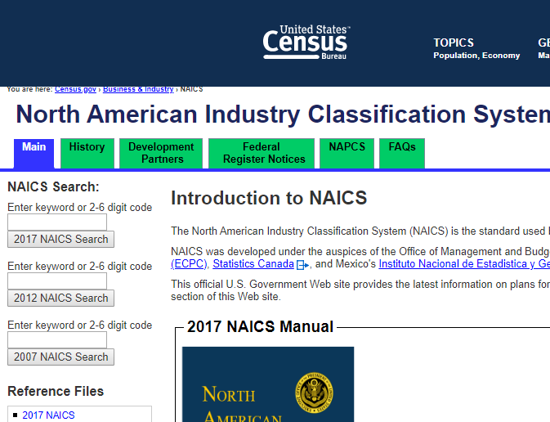
What does / did the government buy? Know your NAICS code
https://www.census.gov/eos/www/naics/

Slide 7
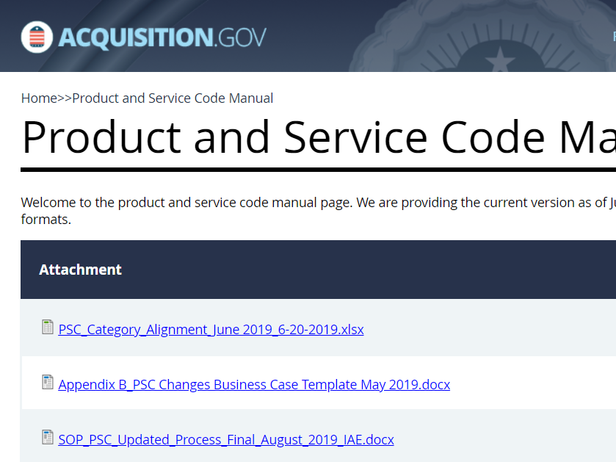
What does / did the government buy? Know your PSC code
https://www.acquisition.gov/PSC_Manual

Slide 8


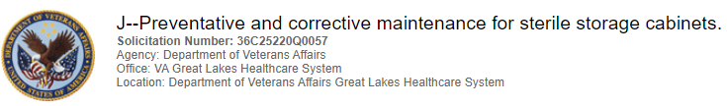

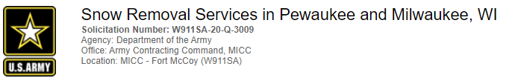
What does the federal government buy?
---EVERYTHING---
Notes:
Current opportunities – the federal government buys everything
All current WI opportunities
Construction, manifesting, R&D, goods and services
We will be focusing on goods and services

Slide 9
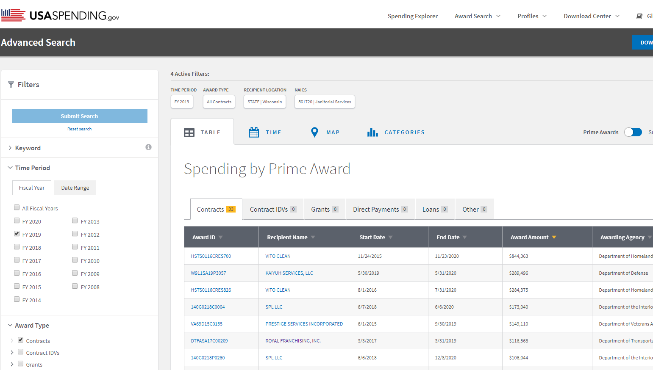
What DID the government buy? USASPENDGING.GOV
Notes:
Search for WI Janitorial companies by NAICS

Slide 10
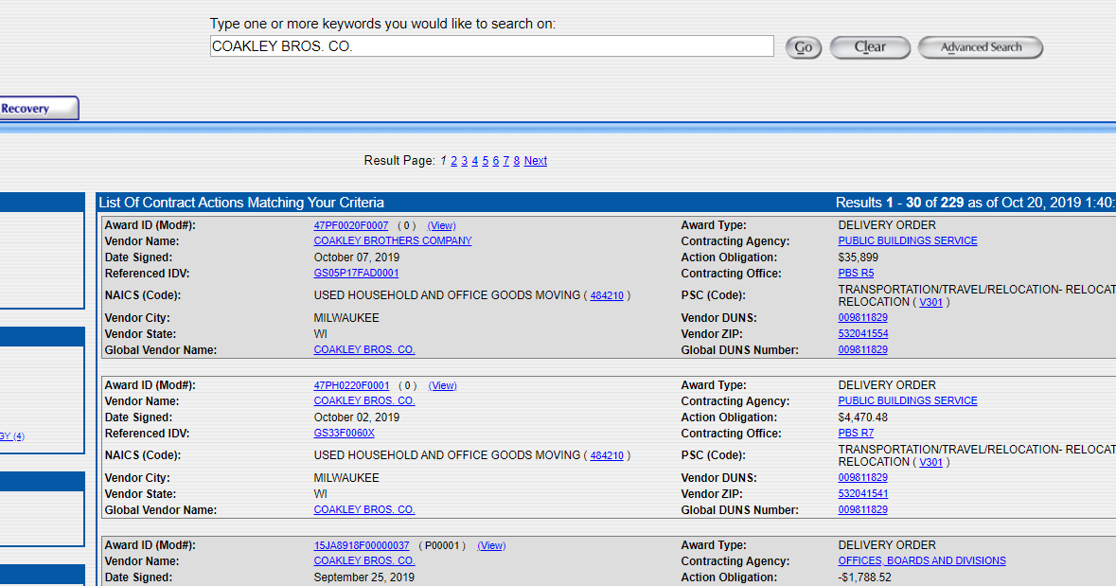
What DID the government buy? FPDS.GOV

Slide 11
How does the government buy?
Formal proposal
On line – GSA Advantage, eBuy, NASA SEWP, and others
Simple bid
Credit cards
DEPENDS ON
  Regulations
  Size of requirement
  Type of requirement
  Agency
  Planned vs emergency
  Commercial vs military
  Other

Slide 12
Leveraging small business programs
23 percent of prime contracts and subcontracts for small businesses table of size standards;
5 percent of prime and subcontracts for women-owned small businesses;
5 percent of prime contracts and subcontracts for Small Disadvantaged Businesses (including minority);
3 percent of prime contracts and subcontracts for HUBZone small businesses;
3 percent of prime and subcontracts for service-disabled veteran-owned small businesses [VA also has both a veteran and service disabled veteran business preference with a higher goal ].
LARGE PRIME CONTRACTORS must also negotiate small business goals
ALL SMALL MENTOR PROTÉGÉ PROGRAM – can create Joint Ventures with larger more experienced business

Slide 13
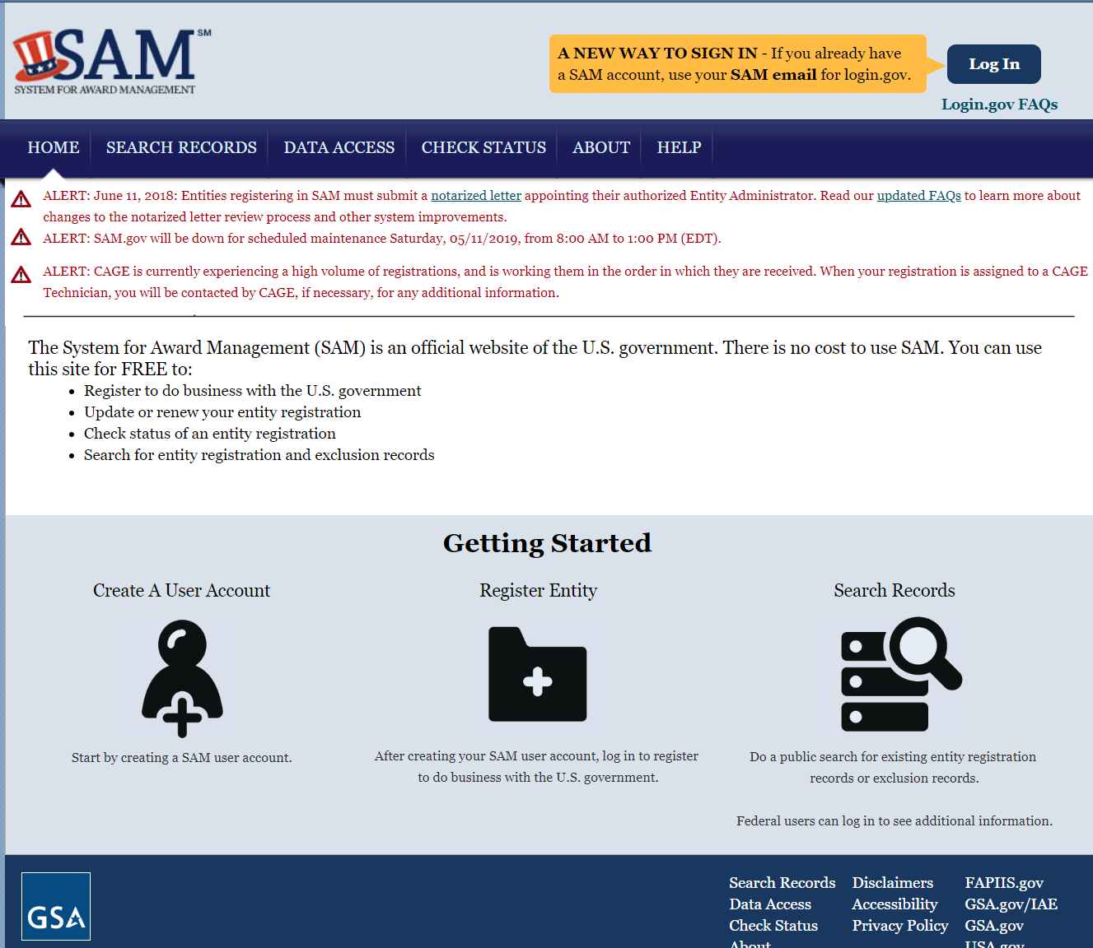
THE BASICS – register in SAM

Slide 14
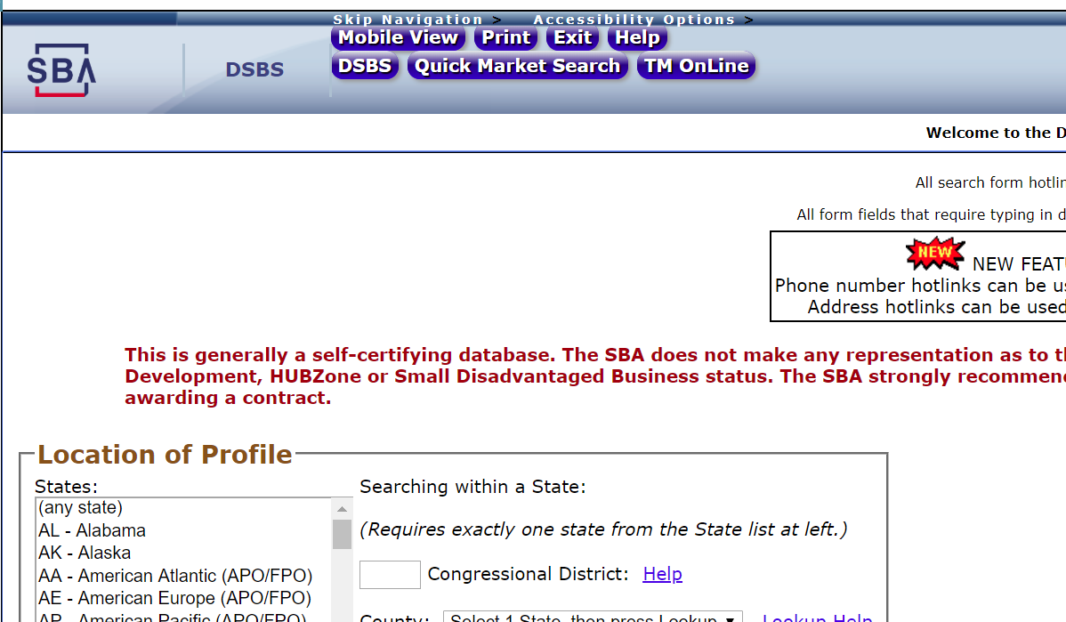
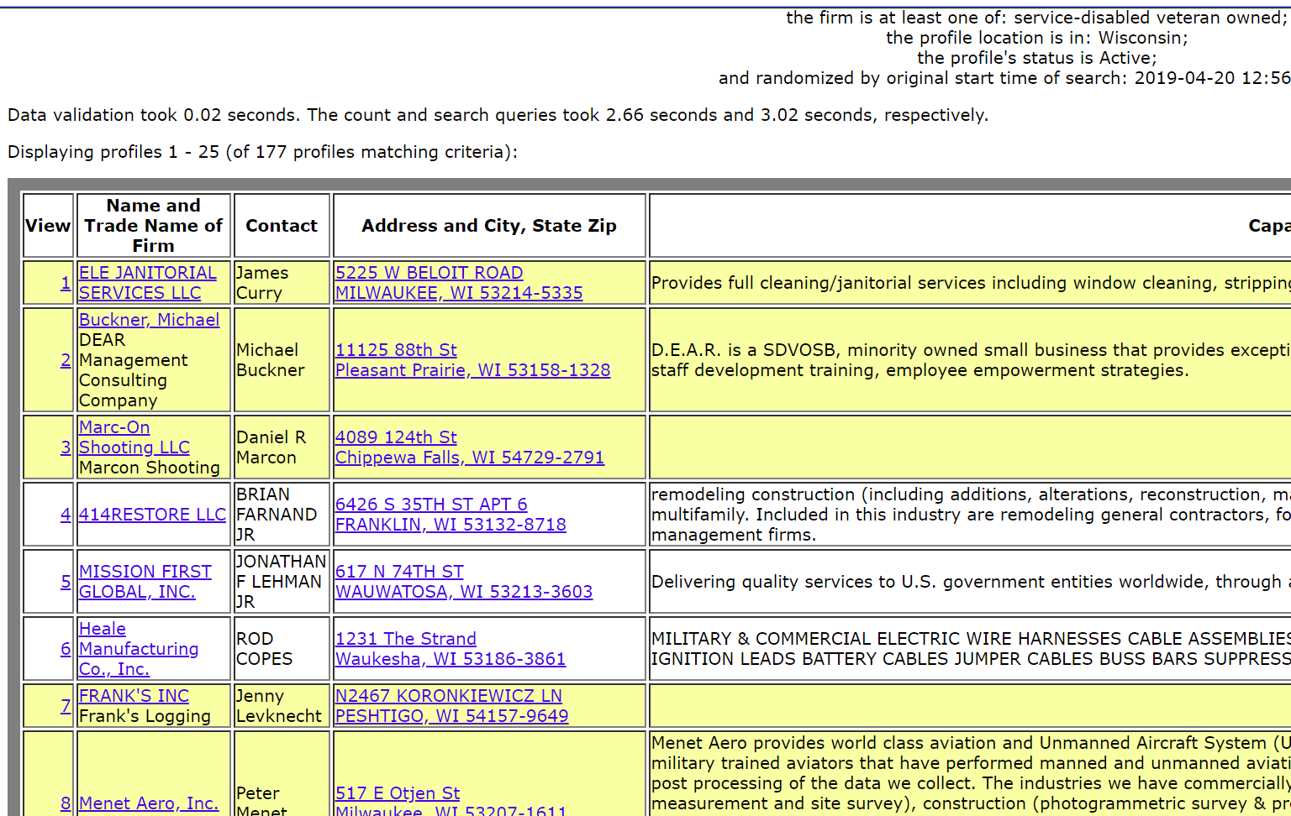
THE BASICS – complete a DSBS profile

Slide 15
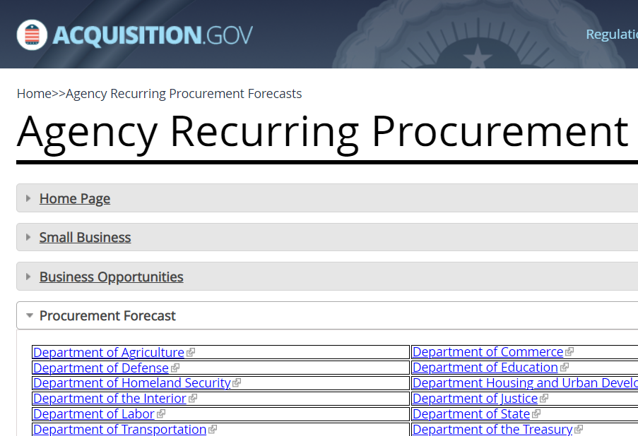

THE BASICS – MARKET RESEARCH
Review procurement HISTORY – USASPENDING or FPDS
Review CURRENT opportunities – fbo.gov, ebuy, other…..
Review FORECASTS
https://www.acquisition.gov/procurement-forecasts

Slide 16
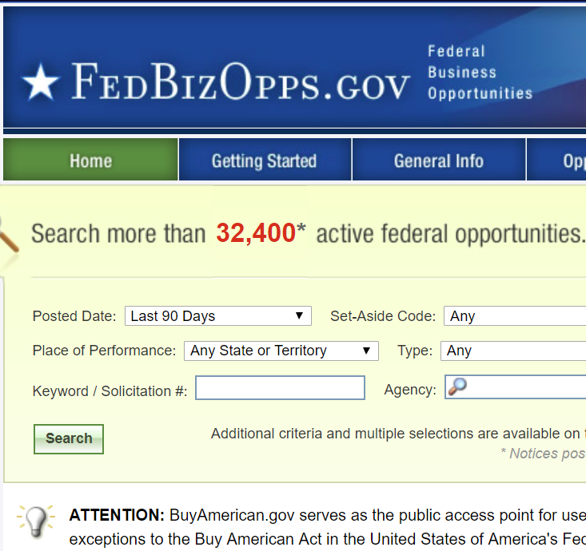
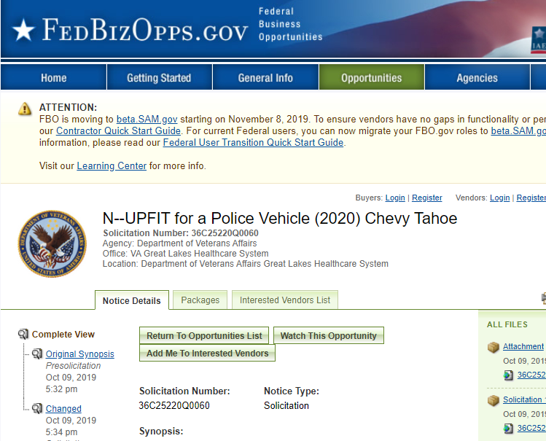
THE BASICS – Locating opportunities
**FBO.GOV will be moving to https://beta.sam.gov Nov 8 2019

Slide 17
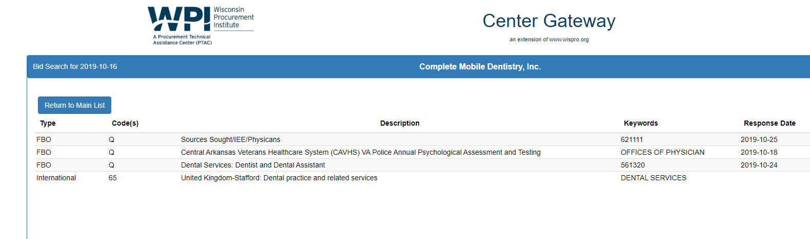
THE BASICS – Locating opportunities
WPI NO COST SERVICE

Slide 18
THE BASICS – Locating opportunities
If you have a GSA Schedule - https://www.ebuy.gsa.gov/ebuy/ [must be GSA Schedule holder]
FedBid – Unison – used by some Federal agencies - https://www.unisonglobal.com/product-suites/acquisition/marketplace/
Pay for service – evaluate and verify prior to commitment

Slide 19
THE BASICS – develop strong TARGETED MARKETING MATERIALS
Business card
Capabilities statement
Website
Short Elevator “pitch”
Longer “pitch”

Slide 20
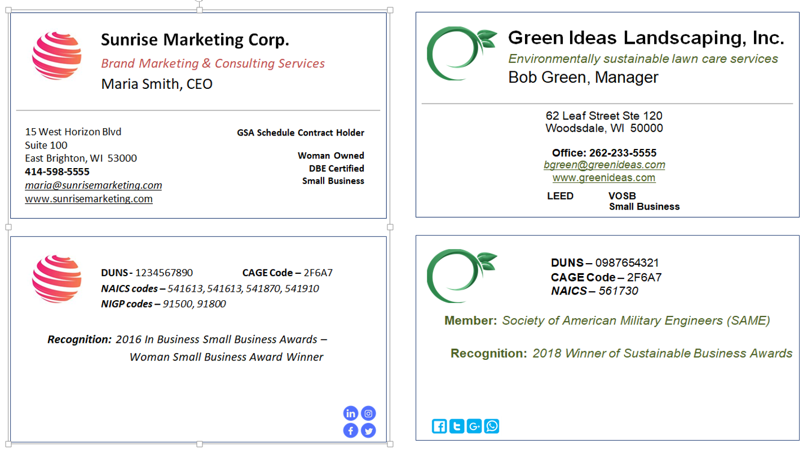
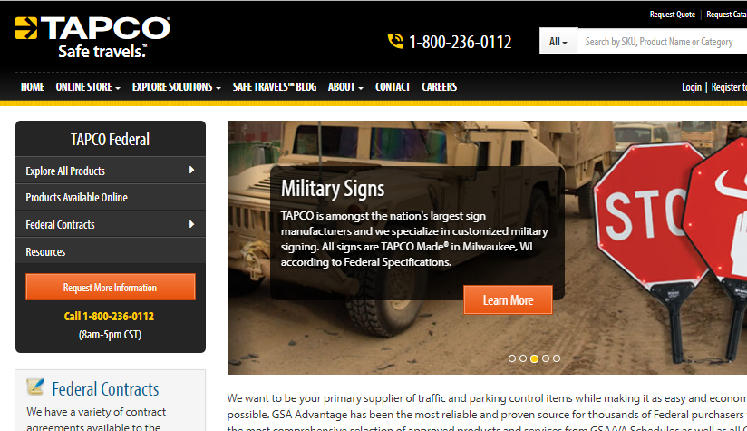
My name is Red Green, President of the Green Barge Company based in Jacksonville, Florida. Our company specializes in shoreline clean up and reconstruction. We are currently working with the USACE on repairing areas on the St. Josephs River damaged after Hurricane Irma. Green Barge is certified as a HUBZone with 10 years of experience in shoreline work. We have an experienced crew with a superior safety record.

Slide 21
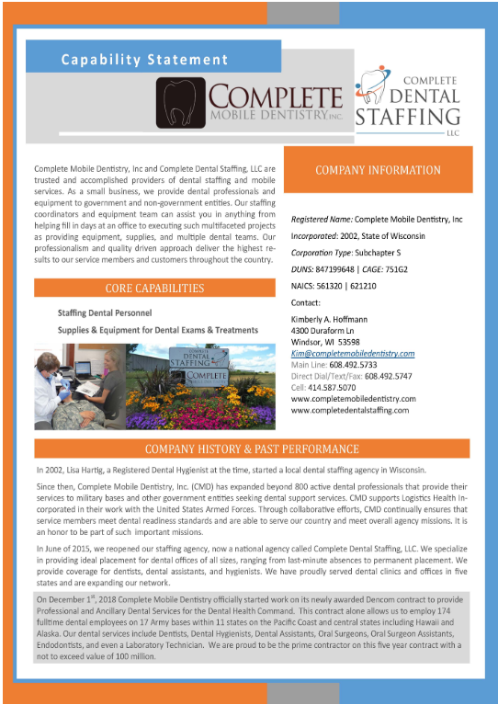
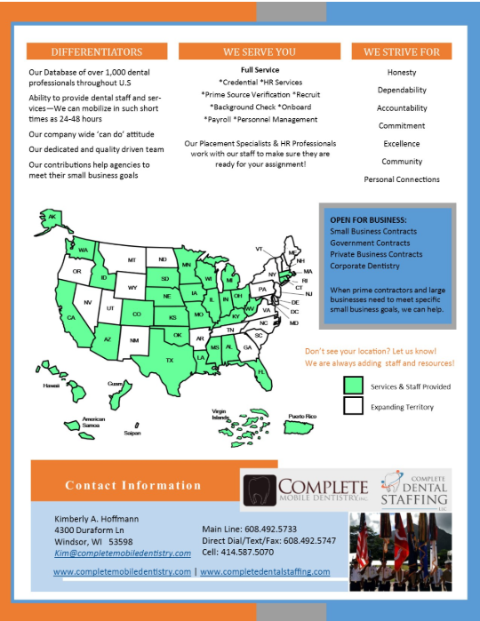

Slide 22
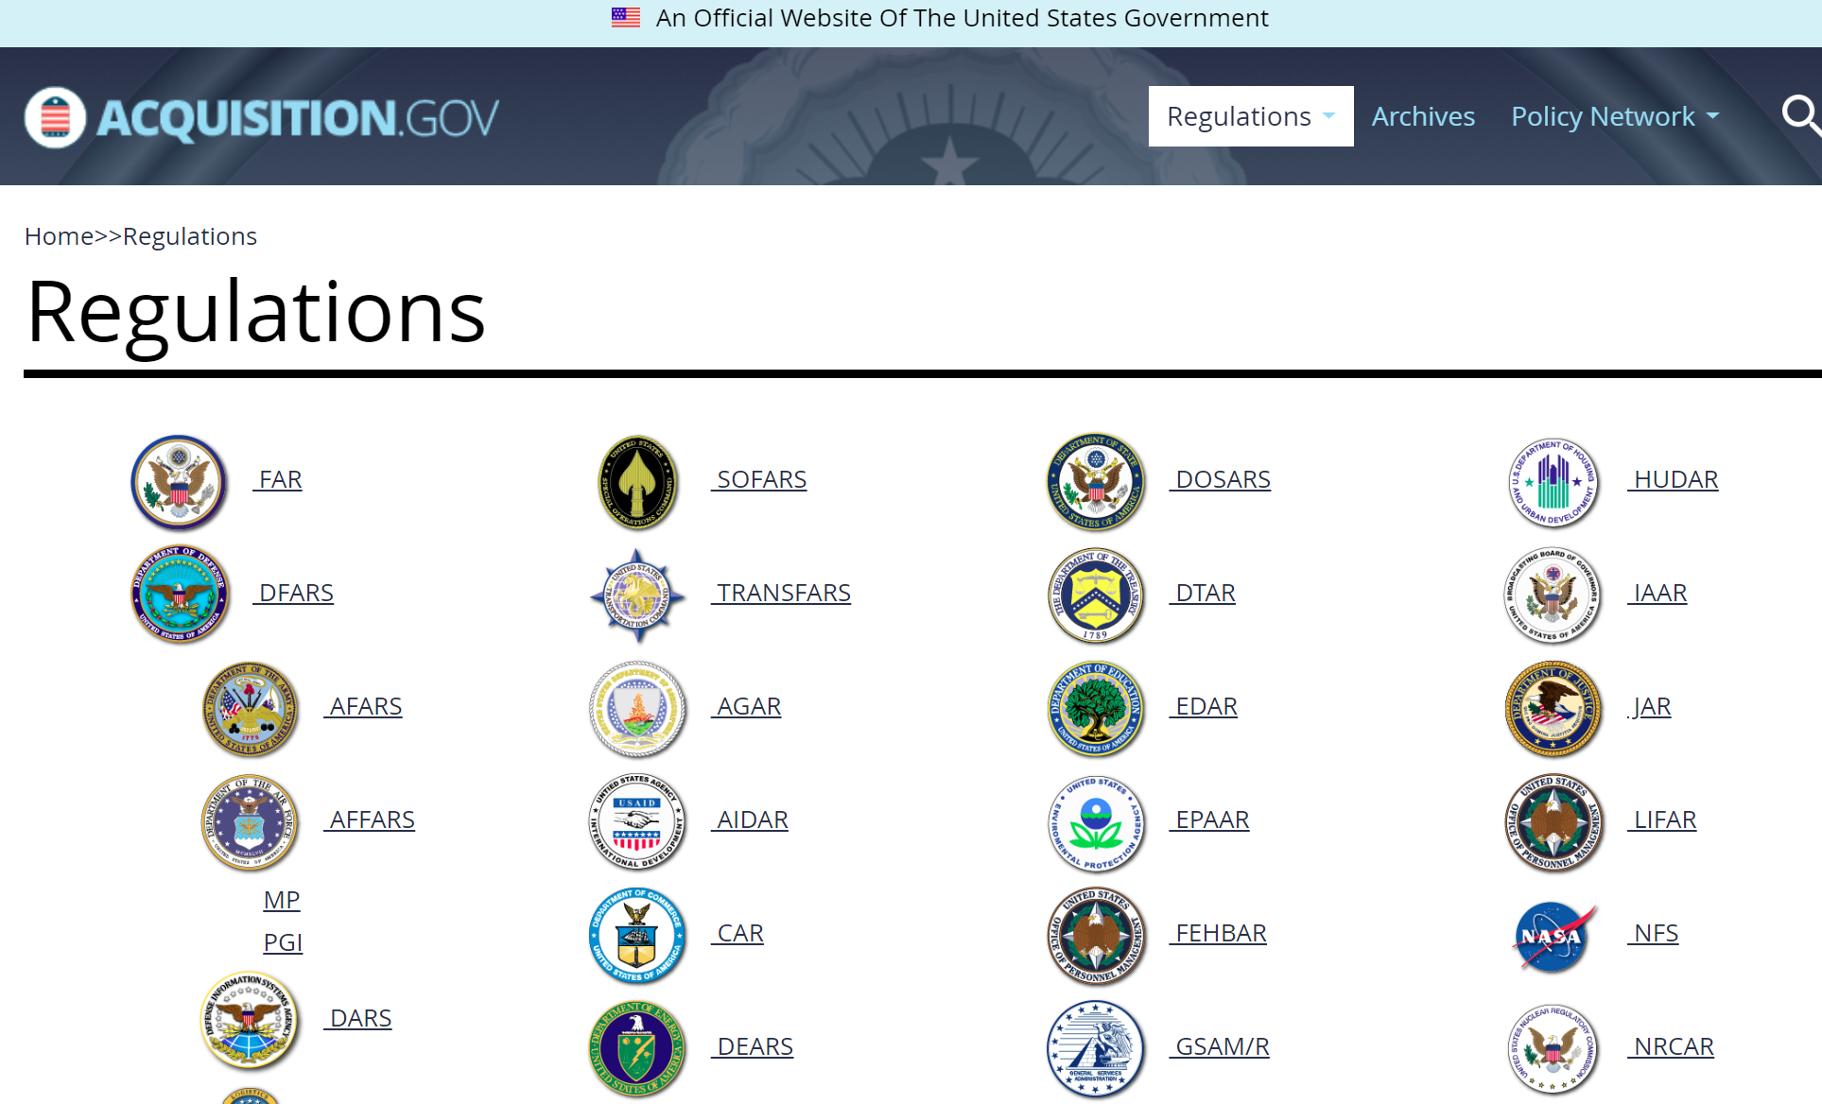
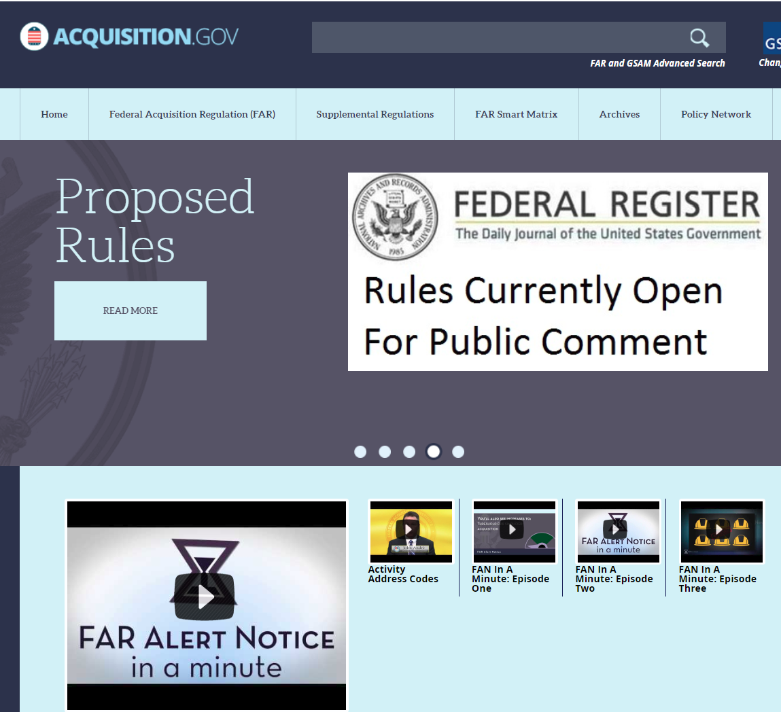
Understand current and upcoming rules, regulations, requirements

Slide 23
Develop relationships Government agencies, current contractors / subcontractors and supporting resources
Industry days, conferences, workshops…..
Federal based organizations such as NCMA, NDIA, SAME, SMALL BUSINESS organizations …….
IN PERSON relationship development with individuals and agencies / primes
  Future MPs or JVs
  Competitors one day – partners the next day

Slide 24
Why develop these relationships?
What does the government REALLY need
What problems do they have that you could solve
Develop trust
Learn and understand the challenges that they buyer or end user is having –with current suppliers, requirements, deadlines, funding……
Learn more about what primes are doing – potential for subcontracting

Slide 25
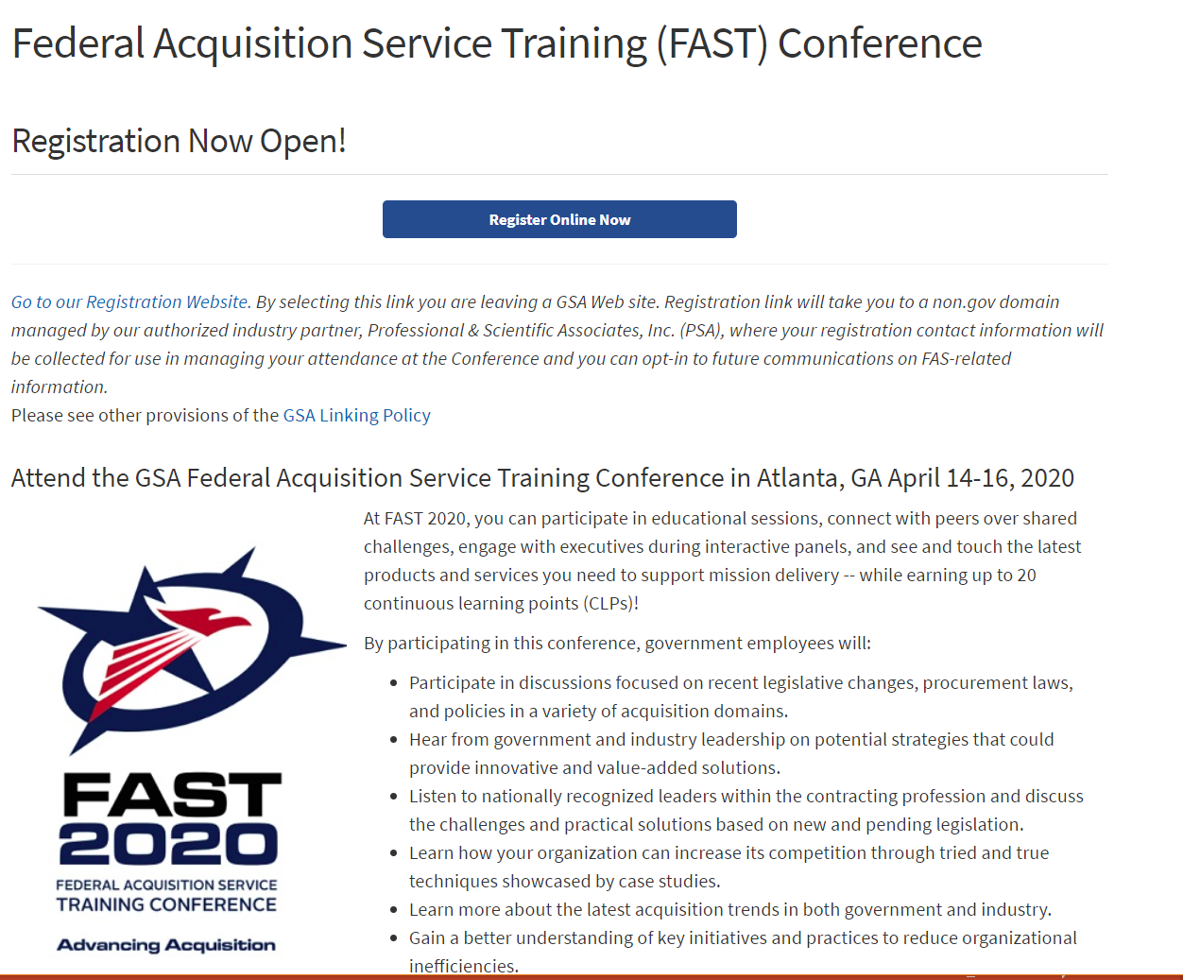
Other stuff – GSA Conference is back
https://www.gsa.gov/about-us/organization/federal-acquisition-service/customer-and-stakeholder-engagement/federal-acquisition-service-training-fast-conference

Slide 26
Other stuff –GSA MAS consolidation
Last November, the agency unveiled plans to unite the 24 siloed schedules into one intuitive system. On Oct. 1, the agency completed the first phase of the integration and released the new single solicitation, where everything is in one place.
During phase two, vendors will see a migration of SINs (Special Item Numbers) and will have the opportunity to select SINs that were previously across separate Schedules.
Phase three in mid- to late-July of next year - the final phase will primarily support contractors who have multiple contracts with more than five years left to consolidate into one single contract under the new Schedule.

Slide 27
Other stuff –”Amazon for Government”
Nearly two years ago, the General Services Administration began a journey to develop an online marketplace for federal acquisition at the behest of Congress.
In Congress, the e-commerce platform idea was dubbed "Amazon for government," and the provision was tucked in the 2018 National Defense Authorization Act signed in December 2017.
Earlier this month, GSA rolled out the initial vehicle it wants to use to test its online purchasing platform pathway. In a solicitation, GSA asked commercial e-commerce platform providers to compete for its "proof of concept" model that will give federal buyers with government purchase cards an online marketplace where they can buy commercial products priced below the micropurchase threshold of $10,000.

Slide 28
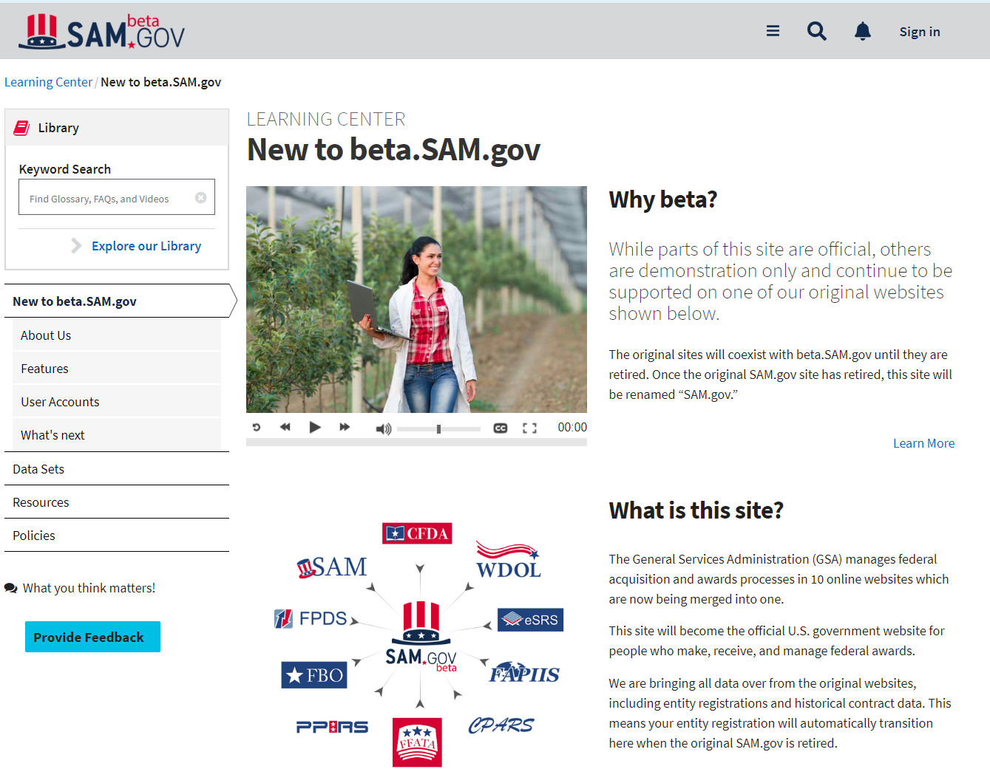
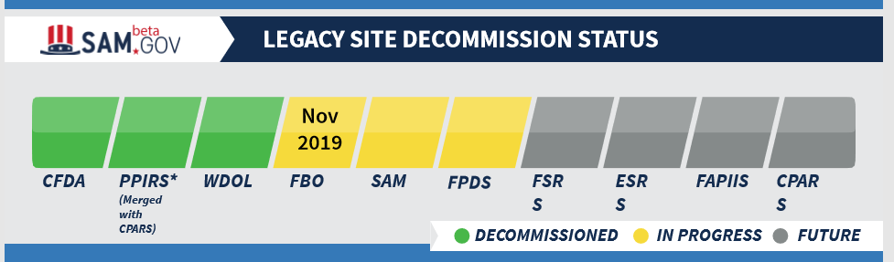
Other stuff – migration to beta.sam.gov

Slide 29
Ten databases rolled into one
Entity Information: System for Award Management (SAM.gov) – Registrations and Exclusions
Contract Opportunities: Federal Business Opportunities (fbo.gov)
Contract Data: Federal Procurement Data System (fpds.gov)
Sub-Award Data: Electronic Subcontracting Reporting System (eSRS.gov), Federal Funding Accountability and Transparency Act Subaward Reporting System (fsrs.gov)
Wage Determinations: Wage Determinations OnLine (wdol.gov)
Past Performance: Contractor Performance Assessment Reporting System (cpars.gov), Past Performance Information Retrieval System (ppirs.gov), Federal Awardee Performance and Integrity Information System (fapiis.gov)
Assistance Listings: Catalog of Federal Domestic Assistance (cfda.gov)

Slide 30
Other stuff -
Trend to multiyear contracts
  Great if you win
  If you don’t, may be several years before next opportunity
Increased importance of security – cyber, data, information (FAR / DFAR)
Back to the days of bundling – consolidation of requirements

Slide 31
Other stuff
Consider being a SUBCONTRACTOR
  Easier entry
  Less direct government burden
  Smaller, more defined work
  Large primes are required to work with small businesses
    Register as a potential sub in Prime web portals
    Meet with Prime buyers when possible
    Be aware of Prime contractor bid targets early in the process as well as their awards

Slide 32
A couple more things
Beware of consultants / services soliciting work with your business. Make sure there is value in what they are offering
Government websites will end in .mil and .gov [with very minor exception of some support work contracted to industry]
Do your homework and be aware of what is going on in the marketplace
ASK, NETWORK, LEARN, MARKET and SELL.

Slide 33
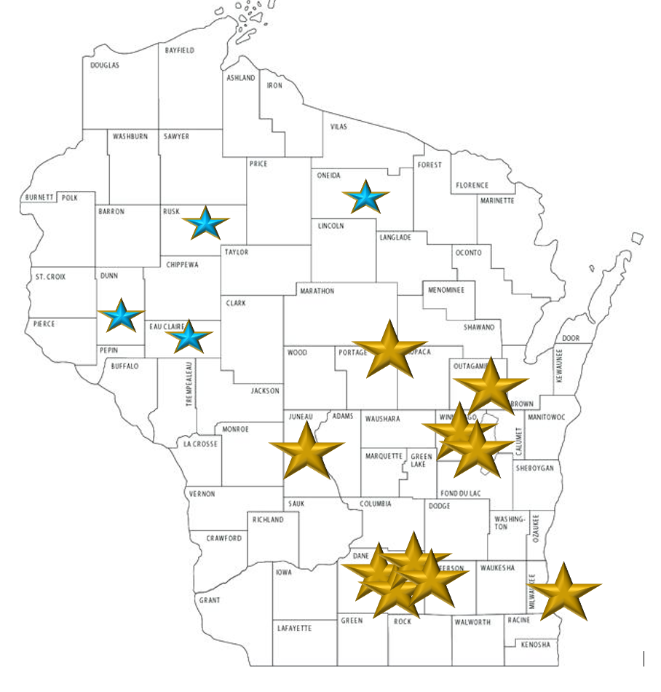
NEED HELP - contact
Kim Garber | Manager, Small Business Programs
Wisconsin Procurement Institute (WPI)
A Procurement Technical Assistance Center (PTAC)
Office: 414/270-3600 | Mobile: 608/444-0047 | Fax: 414/270-3610 | www.wispro.org
HQ – 10437 Innovation Dr., Suite 320, Milwaukee, WI 53226
Offices throughout the State of Wisconsin
AND big THANK YOU TO
Kim HoffmanN, Complete Mobile Dentistry

