Slide 1
Acquisition Hour
The Procurement Integrated Enterprise Environment (PIEE) Part 2
July 12, 2022
7/12/22

Slide 2

Webinar Etiquette
PLEASE
Log into the GoToWebinar session with the name that you registered with online
Place your phone or computer on MUTE
Use the QUESTIONS option to ask your question(s).
We will share the questions with our guest speaker who will respond to the group
THANK YOU!
7/12/22

Slide 3

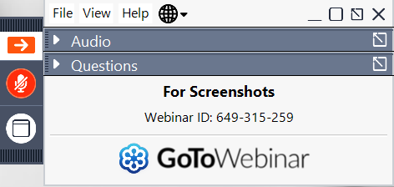
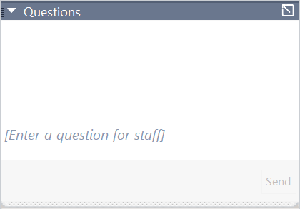
Questions?
Opening the Questions Box
Click here to access within the Control Panel
Using the Questions Box
Type questions here at any time during a presentation
Click Send when ready to submit a question
6/24/20
Page 3

Slide 4
ABOUT WPI Supporting the mission
Celebrating 35 Years of
serving Wisconsin Business!
7/12/22

Slide 5

Assist businesses in creating, developing and growing their sales, revenue and jobs through Federal, State and Local Government contracts.
INDIVIDUAL COUNSELING – At our offices, at client’s facility or via telephone/virtually
SMALL GROUP TRAINING – Workshops and webinars
CONFERENCES to include one on one or roundtable sessions
Last year WPI provided training at over 100 events and
provided service to over 1,200 companies
The Wisconsin Procurement Institute, serves as Wisconsin’s Procurement Technical Assistance Center (PTAC). This procurement technical assistance center is funded in part through a cooperative agreement with the Department of Defense. WPI is also funded in part by the Wisconsin Economic Development Corporation (WEDC). The content of any written materials or verbal communications of the PTAC does not necessarily reflect the official views of or imply endorsement by our funders.
7/12/22

Slide 6
Sign-up for our Newsletter
Stay up-to-date with the latest WPI news and events.
https://www.wispro.org/newsletter-signup/
7/12/22

Slide 7
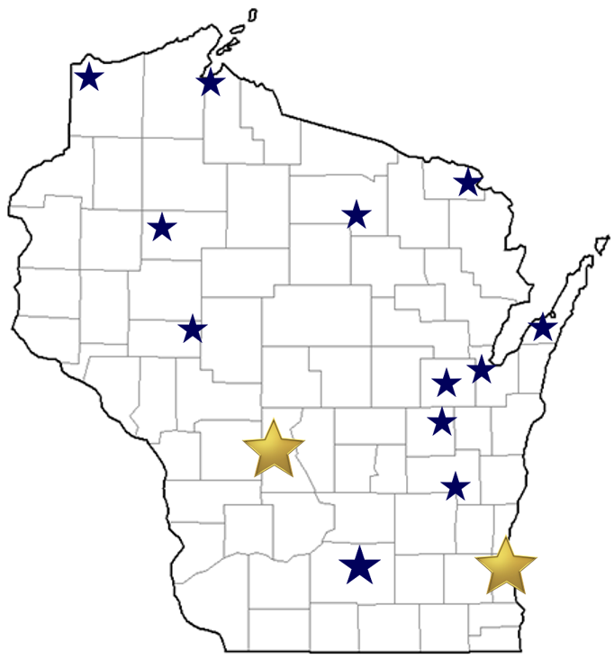
WPI Office Locations
OSHKOSH
Fox Valley Technical College
Greater Oshkosh Economic Development Corporation
EAU CLAIRE
Western Dairyland
LADYSMITH
Indianhead Community Action Agency
RHINELANDER
Nicolet Area Technical College
ASHLAND
Ashland Area Development Corporation
FLORENCE
Florence County Economic Development
DOOR COUNTY
NE WI Technical College
Door County Economic Development Corporation
SUPERIOR
Small Business Dev Center; UW Superior
MILWAUKEE
Technology Innovation Center
MADISON
FEED Kitchens
Dane County Latino Chamber of Commerce
Wisconsin Manufacturing Extension Partnership (WMEP)
Madison Area Technical College (MATC)
CAMP DOUGLAS
Juneau County Economic Development Corporation (JCEDC)
FOND DU LAC
Envision Greater Fond du Lac
GREEN BAY
NWTC Startup Hub
APPLETON
Fox Valley Technical College

Slide 8
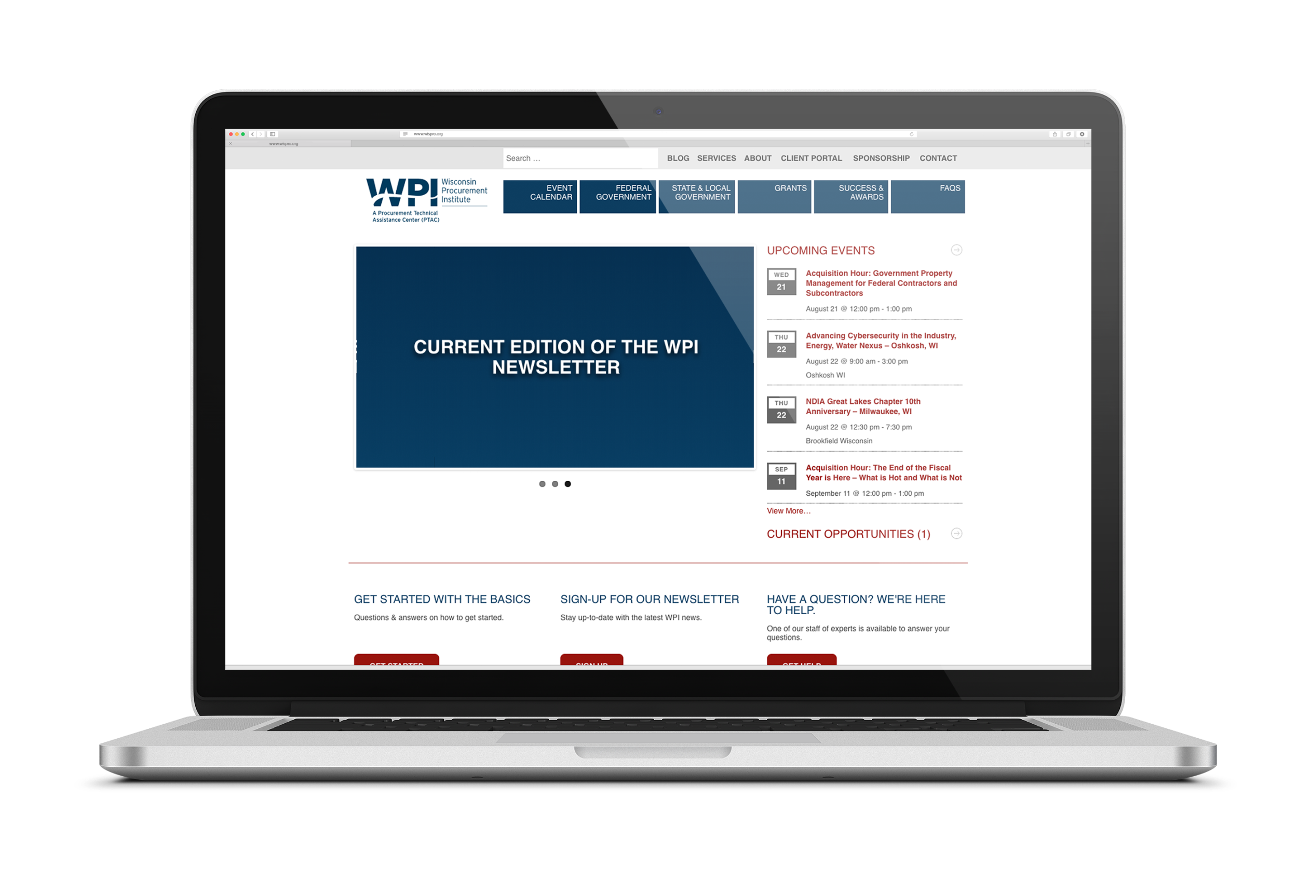
www.wispro.org
7/12/22

Slide 9
Questions?
Opening the Questions Box
Click here to access within the Control Panel
Using the Questions Box
Type questions here at any time during a presentation
Click Send when ready to submit a question
6/24/20
Page 9

Slide 10
What we will Cover Today
What is PIEE
What is WAWF
Keeping up with PIEE and WAWF
Getting Started in PIEE, the “10 step program”
Using the training site
Do and don’t do in WAWF
My Invoice

Slide 11
What is PIEE

Slide 12
What IS piee?
2003
2014
2018
WAWF
WAWF e-business suite
IRapt
PIEE e-business suite
WAWF

Slide 13
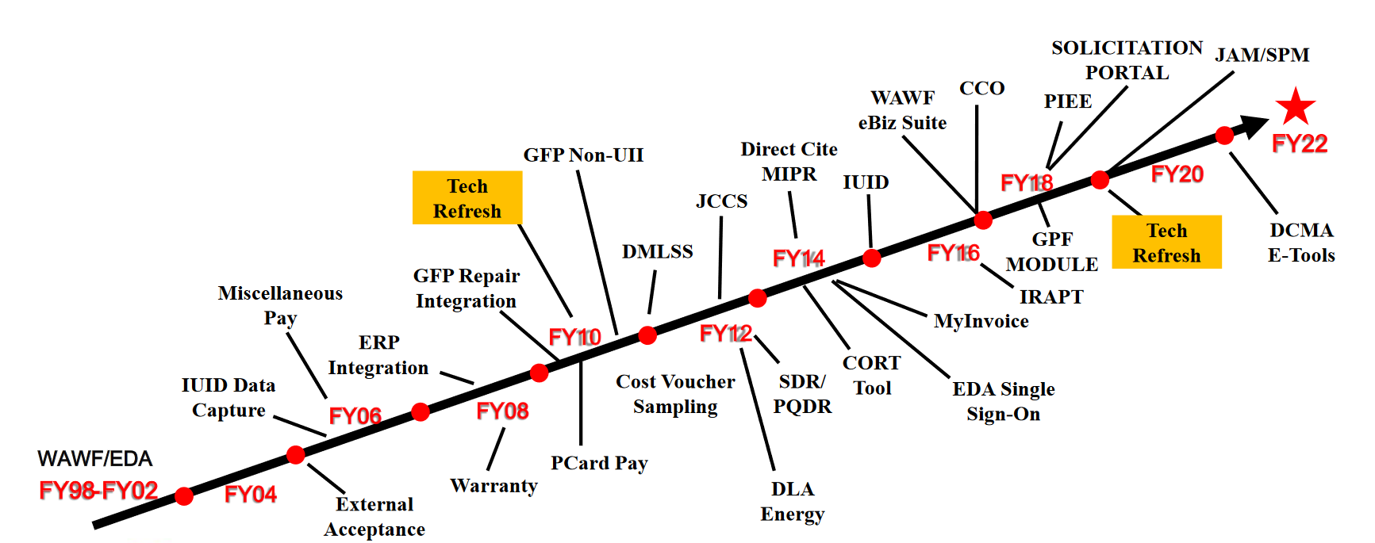
What IS piee?

Slide 14
What IS piee?
The Procurement Integrated Enterprise Environment (PIEE) is the primary enterprise procure-to-pay (P2P) application for the Department of Defense and its supporting agencies.

Slide 15
What IS piee?
The specific capabilities, formerly managed as standalone systems, include many DoD and Federal enterprise capabilities.
such as
Wide Area Workflow (WAWF),
Electronic Data Access (EDA),
Clause Logic Service (CLS),
Contracting Officer Representative Tracking (CORT) Tool,
and National Industrial Security Program (NISP) Contract Classification System (NCCS).
There are upwards of 20 unique capabilities managed under PIEE

Slide 16

What IS piee?
6.12.1 – May 2022
Release 6.13.0 Planned Deployment of July 2022, Consisting of Seven (7) ECPs

Slide 17
What IS piee?
The Procurement Integrated Enterprise Environment (PIEE) is the DoD and Federal one-stop-shop for procurement capabilities.
The PIEE is now home to Wide Area Workflow and Electronic Data Access (EDA), MyInvoice, and capabilities including:
single sign on/role-based access based on job series
pre-award, award and post-award administration
payment
property management
purchase card
contract close out

Slide 18
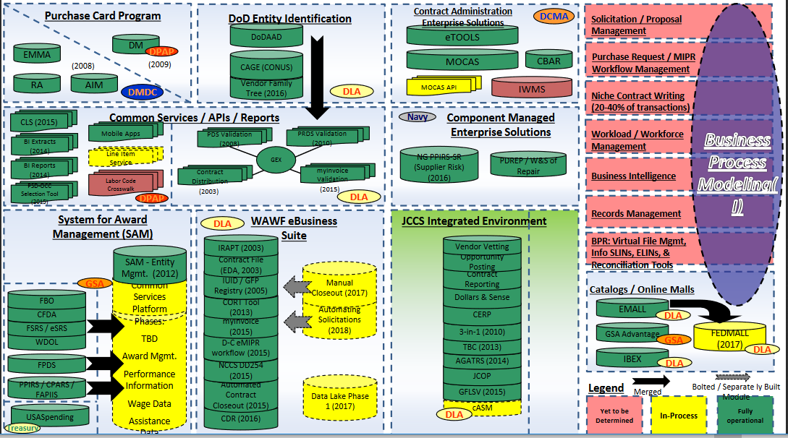
What IS piee?

Slide 19
What IS piee?
https://www.acq.osd.mil/asda/dpc/ce/cap/piee.html
PIEE Capabilities

Slide 20
CAPABILITIES
Clause Logic Service (CLS)
Contract Closeout Module (CCM)
Contract Deficiency Report (CDR)
Electronic Military Interdepartmental Purchase Request (eMIPR)
Government Furnished Property (GFP)
Item Unique Identification (IUID) Registry
Joint Appointments Module (JAM)
myInvoice
NISP Contract Classification System (NCCS)
Procurement Administrative Lead Time (PALT) Tool
Protest Tracker Tool
Procurement Process Model Library (PPML)
Purpose Code Management (PCM)
Records Retention & Destruction
Single Sign-on (SSO)
Solicitation Portal
Supplier Performance Risk System (SPRS)
Surveillance and Performance Monitoring (SPM)
Wide Area WorkFlow (WAWF) (formerly iRAPT)
Electronic Data Access (EDA)
Management Reporting System (MRS)

Slide 21
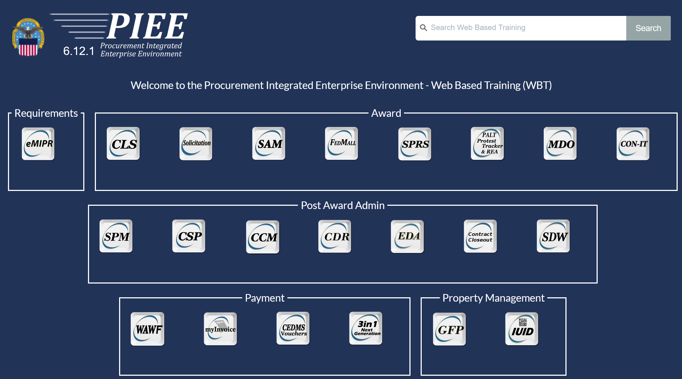
What IS piee?

Slide 22
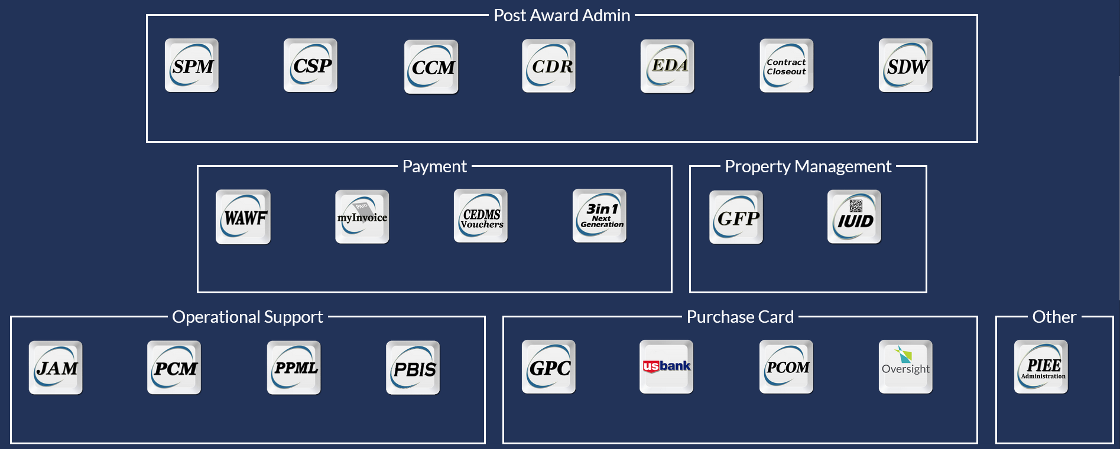
What IS piee?

Slide 23
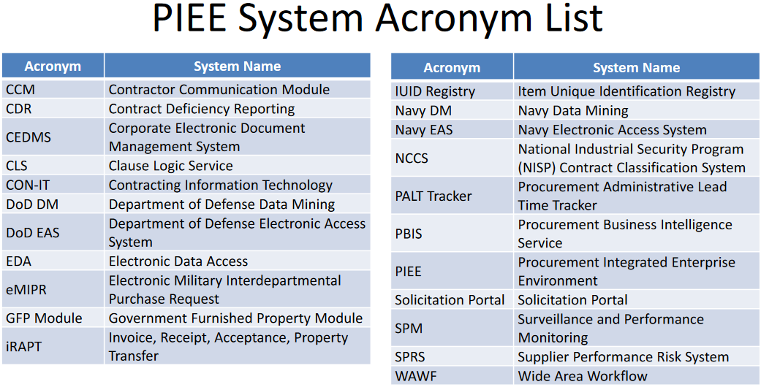
What IS piee?
https://wawftraining.eb.mil/wbt/xhtml/wbt/portal/overview/Glossary.xhtml

Slide 24
The modules
Award:
Fedmall
Solicitation
SPRS
Post Award Administrations:
CCM
CSP
EDA
Property Management
GFP
IUID

Slide 25
FEDMALL
FedMall is an eCommerce ordering system for the Department of Defense, federal, state, and authorized local agencies to search for and acquire products from government reserves and commercial sources.
https://www.dla.mil/Working-With-DLA/Applications/FedMall/

Slide 26
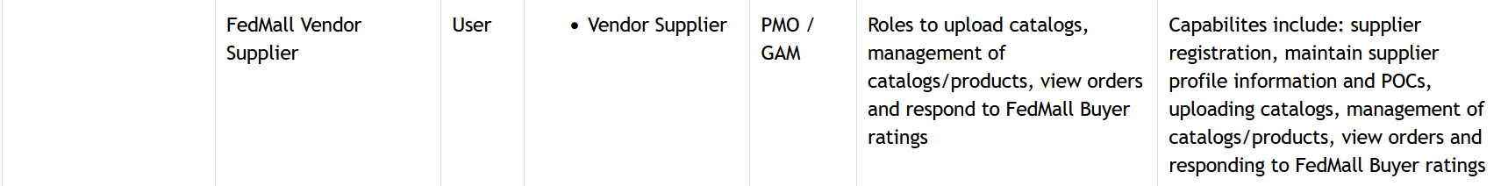
FEDMALL

Slide 27
FEDMALL
More information on FedMall: https://www.dla.mil/Working-With-DLA/Applications/FedMall/

Slide 28
solicitation
Purpose
PIEE added the Solicitation Portal Module after customers expressed a need for a more automated process to post solicitations and their attachments and capture offer responses. This tool leverages existing data standards such as PDS and GSA’s Contract Opportunity APIs to receive solicitations from the various Contract Writing Systems (CWS) used by the government and automatically share them with the Government Point of Entry (GPE) FedBizOpps (FBO). The solicitation documents and attachments are available on a public webpage for review by Industry. The public access allows the solicitations and their attachments to be viewable by all interested Industry partners in one consolidated location. A separate portal that requires a secure log in and is based on approved role is provided for collecting Industry Offer Responses, Industry Reps and Certs from SAM and granting access to those offers to the government users. This application has streamlined the government solicitation and offer response process and created an interface to retrieve representations and certifications efficiently.

Slide 29
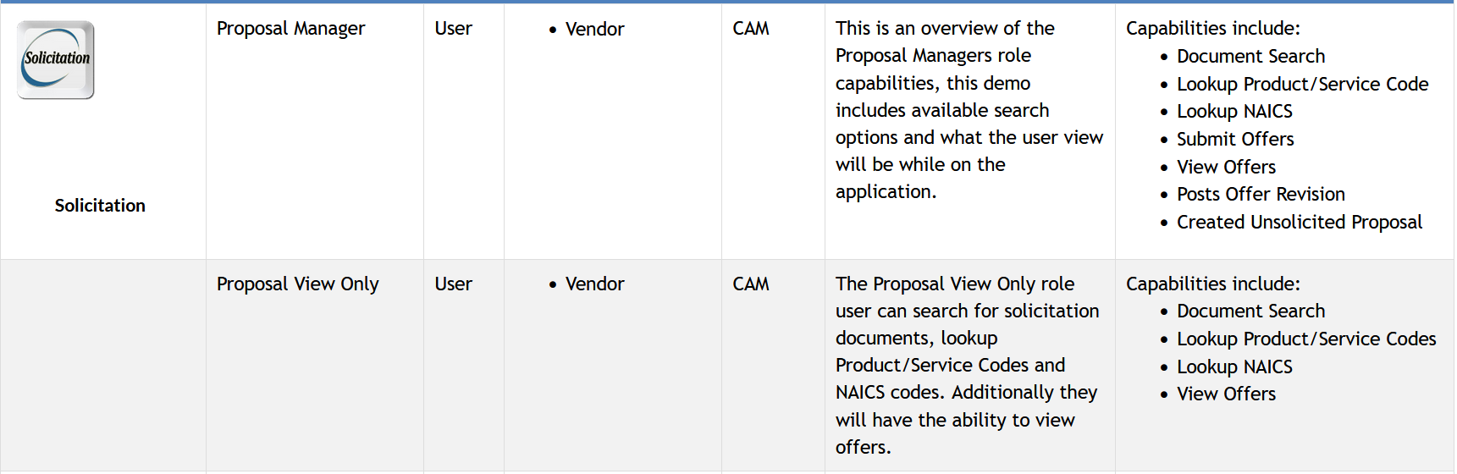
solicitation

Slide 30
sprs
SPRS is the Department of Defense’s single, authorized application to retrieve suppliers’s performance information. SPRS is web-enabled enterprise application that gathers, processes, and displays data about the performance of suppliers. The Defense Federal Acquisition Regulation Supplement (DFARS) Subpart 213.1 requires contracting officers to consider this data for supply contracts valued at less than or equal to $1 million

Slide 31
sprs
SPRS compiles supplier’s past performance data in areas of product delivery and quality to determine risks and creates a Supplier Risk Score used by procurement specialists. The quality and delivery classifications identified for a supplier in SPRS will be used by the contracting officer to evaluate a supplier’s past performance in conjunction with the supplier’s references (if requested) and other provisions of the solicitation under the past performance evaluation factor.

Slide 32
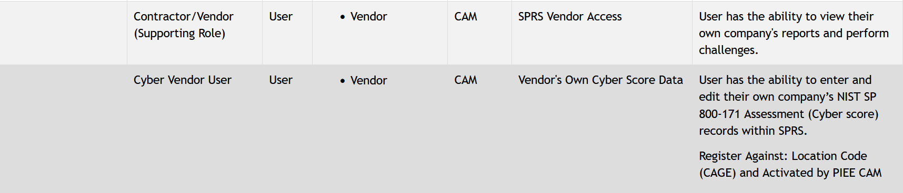
sprs

Slide 33
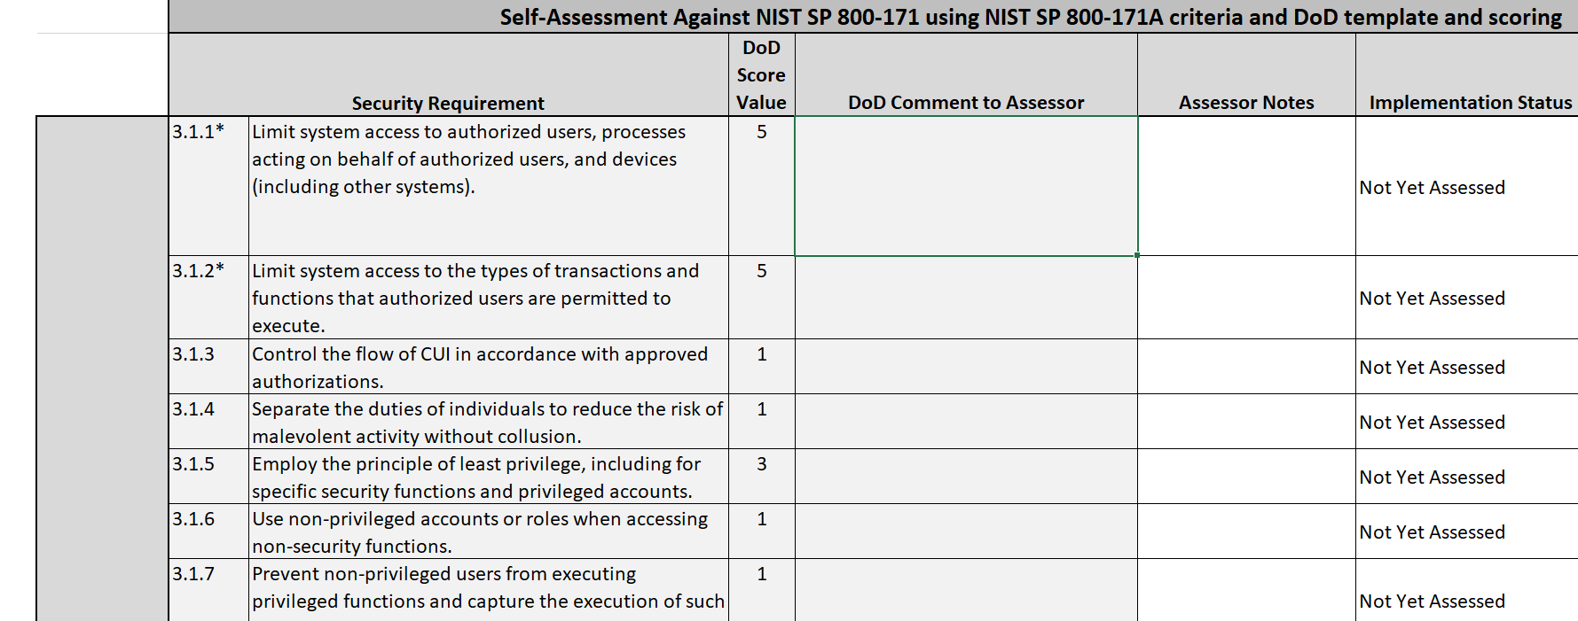
sprs

Slide 34
sprs
Training and information on SPSR:
https://www.sprs.csd.disa.mil/webtrain.htm

Slide 35
CCM
The Contracting Communication Module
The Contracting Communication Module (CCM) application provides users with a secure repository to save and share their attachments and two-way communications.
Even though these communications and attachments reside within the CCM application, users never feel disconnected due to constant and dependable email notifications. Every document is protected within this module including those at rest and in transit.

Slide 36
CCM
The CCM will be automatically available if the user has one of the following roles:
WAWF Admin By View Only
WAWF Acceptor
WAWF Vendor
SPM COR
SPM Contracting Officer
SPM Contracting Specialist

Slide 37
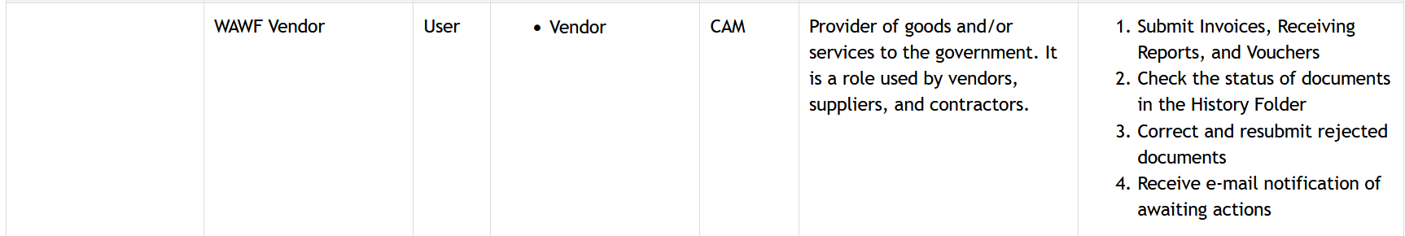
CCM
The CCM will be automatically available if the user has one of the following roles:

Slide 38
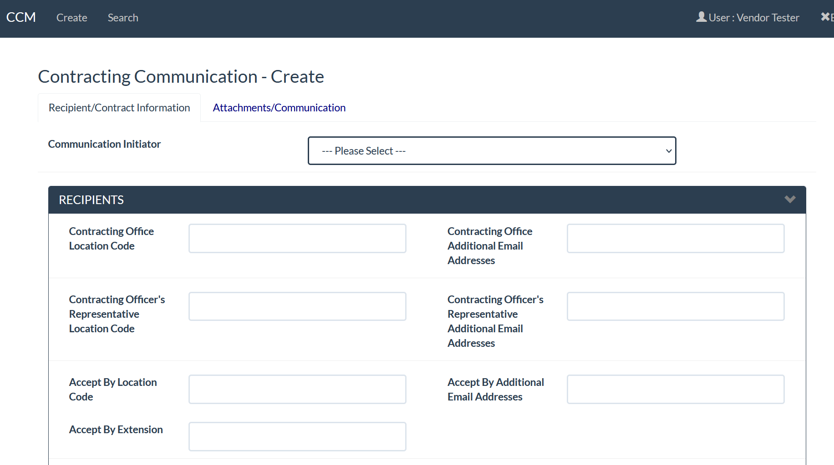
CCM

Slide 39
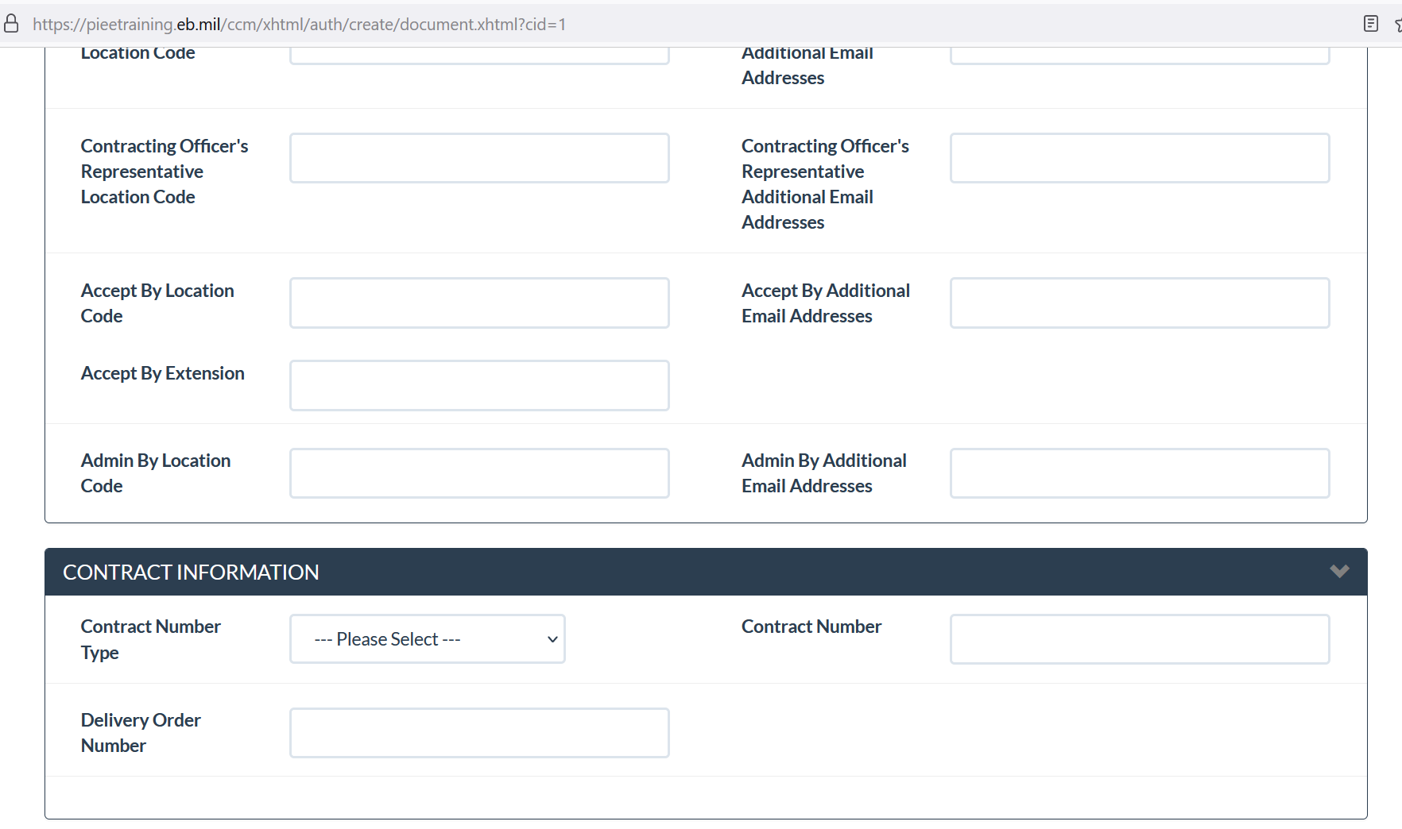
CCM

Slide 40
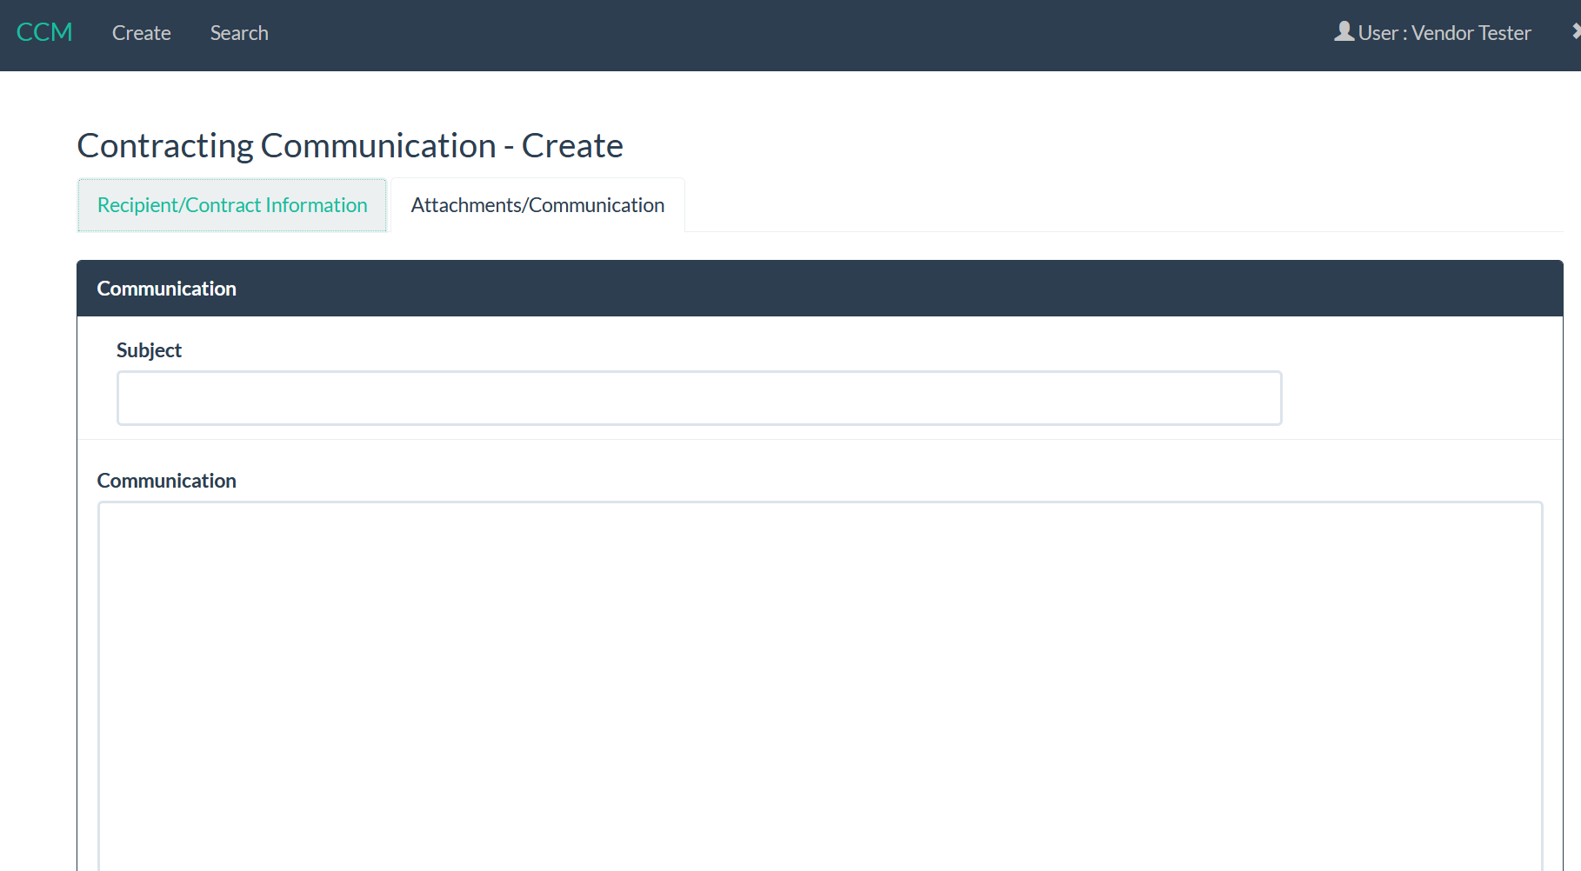
CCM

Slide 41
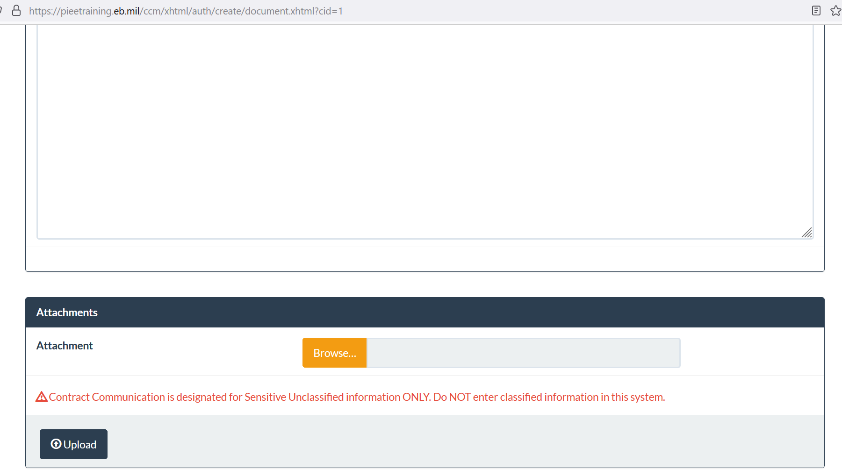
CCM

Slide 42
Csp
The Defense Contract Audit Agency (DCAA) is developing a Contractor Submission Portal (CSP) to streamline receipt of contractors’ cost proposals that are submitted in accordance with the Federal Acquisition Regulation Allowable Cost and Payment Clause (FAR 52.216-7(d)(2)).

Slide 43
Csp
PIEE provides a Single Sign On (SSO) capability for CSP. PIEE users with the Vendor role Vendor Contributor will have access to CSP and will have user registration and account management capabilities, this module will follow the PIEE Procurement/Finance/Logistics group structure. Additionally, the PIEE Super Admin or WAWF PMO will have the ability to turn on/off the CSP interface without a code change via System Properties. The Contractor Administrator will have access to the PIEE Administration console for user/role management.

Slide 44
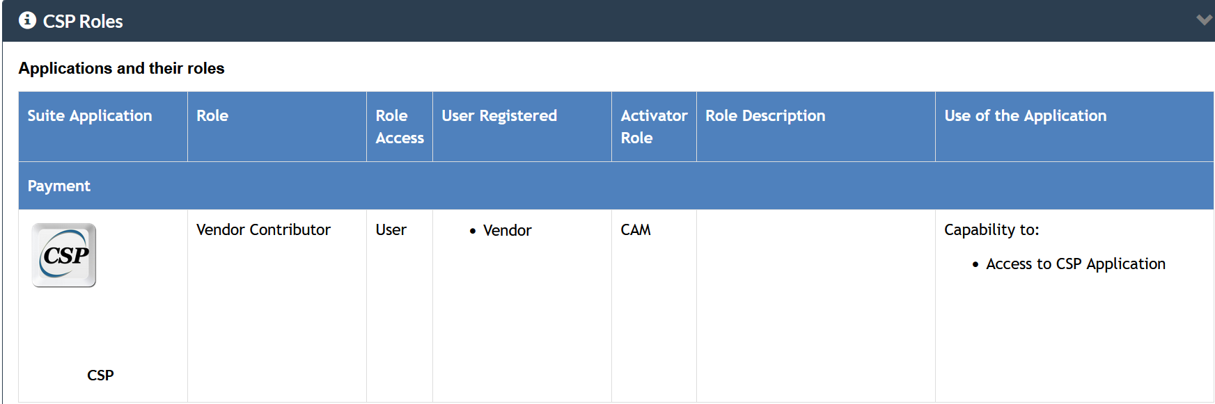
Csp

Slide 45
EDA
The Electronic Data Access (EDA) program is one of the Defense Logistics Agency (DLA) Sourcing Environment programs. EDA supports the goals of the DLA to simplify and standardize the methods that DoD uses to interact with commercial and government suppliers in the acquisition of catalog, stock, as well as made-to-order and engineer-to-order goods and services initiatives to increase the application of Electronic Business/Electronic Commerce (EB/EC) across the Department of Defense (DoD). The EDA is a web-based system that provides secure online access, storage, and retrieval of Contracts, Contract modifications, Government Bills of Lading (GBLs), and Contract Deficiency Reports to authorized users throughout the DoD.

Slide 46
EDA
EDA Vendor User Role
Vendor
When a vendor registers for access to WAWF, they are automatically registered for a vendor role in EDA for EDA access.
EDA provides view-only capability of contract documents that match the validated DUNS or CAGE codes that the vendor is registered for.
EDA offers Electronic search and retrieval - 24/7 access/retrieval capability

Slide 47
EDA
Dashboard
https://pieetraining.eb.mil/wbt/xhtml/wbt/eda/overview/dashboard.xhtml

Slide 48
EDA
Closeout search
https://pieetraining.eb.mil/wbt/xhtml/wbt/eda/searches/contractCloseoutSearch.xhtml

Slide 49
GFP
The GFP application in PIEE allows users to create and manage GFP Attachments and GFP Property Transfer Documents. GFP Attachments are created to track all items that belong to that Contract. Property Transfer Documents are created to track Government Property. "Government property” means all property owned or leased by the Government. Government property includes both Government-furnished property and contractor-acquired property. Government property includes material, equipment, special tooling, special test equipment, and real property.

Slide 50
GFP
The GFP application will allow for the creation of a GFP Attachment. There are four types of GFP Attachments: Contract Award, Contract Modification, Solicitation, and Solicitation Amendment.

Slide 51
GFP
Property Transfer
Purpose
The GFP Application allows the creation of Property Transfer documents. "Property in the possession of, or directly acquired by, the Government and subsequently furnished to the contractor for performance of a contract. Government furnished property includes, but is not limited to, spares and property furnished for repairs, maintenance, overhaul, or modification. Government furnished property also includes contractor acquired property if the contractor acquired property is a deliverable under a cost contract when accepted by the Government for continued use under the contract." Reference: Federal Acquisition Regulation Part 45.101

Slide 52
GFP
Property Loss
Purpose
The GFP Module will allow the creation of Property Loss Cases to report the details of GFP leaving the DoD Inventory due to Property Loss. The Mission of the GFP Module is to centralize information about GFP over its lifecycle, including events that cause them to leave the DoD’s inventory/accountability.

Slide 53
GFP
Contractor Acquired Property
Purpose
The GFP Module will allow the creation of Contractor Acquired Property Pre-screening documents by a Vendor Contractor Property Manager to be sent to the Government for determination of inventory scheduling. The mission of the GFP Module is to centralize information about GFP over the lifecycle including events that cause them to leave DoD inventory/accountability.

Slide 54
GFP
Plant Clearance
Purpose
Plant Clearance allows acquiring agencies to view excess property, create requisitions, and see the status of current requisitions. Contractors with the role Contractor Property Manager will be able to create and submit Plant Clearance Inventory Schedule documents in GFP. The submitted Plant Clearance Inventory Schedule documents will be reviewed and accepted by Plant Clearance Officers (PLCO) or Support Plant Clearance Officers (Support PLCO).
After a PLCO or a Support PLCO has accepted an Inventory Schedule document, a PLCO will be able to create a Case document from the Inventory schedule and apply screener rules to the line items. Screener Rules dictate how long and who may view the line items that have been submitted on an accepted Inventory Schedule that is established to a Plant Clearance case. Those with a DoD Screener role may view items within the module that are marked as Standard Screening or Special Screening. Standard Screening is available for 20 days, after that the items are sent to GSA for days 21-46. Special Screening is available for 20 days. If items are marked as GSA Screening only, they are sent directly to GSA and can't be screened in the module. There is also an option for the screener rules to skip the screening process.
Once Cases have been established from the Plant Clearance Inventory Schedules PLCOs and DoD Screeners may create a Transfer Request from the line items to be reviewed by a PLCO. A PLCO will review the Transfer Requests and Accept or Reject the requests.

Slide 55
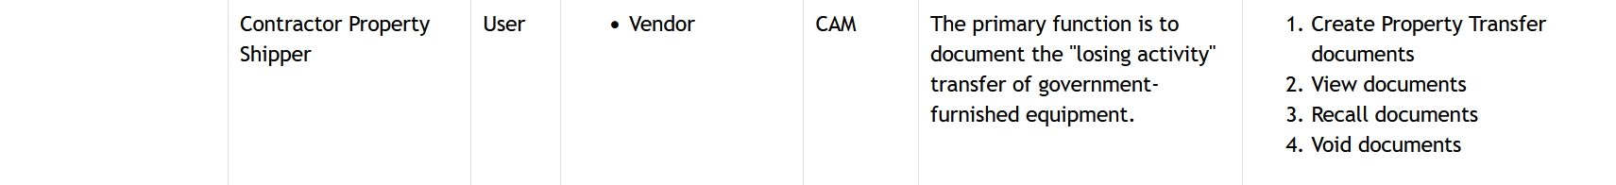
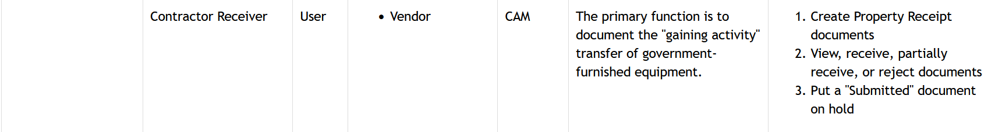
GFP
Vendor users

Slide 56
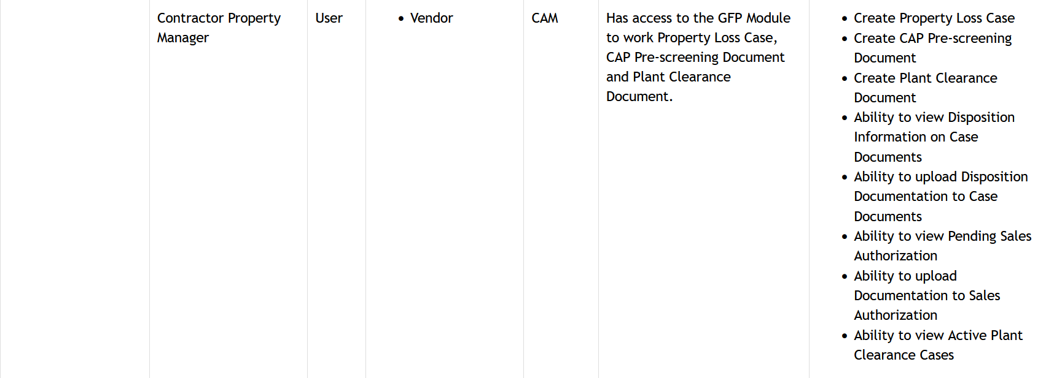
GFP
Vendor users

Slide 57
IUID
Purpose
Item Unique Identification (formerly Unique Item Identification - UID) is the system of marking and valuing tangible property furnished by the DoD and making the item information available in support of DoD logistics and contracting. The DoD can track the tangible item in maintenance, repair, and/or supply. For small business and commercial items, the expectation is that the items will be marked concurrent with delivery. The policies, standards, and procedures of this system are managed by the UID Program Office.

Slide 58
IUID
Background
Unique Identification (UID) is an essential program for the war fighter and for you. It supports DoD operational readiness and benefits your business. DFARS 211.274-1 - General mandates Item Unique Identification (IUID) and valuation as a system of marking and valuing items delivered to DoD that enhances logistics, contracting, and financial business transactions supporting the United States and coalition troops.
What requires an IUID?
Contracts require DoD recognized unique identification (UID) for all property items delivered to the Government if any one of the following conditions is met:
The acquisition cost (unit cost) is $5000 or more
It is either a serially managed item, a mission essential item, a controlled inventory piece of equipment, a reparable item, or a consumable item
It is a component of a delivered item
The program manager has determined that UID is required

Slide 59
IUID
IUID Registry Responsibility
Your job is to ensure the visibility of government furnished property by submitting the Unique Item Identifier (UII) data elements to the IUID Registry. The IUID Registry is a database operated by the Defense Logistics Information Service. It collects Government Furnished Property IUID information and distributes it to authorized Registry users. You submit the UII data elements to the IUID Registry during the process of creating a Receiving Report (DD250), Reparables Receiving Report, Combo, or GFP Transfer/Receipt using PIEE.

Slide 60
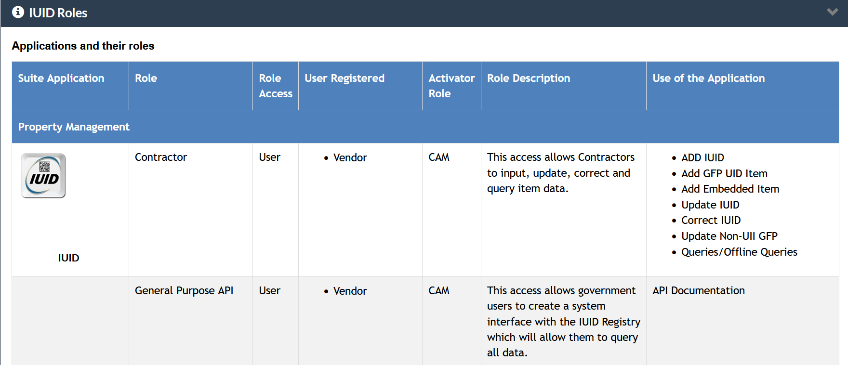
IUID
User

Slide 61
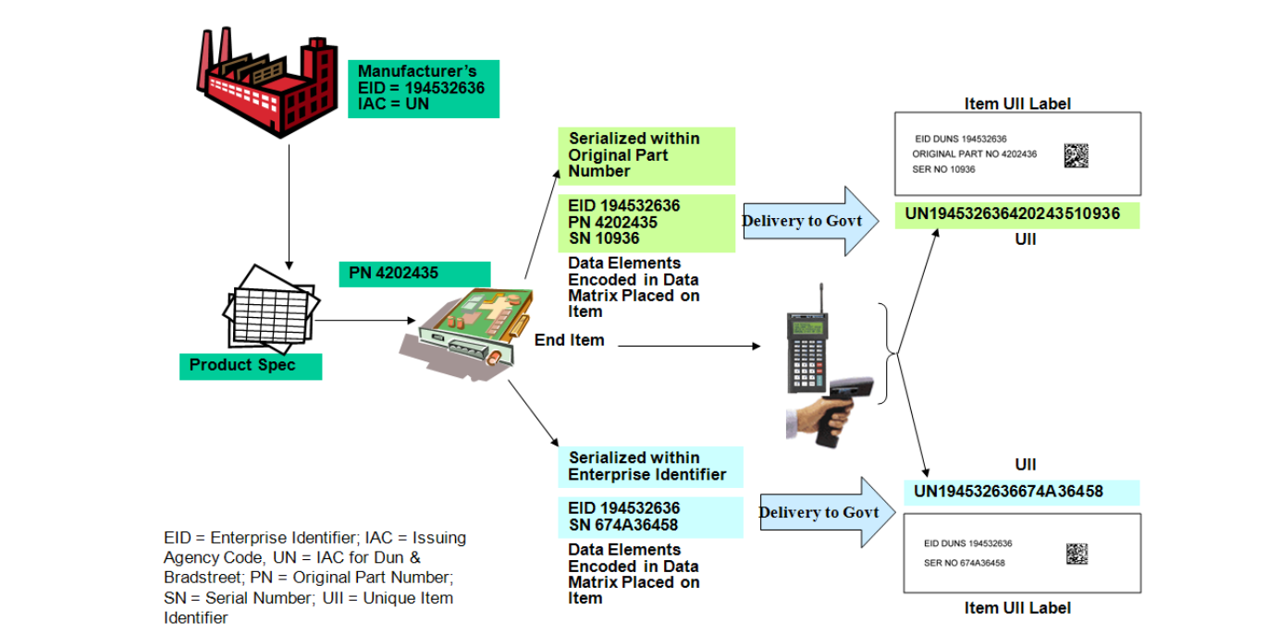
IUID
https://dodprocurementtoolbox.com/site-pages/unique-id-tools
UII Determination process

Slide 62
Adding a role in piee
Every Vendor must register in the Procurement Integrated Enterprise Environment for the specific applications they wish to use.
Note: When registering for the WAWF application, will give the vendor automatic access to the myInvoice application.
To use an application in the Procurement Integrated Enterprise Environment system, you must establish a personal account in the system.
This account is activated by your Government Administrator or the Procurement Integrated Enterprise Environment Customer Support Center.
You will need to take several steps to establish your personal account:
On the PIEE Home Page, click the Help/Training button in the upper right hand corner for steps needed to complete before registering.
Complete your Vendor activation requirements (See Vendors Getting Started section on the Help/Training page).
Set up your PC to use the applications (See Machine Setup link on the Help/Training page).
Self-register as "Vendor" or your Contractor role for your CAGE codes (See the demo below for help with Self Registration).
Have your GAM activate your account.

Slide 63
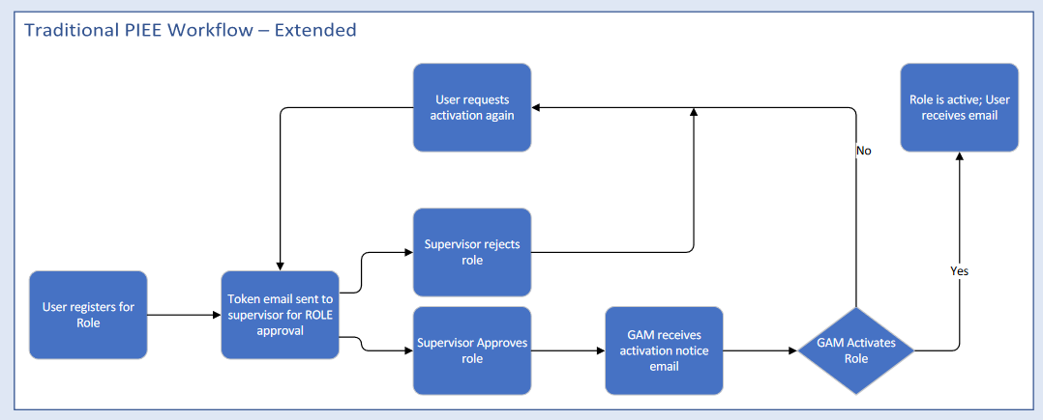
Adding a role in piee
https://pieetraining.eb.mil/wbt/xhtml/wbt/portal/overview/vendorRegister.xhtml

Slide 64
Keeping up with PIEE AND wawf

Slide 65
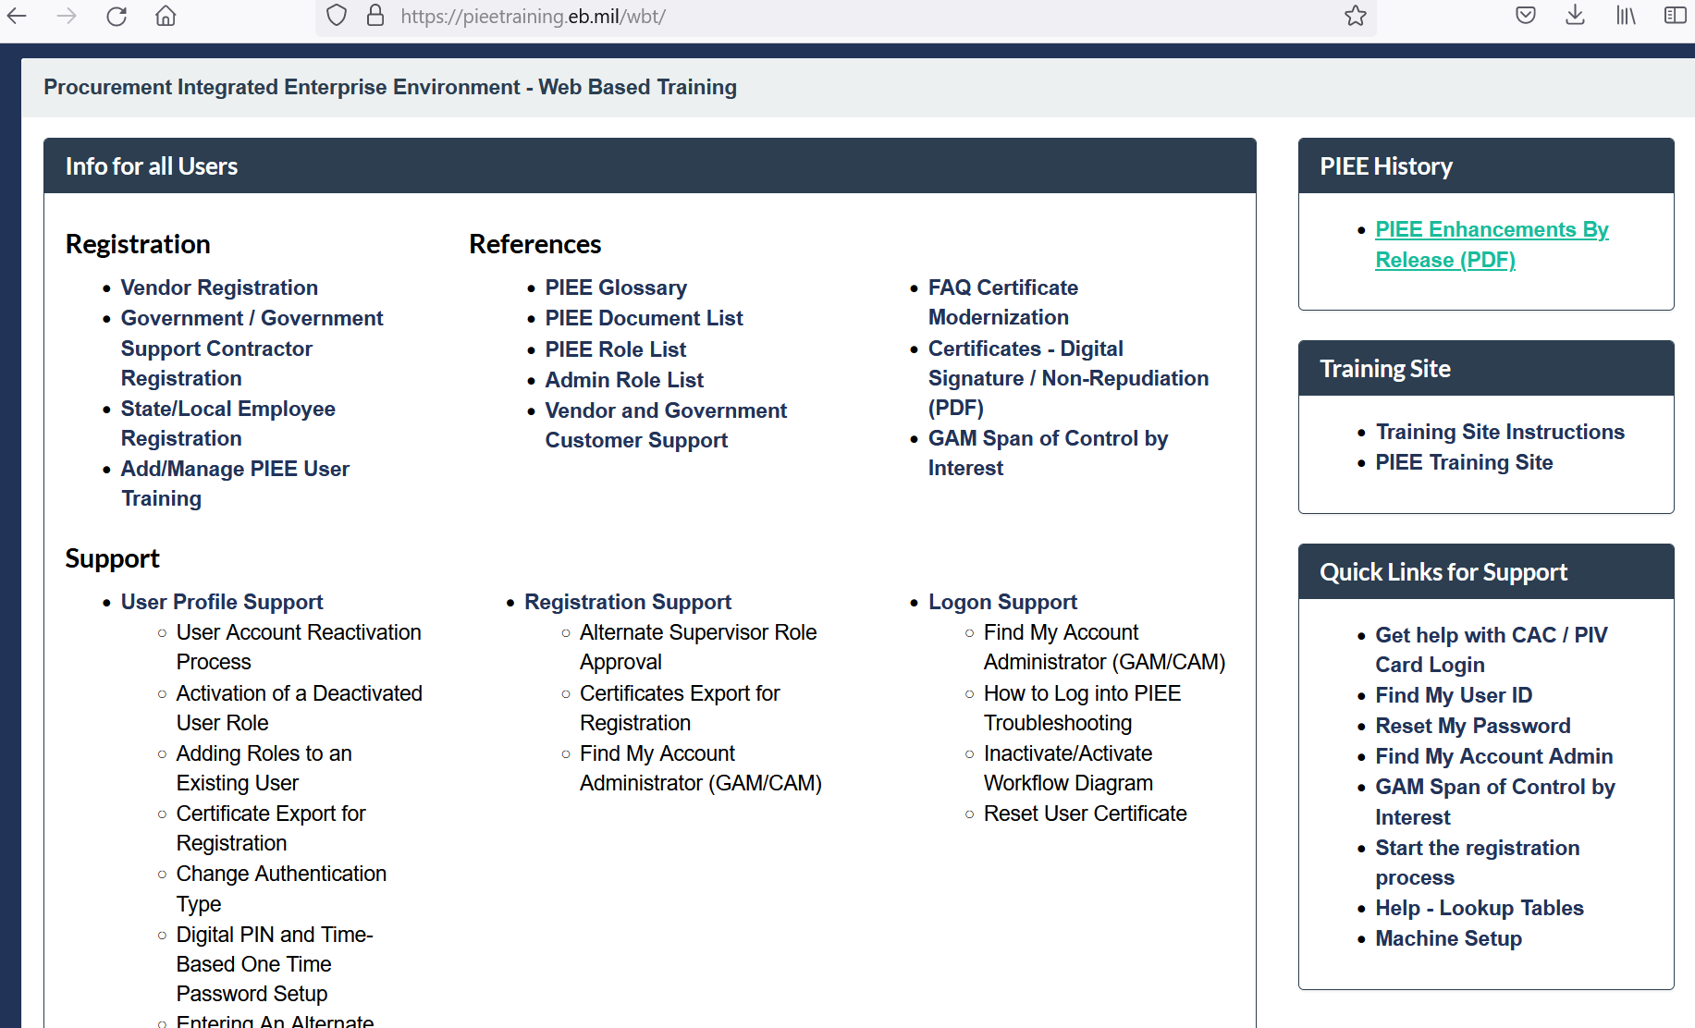
Updates are found under:
https://pieetraining.eb.mil/wbt/

Slide 66
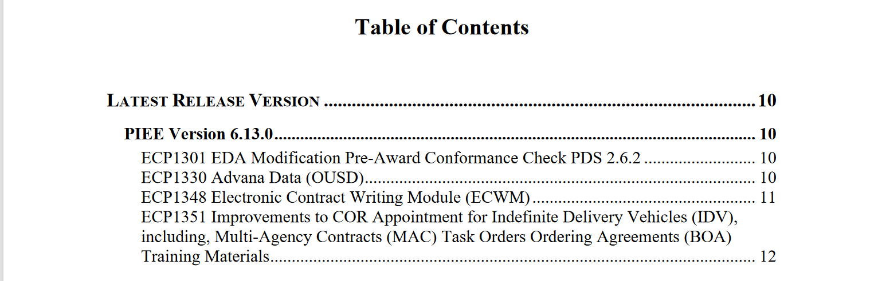
What IS NEW?

Slide 67
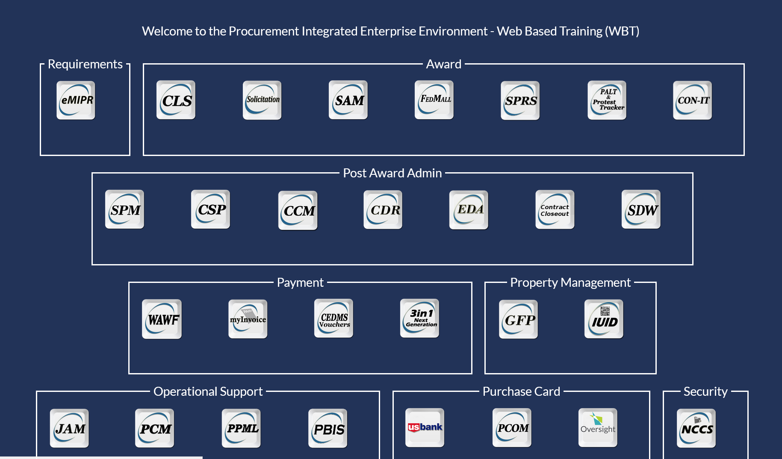
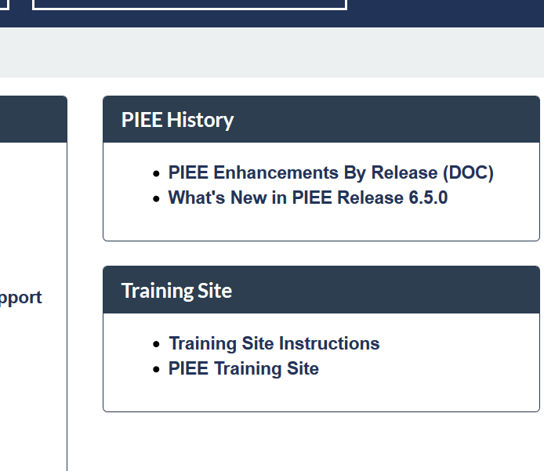
Updates CAN BE FOUND UNDER THE TRAINING SITE AS WELL

Slide 68
CUSTOMER SUPPORT

Slide 69
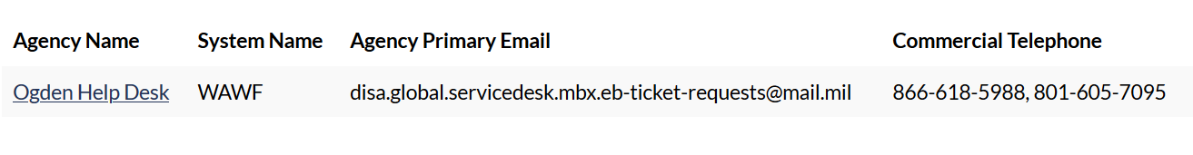
PIEE customer sUPPORT

Slide 70
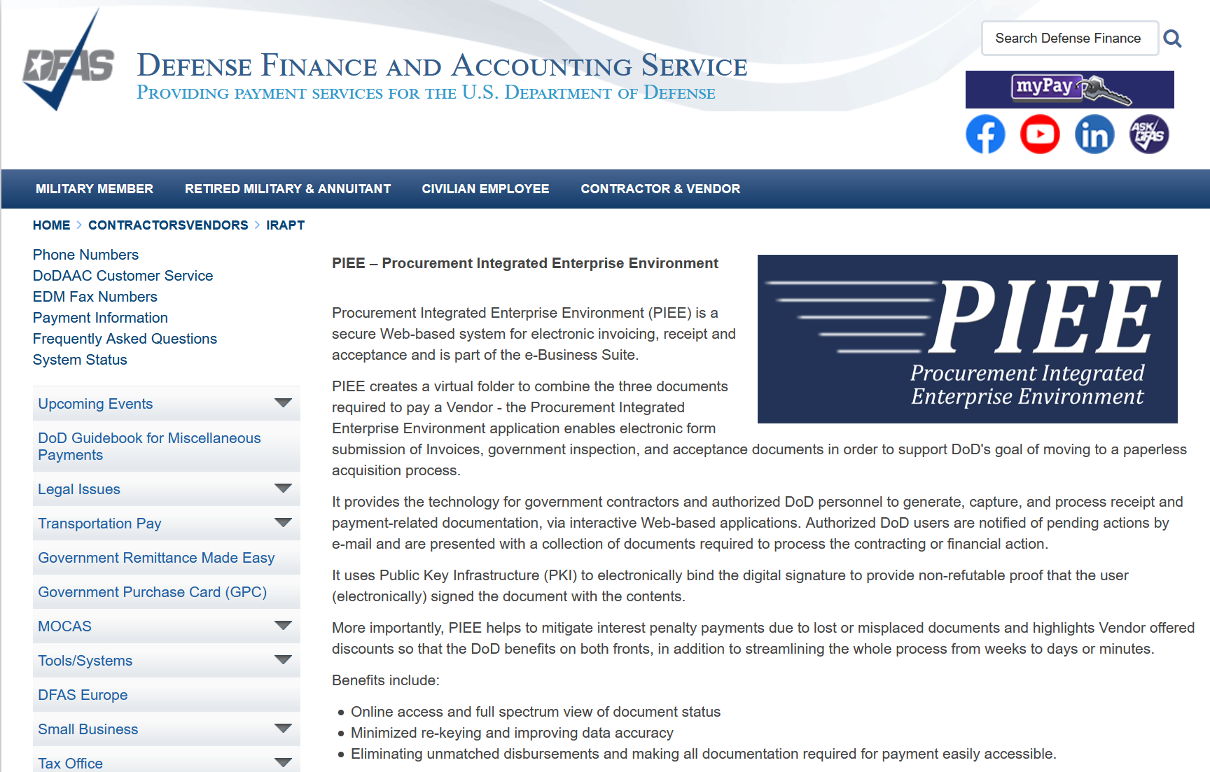
Dfas customer support
https://www.dfas.mil/contractorsvendors/irapt/

Slide 71
UPCOMING TRAINING - EVENTS
5/19/21

Slide 72

Introducing Cybersecurity Series with American Family Insurance, WBDC and WPI
July 27
This is a series presented by American Family Insurance in partnership with the Women’s Business Development Center (WBDC) and Wisconsin Procurement Institute (WPI).
Guest Speaker: Andy Fiumefreddo is IT Security & Risk Manager – Consulting, Assessments, & Third-Party with American Family Insurance.
Registration now open at
www.wispro.org/events
7/12/22

Slide 73

July 13-14
The 16th Annual GOBC will take place live and in-person at
Volk Field Air National Guard Base in Camp Douglas, WI.
Day 1: Grants and Funding
Day 2: Selling to the Government and Corporations
Registration now open at
www.wigobc.org
7/12/22

Slide 74
ACQUISITION HOUR LIVE WEBINAR SERIES
July 12, 2022
The Procurement Integrated Enterprise Environment (PIEE) and Wide Area Workflow (WAWF) CLICK HERE for additional information Presented by Benjamin Blanc, Wisconsin Procurement Institute
August 9, 2022
The Federal Spend to the End
CLICK HERE for additional information Presented by Marc Violante, Wisconsin Procurement Institute
August 16, 2022
Preparing a Winning Government Proposal
CLICK HERE for additional information Presented by Carol Murphy, Wisconsin Procurement Institute
August 23, 2022
Disaster Contracting
CLICK HERE for additional information Presented by Marc Violante, Wisconsin Procurement Institute
…More at wispro.org/events
7/12/22

Slide 75
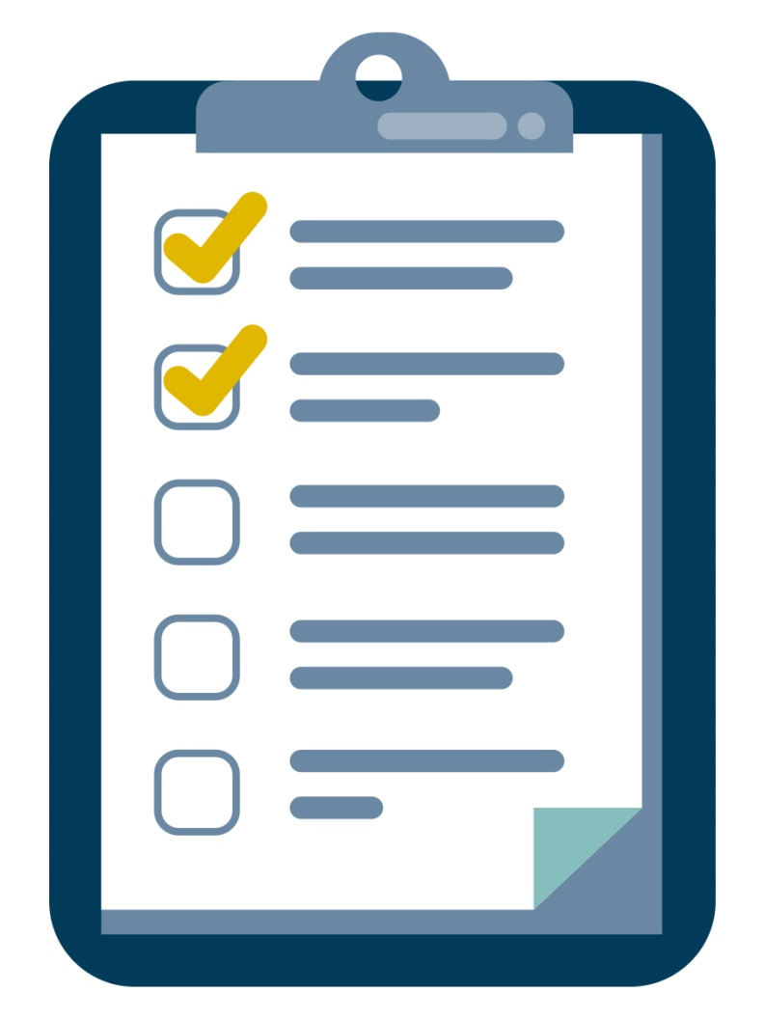
SURVEY
7/12/22

Slide 76

CONTINUING PROFESSIONAL EDUCATION
CPE Certificate available, please contact:
Benjamin Blanc
benjaminb@wispro.org
7/12/22

Slide 77
Presented By Wisconsin Procurement Institute (WPI) www.wispro.org
Benjamin Blanc
Wisconsin Procurement Institute
benjaminb@wispro.org | 414-270-3600
10437 Innovation Drive, Suite 320 Milwaukee, WI 53226
7/12/22

