Slide 1
Acquisition Hour
Government Property Management for Federal Contractors and Subcontractors
September 21, 2022
7/21/21

Slide 2

Webinar Etiquette
PLEASE
Log into the GoToWebinar session with the name that you registered with online
Place your phone or computer on MUTE
Use the QUESTIONS option to ask your question(s).
We will share the questions with our guest speaker who will respond to the group
THANK YOU!
7/21/21

Slide 3

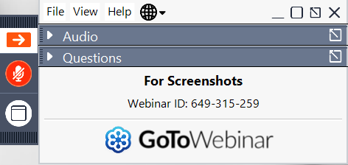
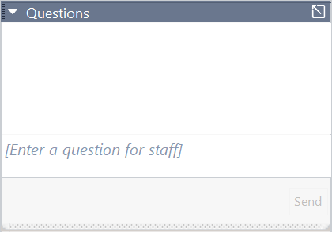
Questions?
Opening the Questions Box
Click here to access within the Control Panel
Using the Questions Box
Type questions here at any time during a presentation
Click Send when ready to submit a question
6/24/20
Page 3

Slide 4
ABOUT WPI Supporting the mission
Celebrating 34 Years of
serving Wisconsin Business!
7/21/21

Slide 5

Assist businesses in creating, developing and growing their sales, revenue and jobs through Federal, State and Local Government contracts.
INDIVIDUAL COUNSELING – At our offices, at client’s facility or via telephone/GoToMeeting
SMALL GROUP TRAINING – Workshops and webinars
CONFERENCES to include one on one or roundtable sessions
Last year WPI provided training at over 100 events and
provided service to over 1,200 companies
WPI is a Procurement Technical Assistance Center (PTAC) funded in part by the Defense Logistics Agency (DLA), WEDC and other funding sources.
7/21/21

Slide 6
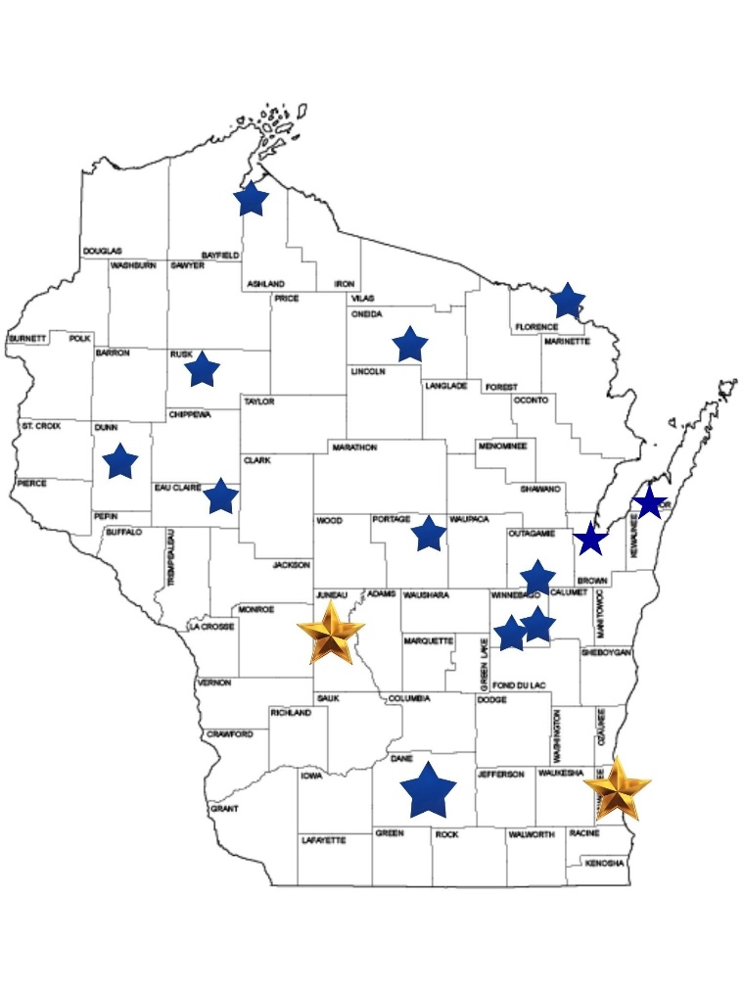
WPI Office Locations
MILWAUKEE
Technology Innovation Center
MADISON
FEED Kitchens
Dane County Latino Chamber of Commerce
Wisconsin Manufacturing Extension Partnership (WMEP)
Madison Area Technical College (MATC)
CAMP DOUGLAS
Juneau County Economic Development Corporation (JCEDC)
STEVENS POINT
IDEA Center
APPLETON
Fox Valley Technical College
SUPERIOR
Small Business Dev Center; UW Superior
OSHKOSH
Fox Valley Technical College
Greater Oshkosh Economic Development Corporation
EAU CLAIRE
Western Dairyland
MENOMONIE
Dunn County Economic Development Corporation
LADYSMITH
Indianhead Community Action Agency
RHINELANDER
Nicolet Area Technical College
ASHLAND
Ashland Area Development Corporation
FLORENCE
Florence County Economic Development
DOOR COUNTY
NE WI Technical College
Door County Economic Development Corporation
7/21/21

Slide 7
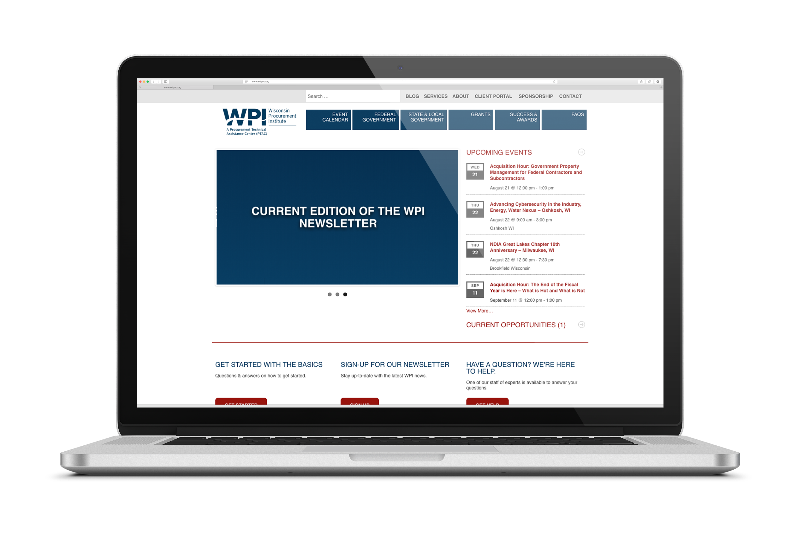

www.wispro.org
7/21/21

Slide 8
What we will learn today

Slide 9
What we will Cover Today
Definitions of Government Property
The FAR Clauses and the FAR supplements
The Property Management System
Subcontractors – what to know

Slide 10
Definitions of Government Property

Slide 11
The definitions of government property (GP)
“Government property” means all property owned or leased by the Government. Government property includes both Government-furnished property and contractor-acquired property. Government property includes material, equipment, special tooling, special test equipment, and real property. Government property does not include intellectual property and software.
FAR45.101

Slide 12
The definitions of government property (GP)
Types of GP
Equipment
Material
Special Tooling
Special Test Equipment
Real Property

Slide 13
The definitions of government property (GP)
FAR
45.101
Government Property
Government Furnished Property
Contractor Acquired Property

Slide 14
The Government Furnished Property
Government Furnished Property (GFP) “Government-furnished property” means property in the possession of, or directly acquired by, the Government and subsequently furnished to the contractor for performance of a contract. Government-furnished property includes, but is not limited to, spares and property furnished for repair, maintenance, overhaul, or modification.
Government-furnished property also includes contractor-acquired property if the contractor-acquired property is a deliverable under a cost contract when accepted by the Government for continued use under the contract.

Slide 15
The Government Furnished Property
Title to GFP ALWAYS Vests in the Government
FAR 45.401
FAR 52.245-1

Slide 16
Contractor Acquired Property
Contractor Acquired Property (CAP) “means property acquired or otherwise provided by the contractor for performing a contract and to which the government has title”.

Slide 17
Contractor Acquired Property
Title for CAP… IT DEPENDS!
FIXED PRICE CONTRACTS (45.402)
ONLY THE DELIVERY END ITEM
COST REIMBURSMENT CONTRACTS (52.245-1(e) )
Government has TITLE to ALL property the contractor acquires IF:
It is
Reasonable
Allowable
Allocable
It is charged as a Direct Item of cost
In accordance with the contractor’s disclosure statement
See 52.216-7 and Subpart 31.2

Slide 18
The FAR Clauses and the FAR supplements

Slide 19
Regulatory Landscape
Federal Acquisition Regulation
Part 45-Government’s Policy
52.245-1 Government Property and its alternates I & II (last modified Jan 2017)
52.245-2 Government Property Installation Operation Services (April 2012)
52.245-9 Use and Charges (April 2012)

Slide 20
52.245-1
(a) Definitions
(b) Property Management
(c) Use of Government Property
(d) Government-furnished Property
(e) Title to Government Property
(f) Contractor Plans and Systems
(g) System Analysis
(h) Contractor Liability for Government Property
(i) Equitable Adjustment
(j) Contractor Inventory Disposal
(k) Abandonment of Government Property
(l) Communications
(m) Contracts Outside The United States

Slide 21
52.245-1
Christian doctrine:
the Christian doctrine permits the incorporation by operation of law of mandatory contract clauses which express a significant or deeply ingrained strand of public procurement policy
52.245-1 Mandatory or not Mandatory?
In solicitation and contract for all cost type, T&M, and in labor hour and fixed-price when the Government will provide property*
*for more info see: https://cdn.ymaws.com/www.npma.org/resource/dynamic/forums/20210207_213311_20104.pdf

Slide 22
52.245-1 Alt I
Substitute the following to (h) (1)
(h)(1) The Contractor assumes the risk of, and shall be responsible for, any loss of Government property upon its delivery to the Contractor as Government-furnished property. However, the Contractor is not responsible for reasonable wear and tear to Government property or for Government property properly consumed in performing this contract.
Used ONLY with FIXED PRICE contracts that DO NOT require the submission of certified cost and pricing data

Slide 23
52.245-1 Alt II
Substitute (e) (3): Title under Cost-Reimbursement or Time-and-Material Contracts or Cost-Reimbursable contract line items under Fixed-Price contracts.
(i) Title to all property purchased by the Contractor for which the Contractor is entitled to be reimbursed as a direct item of cost under this contract shall pass to and vest in the Government upon the vendor's delivery of such property. (…)
For
(e)(3) Title to property (and other tangible personal property) purchased with funds available for research and having a unit acquisition cost of less than $5,000 shall vest in the Contractor upon acquisition or as soon thereafter as feasible; provided that the Contractor obtained the Contracting Officer's approval before each acquisition. Title to property purchased with funds available for research and having a unit acquisition cost of $5,000 or more shall vest as set forth in this contract. (…)

Slide 24
52.245-1 Alt II
Alternate II to the Government Property clause, FAR 52.245-1, is used in contracts with nonprofit organizations and provides for the vesting of title to the nonprofit in accordance with statutory allowance.
Universities and scientific research organizations

Slide 25
52.245-2
Insert the clause WITH 52.245-1 according to 45.107:
in fixed-price service contracts to be performed on a Government installation when Government furnished property will be provided for initial provisioning ONLY and the Government is not responsible for repair or replacement.

Slide 26
52.245-2
(a) This Government Property listed in paragraph (e) of this clause is furnished to the Contractor in an “as-is, where is” condition. The Government makes no warranty regarding the suitability for use of the Government property specified in this contract. The Contractor shall be afforded the opportunity to inspect the Government property as specified in the solicitation.

Slide 27
52.245-2
(b) The Government bears no responsibility for repair or replacement of any lost Government property. If any or all of the Government property is lost or becomes no longer usable, the Contractor shall be responsible for replacement of the property at Contractor expense. The Contractor shall have title to all replacement property and shall continue to be responsible for contract performance.

Slide 28
52.245-2
(c) Unless the Contracting Officer determines otherwise, the Government abandons all rights and title to unserviceable and scrap property resulting from contract performance. Upon notification to the Contracting Officer, the Contractor shall remove such property from the Government premises and dispose of it at Contractor expense.

Slide 29
52.245-2
(d) Except as provided in this clause, Government property furnished under this contract shall be governed by the Government Property clause of this contract.
(e) Government property provided under this clause:

Slide 30
52.245-2
Used only:
With FIXED price contracts
When it is to be performed on GOVERNMENT INSTALLATIONS
Where Government-furnished property is to be provided for INITIAL PROVISIONING ONLY
Where the Government is NOT responsible for repair or replacement of the Government-furnished property

Slide 31
52.245-2
Not Used
With Cost Reimbursement contracts
When NOT performed on a Government installation
Where the Government IS responsible for repair or replacement of the Government- furnished property

Slide 32
52.245-9
Use and Charges
The contracting officer SHALL insert the clause at 52.245-9, Use and Charges, in solicitations and contracts when the clause at 52.245-1 is included.

Slide 33
52.245-9
(b) Use of Government property. The Contractor may use the Government property without charge in the performance of—
(1) Contracts with the Government that specifically authorize such use without charge;
(2) Subcontracts of any tier under Government prime contracts if the Contracting Officer having cognizance of the prime contract—
(i) Approves a subcontract specifically authorizing such use; or
(ii) Otherwise authorizes such use in writing; and
(3) Other work, if the Contracting Officer specifically authorizes in writing use without charge for such work.

Slide 34
52.245-9
(c) Rental. If granted written permission by the Contracting Officer, or if it is specifically provided for in the Schedule, the Contractor may use the Government property (except material) for a rental fee for work other than that provided in paragraph (b) of this clause. Authorizing such use of the Government property does not waive any rights of the Government to terminate the Contractor’s right to use the Government property. The rental fee shall be determined in accordance with the following paragraphs.
Material is consumed not rented
All other GP can be rented

Slide 35
52.245-9
(d) General
The ACO is the Go to person
What is needed to ask for authorization:
What Property
For how long
Estimated rental charge
Do not anticipate approval
Rental shall not interfere with Primary use

Slide 36
52.245-9
(e) Rental charge
3 methods
Appraisal method
Formula method
Alternative method (contractor proposed)
(f) Rental payments
Treasurer of the U.S
(g) Use revocation (Government can revoke at any time)
(h) Unauthorized use (Fines, imprisonment)

Slide 37
52.245-9
Addresses the authorized use of Government Property in the contractor’s possession
Addresses the calculation of rental charges when necessary, which may be applied pre-award or post-award
Provides reference to the collection of any rent and the statutory penalties that may be invoked for unauthorized use of GP

Slide 38
52.245-9
Application
Anytime FAR 52.245-1 (Government Property clause) is applied in the solicitation or contract, then FAR 52.245-9 MUST ALSO BE INCORPORATED into the contract

Slide 39
The FAR Supplements
DFARS
AGAR
AIDAR
CAR
DEARS
DIARS
DOLAR
DOSAR
DTAR
EDAR
EPAAR
FEBAR
GSAM
HHSAR
HSAR
HUDAR
IAAR
JAR
LIFAR
NFS
NRCAR
TAR
VAAR

Slide 40
The FAR Supplements
Many agencies have issued supplementation to the FAR government Property Requirements.
Read your contract
Know the supplements

Slide 41
DFAR
Six DoD-specific clauses related to Government Property
found in DFARS:
252.211-7007
252.245-7000
252.245-7001
252.245-7002
252.245-7003
252.245-7004

Slide 42
Five DFARS Government Property Clauses that are LINKED to the FAR 52.245-1
252.245-7001 : Tagging, Labeling and Marking of GFP
252.245-7002 : Reporting Loss of Government Property
252.245-7003 : Contractor Property Management System Administration
252.245-7004 : Reporting, Reutilization and Disposal (Dec 2017)
252.211-7007 : Reporting of Government Furnished Property
If FAR 52.245-1 is used in the contract, then all five of these DFARS MUST be used

Slide 43
One additional DFARS Government Property Clause
252.245-7000, Government-Furnished Mapping, Charting and Geodesy Property
Use the clause, in solicitations and contracts when mapping, charting, and geodesy property is to be furnished
this clause does NOT require the concurrent inclusion of FAR 52.245-1 and 52.245-9

Slide 44
THE GFP Module
The DOD has implemented a GFP module in PIEE and several function are already active:
GFP Attachment April 2018
GFP Property Transfer July 2018
GFP Plant Clearance and Property Loss November 2019
Still to be deployed:
Item update while in contractor custody
Data Integration
https://dodprocurementtoolbox.com/site-pages/general-gfp-information

Slide 45
THE GFP Module
The DOD has implemented a GFP module in PIEE and several function are already active:
GFP Attachment April 2018
GFP Property Transfer July 2018
GFP Plant Clearance and Property Loss November 2019
Still to be deployed:
Item update while in contractor custody
Data Integration
https://dodprocurementtoolbox.com/site-pages/general-gfp-information

Slide 46
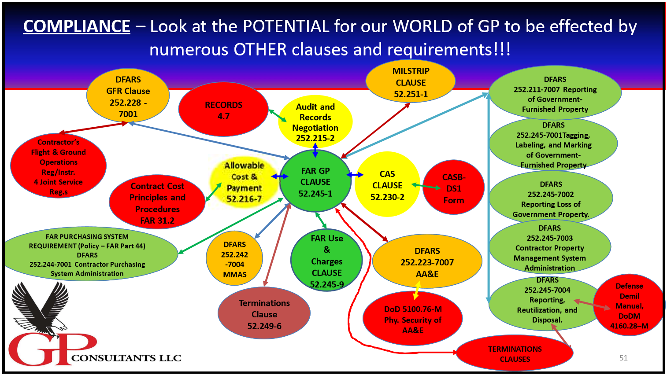
DR. DOUGLAS N. GOETZ: IS THERE MORE TO GOVERNMENT PROPERTY THAN THE GOVERNMENT PROPERTY CLAUSE? – 59TH SEMINAR ON GOVERNMENT CONTRACTS – SEPT 9TH, 2020

Slide 47
The Property Management System

Slide 48
What does FAR 52.245-1 say?
52.245-1(b)
The Contractor SHALL have a system of internal controls to manage (control, use, preserve, protect, repair and maintain) Government property in its possession.
52.245-1 (f) (1)
Contractors SHALL establish and implement property management plans, systems, and procedures at the contract, program, site or entity level to enable the following outcomes:
52.245-1 (g) Systems analysis.
(1) The Government shall have access to the contractor's premises and all Government property, at reasonable times, for the purposes of reviewing, inspecting and evaluating the Contractor's property management plan(s), systems, procedures, records, and supporting documentation that pertains to Government property. This access includes all site locations and, with the Contractor’s consent, all subcontractor premises. (…)

Slide 49
The Property Management System
The Property Management System is MANDATORY
Its design and implementation is left to the contractor :
The Contractor may employ the following:
Customary Commercial Practices –Voluntary Consensus Standards
Industry Leading Practices and Standards
The System will be Audited by DCMA to determine if it is adequate/inadequate

Slide 50
The Property Management System
The System is comprised of written policies, procedures, operational guidelines and related records as well as the management information system that facilitate performing those functions. Within these documents the roles and responsibilities of each participant in a process are defined *
*Fundamental of Property Management – NPMA

Slide 51
System Requirements 52.245-1
Paragraph (f) & (j) – Specific system requirements
with some freedoms
(f) Contractor plans and systems
Plans and systems at the contract, program, site or entity level that reflect their efforts to obtain best value (freedom)
Addresses 14 outcomes/processes
(j) Contractor Inventory Disposal
Addresses 1 outcome/process (restrictive)

Slide 52
The Property Management System
Must include the 15 REQUIRED outcome
Acquisition
Receipt
Identification
Records
Physical Inventory
Subcontractor control
Reports
Relief of Stewardship
Utilization
Consumption
Movement
Storage
Maintenance
Disposal
Property closeout

Slide 53
The Property Management System
ACQUISITION PROCESS
A contractual requirement that contractors have a process for managing the acquisition of property that IS or BECOMES Government property
Government Furnished Property (Government always has title)
Contractor Acquired Property (It depends!)

Slide 54
The Property Management System
FAR 52.241-1 (f) The contractor shall document that all property was acquired consistent with its engineering, production, planning and material control operation

Slide 55
The Property Management System
3 main concerns
Who has Title
Classification (Material, ST, STE, Equipment (real property may only be acquired as authorized by law)
Reasonableness of quantities acquired (FAR 31.201-3)

Slide 56
52.245-1
52.245-1(e)
WHAT & WHEN the Government has/takes title to
1. All GFP – no matter what
2. For CAP it depends:
Under fixed price type contracts: The government owns the Deliverable End Item
Under cost Type contracts the government has title to all property the contractor acquires if:
Reasonable
Allocable
Allowable
It is charged as direct item of cost
In accordance with the contractor’s disclosure statement

Slide 57
The Property Management System
RECEIVING PROCESS:
FAR 52.245-1(f) The contractor shall RECEIVE Government Property, record the information necessary to meet the record requirement (…) and manage any discrepancies incident to shipment (…)

Slide 58
The Property Management System
Receiving process:
Includes
Notification (to receiving department of Due-in assets)
Physical Delivery and Initial inspection (no obvious or visible damages and quantity matches the transportation document)
Discrepancies (identification and resolution)
Reconciliation (Against the Due-In record)
Receiving Reports (must be documented! DD form 250, DD form 1149, freight bill, Bill of lading, packing list etc…)
Release of Assets (from receiving organization, for quality or technical acceptance)
Inspection (The procedure should outline the inspection responsibility and indicate the type of GP that require further technical inspection/test)
Distribution of assets (to appropriate storage area, stockroom or release for use as authorized by contract terms)

Slide 59
The Property Management System
IDENTIFICATION PROCESS
FAR 52.245-1(f) The contractor shall receive Government Property, record the information necessary to meet the record requirement (…) IDENTIFY as government owned in a manner appropriate to the type of property (e.g, stamp, tag, mark or other identification) and manage any discrepancies incident to shipment

Slide 60
The Property Management System
Identification process:
2 requirements:
Indication of government ownership (Classification)
Stamp, tag, mark etc… S/N where appropriate
The Physical EVIDENCE that a piece of described property exists and is the very same item that is described or asserted (Identity)

Slide 61
The Property Management System
Identification methods are numerous
Bar coding
Stamping
Marking
Etching
Network Pinging
Radio Frequency Identification (RFID)
Selection of the methods is determined by several criteria (type of assets, data collection, environment, Ease of reading, size of the tag, surface of application, cost…)

Slide 62
The Property Management System
RECORD PROCESS
Record and the maintaining of records are applicable to EVERY process set forth by the Government property clause

Slide 63
The Property Management System
Record process:
FAR 52.245-1(f) (1)(iii) Records of Government property.
The Contractor shall create and maintain records of all Government property accountable to the contract, including Government-furnished and Contractor-acquired property.
(A) Property records shall enable a current, auditable record of ALL TRANSACTIONS (…)

Slide 64
The Property Management System
Record process:
The clause includes the data that are needed:
The name, part number and description, National Stock Number (if needed for additional item identification tracking and/or disposition) and other data elements as necessary and required in accordance with the terms and conditions of the contract.
Quantity received (or fabricated), issued, and balance-on-hand.
Unit acquisition cost.
Unique-item identifier or equivalent (if available and necessary for individual item tracking).
Unit of measure.
Accountable contract number or equivalent code designation.
Location.
Disposition.
Posting reference and date of transaction.
Date placed in service (if required in accordance with the terms and conditions of the contract).

Slide 65
The Property Management System
FAR 52.245-1 (g) Systems analysis.
(1) The Government shall have access to the contractor's premises and all Government property, at reasonable times, for the purposes of reviewing, inspecting and evaluating the Contractor's property management plan(s), systems, procedures, records, and supporting documentation that pertains to Government property. This access includes all site locations and, with the Contractor’s consent, all subcontractor premises.
(2) Records of Government property shall be readily available to authorized Government personnel and shall be appropriately safeguarded.

Slide 66
The Property Management System
Record retention: FAR 4.7
Policy 4.703
Financial and Cost Accounting: 4.705-1
Acquisition and Supply records: 4.705-3

Slide 67
The Property Management System
PHYSICAL INVENTORY
52.245-1(f)(1)(iv):Physical inventory. The Contractor shall periodically perform, record, and disclose PHYSICAL INVENTORY results. A final physical inventory shall be performed upon contract completion or termination. The Property Administrator may waive this final inventory requirement, depending on the circumstances (e.g., overall reliability of the Contractor's system or the property is to be transferred to a follow-on contract).

Slide 68
The Property Management System
It is the contractor’s responsibility to establish the process, the methods and methodologies to accomplish this process in accordance with and using Industry Leading practices and voluntary consensus standards (VCS)

Slide 69
The Property Management System
ASTM Standard E2132-01(2007), “Standard Practice for Physical Inventory of Durable, Moveable Property,” ASTM International, West Conshohocken, PA.

Slide 70
The Property Management System
Type of Physical Inventory
Wall to wall
Closed store
Open store
Cyclic
Sampling
…

Slide 71
The Property Management System
The contractor establishes
The type and Frequency of the Physical Inventory based on
Contractor’s practices
Type of GP
Use of GP
$ Value
Sensitivity
Reliability of Contractor’s PMS
Provide written procedures describing the process and outcomes

Slide 72
The Property Management System
FAR 52.245-1(f) (vi) Reports. The Contractor shall have a process to create and provide reports of discrepancies, loss of Government property, PHYSICAL INVENTORY results, audits and self-assessments, corrective actions, and other property related reports as directed by the Contracting Officer.

Slide 73
The Property Management System
Discrepancies
Usual standards
High 0% discrepancies
Low 10%
Standard ½ % - 5%
Ratio can affect the Risk Assessment placed on the contractor and subsequent audit frequency
Impact the determination of compliance of the PMS which may impact Liability

Slide 74
The Property Management System
STORAGE
FAR 52.245-1(f)(1)(viii) Utilizing Government property.
(A) The Contractor shall utilize, consume, move, and STORE Government Property only as authorized under this contract. The Contractor shall promptly disclose and report Government property in its possession that is excess to contract performance.
(B) Unless otherwise authorized in this contract or by the Property Administrator the Contractor shall not commingle Government material with material not owned by the Government.

Slide 75
The Property Management System
Storage:
Proper Identification of storage locations
Items separation
In-Storage Maintenance
Efficient movement of items
Locating the items when needed

Slide 76
The Property Management System
Storage:
Covered or open
Covered storage
General Purpose
Controlled humidity
Refrigerated
Flammable storage
Shed
Transitory shelter
Non Covered
Improved
Unimproved

Slide 77
The Property Management System
Storage:
Commingling
Where an item when placed with or next to another like item LOSES its ability to be IDENTIFIED as to OWNERSHIP
Collocated
Where an item when placed with or next to another like item RETAINS its ability to be IDENTIFIED as to OWNERSHIP
YOU SHALL NOT COMMINGLE!

Slide 78
The Property Management System
MOVEMENT
FAR 52.245-1(f) (1) (viii) Utilizing Government property.
(A) The Contractor shall utilize, consume, MOVE, and store Government Property only as authorized under this contract. The Contractor shall promptly disclose and report Government property in its possession that is excess to contract performance.
(B) Unless otherwise authorized in this contract or by the Property Administrator the Contractor shall not commingle Government material with material not owned by the Government.

Slide 79
The Property Management System
The process of Movement includes
Local (onsite from one location to another)
Off-site (authorization to move, documentation, user responsibility, property record updated…)
Records (must be annotated, change of custodians?, time frame for return?...)
Property Movement documents (Move tickets, travelers, hand receipts…)
Packaging (if need to meet certain requirement regarding transport of goods)
Shipping (from a geographic area to another, Must be authorized, documented)
Hazardous Material/Waste (governed by Title 49 CFR)

Slide 80
The Property Management System
UTILIZATION
52.245-1 (f) (1) (viii) Utilizing Government property.
(A) The Contractor shall UTILIZE, consume, move, and store Government Property only AS AUTHORIZED under this contract. The Contractor shall promptly DISCLOSE and REPORT Government property in its possession that is excess to contract performance.

Slide 81
The Property Management System
GP is generally authorized for use on the contract under which it is accountable.
Contractor are generally NOT authorized to use GP for any other use, Government or Commercial.
The contractor must obtain WRITTEN APPROVAL from the CO having cognizance over the property prior to use

Slide 82
The Property Management System
A word about Excess Property:
Contractor must have a process to identify GP in excess to contractual requirement (Measure and record USE)
GP that has no current usage or activity should be reviewed to initiate disposal action or justify retention.

Slide 83
The Property Management System
CONSUMPTION PROCESS
52.245-1 (f) (1) (viii) Utilizing Government property.
(A) The Contractor shall utilize, CONSUME, move, and store Government Property only AS AUTHORIZED under this contract. The Contractor shall promptly DISCLOSE and REPORT Government property in its possession that is excess to contract performance.

Slide 84
The Property Management System
Consumption is MATERIAL ONLY
The process consist in 4 elements:
Issuance of material in reasonable and proper quantity
Actual usage of material
Return of any unused portion to stock
Part or components removed or recovered from repairs, rework, testing etc… those parts are returned to stock with the prospect of future use or disposition

Slide 85
The Property Management System
REPORTING PROCESS
52.245-1 (f) (1) (vi) Reports
The Contractor shall have a process to create and provide reports of discrepancies, loss of Government property, physical inventory results, audits and self-assessments, corrective actions, and other property related reports as directed by the Contracting Officer.

Slide 86
The Property Management System
Many different reports
Discrepancies (see receiving process)
Loss Theft Damage or Destruction (sometimes Automated DOD: PCCARS: Plant Clearance Automated Reutilization Screening System - 52.245-1(f) (1) (vi) (B) contains the guidelines regarding the required Data)
Physical Inventory results (reporting all overages and shortages)
Audits and Self Assessments (when findings are significant)
Correctives actions, Plans (Reporting change in the PMS system)
Other property related reports as directed by the CO
Any other contractually required reports

Slide 87
The Property Management System
MAINTENANCE PROCESS
52.245-1 (b) Property management.
(1) The Contractor shall have a system of internal controls to manage (control, use, preserve, protect, repair and MAINTAIN) Government property in its possession. (…)

Slide 88
The Property Management System
The Maintenance process
General Maintenance: Routine day by day maintenance that is required for efficient and economical operation of GP (Includes inspecting, cleaning, adjusting, calibrating…)
Preventive Maintenance: part of the General Maintenance requirement

Slide 89
The Property Management System
The Maintenance process
General and preventive maintenance are to be performed by the contractor as part of its SOP. The costs of this maintenance program are generally included in the cost of contract as an overhead charge.
The government generally does not pay additional expenses for general or preventive Maintenance of GP.

Slide 90
The Property Management System
Relief of stewardship responsibility and liability. LTDD
52.245-1 (f) (1)(vii) Relief of stewardship responsibility and liability. The Contractor shall have a process to enable the prompt recognition, investigation, disclosure and reporting of loss of Government property, including losses that occur at subcontractor or alternate site locations.

Slide 91
The Property Management System
Relief of stewardship responsibility and liability.
Generally the contractor is NOT held liable for LTDD under:
Cost reimbursement contracts
Time and material contracts
Labor Hour contracts
Fixed-price contracts awarded on the basis of submission of certified cost or pricing data.

Slide 92
The Property Management System
Relief of stewardship responsibility and liability.
Generally the contractor IS held liable for LTDD under:
Fixed price contracts for which THERE IS an exception at FAR 15.403-1

Slide 93
The Property Management System
2 forms of liability:
Limited Risk of Loss provision (52.245-1 (h))
Full Risk of Loss provision (52.245-1 alternate I)

Slide 94
The Property Management System
2 forms of liability:
Full Risk of loss provision (52.245-1 alternate I)
Liable to ANY Loss, Theft Damage or Destruction EXCEPT reasonable wear and tear or reasonable and proper consumption
How much liable?: Intrinsic value to define the QUANTUM (replacement cost, repair cost, salvage cost or scrap cost depending on the type of loss and government future need of the GP)

Slide 95
The Property Management System
2 forms of liability:
Limited Risk of loss provision (52.245-1 (h)
1) Unless otherwise provided for in the contract, the Contractor shall not be liable for loss of Government property furnished or acquired under this contract, except when any one of the following applies:
Risk cover by Insurance (Must be specified in the contract)
Willful misconduct, lack of good faith by the MANAGERIAL PERSONNEL (Importance of definitions)
WITHDRAWAL of the Government assumption of risk (PMS is inadequate – ACO authority must be in writing)

Slide 96
The Property Management System
DISPOSITION

Slide 97
The Property Management System
Normally all disposition directs are issued through:
The contract
There may be specific disposition directions provided within the terms and conditions of the contracts. If there are no specific directions within the contract then the GP clause 52.245-1 provides guidance
The PCO, Plant Clearance Officer is the authorized representative that may issue disposition directions

Slide 98
The Property Management System
52.245-1 (j) provide guidance for disposition

Slide 99
The Property Management System
Steps in the Disposition process:
Documentation / notification of excess property
Pick up
Storage
Review for usability
Reutilization
Recycling
Methods of Disposal
Trade-ins / exchange sales
Donation/Destruction/Retirement

Slide 100
The Property Management System
CONTRACT CLOSEOUT
52.245-1 (f)(1)(x) Property closeout.
The Contractor shall promptly perform and report to the Property Administrator contract property closeout, to include reporting, investigating and securing closure of all loss of Government property cases; physically inventorying all property upon termination or completion of this contract; and disposing of items at the time they are determined to be excess to contractual needs.

Slide 101
The Property Management System
Contract Closeout
The Contractor Property Management organization are notified
Perform a final Physical Inventory of GP
Ensure that property transfer to other government contracts are accomplished based upon firm contract requirements that exist on the gaining contract
Monitor the actions of the contractor in returning excess GP inventoried but not referred to the PCO

Slide 102
The Property Management System
Contract Closeout
Advised the cognizant PCO of any residual property requiring disposal
Ensure that excess property is promptly reported on the inventory schedule to the PCO
Ensure that the contractor promptly takes all required actions to complete property management responsibilities and close out record
Require the contractor to submit a zero balance of GP accountable to the contract
Ensure that the processing of all liability actions by the property administrator or the Contracting Officer are completed

Slide 103
Subcontractors – what to know

Slide 104
Subcontractors
As a subcontractor, you will not see the CLAUSE but the REQUIREMENTS of the clause.
A property management system
Liability
Usage
…

Slide 105
Subcontractors
FAR 52.245-1(f)
(v) Subcontract Control -
(A) The Contractor shall award subcontracts that clearly identify items to be provided and the extent of any restrictions or limitations for fabricated items. The Contractor shall ensure appropriate flow down of contract terms and conditions (e.g., extent of liability for loss of Government property).
(B) The Contractor shall assure its subcontracts are properly administered and reviews are periodically performed to determine the adequacy of the subcontractor's property management system: AUDIT

Slide 106
Subcontractors
FAR 52.245-1(f)
(v) Subcontract Control -
Full or limited risk of loss?
If the contract has the alternate 1: then the FULL RISK OF LOSS must be flown down.

Slide 107
Subcontractors
FAR 52.245-1(f)
(v) Subcontract Control -
Full or limited risk of loss?
If the limited risk of loss is in the contract, the prime must make a conscious decision as to whether flow down the limited or full risk of loss
Example: Large quantity of GP? High Dollar value…

Slide 108
Subcontractors
Communication:
Contractor: ensure that the rules that your company establishes are known and applied
Subcontractor: Know what requirements of the clause are flown down to you

Slide 109
Final Words
There are many benefits to be gained by an organization that has an effective and efficient property management function. Certain of these, such as return on investment and reutilization of excess property, have a direct and measurable financial impact. Others, such as compliance with both internal and external procedures and regulations, have an indirect, but no less important value to the organization.*
*Fundamentals of Personal Property Management

Slide 110
Resources:
Acquisition.gov: https://www.acquisition.gov/content/regulations
National Property Management Association: www.npma.org
Wisconsin Procurement Institute
Phone: 414-270-3600 www.wispro.org

Slide 111
Questions?
Opening the Questions Box
Click here to access within the Control Panel
Using the Questions Box
Type questions here at any time during a presentation
Click Send when ready to submit a question
6/24/20
Page 111

Slide 112
UPCOMING TRAINING - EVENTS
7/21/21

Slide 113

NDIA MIDWEST REGIONAL CONFERENCE SERIES
July 22 (GOBC Day 1)
The National Defense Industrial Association’s (NDIA) Great Lakes, Great Rivers and Iowa-Illinois chapters, partnered with the Wisconsin Procurement Institute (WPI), invites you to attend our three-part virtual series featuring leaders in U.S. Defense. In this series, you will have the opportunity to learn about current issues, programs, and priorities critical to Defense contractors and subcontractors.
Registration Now Open
…More at wispro.org/events
7/21/21

Slide 114

Session 3
A ROADMAP TO DEVELOPING SUCCESSFUL TEAMS AND PARTNERSHIPS
Aug 17 | 10 am – Noon REGISTER HERE
Registration Now Open
…More at wispro.org/events
7/21/21

Slide 115


Summer Cyber reboot LIVE WEBINAR SERIES
July 29, 2021 – August 5, 2021 – August 26, 2021 – September 2, 2021 – | Fundamentals of Cyber Security for Federal Contractors NIST’s Cybersecurity Framework and the FAR/DFARS NIST’s Tips and Tactics for Ransomware Protection Computer Security Incidents
Register at: https://www.wispro.org/faqs/what-is-wpis-current-cyber-friday-webinar-schedule/
Presented by
7/21/21

Slide 116
ACQUISITION HOUR LIVE WEBINAR SERIES
July 21, 2021
Acquisition Hour: Government Property Management for Federal Contractors and Subcontractors CLICK HERE for additional information Presented by Benjamin Blanc, Wisconsin Procurement Institute
August 11, 2021
Acquisition Hour: The Federal Spend to the End CLICK HERE for additional information Presented by Marc Violante, Wisconsin Procurement Institute
August 17, 2021
Acquisition Hour: Overview of CPARS CLICK HERE for additional information Presented by Carol Murphy, Wisconsin Procurement Institute
…More at wispro.org/events
7/21/21

Slide 117
Questions?
Opening the Questions Box
Click here to access within the Control Panel
Using the Questions Box
Type questions here at any time during a presentation
Click Send when ready to submit a question
6/24/20
Page 117

Slide 118
Cybersecurity – update – December 2020
CMMC -
Implementation continues
Pathfinder contracts to be announced soon – article, Dec 1, 2020
CMMC requirements will be included
Full implementation expected by Oct 2025
New clauses and requirements –
DFARS 252.204-7019
DFARS 252.204-7020 – applies to contracts subject to 252.204-7012
With few exceptions, these requirements apply to all Primes and Subcontractors
Consistent with philosophy shift of self-attest to verifiable
Three levels – Base – self-performed , Medium & High - DCMA
7/21/21

Slide 119
252.204-7020 – Basic Assessment
Requires
System Security Plan(SSP)
Plan of Action – with dates for outstanding items
Basic Assessment
Six elements uploaded to Supplier Performance Risk System (SPRS)
System Security Plan name (if more than one system is involved)
Brief description of Plan Architecture
CAGE code associated with SSP
Date Assessment performed
Summary Score
Date a score of 110 to be achieved
7/21/21

Slide 120
Current Cyber Requirements
FAR 52.204-21 – Federal Contract Information
DFARS 252.204-7012
Requirements cited in solicitation/contract
Need assistance – please contact Marc Violante from WPI at marcv@wispro.org or 920-456-9990
7/21/21

Slide 121

SURVEY
7/21/21

Slide 122

CONTINUING PROFESSIONAL EDUCATION
CPE Certificate available, please contact:
Benjamin Blanc
benjaminb@wispro.org
7/21/21

Slide 123
Presented By Wisconsin Procurement Institute (WPI) www.wispro.org
Benjamin Blanc
Wisconsin Procurement Institute (WPI)
benjaminb@wispro.org | 414-270-3600
10437 Innovation Drive, Suite 320 Milwaukee, WI 53226
7/21/21

