Slide 1
Unified certification program (ucp)

Slide 2
Unified certification program (UCP)
Disadvantaged Business Enterprise (DBE) – UCP
NOTE: The DBE certification is part of the UCP – there are multiple certifying agencies and multiple agencies accept DBE certification. This will be discussed in more detail later in the presentation. The UCP Certification Program does not have the one year In Business requirement.
Definition of Minority & Disadvantaged: Disadvantaged Status - Belong to an ethnic minority group: Native American, Black, Hispanic, Asian Indian, Asian Pacific or women.
Eligibility Requirement – 51 % owned and controlled by disadvantaged person(s). Small Business Status – must be a small business as defined by SBA size standards. It must not have annual average gross receipts over $19M in the previous 3 years or $40M for airport concessionaires. Personal net worth less than $1.32M excluding home & ownership in business.
No cost
Re-evaluated every 3 years

Slide 3
Unified certification program (UCP)
Where and How do I get certified?
Contact one of the four certifying agencies - Wisconsin Department of Transportation, Milwaukee County – Community Business Development Partners, Dane County Purchasing Division- Contract Compliance or City of Madison Department of Civil Rights – Target Business Enterprise Program.
WisDOT : http://wisconsindot.gov/Pages/doing-bus/civil-rights/dbe/eligibity-requirements.aspx
The federal DBE program requires all DBE firms to submit an annual affidavit and business taxes annually.
Milwaukee County Online Certification: processes applications submitted by firms interested in working on projects that are partially funded by the USDOT, FAA, FHWA, or FTA. The County of Milwaukee shall process applications for airport concessionaires located anywhere in this state. https://county.milwaukee.gov/EN/Administrative-Services/Community-Business-Development-Partners
Checklist: http://county.milwaukee.gov/ImageLibrary/User/maverkamp/CBDP/Supporting_Docs_Checklist_NEW_APP.pdf

Slide 4
Unified certification program (UCP)
Disadvantaged Business Enterprise (DBE) – UCP
Where and How do I get certified?
Dane County: Only certifies airport concessionaires – contact Wesley Sparkman, Contract Compliance Officer 608.266-5623 sparkman@countyofdane.com for additional information.
City of Madison: The City of Madison shall provide certification-related services to firms located in Dane County, and shall process only applications submitted by firms interested in working on projects assisted by the Federal Transit Administration (FTA).
Application is available online: http://www.cityofmadison.com/civil-rights/contract-compliance

Slide 5
Unified certification program (UCP)
Benefits – WisDOT
Database of all certified companies with NAIC’s codes for Buyers to easily find you: http://wisconsindot.gov/Pages/doing-bus/civil-rights/dbe/certified-firms.aspx
Support Services are available to certified firms free of charge including technical, marketing and financial assistance. Matrix: http://wisconsindot.gov/Documents/doing-bus/civil-rights/dbe/business-cntrctng-matrix.pdf
WisDOT offers two programs designed to assist DBEs making connections with Prime contractors: Mentor Connection (6-month) and Mentor Protégé (3-year): http://wisconsindot.gov/Documents/doing-bus/civil-rights/dbe/mentor-protege.pdf
Mega project goal setting for DBE participation
National goal of placing at least 10 percent of federal highway and transit funds with persons who qualify as disadvantaged small business operators.
UCP is a cooperative of 24 different Wisconsin cities, counties , airport and transit authorities that benefit from USDOT funding – incorporate DBE goals into their federally funded transportation projects.

Slide 6
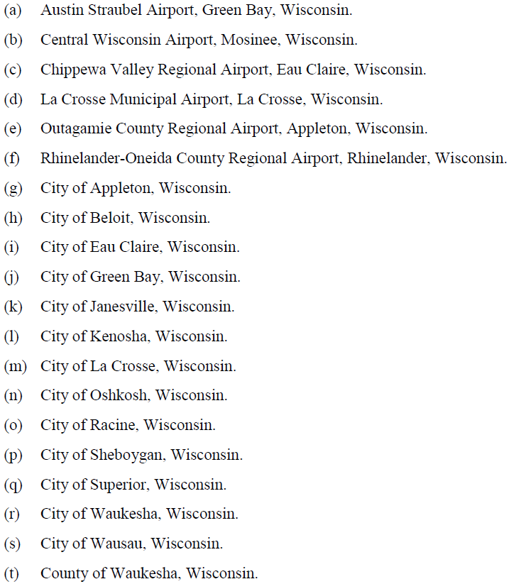
Unified certification program (UCP)

Slide 7
Local governments

Slide 8
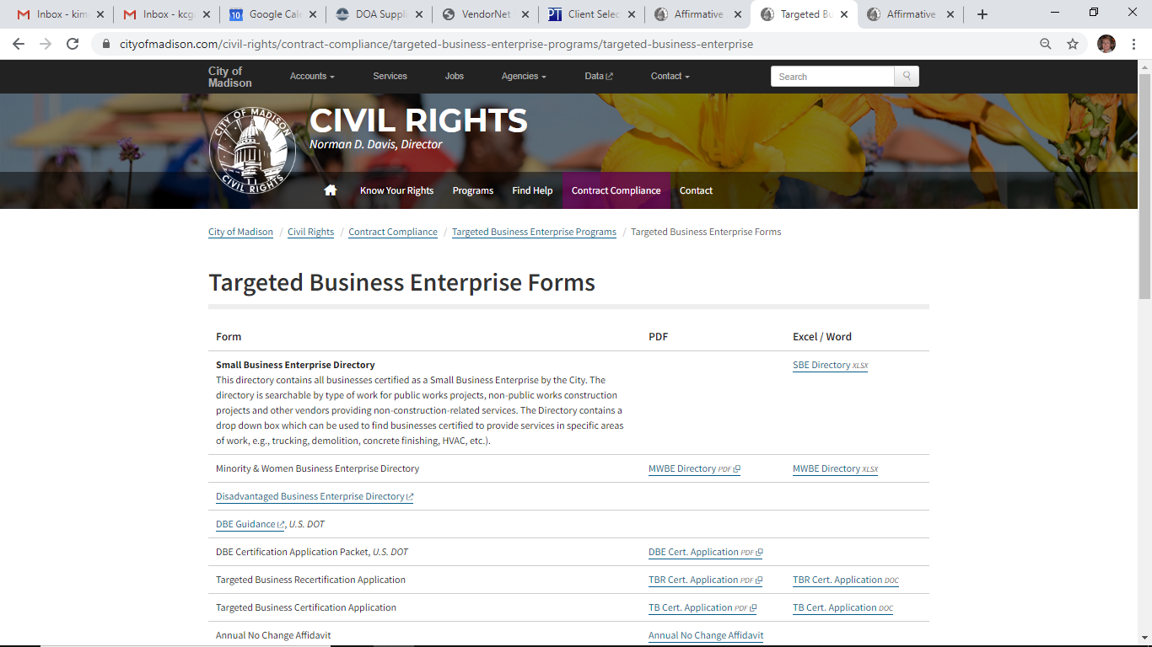
Local governments – city of Madison
https://www.cityofmadison.com/civil-rights/contract-compliance/targeted-business-enterprise-programs

Slide 9
Local governments
City of Madison – Targeted Business Certification Program
The MADcertification Program is the targeted business certification program of the City of Madison. The program has been designed to perform the function of certifying targeted businesses for participation on City projects with targeted business goals including WBE’s.
Where and How do you get certified?
Certification available online at: http://www.cityofmadison.com/civil-rights/documents/AAPInstructions.pdf and must be submitted to City of Madison, Affirmative Action Division, 210 Martin Luther King, Jr. Blvd., Rm. 523 , Madison, WI 53703.
Certification length – Recertification annually
Cost for Certification – There is no cost for certification.

Slide 10
Local governments – Milwaukee County
Milwaukee County – DBE Program
See UCP Certification
Community Business Development Partners (CBDP) administers the Disadvantaged Business Enterprise (DBE), Small Business Enterprise (SBE) and Airport Concession Disadvantaged Business Enterprise (ACDBE) programs. These programs promote economic opportunities for minority, women, and emerging small businesses.
https://mke.diversitycompliance.com/Default.asp
https://mke.diversitycompliance.com/FrontEnd/StartCertification.asp?TN=mke&XID=9416

Slide 11
Milwaukee county
Milwaukee County strives to meet a Targeted Business Enterprise goal across all county services of 25% for construction related activities and 17% for all other procurement and professional service activities. Milwaukee County reviews RFP's and past history data as well as looking at departmental activities and achievement history to determine the appropriate goals using the US DOT recommendations for determining availability by NAICS code and utilizing US Census and other available data.
US DOT Goal Setting - FAA DBE
Milwaukee County General Mitchell International Airport has budgeted FAA-assisted contracts for FFY2017-2019 totaling $23,029,500. The overall DBE goal is 19.3%, 7.7% will be race-neutral and 11.6% race-conscious.
The County has set the following preliminary goals for DBE participation on these contracts by sector:
Construction Projects: 20.6% of funds anticipated for construction projects
Professional Services/Procurement: 6.6% of funds anticipated for professional services and procurement of equipment

Slide 12
Wisconsin UCP, DBE, and ACDBE Certifying Agencies & contacts
Wisconsin DOT​ Office of Business Opportunity & Equity Compliance
4822 Madison Yards Way Madison, WI 53705 P.O. Box 7965 Phone: (608) 266-8216 Fax: (608) 267-3641 Email: DBE_Alert@dot.wi.gov DBE Certifications Only Wisconsin and Non-Wisconsin firms
City of Madison ​​Civil Rights Affirmative Action Division
Dane County City-County Building, Room 523 210 Martin Luther King Jr. Blvd. Madison, WI 53703 Phone: (608) 266-4910 Fax: (608) 266-6514 TTY: (609) 266-4083 TTY http://www.cityofmadison.com/dcr/ DBE Certifications Only Wisconsin Firms Only
Dane County ​​Office of Equity and Inclusion
Dane County ​City-County Building, Room 356 210 Martin Luther King Jr. Blvd. Madison, WI 53703 Phone: (608) 283-1391 Fax: (608) 266-2138 https://oei-exec.countyofdane.com/ DBE and ACDBE Certifications Wisconsin Firms Only
Milwaukee County Community Business Development Partners
Milwaukee County will only accept online Applications Click here for Online application DBE Program Administrators (414) 278-4747 Phone (414) 223-1958 fax CBDP Site Info DBE and ACDBE Certifications Wisconsin and Non-Wisconsin firms

Slide 13
Local governments
Milwaukee Metropolitan Sewerage District (MMSD) – Small, Veteran, Women, Minority (SWMBE) Businesses – 318 certified in their database
To apply for MMSD SBE certification, businesses must complete the application. https://www.mmsd.com/procurement/supplier-diversity MMSD SBE Certification is valid for three years. Firms wishing to renew their certification must submit a new application and business tax returns for the past three years.
Effective December 5, 2017, the Milwaukee Metropolitan Sewerage District (MMSD) modified its Small Business Enterprise (SBE) certification program to align with the U.S. Small Business Administration (SBA) in its definition of a small business. Previously, MMSD defined a small business as a business not exceeding 2.5 million in gross sales during the most recent calendar or fiscal year. Moving forward, a small business is defined as a business not exceeding the SBA size standard for its industry. A size standard represents the largest size that a business (including its subsidiaries and affiliates) may be to remain classified as a small business. SBA size standards vary by industry classification and can be defined by average annual receipts for the past three years or average number of employees over the past twelve months. Businesses can use the SBA size standards tool to determine if their business can be classified as a small business.
NOTE: MMSD does recognize other certifications:

Slide 14
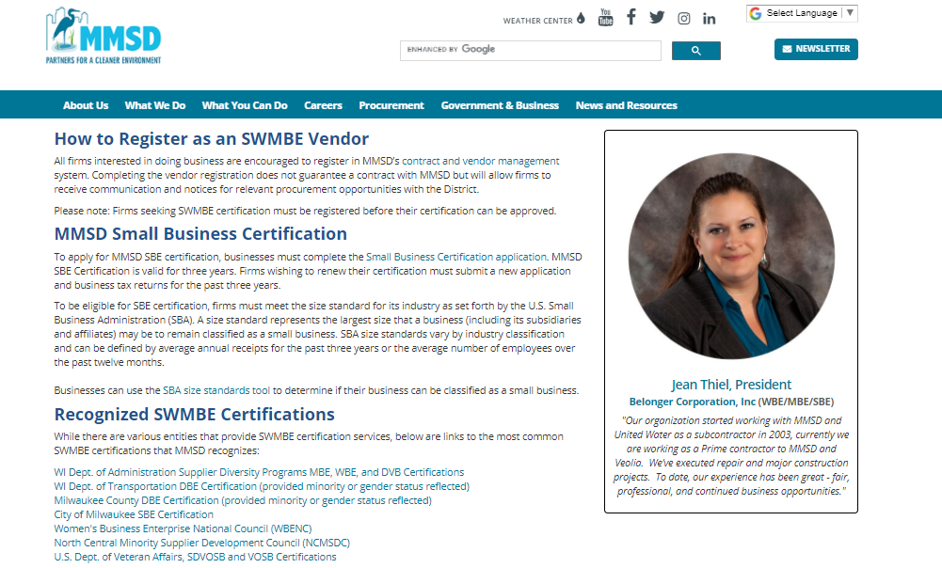

Slide 15
Local governments
Milwaukee Public Schools (MPS) – Historical Underutilized Businesses Program
Note: MPS does not certify you as a HUB. However, if you are certified as an 8(a) or EDWOSB / WOSB by the SBA, WBE by the state of WI, SBE by the city of Milwaukee, or DBE by WisDOT or Milwaukee county you may participate in this program.
List of accepted certification agencies: http://mps.milwaukee.k12.wi.us/MPS-Shared/Documents1/AcceptedCertificationAgenciesPortalcopy092514.docx
Where and How do I get certified? Submit recognized certification to Contact Contract Compliance Services - http://mps.milwaukee.k12.wi.us/en/District/About-MPS/School-Board/Contract-Compliance-Services.htm
Cost – There is no cost for this certification

Slide 16
Local governments
Milwaukee Public Schools (Continued)
35% goal for HUB certified firms
Ability to participate in MPS subcontracts that require a HUB utilization plan
Joint Venture & Mentor Protégé agreements are encouraged
HUB Requirements are for contracts over $50,000

Slide 17
Corporate certifications

Slide 18
Third party certifiers
There are currently four entities that the SBA has approved as third-party certifiers:
The National Women’s Business Owners Corporation (NWBOC)
Women’s Enterprise National Council (WBENC)
The U.S. Women’s Chamber of Commerce (USWCC)
The El Paso Hispanic Chamber of Commerce (EPHCC)

Slide 19
Third party certifier Notes:
Pros
Provides additional contacts – resources
Many Prime Contractors or Large Businesses require third party certification
Cons
There is a cost

Slide 20
Gender/race neutral certifications

Slide 21
Gender/race neutral certifications
HUBZone Certification (Federal): https://www.sba.gov/contracting/government-contracting-programs/hubzone-program
Service Disabled Veteran Owned Businesses (Federal): https://www.sba.gov/contracting/government-contracting-programs/service-disabled-veteran-owned-businesses
Disabled Veteran-Owned Business Enterprise (State of Wisconsin): https://doa.wi.gov/Pages/StateEmployees/ProgramDescription.aspx
Small Business Enterprise (SBE) (City of Milwaukee): http://city.milwaukee.gov/Directory/OSBD/Certifications.htm#.V_vLNSSo6io

Slide 22
Gender/race neutral certifications
Small Business Enterprise (SBE) (City of Madison): http://www.cityofmadison.com/dcr/aatbdir.cfm
Emerging Small Business Enterprise (ESBE) (Dane County): https://danepurchasing.com/
Section 3 (Housing Authority of the City of Milwaukee, various municipalities): http://www.hacm.org/business/section-3-business
Housing Authority's Emerging Business Enterprise (EBE) Program – City of Milwaukee: http://www.hacm.org/business/ebe-program

Slide 23
Last word on certifications
Never imply the Government must purchase from you since you have a certification
Certifications can provide a competitive edge through
Set asides
Equally submitted proposals
Acquiring or selling company: be aware of contracts that may be affected based on certifications
Contact WPI for free assistance in registrations and certification applications

