Slide 1
Acquisition Hour
The SBA 8(a) Program and Small Disadvantaged Business (SDB) Program
January 10, 2023
1/10/23

Slide 2

Webinar Etiquette
PLEASE
Log into the GoToWebinar session with the name that you registered with online
Place your phone or computer on MUTE
Use the QUESTIONS option to ask your question(s).
We will share the questions with our guest speaker who will respond to the group
THANK YOU!
1/10/23

Slide 3

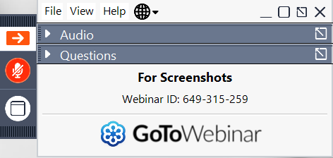
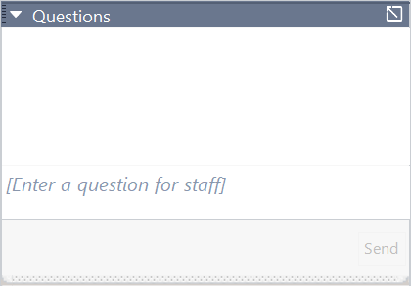
Questions?
Opening the Questions Box
Click here to access within the Control Panel
Using the Questions Box
Type questions here at any time during a presentation
Click Send when ready to submit a question
6/24/20
Page 3

Slide 4
ABOUT WPI Supporting the mission
Celebrating 35 Years of
serving Wisconsin Business!
1/10/23

Slide 5

Assist businesses in creating developing and growing their sales revenue and jobs through Federal State and Local Government contracts.
INDIVIDUAL COUNSELING – At our offices at client’s facility or via telephone/virtually
SMALL GROUP TRAINING – Workshops and webinars
CONFERENCES to include one on one or roundtable sessions
Last year WPI provided training at over 100 events and
provided service to over 1200 companies
The Wisconsin Procurement Institute serves as Wisconsin’s Procurement Technical Assistance Center (PTAC). This procurement technical assistance center is funded in part through a cooperative agreement with the Department of Defense. WPI is also funded in part by the Wisconsin Economic Development Corporation (WEDC). The content of any written materials or verbal communications of the PTAC does not necessarily reflect the official views of or imply endorsement by our funders.
1/10/23

Slide 6
Sign-up for our Newsletter
Stay up-to-date with the latest WPI news and events.
https://www.wispro.org/newsletter-signup/
1/10/23

Slide 7
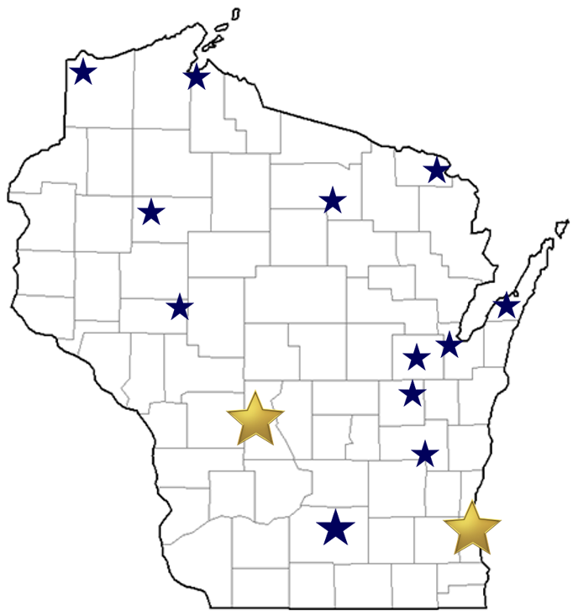
WPI Office Locations
OSHKOSH
Fox Valley Technical College
Greater Oshkosh Economic Development Corporation
EAU CLAIRE
Western Dairyland
LADYSMITH
Indianhead Community Action Agency
RHINELANDER
Nicolet Area Technical College
ASHLAND
Ashland Area Development Corporation
FLORENCE
Florence County Economic Development
DOOR COUNTY
NE WI Technical College
Door County Economic Development Corporation
SUPERIOR
Small Business Dev Center; UW Superior
MILWAUKEE
Technology Innovation Center
MADISON
FEED Kitchens
Dane County Latino Chamber of Commerce
Wisconsin Manufacturing Extension Partnership (WMEP)
Madison Area Technical College (MATC)
CAMP DOUGLAS
Juneau County Economic Development Corporation (JCEDC)
FOND DU LAC
Envision Greater Fond du Lac
GREEN BAY
NWTC Startup Hub
APPLETON
Fox Valley Technical College

Slide 8
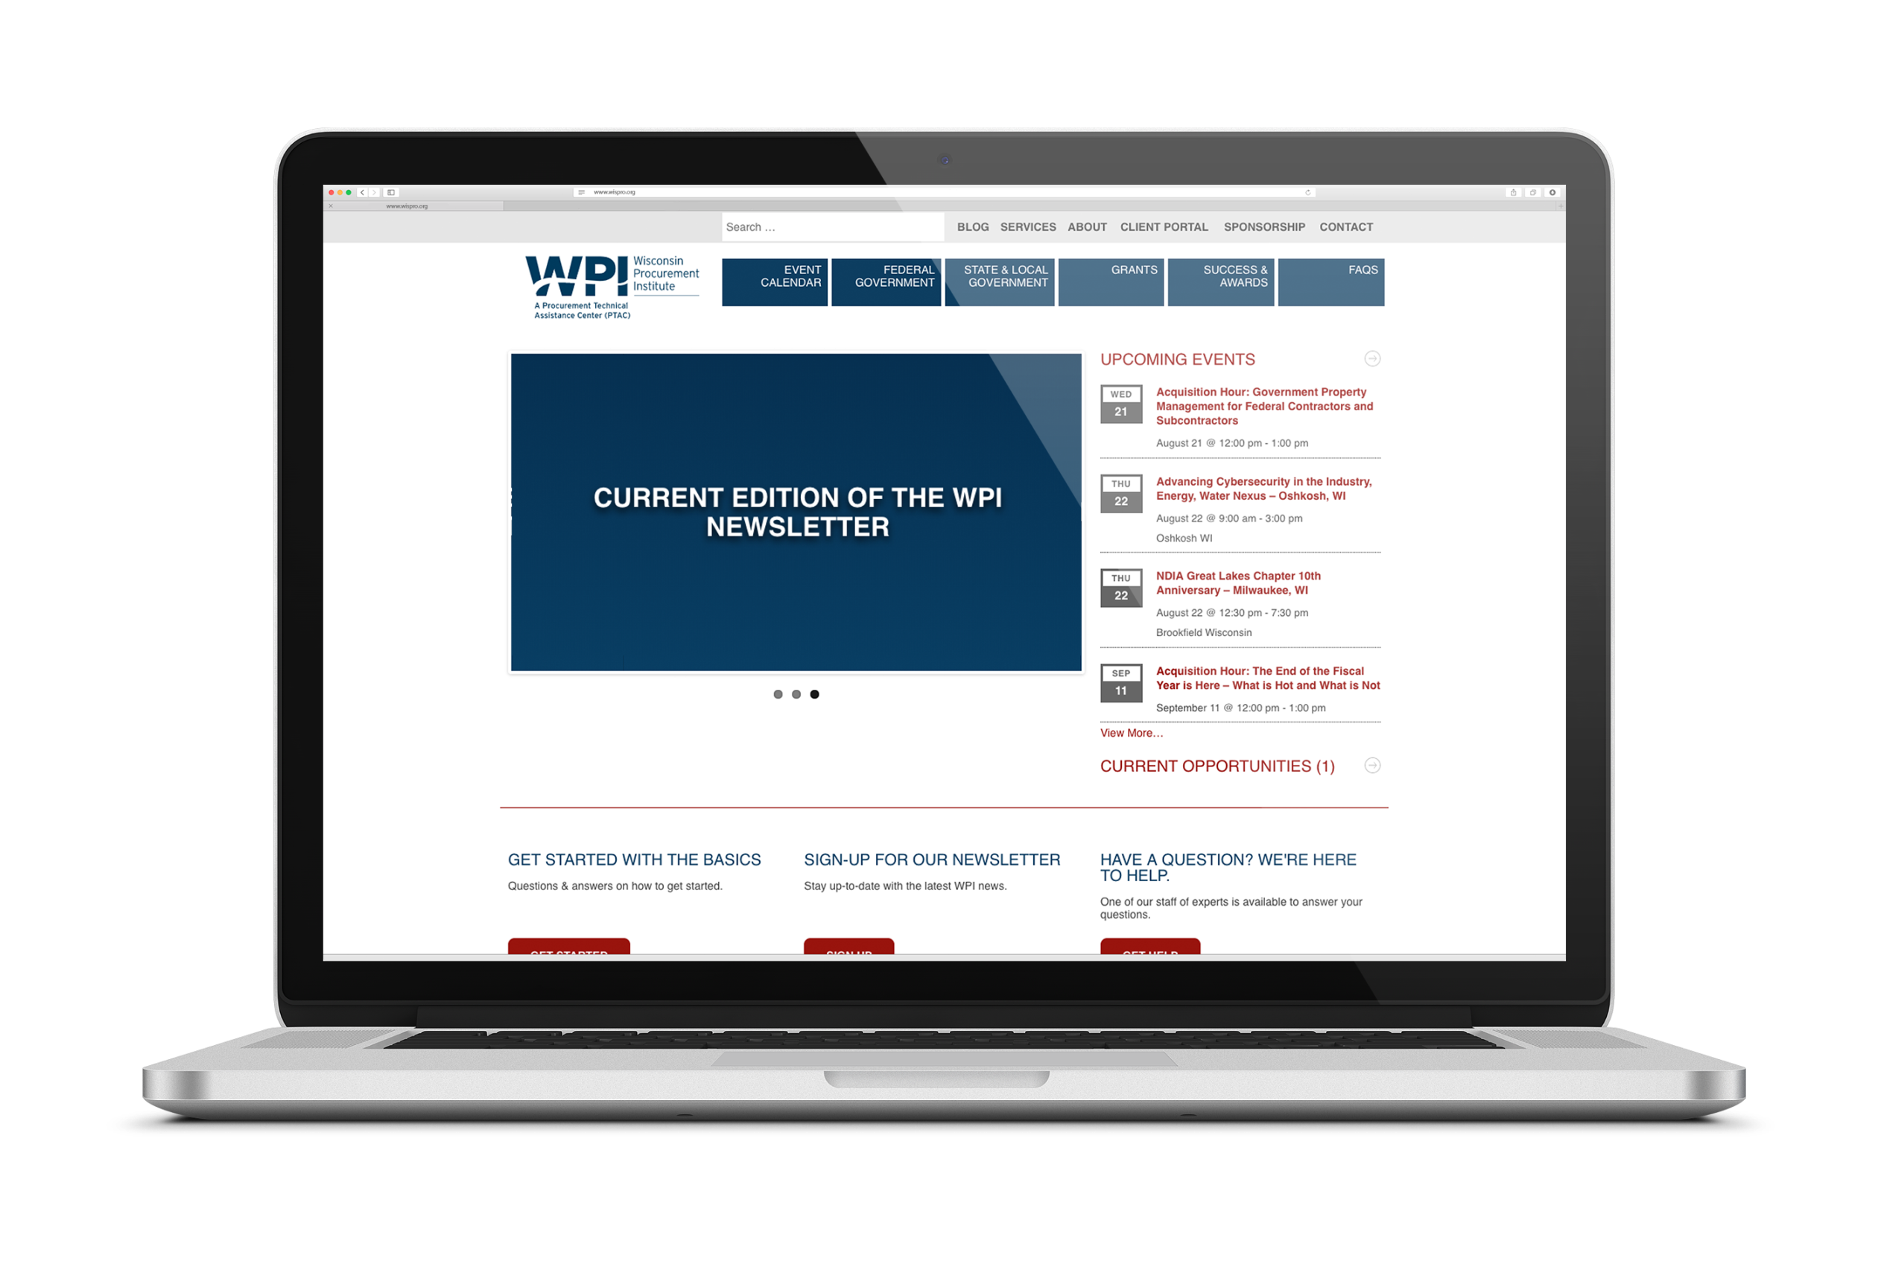
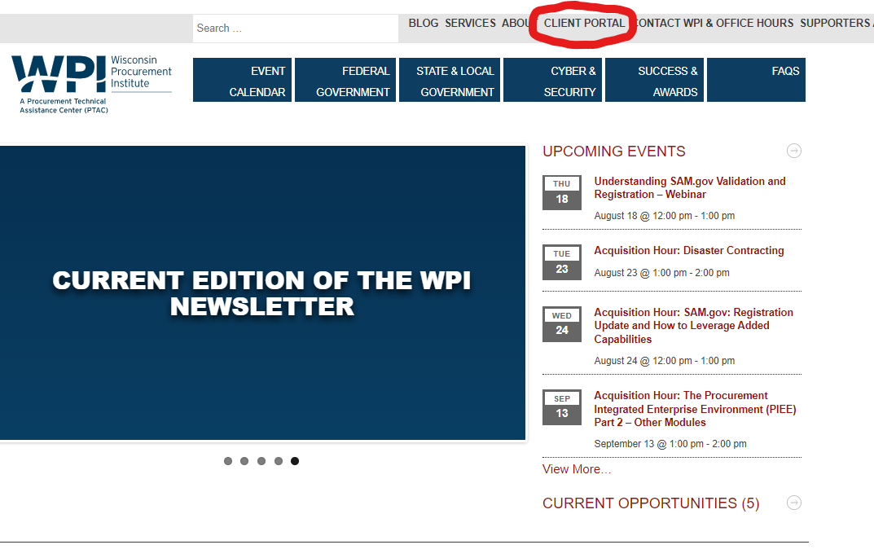
www.wispro.org
1/10/23

Slide 10
8(a) Business Development Certification Program Shane Mahaffy Lead Business Opportunity Specialist

Slide 11
Set-Aside for Certification Programs and Socio-Economic Categories
Targeted set-asides and acquisition goals:
Women-Owned Small Businesses (5%)
Small Disadvantaged Businesses (including 8(a) certified) (12%)
HUBZone Businesses (3%)
Service-Disabled Veteran-Owned Small Businesses (3%)
Set-asides are reserved for small business between $3,500 (Micro- purchase Threshold) to $250,000 (Simplified Acquisition Threshold)
Notes:
Targeted Set-asides and Acquisition Goals
Women-owned small businesses - (5%)
Small disadvantaged businesses including 8(a) certified - (12%)
HUBZone - (3%)
Service-disabled veteran-owned small businesses - (3%)
Overall small business goal of 23%
Set-asides are reserved for small business between the Micro-purchase Threshold and the Simplified Acquisition Threshold.

Slide 12

Wisconsin FY21 Small Business Contract Numbers
Wisconsin Small Businesses received in excess of $1.1 Billion with the U.S. Government
Small Disadvantaged Business received over $417 Million
Notes:
FY2021
Wisconsin’s small businesses received $1,103,378,633 (18% of total WI contract dollars) of business with the U.S. Government.
SDB– Amount: $417,446,937

Slide 13

8(a) Business Development Program
Access to business development support
Build capacity and grow through contracts
Nine-year program available once per lifetime
Notes:
Designed to assist socially and economically disadvantaged owned small businesses compete in the federal marketplace.
A certified firm has the potential to receive sole source contracts (no competition) up to $4.5 million for goods and services, including construction, and $7.0 million for manufacturing requirements.
A certified firm has only one 9-year tenure in this program. The first 4 years are considered a development stage and the last 5 years are considered a transitional stage.
Continuation in the program is dependent upon the firm’s continuing eligibility as a socially and economically disadvantaged firm with day-to-day management control by the individual upon whom eligibility is based.
Sole source awards vs. competition.
Most popular/most used contracting vehicle in government.
Identify in System Award Management (SAM) as an 8(a) firm.
Contract opportunities which are only available for 8(a) firms.
Available to obtain a Mentor and waive affiliation for purposes of competing on larger federal contracts as a joint venture.
Take advantage of specialized training, counseling, marketing, technical and management assistance, and high-level executive development provided by SBA and our resource partners.

Slide 14
Participation and Continued Eligibility
Participation Starts at Date of Approval
Developmental
Transitional
Years 1-4
Years 5-9
To maintain eligibility:
Submit 8(a) annual update on time
Inform SBA of all material and business changes (prior approval required)
Maintain SAM and DSBS profiles
Notes:
Participation
Participation in the program is divided into two phases over nine years: a four-year developmental stage and a five-year transition stage.
Continuation in the program is dependent on staying in compliance with program requirements.
Participation is ONE TIME ONLY for firms and individuals.
Continued Eligibility
Timely submission of 8(a) Annual update; access to individual and business records; including submission of year-end financial statements and tax returns.
Inform SBA of all material changes.
SBA’s prior written approval is required on business structure changes, ownership changes, name changes and management changes. (A firm can be terminated from the program by not gaining SBA’s prior written approval.)
Maintain System for Award Management (SAM) and Dynamic Small Business Search (DSBS) profiles, at all times.

Slide 15
Is the 8(a) Certification Appropriate for You?
Commercial and government balance
Socially and economically disadvantaged
Marketing ability
Diminished ability to compete
Proper NAICS codes
Net worth requirements
Notes:
The potential business must:
Be in business for at least two years in its primary NAICS Code. This will be verified by federal tax returns to demonstrate their potential for success.
Be able to maintain a balance between their commercial business and government business.
Be able to market the firm’s business.
Be a small business concern in its primary industry classification (NAICS Code), determined by revenue or employees.
At least 51% unconditionally and directly owned by one or more socially and economically disadvantaged individuals who are citizens of the United States, except for concerns owned by Indian tribes, Alaska Native Corporations, Native Hawaiian Organizations or Community. development Corporations.
Socially and economically disadvantaged firms whose ability to compete in free enterprise has been impaired due to diminished capital and credit opportunities. As well as those who have been subjected to racial or ethnic prejudice or cultural bias within American society because of their identification as members of groups without regard to their individual qualities.

Slide 16
8(a) Program Expectations
Setting Expectations

Progress measurement

Is a business development program

Not suited for all firms

Limited total dollar value of contracts
Notes:
Is a business development program.
8(a) Participants are not in any way guaranteed or entitled to receive federal contracts
Not suited for all firms:
Not yet in business or less than 2 years in business
Too small to effectively pursue federal prime contracts
No experience in public contracting (local, state or federal)
May produce a service/product not purchased through prime contracts
8(a) BD Program Goals and Requirements (CFR 124.104)
Maintain a balance between your commercial and government business.
Limit on total dollar value of 8(a) contracts that a firm can receive in program:
(1) for a firm having a average annual receipts-based primary NAICS Code, $100 million and
(2) for a firm having an employee-based primary NAICS code, the limit is $100 million.
Monitor and measure progress of participants through annual reviews, business planning, systematic evaluations.

Slide 17

When Should You Apply?
Are You Ready…
8(a) Is One-time Only
01
Do you have the CAPACITY to deliver on federal contracts?
02
Do you have sufficient CASH FLOW?
03
Do you have demonstrated CAPABILITY (past performance)?
04
Can you demonstrate successful PAST PERFORMANCE?
05
Are you open to ADVICE on growing your business?
Notes:
The 8(a) program is a one-time only, 9-year program.
Think about WHEN to apply to the program so you can make the most of the limited time and increase your chances of winning contracts.
Ask yourself these questions and be honest with yourself.
If you’re a single-person company who has never done a contract larger than $X, you may want to focus on building your business a bit more before applying for the program.
Presenter Tip: Talk about the appropriate timing for a business to enter the 8(a) business development program in order to be successful. Highlight the factors to be considered before applying and provide case studies of success and failures based on timing.
The 8(a) program is a one-time only, 9-year program.
Think about WHEN to apply to the program so you can make the most of the limited time and increase your chances of winning contracts.
Ask yourself these questions and be honest with yourself.
If you’re a single-person company who has never done a contract larger than $X, you may want to focus on building your business a bit more before applying for the program.

Slide 18
Designated Socially Disadvantaged Criteria
Designated Groups
01
Black American
Asian Pacific American
Hispanic American
Native American
Subcontinent Asian American
Non-Designated Group Criteria
02
Preponderance of evidence
Race, ethnicity, gender, physical handicap, long-term environmental issues
Chronic and substantial
Negative impact to business advancement
Notes:
Designated Socially Disadvantaged Groups
Black American
Asian Pacific American
Individuals with origins from Burma, Thailand, Malaysia, Indonesia, Singapore, Brunei, Japan, China, Taiwan, Laos, Cambodia, Vietnam, Korea, The Philippines, U.S. Trust Terr. of the Pacific Islands, Rep. of the Marshall Islands. Fed. States of Micronesia, Comm. of the Northern Mariana Islands, Guam, Samoa, Macao, Fiji, Tonga, Kiribati, Tuvalu, or Nauru
Hispanic American
Individuals of Spanish and Portuguese descent
Native American
Alaska Natives, Native Hawaiians, or enrolled members of Federally or State recognized Indian Tribe. If not an enrolled member of a Federally or State recognized Indian Tribe an individual must meet the “Preponderance of the Evidence” standard.
Subcontinent Asian-American
Individuals with origins from India, Pakistan, Bangladesh, Sri Lanka, Bhutan, the Maldives Islands, or Nepal.
Some businesses believe that if their firm is approved for Disadvantaged Business Enterprise (DBE) certification by their state or other entity, the firm automatically is eligible for SBA’s certification. This is not so. Each agency's definition and qualification requirements are different.
Non-designated Group Criteria
A “Preponderance of the Evidence;”
May stem from race, ethnic origin, gender, physical handicap, long term environmental isolation, or other similar causes;
Personally suffered disadvantage in the United States;
Must be chronic & substantial;
Discrimination must have negatively impacted on business advancement.

Slide 19
Economically Disadvantaged Requirements to Qualify
Personal net worth (assets minus liabilities) less than $850,000
Three-year average income is $400,000 or less
Fair market value of all assets is $6.5 million or less
87 FR 69118 Effective December 19, 2022
Notes:
Economically Disadvantaged Requirements to Qualify
Personal net worth (assets minus liabilities) must be less than $850,000 excluding:
Net Worth:
Less Equity in business and primary personal residence
Less Income reinvested or used to pay taxes of business
Less Funds reinvested in IRA or other legitimate retirement account*
Less Transferred assets within two years if to or on behalf of immediate family member for select purposes** equals adjusted net worth
Must be IRA or other official retirement account that is unavailable until retirement age without significant penalty.
Applicant must provide, for each retirement account, information regarding the terms and restrictions; and certification that the account is legitimate.
** Select purposes are for that individual’s education, medical expenses or other essential support or to family member in recognition of special event.
Note: Contingent liabilities do not reduce net worth.
Supplemental Requirements
Adjusted gross income average over three years is $4000,000 or less excluding:
Income reinvested or used to pay taxes of business
Fair market value of all assets is $6.5 million or less excluding:
Funds reinvested in IRA or other official retirement account.

Slide 20




8(a) Application Process
BEFORE APPLICATION
Identify NAICS code(s)
Register with SAM
APPLY FOR CERTIFICATION
Review application guide
Gather supporting documentation
Apply online at
RESOURCES
Access resources on the Knowledge Base
For assistance, contact
Notes:
Before Applying
Register for a DUNS number
Identify applicable NAICS code(s)
Register with SAM.gov
Applying for Certification
Review the application guide
Gather documentation
Apply online at certify.sba.gov
Resources
Access resources on the certify.sba.gov Knowledge Base
Certify Quick Start Guide for Firms
8(a) Business Development Program Preparation Checklist
Connect your Business with Certify
MPIN and SAM Explained
Common Error Notices
Not Receiving Confirmation Email
If you are unable to find help using the Certify Knowledge Base feature, please email the Help Desk at help@certify.sba.gov. Please include your company name and DUNS number in your inquiry.

Slide 21


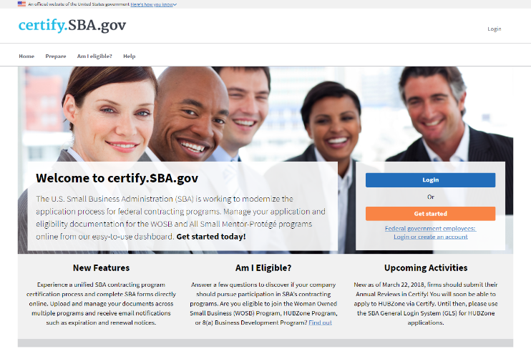
Certification
SBA Certification Portal
SBA’s certification portal where businesses can submit documents to seek SBA certifications
Automatic Migration
Pulls business information from SAM.gov
Online Forms
Forms are completed online. No longer required to upload certain SBA forms
Notes:
SBA’s certification portal where businesses can submit documents to seek SBA certifications.
Pulls business information from SAM.gov.
SBA plans to add other certification programs to certify.SBA.gov in the future.
Forms are completed online - No longer required to upload WOSB Program Certifications (SBA Forms 2413 and 2414) and Personal Financial Statement (SBA Form 413).
Certification questions are filtered by business organization.
Must complete WOSB or EDWOSB certification questionnaire (or application) and add documents to the question when prompted – To be reviewed by CO when in line for award.
Only owner/officer authorized to certify on behalf of company should create account.

Slide 22
Know the Rules for 8(a) Certification
13 CFR
part 124
Eligibility
FAR 19.8
8(a) Contracts
Citizenship & Size
Disadvantaged Criteria
Ownership
Control and Management
Potential
Character
Contract Information
Small Business Programs
Notes:
13 Code of Federal Regulations (CFR) 124
Regulations regarding 8(a) BD Status Determinations (for initial and continued eligibility).
U.S. Citizens 13 CFR § 124.101
Size 13 CFR § 124.102
Socially Disadvantaged 13 CFR § 124.103
Economically Disadvantaged 13 CFR § 124.104
Ownership 13 CFR § 124.105
Control and Management 13 CFR § 124.106
Potential for Success 13 CFR § 124.107
Other 13 CFR § 124.108
Good Character,
One-Time Eligibility
Federal Financial Obligations
Federal Acquisition Regulations (FAR) 19.8
Apply to and government 8(a) contracts. Other key parts of the FAR include:
Subpart 8.4 – Federal Supply Schedules
Part 13 – Simplified Acquisitions
Part 14 – Sealed Bidding
Part 15 – Contracting by Negotiation
Part 16 – Types of Contracts
Part 19 – Small Business Programs

Slide 23

How are we doing? Please take a minute to let us know
www.sba.gov/feedback

Slide 24
SBA - Wisconsin Offices
Wisconsin District Office
310 West Wisconsin Ave.
Suite 580W
Milwaukee, WI
Wisconsin District Office
740 Regent Street
Suite 100
Madison, WI
www.sba.gov/wi
Wisconsin District Office Newsletter:
GET EMAIL UPDATES
Twitter: @SBA_Wisconsin
For Questions, Email: Wisconsin@sba.gov

Slide 25
Locating 8(a) set aside opportunities

Slide 26
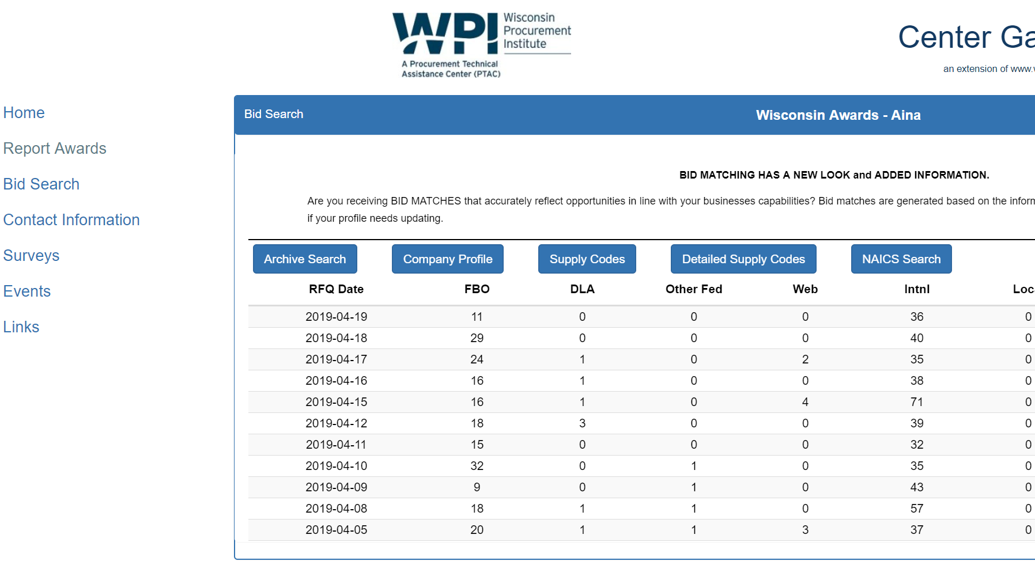
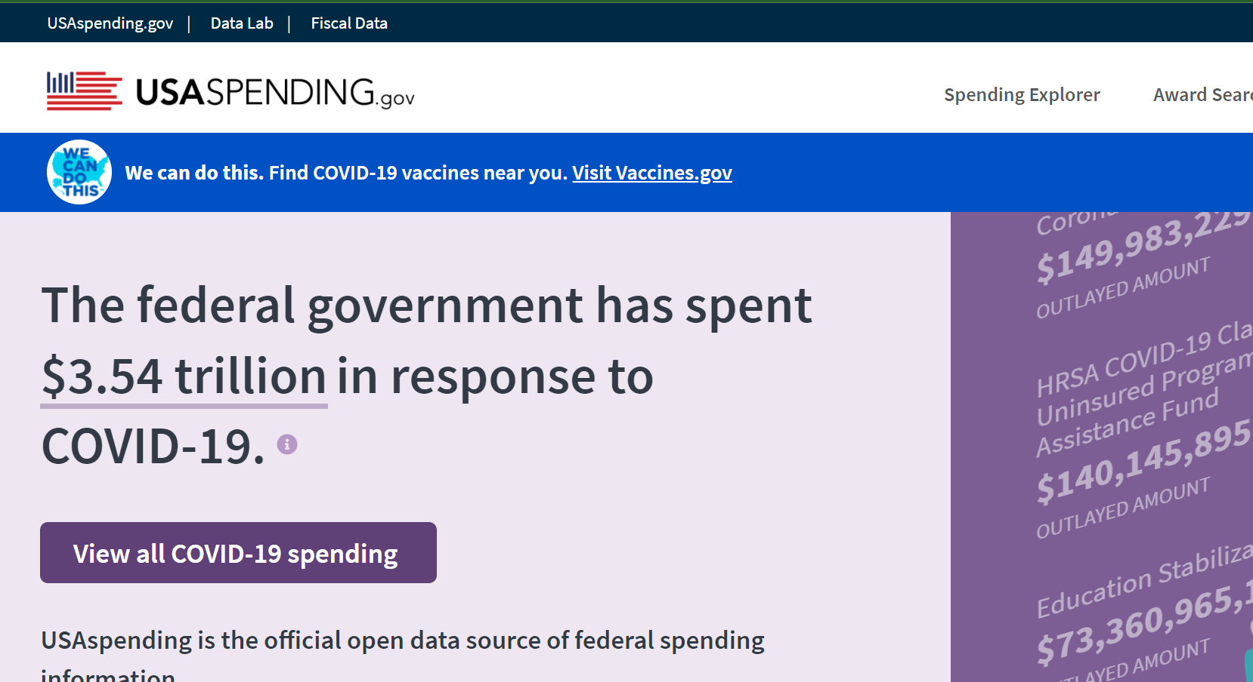
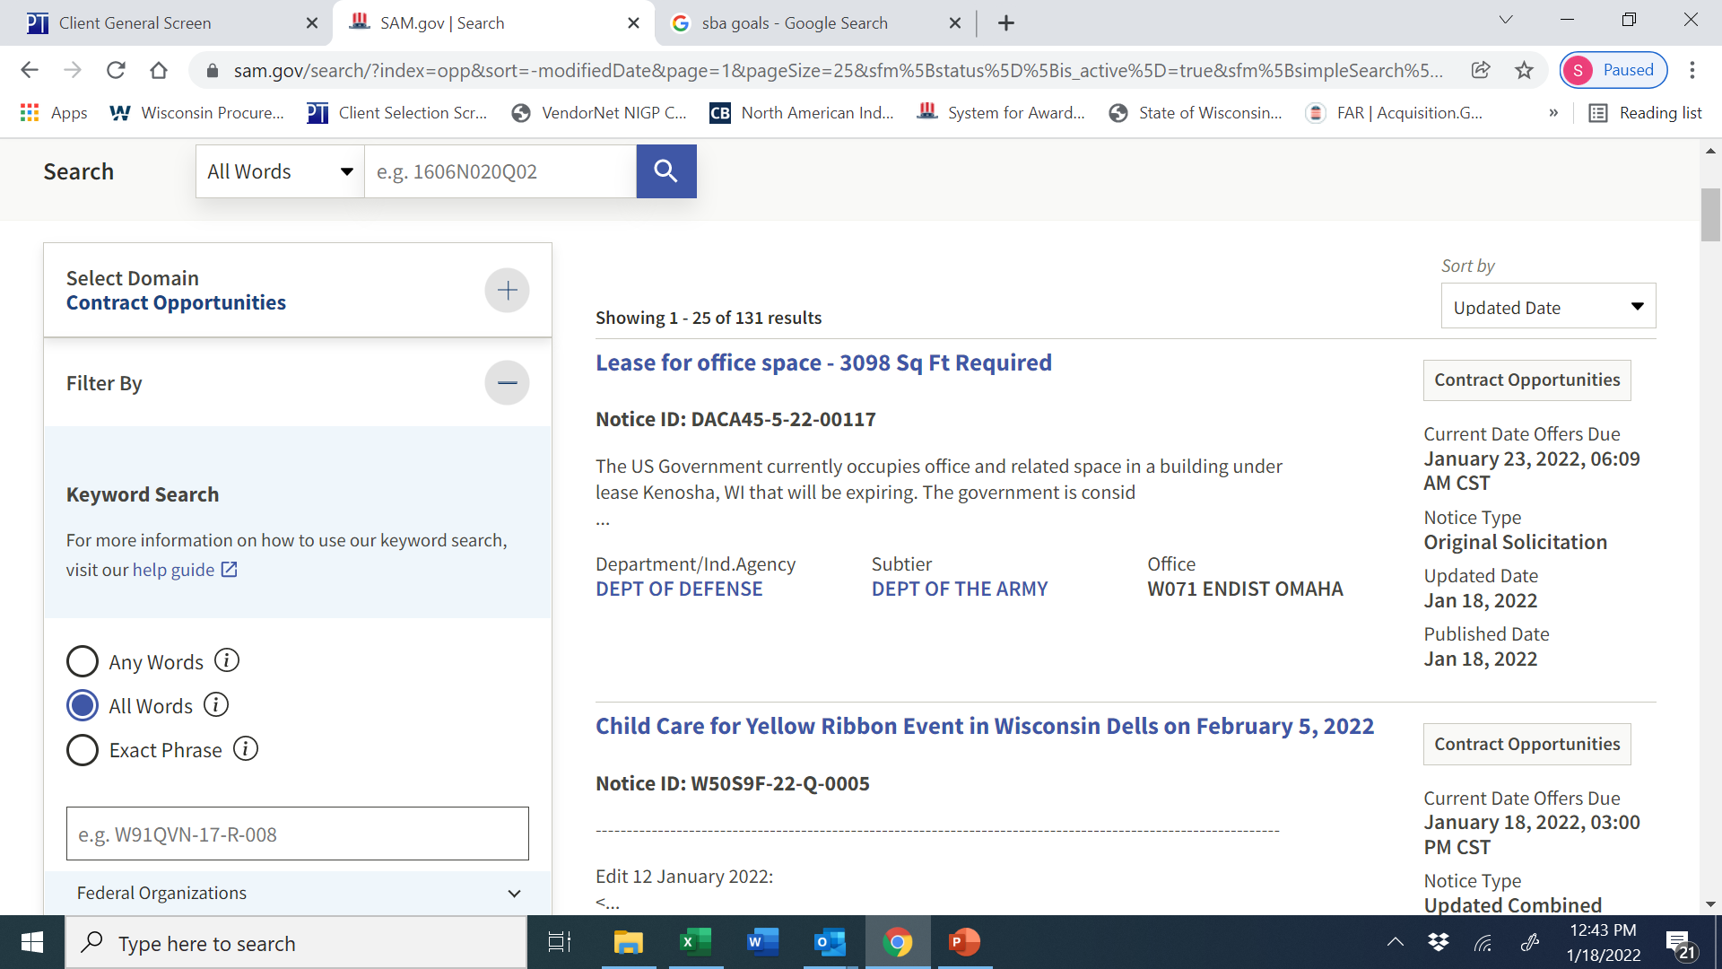
Locating 8(a) set aside opportunities
https://www.usaspending.gov/
Sam.gov

Slide 27
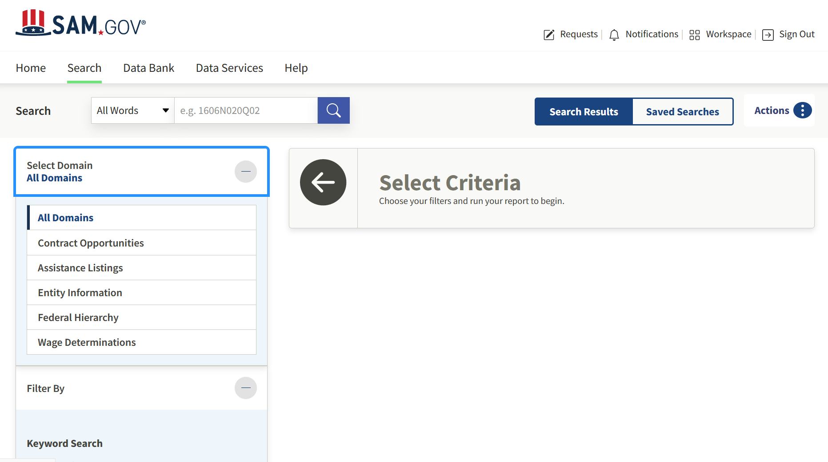
Locating 8(a) set aside opportunities
www.Sam.gov

Slide 28
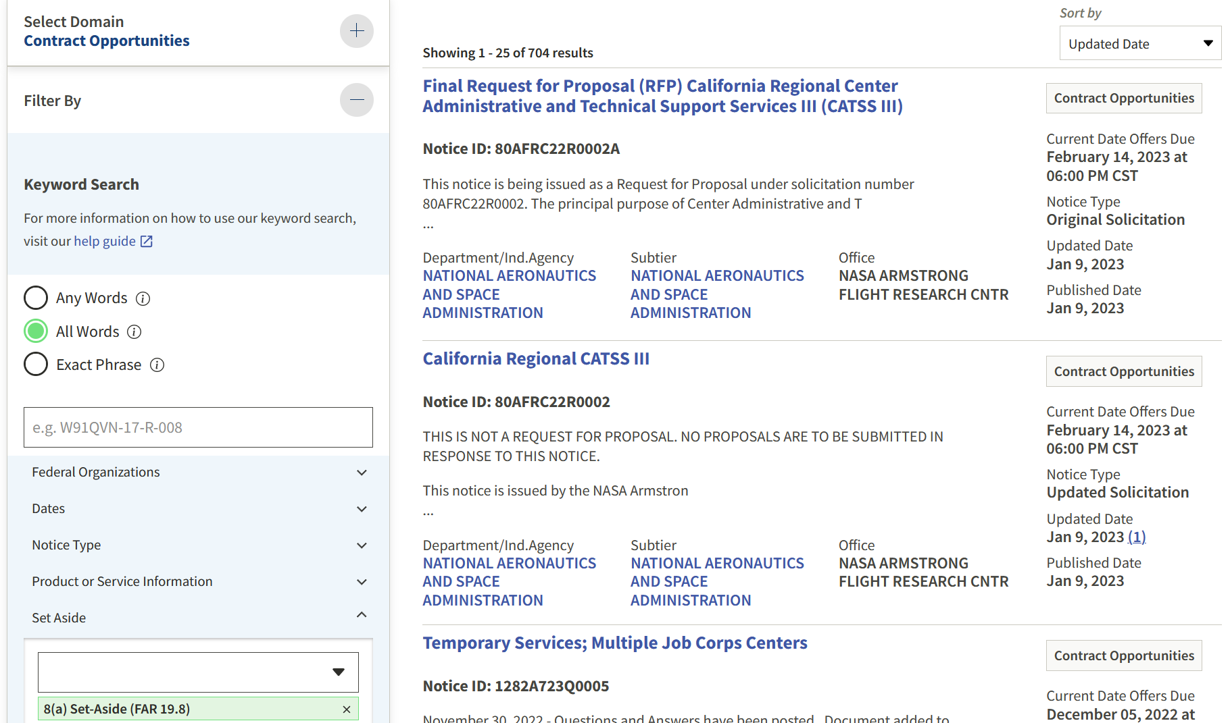
Locating 8(a) set aside opportunities
www.Sam.gov

Slide 29
Locating 8(a) set aside opportunities
https://www.usaspending.gov/

Slide 30
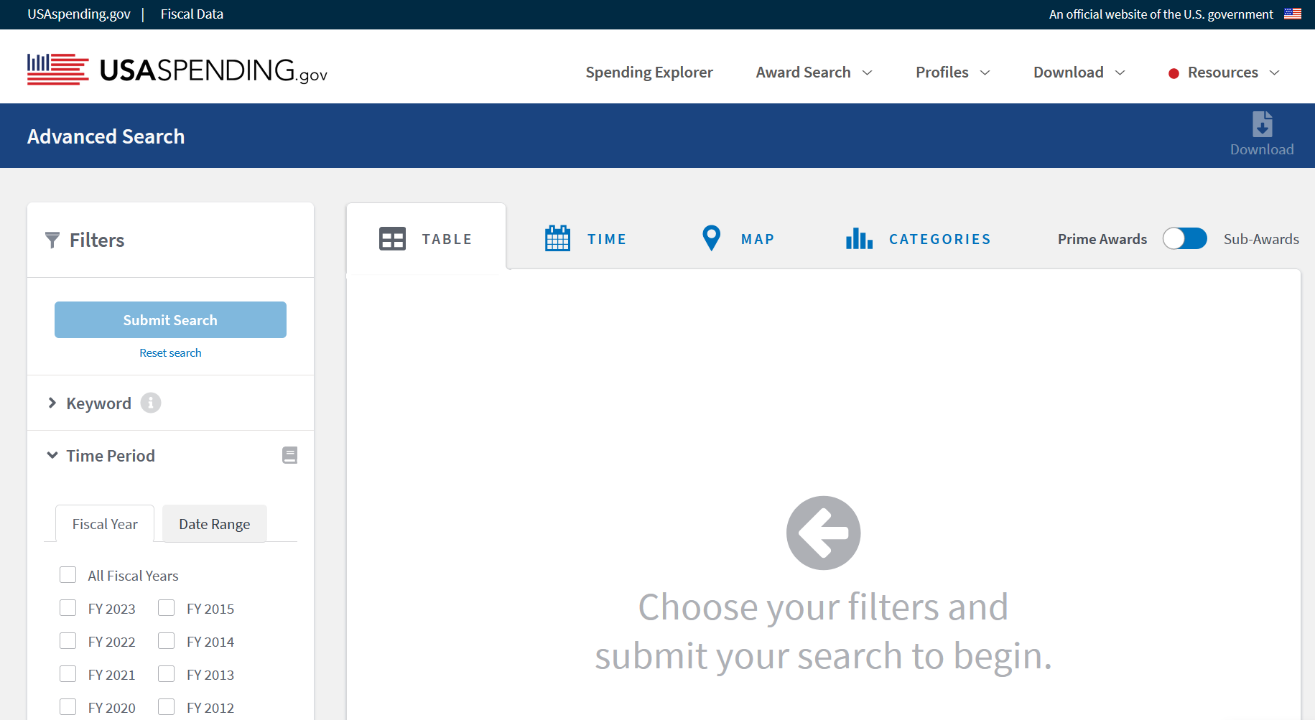
Locating 8(a) set aside opportunities
https://www.usaspending.gov/

Slide 31
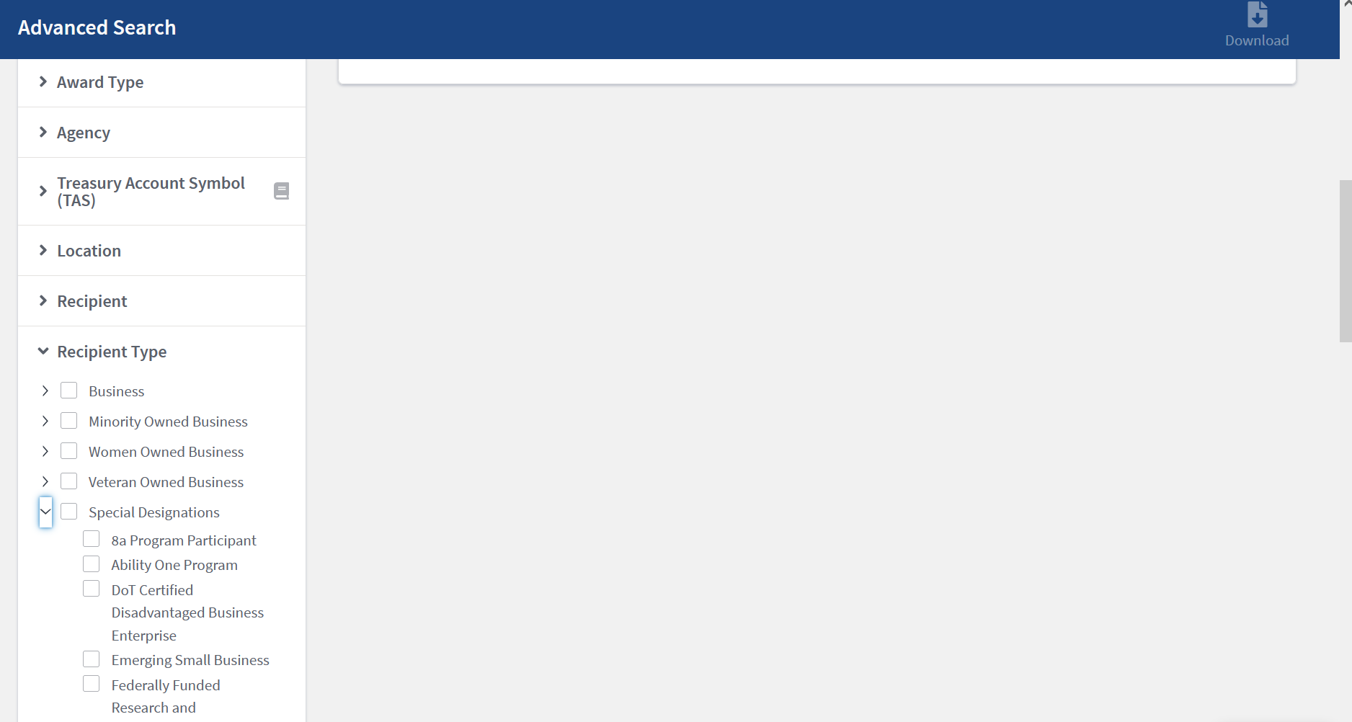
Locating 8(a) set aside opportunities
https://www.usaspending.gov/

Slide 32
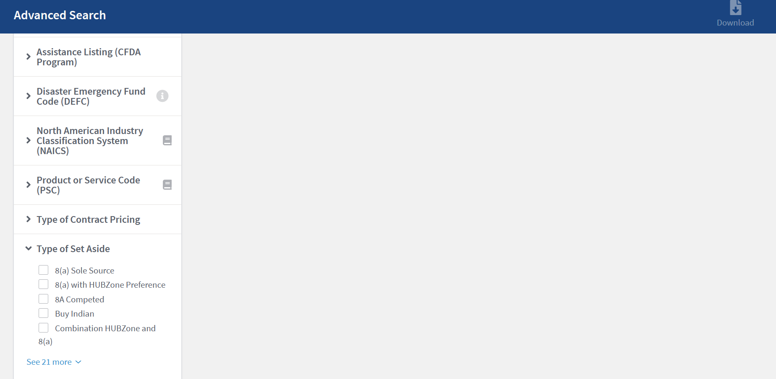
Locating 8(a) set aside opportunities
https://www.usaspending.gov/

Slide 33
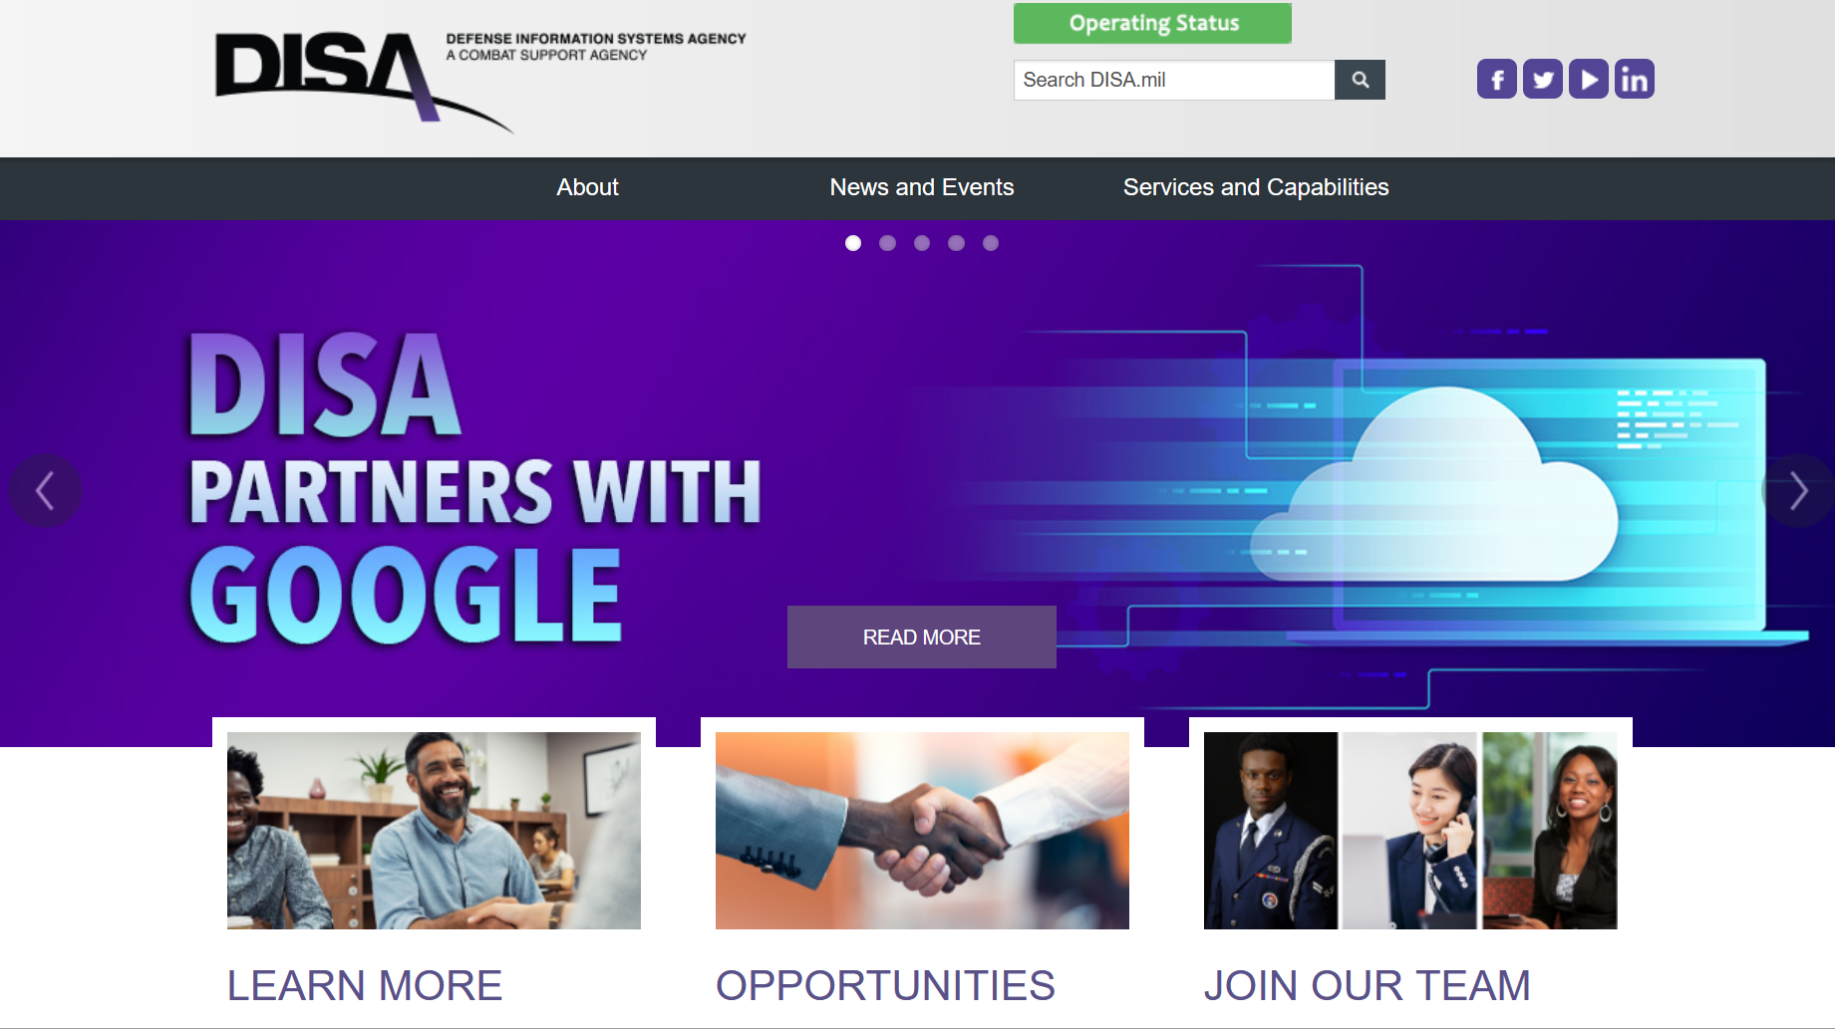
Locating 8(a) set aside opportunities

Slide 34
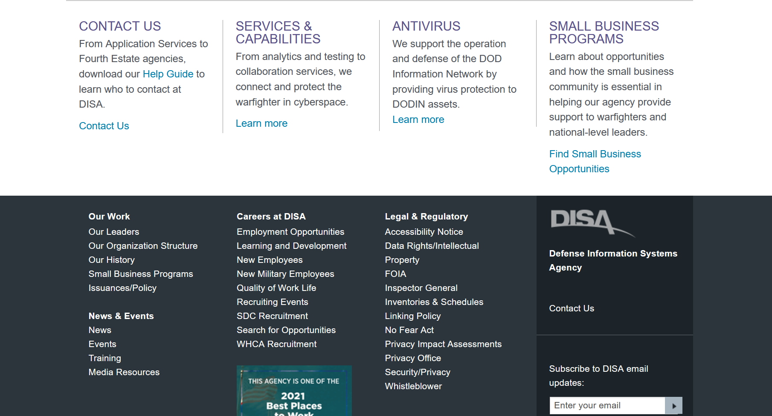
Locating 8(a) set aside opportunities

Slide 35
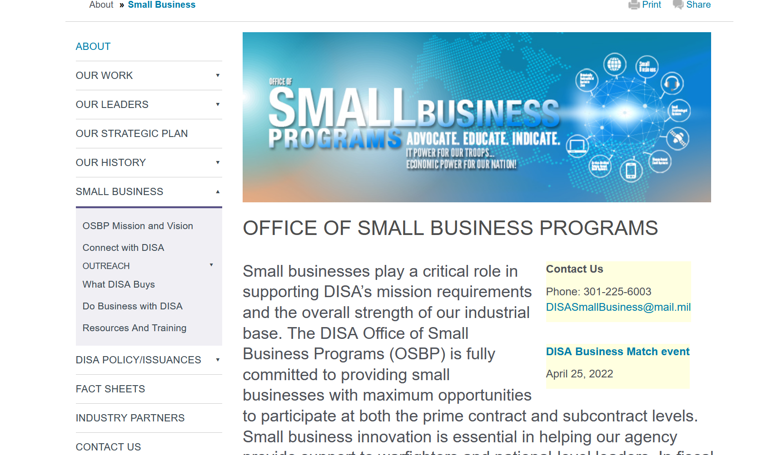
Locating 8(a) set aside opportunities

Slide 36
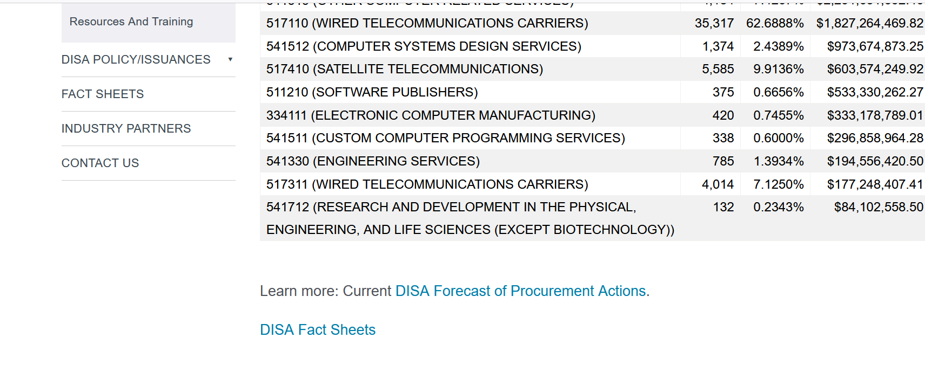
Locating 8(a) set aside opportunities

Slide 37
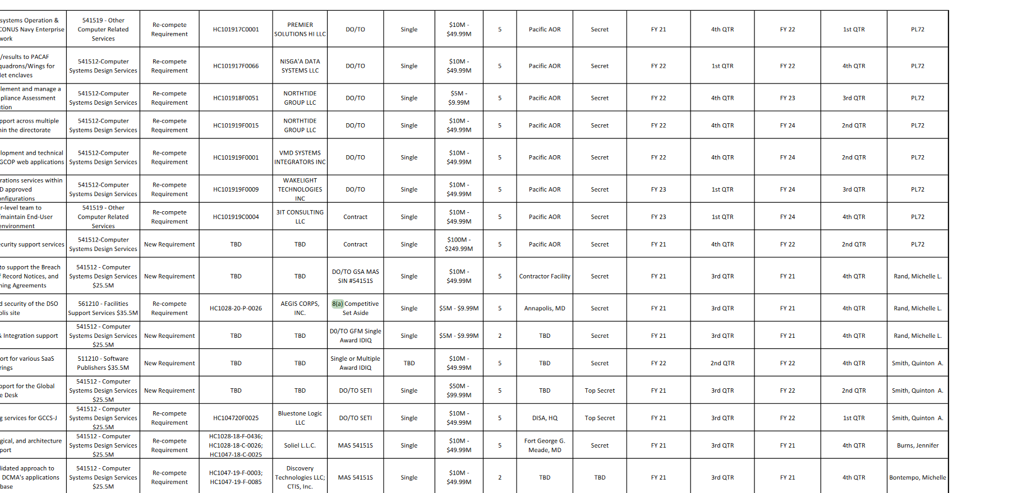
Locating 8(a) set aside opportunities

Slide 38
Locating 8(a) set aside opportunities
WPI Bidmatching Service

Slide 39
Marketing your 8(a) certified business

Slide 40
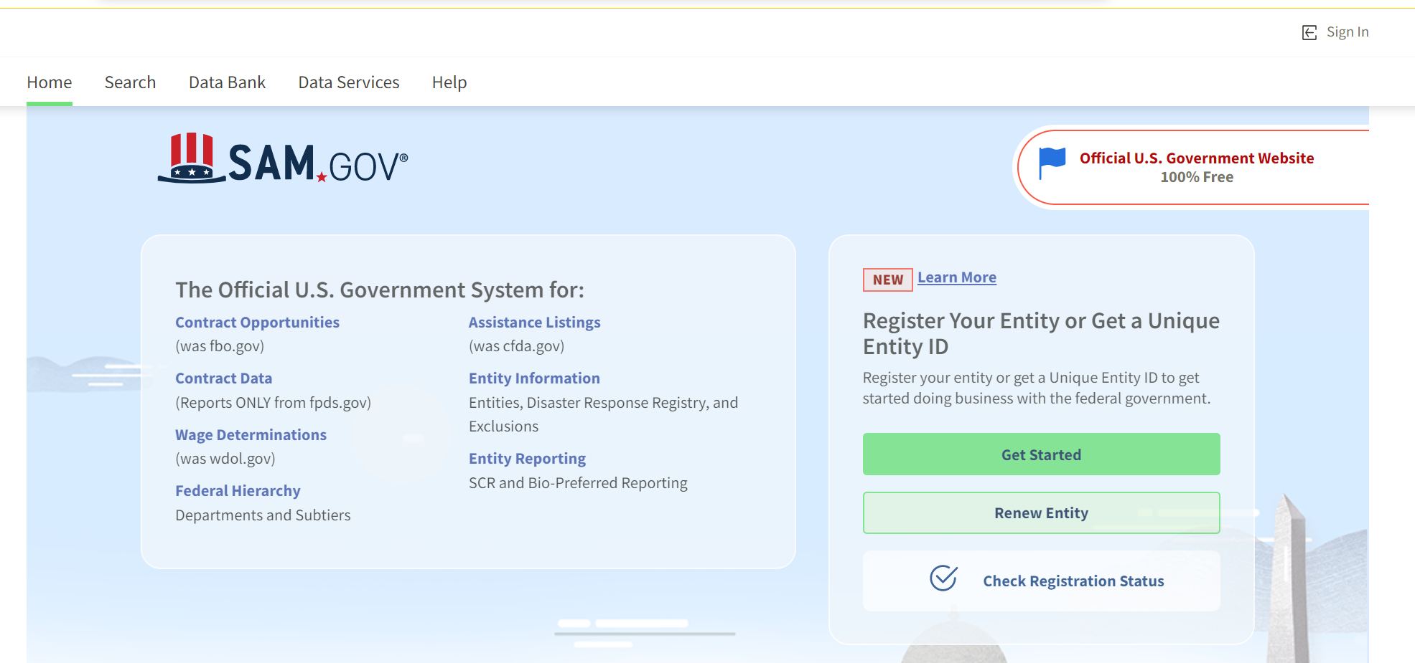
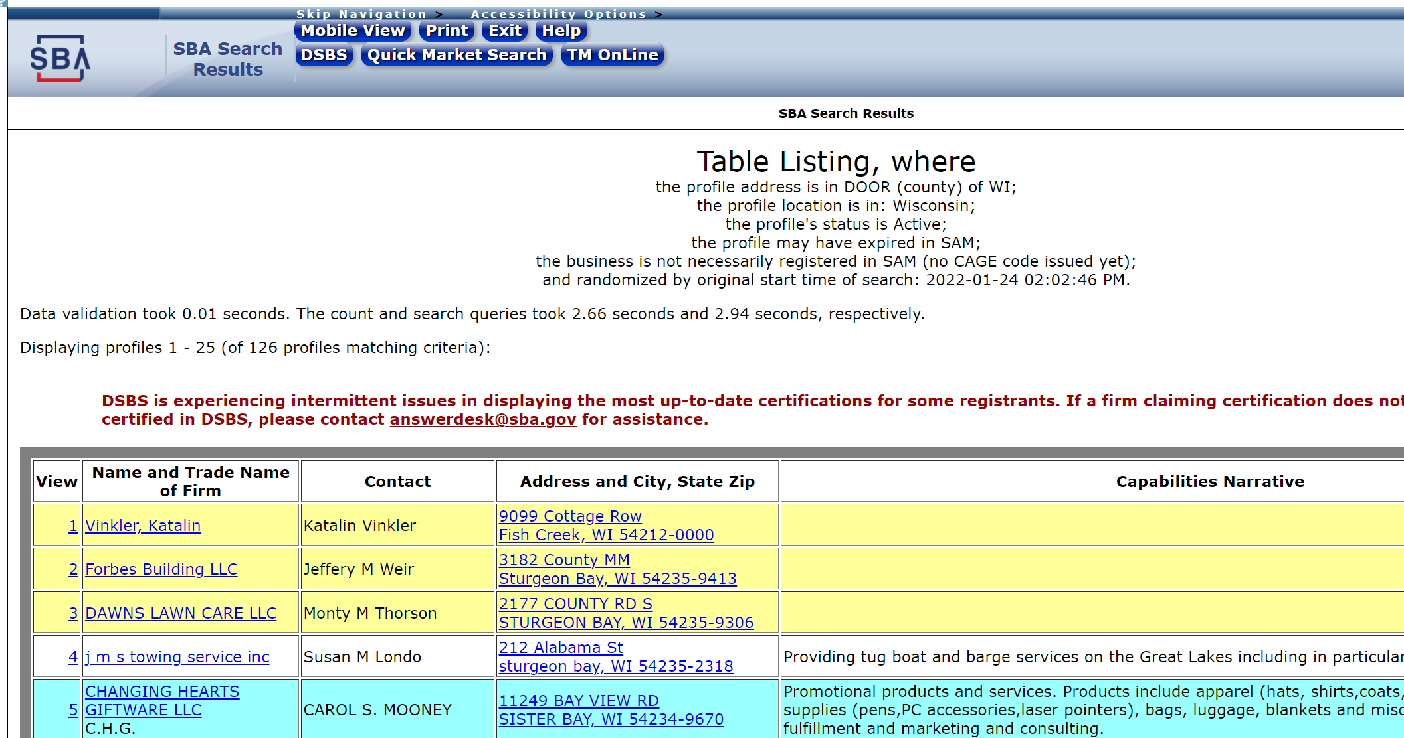
sam.gov
https://web.sba.gov/pro-net/search/dsp_dsbs.cfm

Slide 41
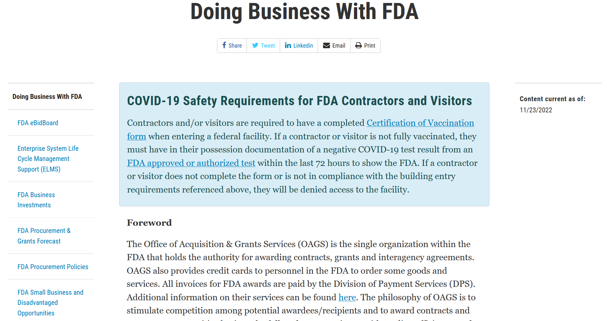

Slide 42
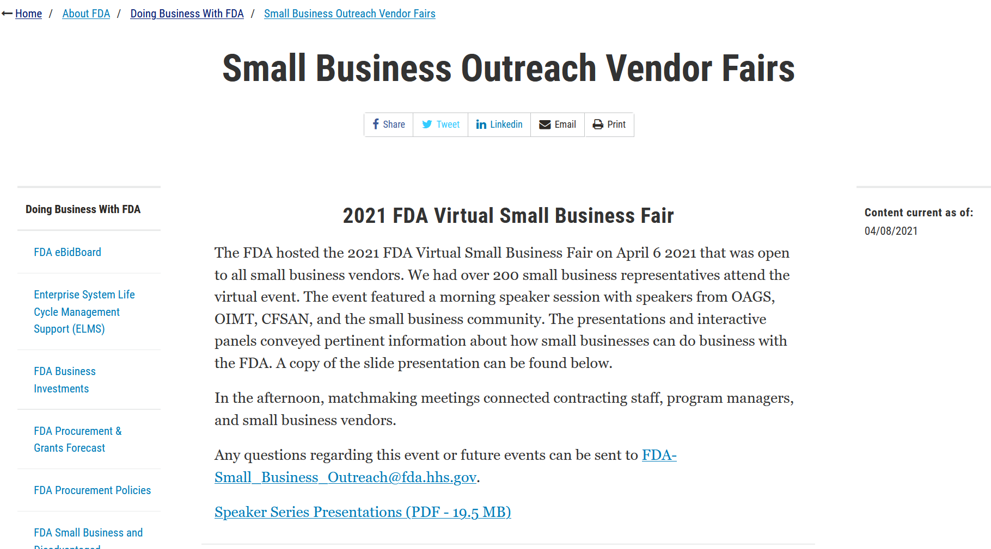

Slide 43
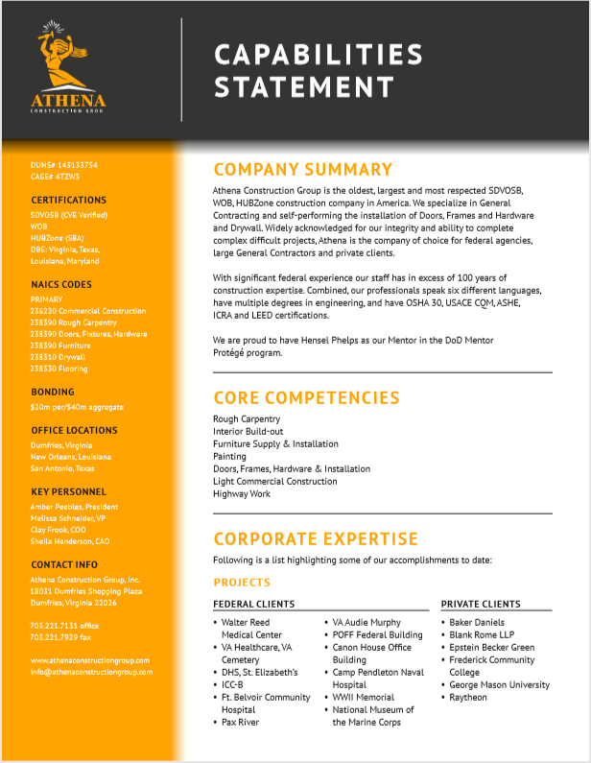
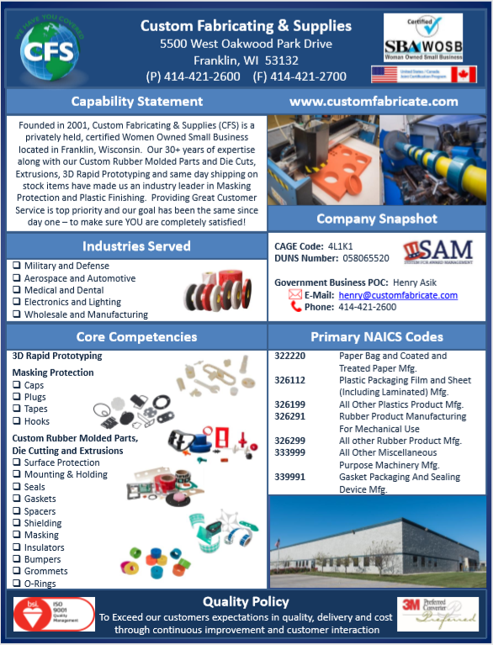
Develop a TARGETED Capabilities Statement

Slide 44
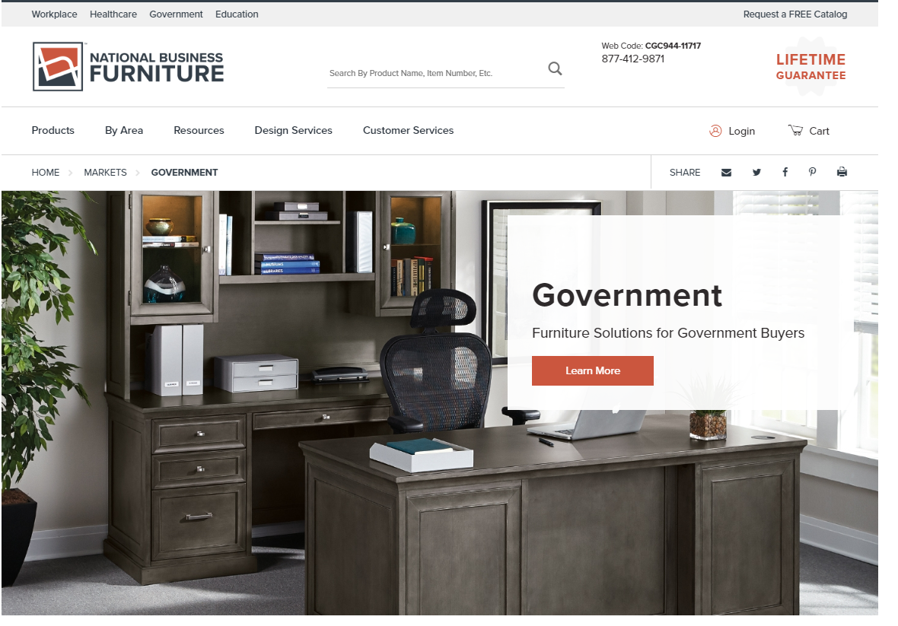
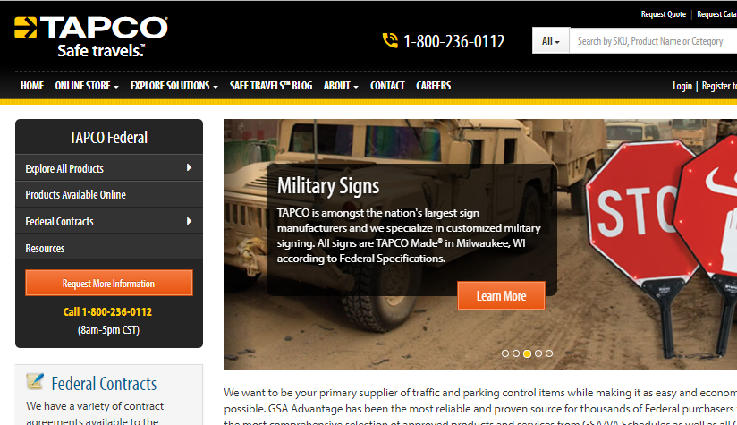
Develop a TARGETED AND STRONG WEBSITE

Slide 45
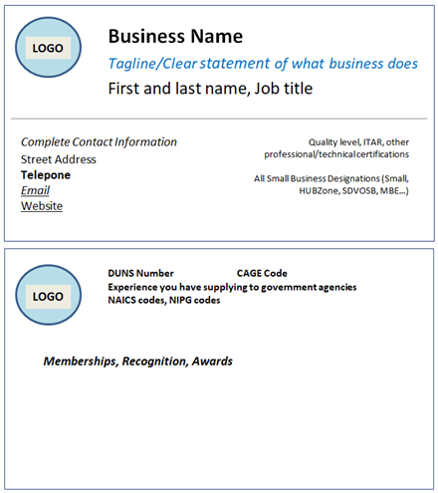
Develop a TARGETED BUSINESS CARD
CLEARLY states what your business DOES – use a tag line if necessary
COMPLETE contact information including street address, telephone and email
NAICS codes – NIGP codes – DUNS – CAGE CODE
Website
Small business designations – small, HUBZone, SDVOSB, MBE…..
Quality level, ITAR, other technical and professional certifications of value to market
ALSO
Professional in appearance – include logo
Light colored background - non glossy paper
If recent “award recipient” – would need to be recognizable
FRONT
BACK
Notes:
Recommend more than one version of business card – commercial vs government
Some business names do not identify what business does – example SMITH AND SONS – need to add “Paving roads for over 30 years”
Should have street address – PO BOX alone not impressive
NIPG codes for state National Institute of Governmental Purchasings' Commodity/Services Code
Website – even if a small godaddy site – very important for follow on
All small business designations – fed, state, local
Recognizable award – 2018 Minority Business of the Year or 2018 Manufacturer of the year

Slide 46
Develop a Prepared VERBAL Introduction of your business
SHORT and TIGHT introductory statement – maybe 30 seconds or so
Who you are
What you do
Keep it businesslike
Try it – refine it – try it – refine it – until you feel it is just right
Good afternoon. Example - My name is Red Green, President of the Green Barge Company based in Jacksonville, Florida. Our company specializes in shoreline clean up and reconstruction.

Slide 47
Questions?
Opening the Questions Box
Click here to access within the Control Panel
Using the Questions Box
Type questions here at any time during a presentation
Click Send when ready to submit a question
6/24/20
Page 47

Slide 48
UPCOMING TRAINING - EVENTS
1/10/23

Slide 49
ACQUISITION HOUR LIVE WEBINAR SERIES
January 11
Acquisition Hour: Overview of the Federal Acquisition Regulations (FAR)
presented by Carol Murphy Government Contract Specialist Wisconsin Procurement Institute
February 1
Acquisition Hour: Preparing a Winning Government Proposal
presented by Carol Murphy Government Contract Specialist Wisconsin Procurement Institute
March 1
Acquisition Hour: Service Contracts with Federal Agencies
presented by Carol Murphy Government Contract Specialist Wisconsin Procurement Institute
March 8
Acquisition Hour: ESRS Individual Subcontractor Reporting (ISR) Basics
presented by Kim Garber Director Small Business Programs Wisconsin Procurement Institute
April 5
Acquisition Hour: Overview of Contractor Performance Assessment Reporting System (CPARS)
presented by Carol Murphy Government Contract Specialist Wisconsin Procurement Institute
…More information and registrations at wispro.org/events

Slide 50

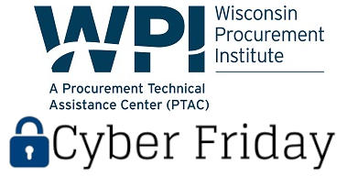

Cyber Friday LIVE WEBINAR SERIES
February 10 – Preparing for Self-Assessment
February 24 – System Security Plan and Plan of Action and Milestones Construction
March 10 – Preparing for a Cyber Incident
March 24 – Protecting the Data
April 14 – The Forensic Record
April 28 – Culture of Security
Presented by
1/10/23

Slide 51

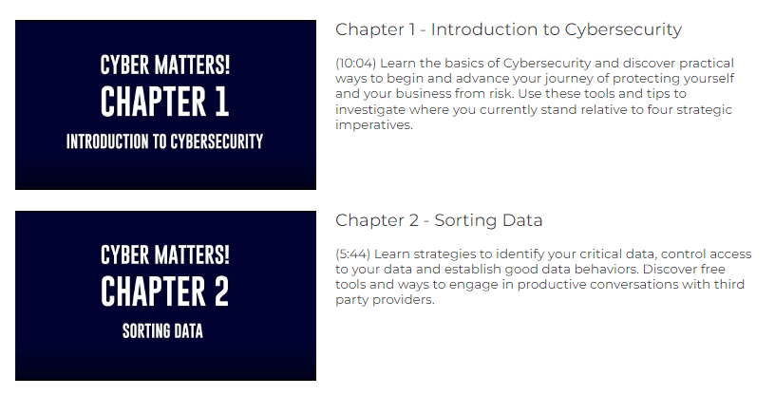
Cybersecurity Matters!
FOR DIVERSE AND SMALL BUSINESSES
Cybercrime is one of the most serious threats facing businesses today. The average hack incapacitates a company for four days and costs more than $3 million to fix.
WEDC wants to help.
Matt Frost from the Wisconsin Procurement Institute provides a broad overview, key factors to consider, and three exercises over eleven short videos. These videos provide the basic knowledge necessary to make Diverse and small companies more secure.
Videos at https://wedc.org/programs-and-resources/cybersecurity-matters/

Slide 52
New HUBZone Counties In WI: Jackson and Marinette
Governor Ever’s application to the U.S. Small Business Administration for HUBZone status for Jackson and Marinette Counties was approved.
Join WPI in person for two events to learn more:
February 8 - “Expanding Business Opportunities in Rural Wisconsin – Jackson County”
February 9 – “Expanding Business Opportunities in Rural Wisconsin – Marinette County”

Slide 53

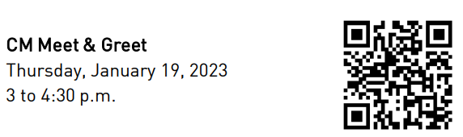
RUSD Construction Manager / General Contractor Meet and Greet
Racine Unified School District (RUSD) is undertaking $595 million in construction projects.
Targeted Businesses are located in Racine, Kenosha, Walworth, Waukesha, and Milwaukee Counties
Bring you business cards and capabilities statements and be ready to meet and pitch!

Slide 54
Sales Opportunities Local with
Government Agencies
January 19
11:00 am - Noon
Madison Area Technical College, Commercial Avenue Campus 2125 Commercial Avenue, Room 242 | Madison, WI 53704
Join Tondra Davis, Director, State of Wisconsin Supplier Diversity Program, and WPI staff to learn more about Wisconsin’s Supplier Diversity Program (SDP) for Minority, Woman and Service-Disabled Veteran owned businesses. She will share with us details about the certification process, how to leverage your certifications, and much more. As this is an in-person event, you will have the opportunity to discuss, ask questions and share information about your business with Ms. Davis. Last year certified businesses received a record $192 million.
wispro.org/events
1/10/23

Slide 55
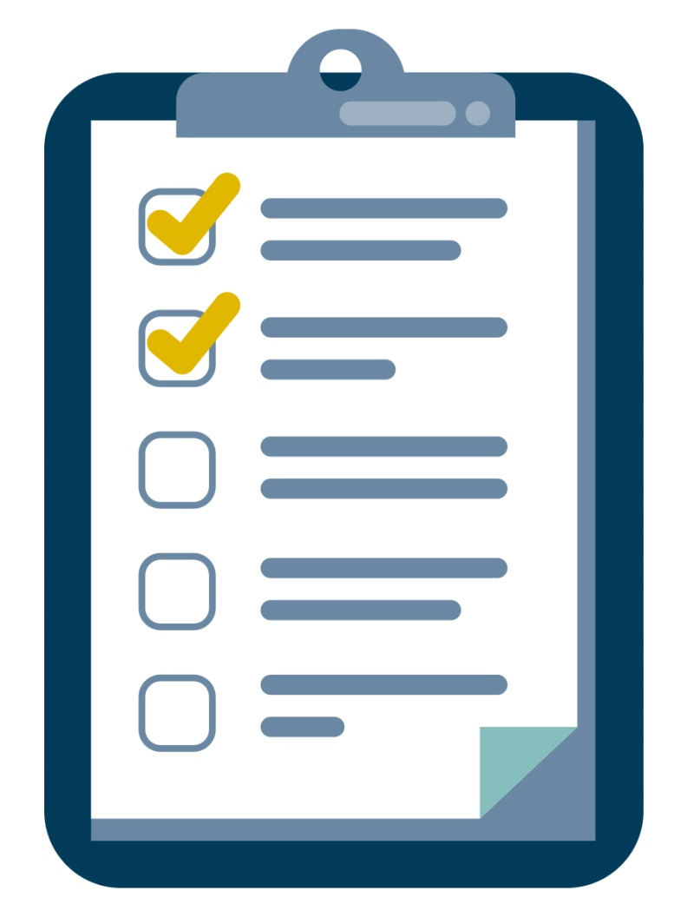
SURVEY
1/10/23

Slide 56

CONTINUING PROFESSIONAL EDUCATION
This webinar is eligible for 1 CPE credit.
For a certificate of this credit please contact:
Caroline Boettcher
carolineb@wispro.org
1/10/23

Slide 57
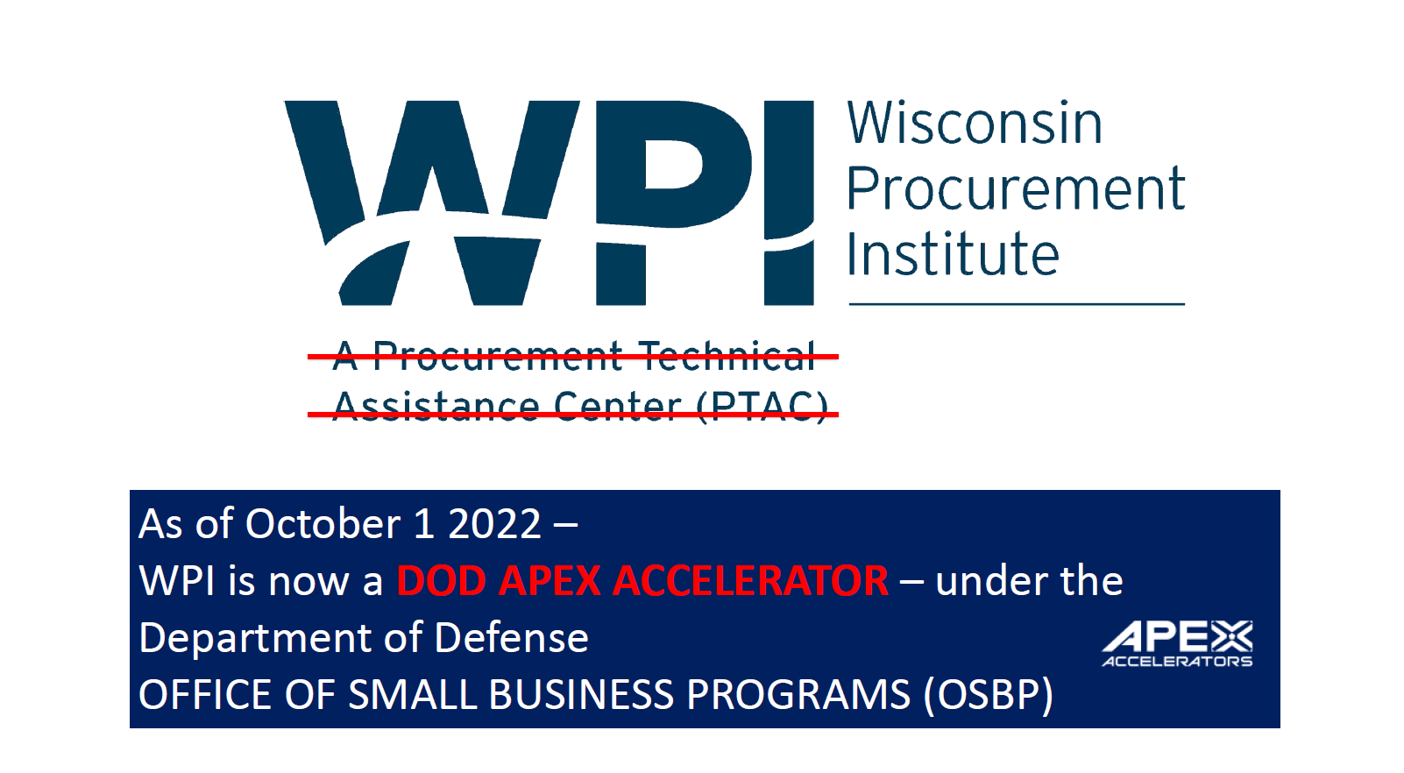

Slide 58
Presented By Wisconsin Procurement Institute (WPI) www.wispro.org
Shane Mahaffy
US Small Business Administration
shane.mahaffy@sba.gov | 414-297-3951
Ben Blanc
Wisconsin Procurement Institute
benjaminb@wispro.org | 414-270-3600
10437 Innovation Drive Suite 320 Milwaukee WI 53226
1/10/23

