Slide 1

Sales Opportunities with Local Government Agencies
Madison, WI
November 13| 10:00 am - Noon
Presented by:
Peter Patten| Megan Rogan| Hazel Schuster -- Dane County
Brittany Garcia -- City of Madison
Michael Steger, Wisconsin Procurement Institute

Slide 2


Webinar Etiquette
PLEASE
Log into the GoToWebinar session with the name that you registered with online
Place your phone or computer on MUTE
Use the QUESTIONS option to ask your question(s).
We will share the questions with our guest speaker who will respond to the group
THANK YOU!

Slide 3

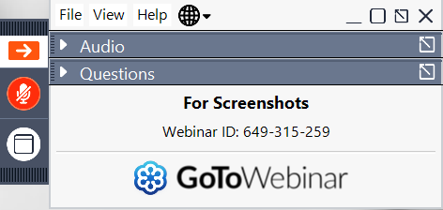
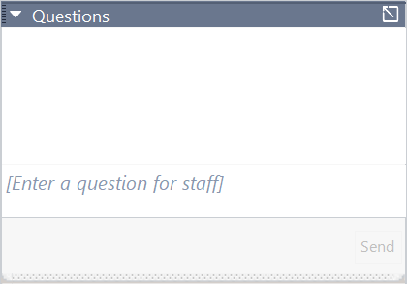
Opening the Questions Box
Click here to access within the Control Panel
Using the Questions Box
Type questions here at any time during a presentation
Click Send when ready to submit a question

Slide 4
Assisting Wisconsin businesses compete in the government marketplace.
WPI is Wisconsin’s APEX ACCELERATOR
The APEX Accelerators program, under management of the Department of Defense (DOD) Office of Small Business Programs (OSBP), plays a critical role in the Department’s efforts to identify and engage with a wide range of businesses entering and participating in the defense supply-chain. The program provides the education and training that all businesses need to participate to become capable of participating in DOD and other government contracts.
WPI provides services to all of Wisconsin’s 72 counties
Individual counseling at our offices, client’s facility or virtually
Small group training – webinars and workshops
Conferences including one on one buyer meetings – Marketplace, The Contracting Academy, Small Business Academy, Wisconsin Federal Contractor Forum, Acquisition Hour, Cyber Fridays, DOD Roadmap series, Government Opportunities Business Conference, End of Year Federal Contractor Update, Annual DOD Contract Management Update, Evening FAR sessions and more……
www.wispro.org

Slide 5
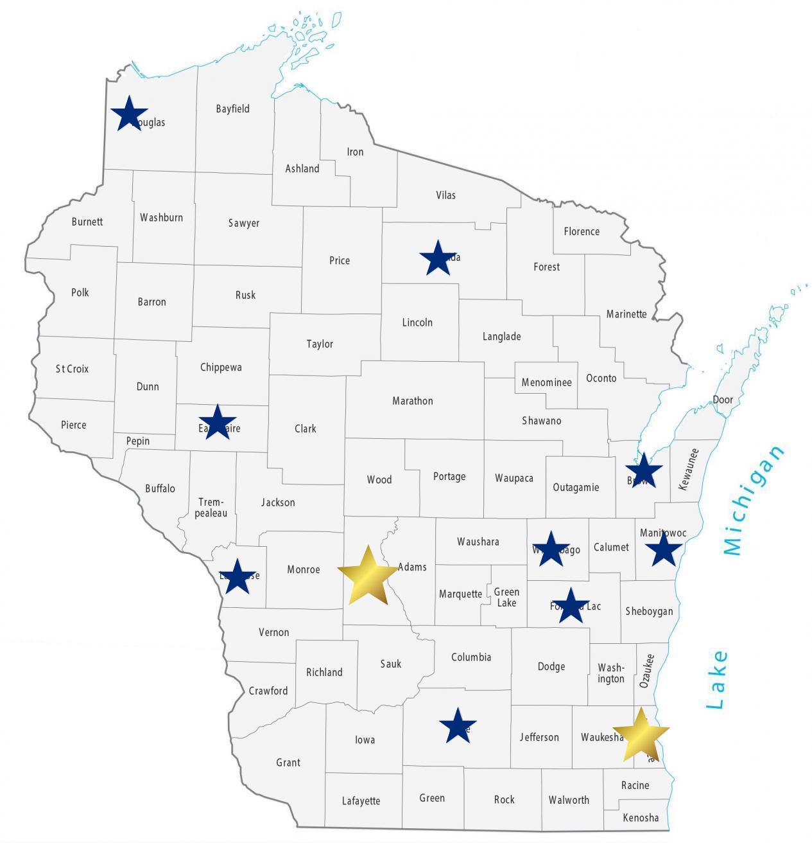
WPI Office Locations
MILWAUKEE
Technology Innovation Center
MADISON
FEED Kitchens
Dane County Latino Chamber of Commerce
Wisconsin Manufacturing Extension Partnership (WMEP)
Madison Area Technical College (MATC)
CAMP DOUGLAS
Juneau County Economic Development Corporation (JCEDC)
EAU CLAIRE
Western Dairyland
FOND DU LAC
Envision Greater Fond du Lac
GREEN BAY
NWTC Startup Hub
LACROSSE
Veterans in Professions
MANITOWOC
Progress Lakeshore
OSHKOSH
Greater Oshkosh
Economic Development Corporation
SUPERIOR
Small Business Dev Center;
UW Superior

Slide 6
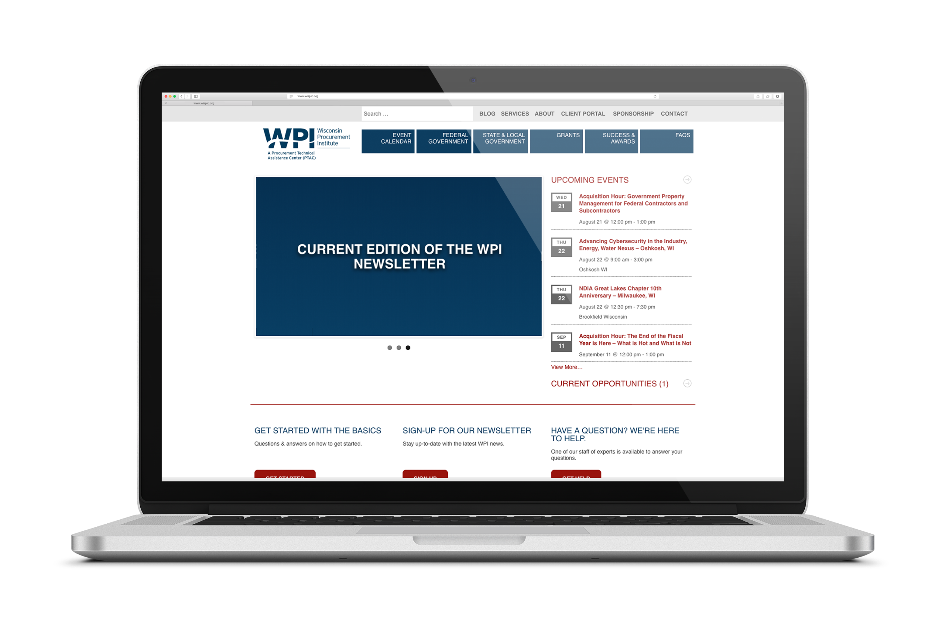
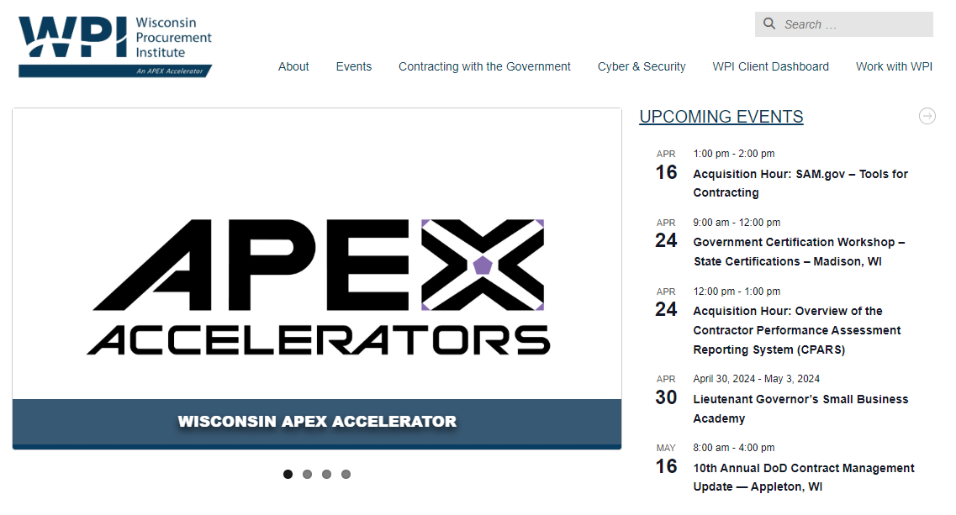
www.wispro.org

Slide 7
Questions?
Opening the Questions Box
Click here to access within the Control Panel
Using the Questions Box
Type questions here at any time during a presentation
Click Send when ready to submit a question
November 13, 2024
6/24/20
Page 7

Slide 8
Significant opportunities exist for small businesses to sell to local government agencies in and around Southeastern Wisconsin. Presentations will be followed by a limited opportunity for one-on-one meetings with Buyers. Meetings between Buyers and Registrants will be coordinated by WPI. Please indicate interest in meetings when registering for this event.
WPI strongly recommends you have a current capabilities statement ready prior to your meetings. Attendees should be ready with a capabilities statement and prepared pitch to take advantage of the meeting time. Assistance to prepare is available with WPI.
Speakers will discuss:
What & how they buy
How they announce opportunities
First Steps – registrations, certifications, other requirements
Provisions for non-performance /Force Majeure

Slide 9
Peter Patten Megan Rogan Hazel Schuster
Dane County
Brittany Garcia
City of Madison

Slide 10
UPCOMING TRAINING - EVENTS
November 13, 2024

Slide 11
Acquisition Hour LIVE WEBINAR SERIES
The Acquisition Hour webinar series covers a range of topics from market entry, sales growth, small business certifications, compliance, and more. Attendees receive 1 CPE credit for attending.
November 13 – Responding to Sources Sought Notices and Preparing a Capabilities Statement
November 19 – Understanding SBA and DOD Mentor Protégé Programs (MPP)
November 22 – CMMC Update – November 2024
December 20 - CMMC Update – December 2024
…More information and registrations at wispro.org/events

Slide 12
Cyber Friday LIVE WEBINAR SERIES
Cyber Friday is a series of one-hour webinars focusing on critical topics for DOD contractors and subcontractors in cyber security, data security, and CMMC. Attendees receive 1 CPE credit for attending.
October 18, 3.1.7 System Maintenance Policy
November 22, 3.1.8 Media Control Policy, Media Destruction Policy and Personnel Security
January 24, 3.1.11 Risk Assessment Policy, Security Assessment Reports
…More information and registrations at wispro.org/events

Slide 13
Emerging Issues WEBINAR SERIES
This series is intended as an information tool and resource for contract managers and those with a compliance function. Attendees receive 1 CPE credit for attending.
Oct 24 – Innovation – What Does Innovation Look Like from DoD’s Perspective?
Nov 21 – The Critical Role Your Accounting System Plays in SBIR/STTR Success
…More information and registrations at wispro.org/events

Slide 14


Expanding Business Opportunities in Rural Wisconsin
The government can be a great customer for your business – especially if you are a small business. The challenge is to know WHAT they buy, HOW they buy it, and WHEN they buy it – AND THEN – how your business can take those first steps to SUCCESSFULLY SELL to the FEDERAL GOVERNMENT. Wisconsin is home to many Federal opportunities from Ft. McCoy, US Army Corps of Engineers, National Park Service, US Forest Service and VA Hospitals and Clinics. It is also home to a number of large prime contractors including Oshkosh Defense, Wisconsin Physician Services and Michels.
November 13
Juneau County
Elroy Theatre
122 S Main St., Elroy, WI 5392
November 14
Black River Falls
Ho-Chunk Gaming (Bingo Hall)
W9010 Hwy 54E, Black River Falls, WI 54615
…More information and registrations at wispro.org/events

Slide 15

- Save the Date -
Dec 10
Virtual | 9:00 am - 4:00 pm
The Contracting Academy (TCA) is an opportunity for businesses to grow their technical knowledge of contracting with Federal Government, State/Local Government, and Government Prime Contractors. The series of workshops will benefit established businesses looking to grow and develop their government sales.
…More information and registrations at wispro.org/events

Slide 16

Dec 11-12
The Baird Center
400 W Wisconsin Ave. Milwaukee WI 53203
Presented by the Wisconsin Economic Development Corporation, MARKETPLACE is the Governor’s Annual Conference on Diverse Business Development. This event connects business owners from across Wisconsin seeking to do business with state, federal and local governments as well as the private sector. The conference provides the opportunity for established minority-, woman-, veteran- and LGBTQ+-owned businesses and small businesses to learn from and connect with resource providers, government representatives, corporate buyers and business professionals to lay a foundation for new partnerships and business opportunities.
MarketplaceWisconsin.com

Slide 17
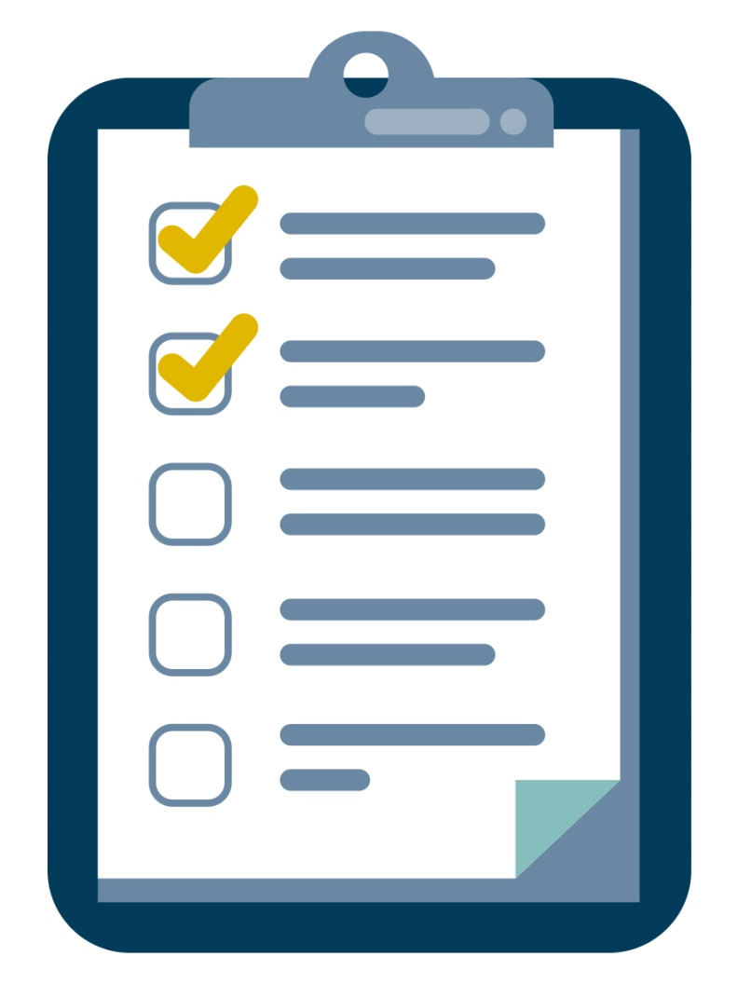
SURVEY
November 13, 2024

Slide 18
Presented By Wisconsin Procurement Institute (WPI) www.wispro.org
Michael Steger
Wisconsin Procurement Institute
MichaelS@wispro.org | 414-270-3600
10437 Innovation Drive Suite 320 Milwaukee WI 53226
November 13, 2024

